Slide 1




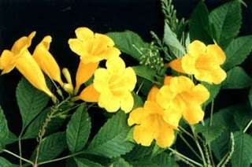
BENTHAM & HOOKER’S SYSTEM OF CLASSIFICATION
Dr.Tripta Jain
Asst. Professor
MLS University

Slide 2
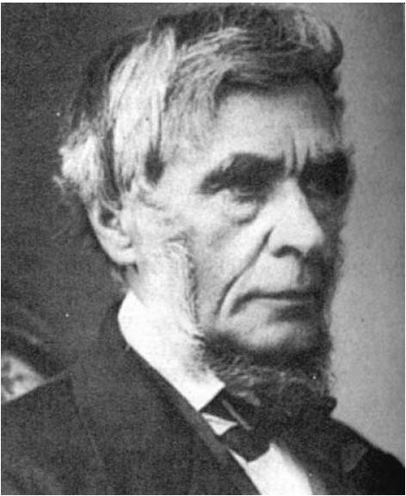
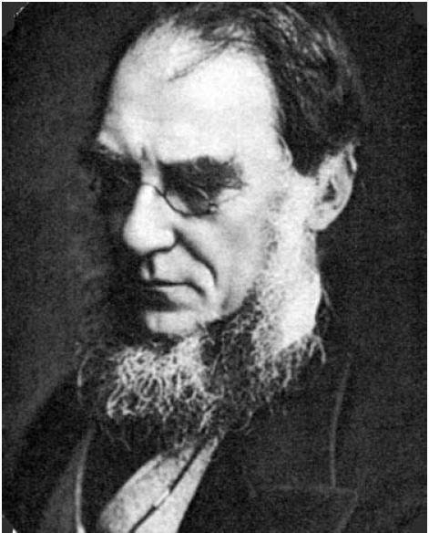
George Bentham (1800-1884)
Sir Joseph Dalton Hooker (1817-1911)

Slide 3
Bentham & Hooker’s system of classification
George Bentham and Joseph Dalton Hooker - Two English taxonomists who were closely associated with the Royal Botanical Garden at Kew, England have given a detailed classification of plant kingdom, particularly the angiosperms.
It’s the most well developed natural classification system , it was published in 3 volume work Genera plantarum (1862-83).
They described 97,205 species of seed plants belonging to 7,569 genera of 202 families starting from Ranunculaceae up to Gramineae.

Slide 4
Bentham & Hooker’s system of classification
The delimitation of genera was based on natural affinities and was pre-Darwinian in concept.
The system divided all the seed plants into three classes
-Polypetalae
Dicotyledons (165 families)
Gymnosperms (3 families) and
Monocotyledons (34 families).
-Gamopetalae
-Monochlamydeae

Slide 6
Class 1: Dicotyledons
Seed with 2 cotyledons
Vascular Bundle in ring
Cambium present
Flowers with pentamerous or tetramerous
Reticulate venation

Slide 7
Subclass 1: Polypetalae
Polypetalae: Flower with 2 whorls of parianth, inner petaloid and outer sepaloid, inner whorl of petals free (14 series, 25 orders and 165 families)
Divided in 3 series:
  Thalamiflorae: flowers hypogynous, sepals free,stamens many, disc absent
    6 Orders: Ranales, Parietales, Polygalineae, Caryophyllineae, Guttiferales and Malvales
  Disciflorae: flowers hypogynous, sepals free/ united, disc present below the ovary
    4 Orders: Geraniales, Olacales, Celastrales and Sapindales
  Calyciflorae: flowers perigynous or epigynous, sapals united
    5 Orders: Rosales, Myrtales, Passiflorales, Ficoidales and Umbellales

Slide 8

SUB-CLASS - POLYPETALAE
petals separate
Series
THALAMIFLORAE
DISCIFLORAE
 | Orders
 |  | Geraniales
 |  | Olacales
 |  | Celastrales
 |  | Sapindales
CALYCIFLORAE
 | Orders
 |  | Rosales
 |  | Myrtales
 |  | Passiflorales
 |  | Ficoidales
 |  | Umbellales
Orders
Ranales
Parietales
Polygalineae
Caryophyllineae
Guttiferales
Malvales

Slide 9

THALAMIFLORAE
Many stamens in the androecium.
Flower is hypogynous
Orders
Ranales
 | Families
 | Ranunculaceae
 | Dilleniaceae
 | Calycanthaceae
 | Magnoliaceae
 | Annonaceae
 | Menispermaceae
 | Berberidaceae
 | Nymphaceae
Parietales
Families
Sarraceniaceae
Papaveraceae
Cruciferae
Capparaceae
Resedaceae
Cistaceae
Violaceae
Canellaceae
Bixaceae.
Polygalineae
 | Families Pittosporaceae Tremandraceae Polygalaceae
Caryophyllineae
 | Families
 |  | Frankeniaceae
 |  | Caryophyllaceae
 |  | Portulacaceae
 |  | Tamaricaceae
Guttiferales
Malvales
 | Families Malvaceae Sterculiacea Tiliaceae
Families
Elatinaceae
Hypericaceae
e
Guttiferae
Theaceae
Dipterocarpaceae
Sarcolaenaceae

Slide 10
DISCIFLORAE
Hypogynous flowers with a cushion-like disc around or below the ovary
Orders
Geraniales
Families
 | Linaceae
 | Humiriaceae
 | Malpighiaceae
 | Zygophyllaceae
 | Geraniaceae
 | Rutaceae
 | Simaroubaceae
 | Ochnaceae
 | Burseraceae
 | Meliaceae
 | Dichapetalaceae
Olacales
Families
 | Olacaceae
 | Aquifoliaceae
Celastrales
 | Families
 |  | Celastraceae
 | St | ackhousiaceae
 |  | Rhamnaceae
 |  | Vitaceae
Sapindales
Families
Sapindaceae
Meliosmaceae
Anacardiaceae
Coriariaceae
Moringaceae

Slide 11
CALYCIFLORAE
Flowers epigynous or perigynous Thalamus is in the form of a cup
Orders
Rosales
 | Families
 |  | Connaraceae
 |  | Leguminosae
 |  | Rosaceae
 |  | Saxifragaceae
 |  | Crassulaceae
 |  | Droseraceae
 |  | Hamamelidaceae
 |  | Bruniaceae
 |  | Haloragaceae
Myrtales
Passiflorales
 | Families
 |  | Loasaceae
 |  | Turneraceae
 |  | Passifloraceae
 |  | Cucurbitaceae
 |  | Begoniaceae
 |  | Datiscaceae
Ficoidales
Families
 | Cactaceae
 | Aizoaceae
Umbellales
 | Families
 | Umbelliferae
 | Araliaceae
 | Cornaceae
Families
Rhizophoraceae
Combretaceae
Myrtaceae
Melastomataceae
Lythraceae
Onagraceae

Slide 12
Subclass 2: Gamopetalae
Gamopetalae: Parianth in two whorls, inner whorl of petals fused
Divided into 3 series:
  Inferae: ovary inferior
    3 orders: Rubiales, Asterales and Campanales
  Heteromerae: Ovary superior, stamens in one or two whorls, carpels more than 2
    3 orders: Ericales, Primulales and Ebenales
  Bicarpellatae: Ovary superior, stamens in one whorls, carpels 2
    4 orders: Gentianales, Polemoniales, Personales and Lamiales

Slide 13

SUB-CLASS - GAMOPETALAE
petals fused
Series
INFERAE
 | Orders
 |  | Rubiales
 |  | Asterales
 |  | Campanulales
HETEROMERAE
 | Orders
 |  | Ericales
 |  | Primulales
 |  | Ebenales
BICARPELLATAE
Orders
Gentianales
Polemoniales
Personiales
Lamiales

Slide 14
INFERAE
Flowers with inferior ovary
Orders
Asterales
 | Families
 |  | Valerianaceae
 |  | Dipsacaceae
 |  | Calyceraceae
 |  | Compositae
Rubiales Campanulales
Families
Families
Caprifoliaceae
Stylidaceae
Rubiaceae
Goodeniaceae
Campanulaceae

Slide 15
HETEROMERAE
Flowers with superior ovary
Number of carpels - more than two
Orders
Ericales
 | Families
 |  | Ericaceae
 |  | Clethraceae
 |  | Epacridaceae
 |  | Diapensiaceae
 |  | Lennoceae
Primulales
 | Families
 |  | Plumbaginaceae
 |  | Primulaceae
 |  | Myrsinaceae
Ebenales
Families
Sapotaceae
Ebenaceae
Styracaceae

Slide 16
BICARPELLATAE
Ovary superior, with 2 carpels
Orders
Polemoniales Lamiales
Gentianales
 | Families
 |  | Oleaceae
 |  | Salvadoraceae
 |  | Apocynaceae
 |  | Asclepiadaceae
 |  | Loganiaceae
 |  | Gentianaceae
Personiales
 | Families
 |  | Scrophulariaceae
 |  | Globulariaceae
 |  | Lentibulariaceae
 |  | Gesneriaceae
 |  | Bignoniaceae
 |  | Pedaliaceae
 |  | Acanthaceae
Families
Families
Polemoniaceae
Myoporaceae
Hydrophyllaceae
Verbenaceae
Boraginaceae
Labiatae
Convolvulaceae
Plantaginaceae
Solanaceae

Slide 17
Subclass 3: Monochlamydeae
Monochlamydeae: flowers apetalous, perianth lacking or if present not differentiated into sepals and petals usually sepaloid
  Curvembryeae: terrestrial plants,embryo coiled, ovule usually 1
  Multiovulate aquaticae: aquatic plants, ovules many
  Multiovulate terrestress: terrestrial plants, ovules many
  Microembryeae: embryo minute
  Daphnales : carpel 1, ovule 1/monocapellary gynoecium
  Achlamydosporae: ovary inferior, unilocular, ovules 1-3
  Unisexuales: flowers unisexual
  Ordines anomali: relationship uncertain

Slide 18




MONOCHLAMYDEAE
only 1 kind of perianth
Series
Curvembryae
Families
Nyctaginaceae
Amaranthaceae
Chenopodiaceae
Batidaceae
Polygonaceae
Phytolaccaceae
Multiovulate Aquaticae
Families
 | Podostemacea
Multiovulate Terrestris
Families
 | Nepenthaceae
 | Cyinaceae
 | Myristicaceae
Daphnales
Achlamydo
-sporae
Ordines Anomali
Microembryae
Unisexuales
Families
Families
Families
Families
Families
e
Piperaceae
Lauraceae
Loranthaceae
Euphorbiaceae
Salicaceae
Chloranthaceae
Proteaceae
Santalaceae
Balanopaceae
Empetraceae
Myristicaceae
Thymelaeaceae
Balanophoraceae
Urticaceae
Ceratophyllaceae
Monimiaceae
Penaeaceae
Ficoidales
Ficoidales
Platanaceae
Lacisternaceae
Elaegnaceae
Leitneriaceae
Juglandaceae
Myricaceae
Casuarinaceae Betulaceae
ficoidales

Slide 19
Class 2: Gymnospermae
Ovules naked
– 3 families
Gnetaceae
Coniferae
Cycadaceae

Slide 20
Class 3: Monocotyledons
Single Cotyledon
Flowers trimerous
Vascular bundle scattered
Sec. growth absent
venation parallel

Slide 21
  Divided into 7 series:
  - Microspermae : Perianth petaloid, ovary inferior, seeds minute
  Epigynae: ovary inferior/ epigynous flower, seeds large
  Coronarieae : ovary superior and trilocular, carpels united, perianth colored/petaloid
  Calycinae: ovary superior, carpels united, perianth green/sepaloid
  Nudiflorae: ovary superior, perianth absent or small scale or hair like structure
  Apocarpae: ovary superior, carpels more than 1, free
  Glumaceae : ovary superior, perianth reduced, flowers enclosed in glumes, seed endospermic

Slide 22

CLASS-MONOCOTYLEDONAE
( 1 cotyledon, flowers trimerous)
Series
Microspermae
Epigynae
Families
Scitamineae
Bromeliaceae
Haemodoraceae
Iridaceae
Amaryllidaceae
Taccaceae
Dioscoreaceae
Coronarieae
Calycinae
Nudiflorae
Apocarpae
Glumaceae
 | Families Eriocaulaceae Centrolepidaceae Restionaceae
 | Cyperaceae
 | Gramineae
Families
Families
Families
Families
Families
Hydrocharitaceae
Roxburghiceae
Flagellariaceae
Pandanaceae
Triuridaceae
Burmanniaceae
Liliaceae
Juncaceae
Cyclanthaceae
Alismataceae
Orchidaceae
Pontederiaceae
Palmae
Typhaceae
Najadaceae
Philydraceae
Araceae
Xyridaceae
Lemnaceae
Mayacaceae
Commelinaceae Rapateaceae

Slide 23
Merits of Bentham and Hooker’s System
Each plant has been described either from the actual specimen or preserved herbarium sheets so that the descriptions are detailed as well as quite accurate.
The system is highly practical and is useful to students of systematic botany for easy identification of species.
The flora describes geographical distribution of species and genera.
The generic descriptions are complete, accurate and based on direct observations.

Slide 24
Merits of Bentham and Hooker’s System
Larger genera have been divided into sub genera, each with specific number of species.
Dicots begin with the order Ranales which are now universally considered as to be the most primitive angiosperms.
Placing of monocots after the dicot is again a natural one and according to evolutionary trends.
The placing of series disciflorae in between thalami florae and calyciflorae is quite natural.
The placing of gamopetalae after polypetalae is justified since union of petals is considered to be an advanced feature over the free condition

Slide 25
Demerits of Bentham and Hooker’s System
Non phylogenetic system of classification, although system was given after the Darwin’s “Origin of Species”, concept of evolution has not been included.
Keeping gymnosperms in between dicots and monocots is anomalous.
Placing of monochlamydeae after gamopetalae does not seem to be natural.
Some of the closely related species are placed distantly while distant species are placed close to each other.

Slide 26
Demerits of Bentham and Hooker’s System
Subclass monochlamydeae is highly artificial, All families with one whorl of perianth have been dumped into it, But by careful analysis they can be redistributed near their relatives.
eg. Certain families of monochlamydeae are closely related to families in polypetalae, e.g. Chenopodiaceae placed under curembyeae but it shows resemblance with Caryophyllaceae of polypetalae.

Slide 27
Demerits of Bentham and Hooker’s System
Advanced families, such as Orchiadaceae have been considered primitive in this system by placing them in the beginning. Placing of Orchidaceae in the beginning of monocotyledons is unnatural as it is one of the most advanced families of monocots.
Similarly, Compositae (Asteraceae) has been placed near the beginning of gamopetalae which is quite unnatural.
Liliaceae and Amaryllidaceae were kept apart merely on the basis of characters of ovary though they are very closely related.

