Slide 1



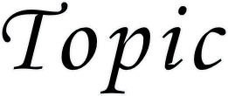
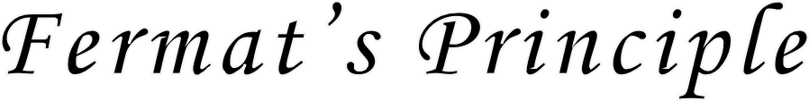

Slide 2



Fermat’s, in 1658, gave a general principle which is stated as follows:
‘A ray of light in passing from one point to another by any number of reflections or refractions chooses a path along which the time taken is the least or minimum.’
This principle is called the principle of least time. One should note that the principle of least time holds for reflection and refraction at plane surfaces only. For reflection and refraction at the spherical surfaces, the actual path of light will be that for which the time taken is either maximum or minimum, but mo other value i.e., the light ray follows a path for which the time taken is the extremum . Thus a general statement of Fermat’s principle is made as follows:

Slide 3

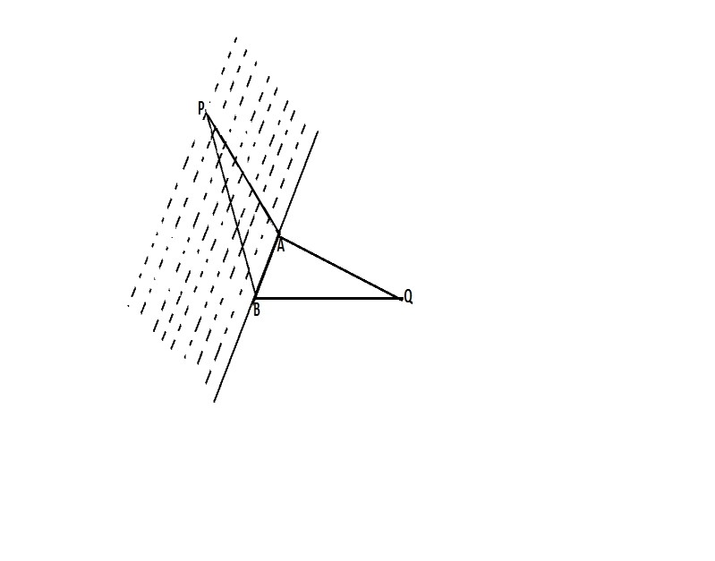
‘A ray of light in passing from one point to the other through any number of reflection or refractions follows a path for which the
optical path is either minimum or maximum i.e., extremum’ (or in other words, the optical path is stationary).

Slide 4

In Fig. let a ray of light passes from a point P to a point Q through the actual path PAQ. There are number of other paths between the points P and Q. Consider one such path PBQ for which the lateral difference in paths is AB=ds.
According to Fermat’s principle, if this difference ds is very small of the first order , then dt the difference of times taken along PAQ and PBQ is very small of the second order, i.e.,
dt/ds=0
A given path is said to be the actual path if and only if all the neighbouring paths of the given path involve time differences which are small of an order higher than the lateral
differences of path.
Now we shall try to prove all the three fundamental laws of geometrical optics,

Slide 5
Rectilinear propagation,
Reflection , and
Refraction,
embodied in Fermat’s principle.
Rectilinear Propagation of Light :- Between two
points in a homogeneous medium, a straight line is the path of least distance and hence it is the path of least time. Thus light travels in straight lines in a homogeneous medium.
Reflection of Light from a Plane Surface:- A beam
of light is reflected from an optical surface in accordance with the following two laws:
(a) The reflected ray lies in the plane of incidence i.e., in the plane which contains the incident ray and normal at the point of incidence.

Slide 6

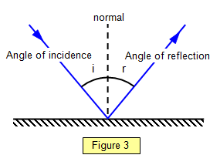





(b) The angle of incidence is equal to the angle of reflection.

Slide 7




In Fig., let a ray of light reaches from a point A to a point A’ after reflection from a plane surface XY following the path AMA’ . The normals from the points A and A’ on the surface XY are respectively AP and A’P’. Let AP=a, A’P’=b, PP’=d, PM=x, hence MP’=d-x.
Since light travels the entire path AMA’ in air , hence optical path travelled by the light between A and A’ is s=AMA’=AM+MA’
AM =
MA’ =
S =
+
If the speed of light in the medium above the reflecting surface is v, the time taken in travelling the distance s is
t =s/v = 1/v ( + )

Slide 8


By fermat’s principle , for the actual path dt/dx=0
dt/dx = 1/v[1/2(2x/
) + ½(2(c-x)(-1)/ =0
PM/AM = MP’/MA’
Now if I is the angle of incidence and r is the angle of reflection , then
From right – angled triangle MPA, sin i =PM/AM and From right – angled triangle MP’A’,sin r = MP’/MA’
sin i = sin r
or i = r
angle of incidence = angle of reflection.
This is the law of reflection of light.

Slide 9

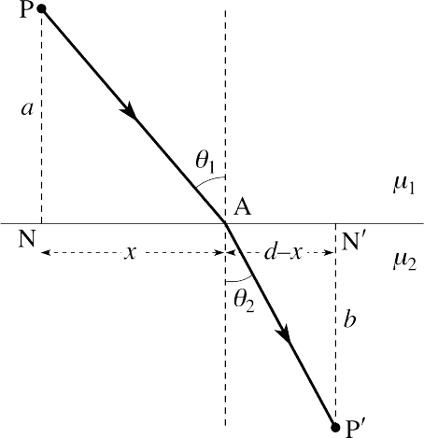
(3) Refraction of Light from a Plane Surface:-

Slide 10


In Fig., a light ray from a point A on medium 1 (refractive index μ1) reaches a point A’ in medium 2(refractive index μ2) after refraction through a surface XY through the path AMA’. The normals from the points A and A’ on the surface XY are respectively AP and A’P’.
Let AP=a, A’P’=b, PP’= d, PM=x and MP’=d-x .
Now if the velocities of light in medium 1 and 2 be v1 and v2 respectively, then the time taken by light to travel A to A’ will be
t = AM/v1 + MA’/v2
t =
/v1+ /v2
By Fermat’s principle, for the actual path dt/dx = 0

Slide 11



1/v1(x/
= 1/v2 (d – x/
)
1/v1 (PM/AM) = 1/v2(MP’/MA’
Now if i the angle of incidence and r is the angle of refraction , then
from right- angled triangle MPA,sin i = PM/AM and from right –angled triangle MP’A’, sin r = MP’/MA’ 1/v1 sin i = 1/v2 sin r
sin i /sin r = v1/v2 = 1μ2
where 1μ2 is the refractive index of second medium with respect to the first medium.
Thus the sine of the angle of incidence bears a constant ratio with the sine of the angle if refraction. This is the law of refraction if light.

