Slide 1
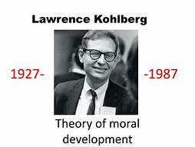
Dr. Hema K Mehar (Assistant Professor)
Department of Psychology,
UCSSH, MLSU, Udaipur

Slide 2
Biography of Kohlberg's
Born on 15th October, 1927 in Bronxville, Newyork.
In 1949 - He begins his doctoral work at the university of Chicago
In 1958 – He completes hid doctoral dissertations research on the moral development of child
In 1969- As a result of his dissertation research, Kohlberg's found professional fame.
1n 1971 - while conducting cross-cultural work in Belize, Kohlberg contracts a tropical disease that plague him physically and mentally for the next sixteen years.
In1987 – On leave from a Massachusetts hospital where he is seeking treatment for the above illness, Kohlberg commits suicide by drowning himself in Boston harbour. He was 59years old.

Slide 3
Theory of moral development
Kohlberg extended piaget’s theory, proposed that moral development is continual process that occurs throughout the lifespan.
He based his theory upon research and interviews with group of young children.
A series of moral dilemmas were presented to these participants and they were also interviewed to determine the reasoning behind their judgement of each scenario.

Slide 4
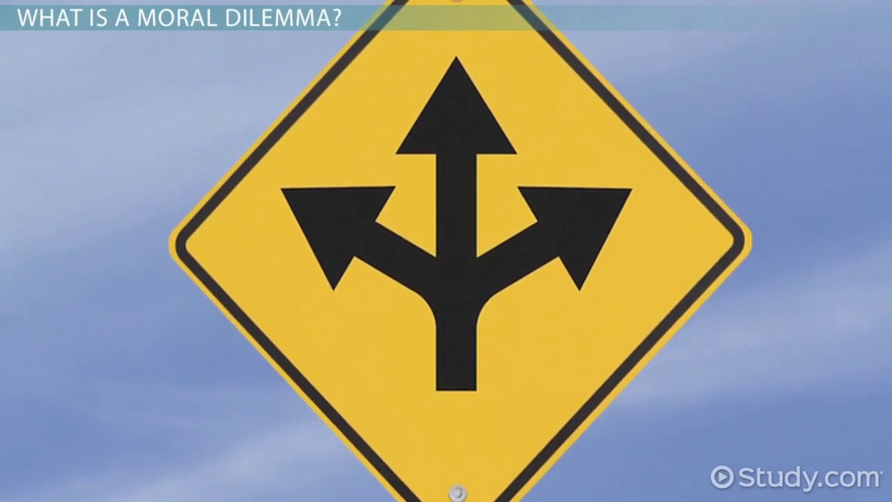
A moral dilemma is a conflict in which you have to choose between two or more actions and have moral reasons for choosing each action.

Slide 5
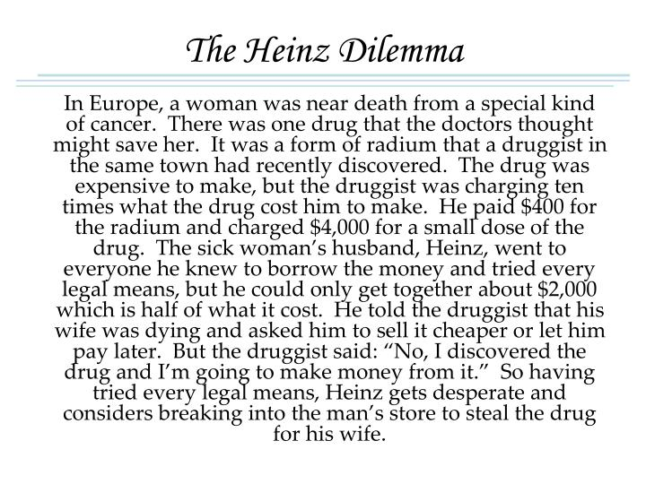
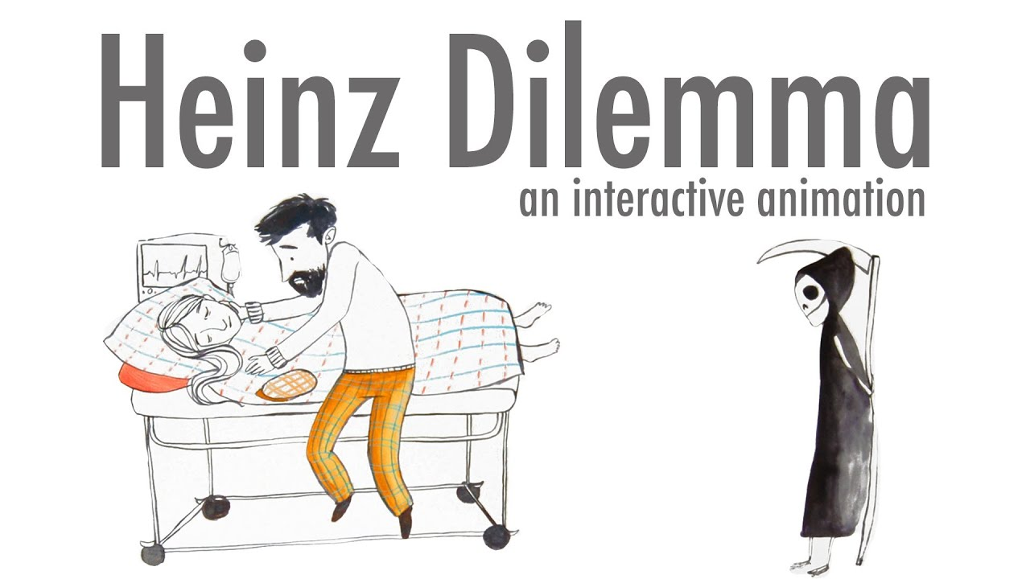
One of the best known stories of Kohlberg's (1958) concerns a man called Heinz who lived somewhere in Europe

Slide 6
Heinz Dilemma
Should the Husband have done that ?......
If yes/no then why do you think so?

Slide 7
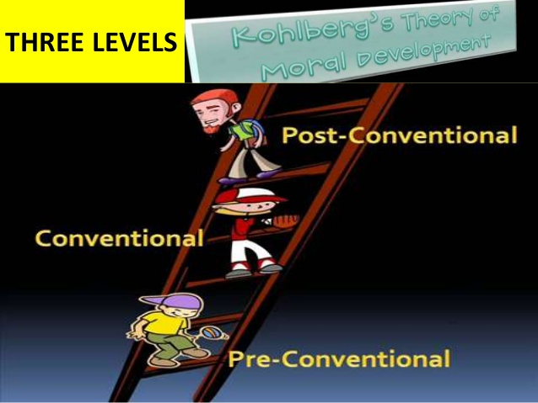
Three Levels of Kohlberg's Theory of Moral Development

Slide 8
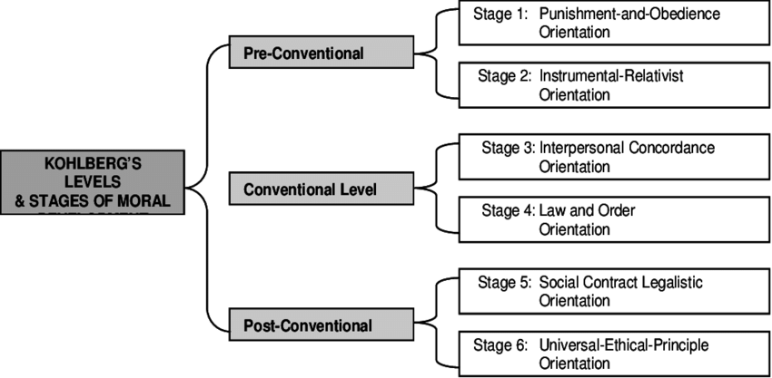
Theory of Moral Development

Slide 9
Level 1 - Preconventional Morality
This level is typically of children ages 4 to 10
First level of Kohlberg's theory of moral reasoning.
A person is motivated by Obedience to authority.
Commonly associated with young children.
Involves little thought about morality.
People act under external controls.
They obey rules to avoid punishment or reap rewards, or act out of self interest.

Slide 10
Stage 1. Obedience & Punishment
Earliest stage of moral development
Common in young children.
Children see rules as fixed and absolute.
Obeying the rules is important to avoid punishment.
Morality is motivated solely by punishment.
Children obey rules to avoid punishment.
“ what will happen to me??”
Eg. “ I will keep quiet so that teacher won’t get mad at me”

Slide 11
Stage 2 - Instrumental purpose / Individualism & Exchange
Also known as personal reward orientation.
Children account individual points of view.
Reciprocity is possible but only if it serves one’s own interest. i.e. Tit For Tat stage.
“ you scratch my back, I’ll scratch yours”.
Children conform to rules out of self interest and consideration for what others can do for them.
Focuses on individualism and different perspectives
The goal is to avoid punishment.
Children recognize that there is not just one right view and that different individuals have different viewpoints.
E.g.. “ I will let you copy mine if you do my homework”

Slide 12
Level 2 – Conventional morality
Also known as morality of conventional role conformity
This level is typically reached after age 10.
People focus on following social norms and customs.
People have internalized the standard of authority figures (begin to internalize the moral standards of valued adult role models).
They are concerned about being “good”, pleasing others and maintain the social order.
Reasoning is based on the norms of the group to which the person belongs.

Slide 13
Stage 3 - Interpersonal Relationships/ Maintaining mutual relationships
Also known as “ Good boy Good Girl” Orientation
“ Am I a good boy or girl?”
Maintaining mutual relationships, approval of others, the golden rule.
Children want to please and help others, can judge the intentions of others, and develop their own ideas of what a good person is. ( emphasizes the maintenance happy interpersonal relationships and pleasing others)
They evaluate an act according to the motive behind it or the person performing it, and they take circumstance into account.
Eg. “ I will buy that dress so that my friends will like me”.

Slide 14
Stage 4 - Maintaining social order
Considers society as a whole when making judgements
“ what if everybody did it?”
People are concerned with doing their duty, showing respect for higher authority and maintaining the social order.
Focus in on maintaining law & order by following rules, doing one’s duty and respecting authority.
Becomes aware of the wider rules of society to avoid guilt.
Please individuals to maintaining social order by following social norms, customs and laws.
Eg. “ You should not bunk the class because its against school rules”.

Slide 15
Level 3 - Post conventional morality
Also called as morality of autonomous moral principle
Ages between early adolescence or not until young adulthood or never.
Judgement is based on self chosen principles.
People now recognize conflicts between moral standards and make their own judgements on the basis of principles of right, fairness and justice.
People generally do not reach this level of moral reasoning until at least early adolescence, or more commonly in young adulthood, if ever.
Moral reasoning is based on individual rights and justice.

Slide 16
Stage 5- Social contract & Individual rights
People think in rational terms, valuing the will of the majority and the welfare of society.
They recognize that there are times when human need and the law conflict, they believe it is better for society in the long run if they obey the law.
Laws are important but members of the society should agree upon these standards.
Becomes aware there are times when they will work against rules or the interest of particular individuals.
Emphasis on the social contract and the maintenance of individual rights.
Eg. “ It is her own decision, we should just respect that”.

Slide 17
Stage 6 - Universal Principles
People do what they as individuals think is right, regardless of legal restrictions or the opinions of others.
They act in accordance with internalized standards, knowing that they would condemn themselves if they did not. ( follow these internalized principles of justice, even if its against the law)
Moral judgement is motivated by one’s own conscience.
People have developed their own set of moral guidelines which may or may not fit the law.
E.g. “ if abortion become legal in our country, I will be one of the people who will be against it because its against God’s law” .
Eg Nelson mandela, mahatma Gandhi.

Slide 18
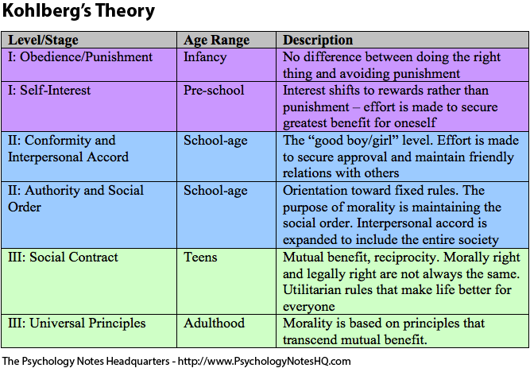
Theory of Moral Development

Slide 19
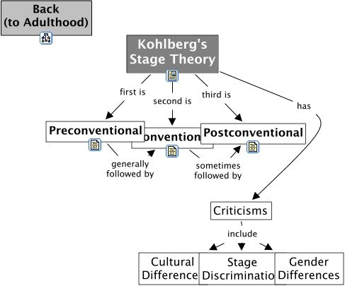
Criticism
Carl gilligam criticized
Individualised socialised researcch.
Not on culture, gender differnces.
It is not universal

Slide 20

Thanks

