Slide 1
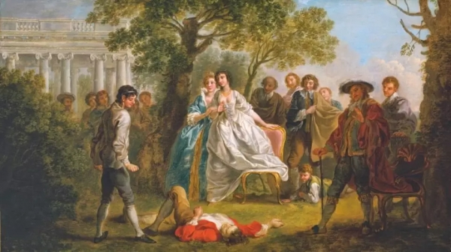
William Shakespeare’s
As You Like It
An Evaluation

Slide 2
List of characters
Orlando
Rosalind
Celia
Touchstone
Oliver
Duke Senior
Duke Frederick
Jacques
Phebe
Silvius
Corin
Audrey

Slide 3
Character Analysis of Orlando
Enmity with Oliver
Lack of formal education
Desperation with his animal like existence
Brave and courageous
Strong and skillful wrestler
Courteous,humble,and gallant
Handsome
Kind and merciful
Moral goodness
Faithful lover
…….continued

Slide 4
Orlando
Poetic
Witty
Candid
Virtuous
Pining for Rosalind

Slide 5
Character Analysis of Rosalind
Witty and wise
Love for her cousin
Love for her father
Beautiful
Kind and generous
Brave and fearless
Skillful simulator
Love for Orlando
Despeartion in love
Skillful storyteller
……..cont..

Slide 6
Rosalind
Practical and farsighted
Knowledgeable
Good at argument
virtuous

Slide 7
Character Analysis of Jacques
Melancholic temperament
Philosopher
Animal lover
Detachment with worldliness
Love for the fool and motley
Love for knowledge
Religious
Love for song
No place for carnal love

Slide 8
Character Analysis of Touchstone
Foolish
Witty
Voluptuous
Candid
equivocator
Funny philosopher
Love for Audrey

Slide 9
Theme of Love
Love at first sight
Carnal love
Spiritual love
Illicit love

Slide 10
Theme of Changeable Human Nature and Adaptation
Change of heart of Oliver
Conversion of Duke Frederick
Duke Senior’s life in the forest
Rosalind and Celia’s disguise

Slide 11
Theme of Juxtaposition of Country and Courtly Life
Courtly life- Duke Frederick, Celia, Rosalind,Oliver, Orlando,Touchstone
Country life-Corin, Silvius, Audrey, Phebe
Adaptation from Courtly life to Country life as all the characters shift to the forest of Arden
Courtly life-Artificiality, conspiration, usurpation, jealousy, superficiality,lack of contentment
Country life-Naturality, genuineness, innocence, love, scarcity of resources, usurpation on wild life, harshness of the weather, joy and merriment
Jacques and Duke Senior’s opinions about both types of lives

Slide 12
Dramatic Irony in the play
Dramatic Irony is a literary technique originally used in Greek tragedy by which the full significance of a character’s words or actions is clear to the audience or reader although unknown to the speaker.
Orlando’s affair with Ganymede is full of ironies.
Phebe’s love for Ganymede and her letter to Ganymede is ironical
Rosalind’s promise to Phebe is ironical
Oliver’s talk with Charles about murder of Orlando
Oliver’s affair with Aliena
Frederick’s fear about the attack and his later conversion

Slide 13
As You Like It : A pastoral Comedy
Definition: Any piece of writing or play performed which has happy marriages in a forest, and has sheeps and shepherds, would come into the category of pastoral genre and if it is inducing laughter, it is a pastoral comedy. The term pastoral refers to the life of the shepherds and shepherdesses or rural folk and their ways of living, manners, and customs.
Pastoral elements in the play:
Exile from city life to the rural life
Adversity of the country life
Life of Duke senior in the Forest of Arden
Life of silvius , corin and other country folks

Slide 14
Rosalind and Celia having a sheepcot in the wood
Jacques’ Appreciation for the rural life
Atmosphere of love and merriment
Wedding of the love couples

Slide 15
Thank You

