Slide 1
Neoproterozoic Geology of Rajasthan
Presentation by
Ritesh Purohit

Slide 2
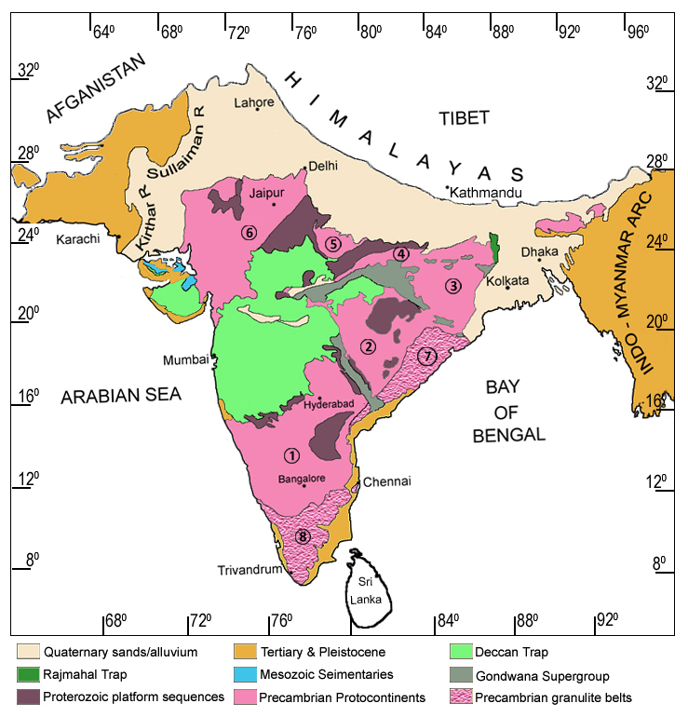
Precambrian rocks of the Indian Shield is made of several Protocontinents and accreted terranes
Protocontinents
1. Dharwar
2. Bastar
3. Singhbhum
4. Rajmahal
5. Bundelkhand
6. Aravalli
Accreted terranes
7. Eastern Ghats
Granulite Belt
8. Southern
Granulite Belt

Slide 3
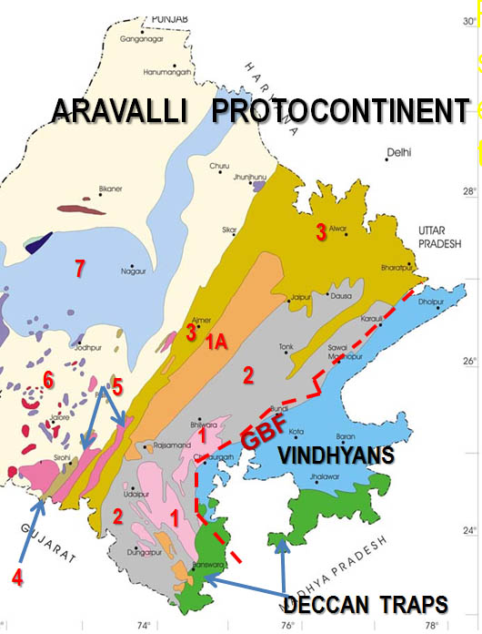
Aravalli Protocontinent constitutes of -
7. Marwar Supergroup
6. Malani Group
5. Erinpura Granite
4. Sirohi Group
3. Delhi Supergroup
2. Aravalli Supergroup
1,1A Archaean Basement
(partially reconstituted)

Slide 4
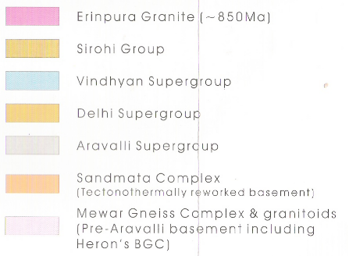
Neoproterozoic rocks occur west of the blue line along the mid-rib of Aravalli Mts
Sn & Sl
Sands & soils
Teritiary formations
Tertiary magmatics, Deccan trap
MSZ
Mesozoic formations
Sn & Sl
Palaeozoic formations
MSG
Marwar Supergroup
4
Malani Group: Felsic & mafic volcanics, sediments, granites
MSG
MLN GP
MSZ
E G
Erinpura granites, ~850 Ma
SG
Sirohi Group
MLN GP
2
5
Vindhyan Supergroup
3
E G
4
Delhi Supergroup
5
3
Aravalli Supergroup
E G
1
2
Sandmata Complex : TTR basement
SG
100km
1
Mewar Gneiss Complex, Archaean
Granitoids (including Heron’s BGC)
GEOLOGICAL MAP OF RAJASTHAN

Slide 5
Three important ensembles that make up the entire span of Neoproterozoic are
Marwar Supergroup
Malani Group
Sirohi Group
Erinpura Granite includes only those granites emplaced during ~850 Ma
coevally with the closing of the Sirohi basin

Slide 6
Neoproterozoic history in Rajasthan began with
diverse tectono-thermal activities over a wide region.
The ages of these events ranging between ~1000 &
1130 Ma match with well-known “Grenvellian” dates
~ 1128 Ma single zircon age of
granulite west of DFB
DELHI FOLD BELT
973 Ma single zircon age
(pegmatite in paragneiss) Agucha
1012 +/- 78 Ma Sm-Nd isochron age
of diorite in DFB rocks (Ranakpur)
~1000 Ma U-Pb lower intercept age of charno-enderbite (Gyangarh)
~992 Ma single zircon (xenocrystic)
age of diorite gneiss (E of Sirohi)
~990 Ma U-Pb zircon & Pb-Pb model age of rhyolite (Deri-Ambaji)
955 +/- 20 Ma Rb-Sr isochron age
of granitoids (Godra)

Slide 7
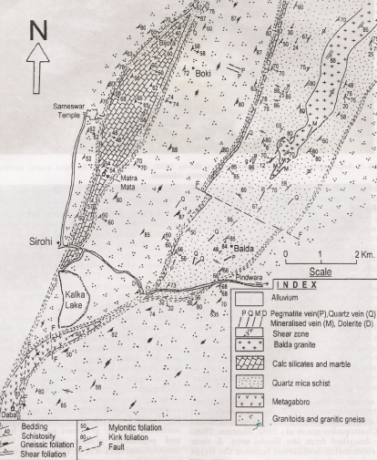
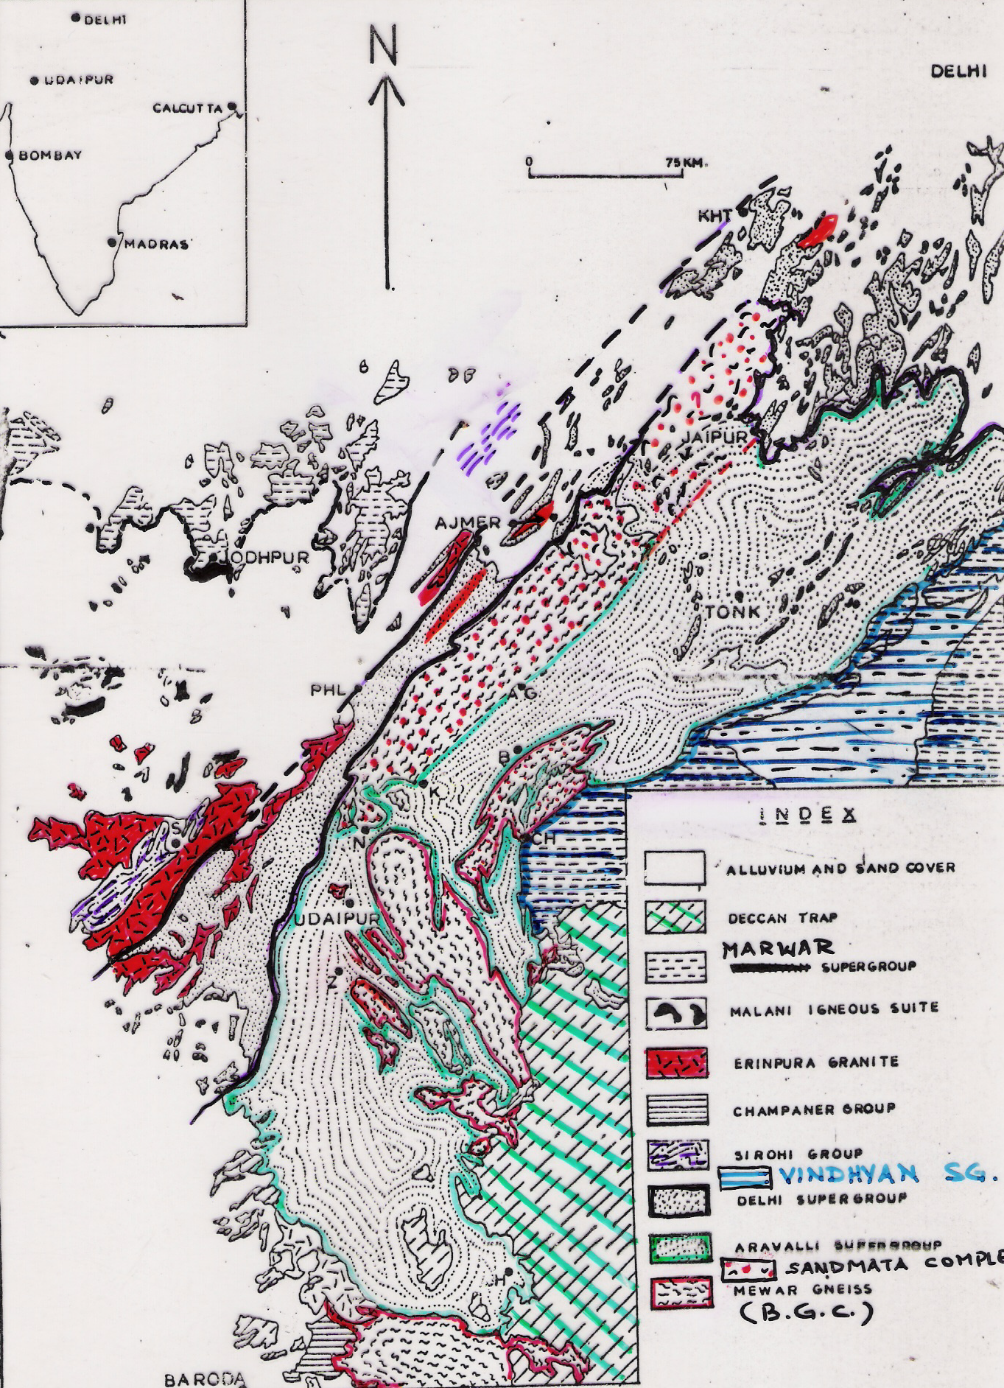
Balda granite
Calc-silicate & marble
Quartz micashist
Quartz micaschist
Sirohi
Granite and granite gneiss
Metagabbro
Sirohi Group is a distinct post-Delhi sedimentary succession that
developed as separate basins west of the Aravalli Mountains

Slide 8
Balda granite
Calc-silicate & marble
Quartz micashist
Quartz micaschist
Sirohi
Granite and granite gneiss
Metagabbro
Sirohi Basins closed with emplacement of synorogenic Erinpura Granite
at ~850 Ma . This also marks the cratonisation of the Aravalli Crust

Slide 9
Sirohi Group comprises a shale-sandstone-carbonate litho-association, without large-sized clasts and volcanogenic rocks.
Basin inversion is marked by emplacement of synkinematic granites at ~850 Ma (Erinpura Granites, sensu stricto). Closing of Sirohi Basins coincides with final cratonisation of Precambrian Aravalli Crust.
There is no deformed orogenic rocks in Rajasthan younger than ~850 Ma.
~850 Ma phase of granite emplacement is a widespread event over entire Indian ‘Shield’, and is correlated with the early phase of the Pan-African (East African) Orogeny.

Slide 10
The Pindwara-Aburoad metasediments overlie the Bhula Granitic Gneisses (~1400 Ma) similar to the Sirohi Metasediments which overlie Veerwara Granitic Gneisses (~990-920Ma)
Deformational and Metamorphic history of Pindwara-Aburoad metasediments is same as of the other Delhi Supergroup rocks whereas that of the Sirohi Group is different and therefore-
In absence of direct contact with the Delhi or the Aravalli Basins the relative stratigraphic relationship of Sirohi Basin is considered youngest in the orogenic cycle.

Slide 11
Like the Aravalli & Delhi ensembles, there is no direct radiometric control over the age of Sirohi Group.
However, single zircon study from Veerwara indicates ~990-920 Ma age of the granitic basement of the Sirohi Group.
The age suggests a much younger startigraphic status of the Sirohi Group metasediments perhaps ~900-850 Ma equivalent to the Lower Shaler Group of Canadian Shield.

Slide 12
The closing of the Sirohi Basin at ~850 Ma completed the process of cratonization of the Aravalli Crust.
All the subsequent geological events in this terrane took place under tectonically quite conditions (anorogenic).

Slide 13
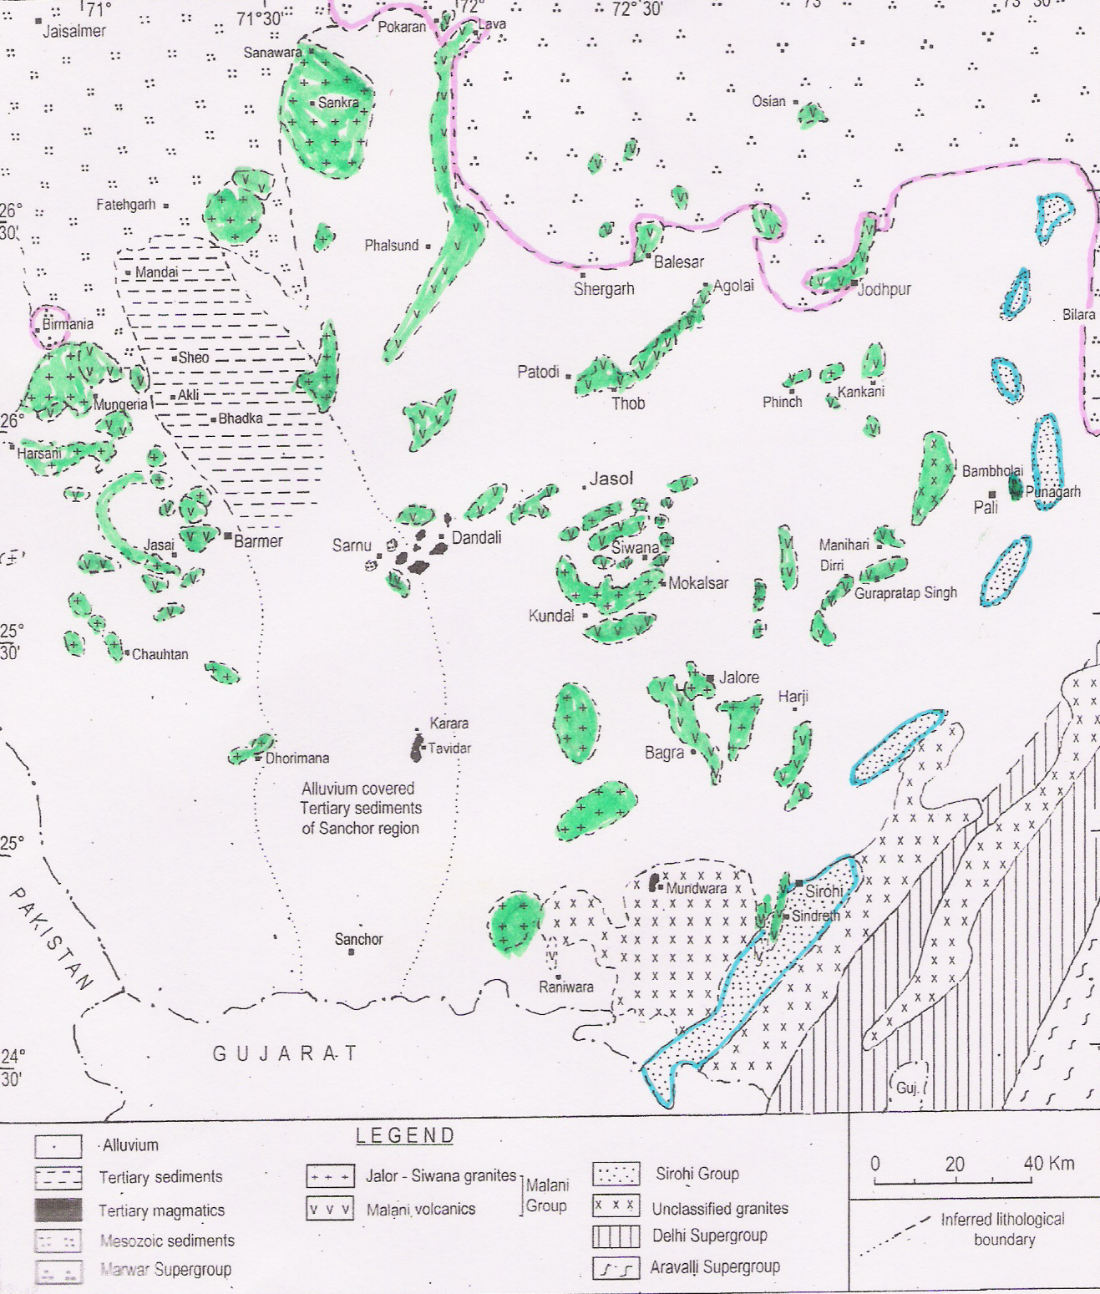
About 100 m.y after
cratonisationstion,
Aravalli Crust was effected by plume related activity resulting in development of bimodal volcanicity and intrusion of alkaline/peralkaline granite along with minor basin formations at several places.
The entire ensemble that formed during 740-780 Ma is described as the
MALANI GROUP
Marwar Supergroup
Sirohi Group

Slide 14
Malani rocks evolved after the closure of Sirohi basins, but possibly with a small hiatus.
Dominant litho-units:
1.Dominantly rhyolite
flows, tuffs, ignimbrites; & local mafic flows;
3.Peralkaline and
peraluminous
granites;
4.Conglomerate and
arkose (local).
JAISALMER
MARWAR SUPERGROUP
Mesozoics
JODHPUR
SIWANA
Tertiaries
JALORE
SIROHI
Delhi Supergroup
40 km
Granites
Sirohi Group
Volcanics
Erinpura & other granites

Slide 15
Because of the formation of variety of rock types within a definite time span between the closing of Sirohi basins and opening of the Marwar basins, it is pertinent to describe these rocks as Malani Group

Slide 16
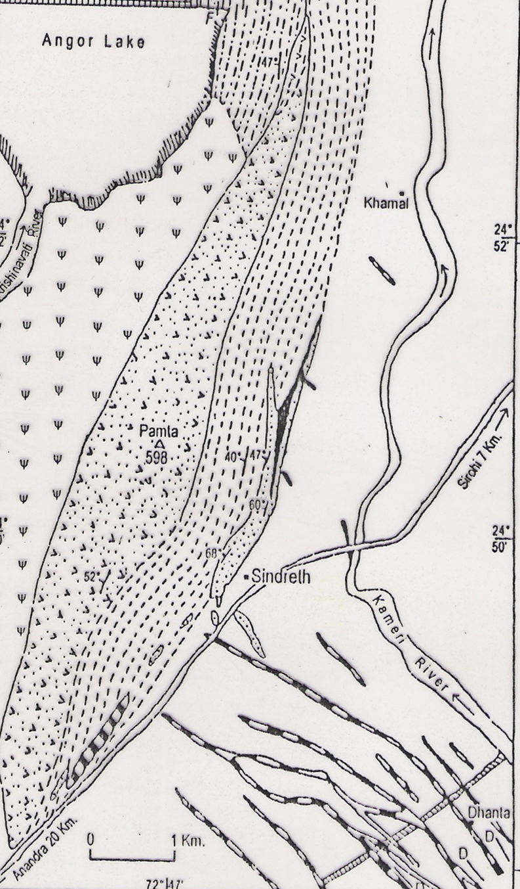
Silicic
tuff
The earliest Malani related magmatism is associated
with ephemeral basin opening
in the easternmost part at
Sindreth and Punagarh. This
was was accompanied by the
emplacement of dyke swarms
(dominantly of feldspar
porphyries).
Basalt
Soil cover
Conglomerate
Pamta Rhyolite
Sindreth
Feldspar porphyry dykes
Volcani-sedimentary
succession at Sindreth

Slide 17
Three phases of Malani igneous activities are recorded west of these eastern Malani rocks :
1. Eruption of mafic flows followed by
voluminous acid flows, culminating with
deposition of tuffs and ignimbrites.
2. Emplacements of discordant peraluminous
and peralkaline granite plutons, ring dykes
and bosses
3. Dykes of basic, acid, trachyte porphyry and
andesite (?)

Slide 18
Oldest component of the Malani Group is ~780 Ma old. While the youngest is ~698 Ma old.
Different dates of other Malani rocks (granites and felsic volcanics) in between the oldest and the youngest ones range between ca 745 and ~727 Ma.
All these dates indicate of repeated plume outbursts over a period of about 80 million years.

Slide 19
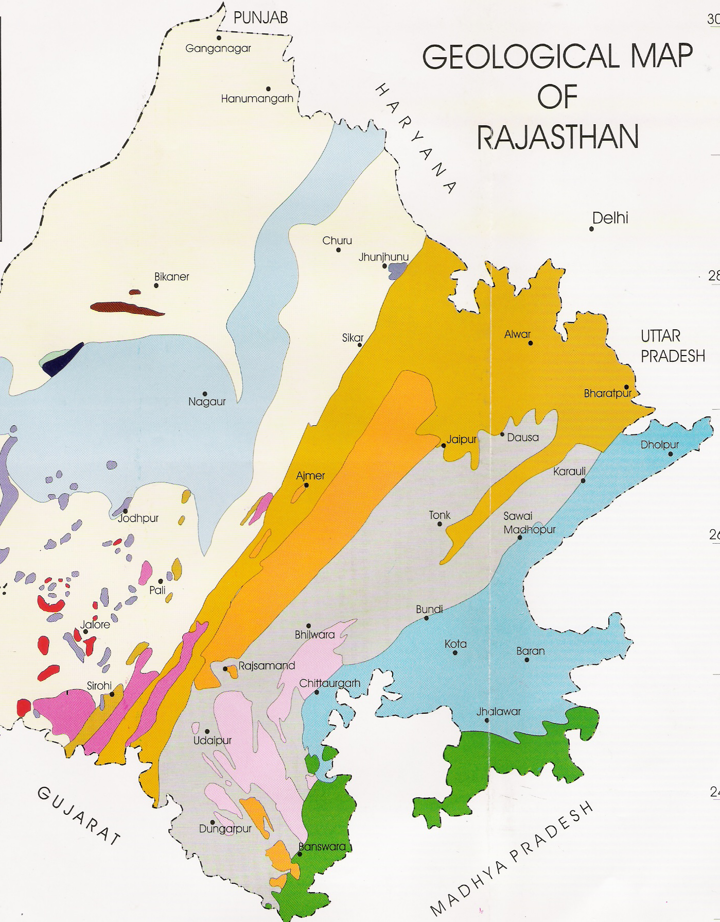
↓Two stable cratonic basins
formed on either side of the
Aravalli Mountians at different times.
↓ The eastern basin with
VINDHYAN SUPERGROUP
evolved earlier, might be
coevally with the Delhi basins
↓ The western basin is the
MARWAR SUPERGROUP
which over lies the
Malani Group. This is the
youngest Precambrian
Stratigraphic ensemble flanking
Aravalli Mountains
MARWAR
SUPERGROUP
VINDHYAN
SUPERGROUP

Slide 20
↓ There are two stable cratonic
basins on either side of Aravalli
Mountains. Correlating the two,
early authors considered the
eastern as
Main Vindhyan Basin
and that across the mountains as
Trans-Aravalli Vindhyans
↓ Recent isotope data indicate an
early opening of eastern basin
(might be coevally with Delhi
basins). By contrast, the western
basin, which unconformably
overlies the Malani Group
evolved much later.
TRANS-ARAVALLI VINDHYANS
Aravalli Mountains
MAIN VINDHYAN
BASIN

Slide 21
↓ Besides difference in age of evolution, studies also indicated lithological and faunal similarity of the “Trans-Aravalli Vindhyans” with the Saline Series of Sub-Himalayan Pakistan rather than with rocks of Main Vindhyan Basin.
↓ Age relationship and Tethyan affiliation disproved early idea that the western basin is truly a “Trans- Aravalli Vindhyan”.
↓ Accordingly the western depositories has been renamed as Marwar Supergroup.
MARWAR SUPERGROUP
Aravalli Mountains
VINDHYAN
SUPERGROUP

Slide 22
Nagaur Group
↓ Marwar Supergroup is a
~2 km thick youngest
Neoproterozoic sequence.
↓ Its eastern margin is marked
by a N-S fault / lineament.
↓ Southern margin is less
regular, exhibiting at
places explicit
unconformable
relationship with the
underlying Malani Group
rhyolites.
BIlara Group
Jodhpur Group
Bikaner
Nagaur
Pre-Malani rocks
Jodhpur
Malani Group
Bilara

Slide 23
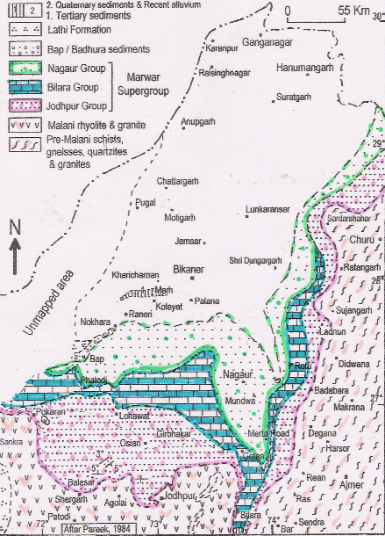
↓ Outcrops of Marwar
Supergroup show gentle
rolling nature, locally defining
broad synformal or domal
fold or have monoclinal dips.
↓ Generally conjugate pattern
of gentle folding with
NNE-SSW & NNW-SSE axial
trends is the possible
manifestations of basement
tectonics, caused by
heterogeneous block
movements along faults in
two directions.
Nagaur Group
BIlara Group
Jodhpur Group
Bikaner
Nagaur
Pre-Malani rocks
Jodhpur
Malani Group
Bilara

Slide 24
↓ The ensemble represents a
typical sand-shale-carbonate
association with evaporites.
↓ Exposed rocks of Marwar
Supergroup occur in two
different basins: Main Marwar
Basin and Birmania Basin.
↓ A number of isolated
subsurface basins have been
identified in the sand covered
northern part showing
evaporite-type depositional
environment. One such
important basin is
Hanseran Sub-basin.
Nagaur Group
BIlara Group
Jodhpur Group
Bikaner
Nagaur
Pre-Malani rocks
Jodhpur
Malani Group
Bilara

Slide 25
Marwar Supergroup includes three
lithostartigraphic units:
*************************************************************
Main Marwar Basin Hanseran Sub-basin
_______________________ ____________________________
Nagaur Group
(75-500 m)
Bilara Group = Hanseran Evaporite Group
(100-300 m) (103-652 M)
Jodhpur Group
(125-240 m)
~~~~~~~~~~~~~~~~~~~~~~~~~~~~~~~~~~~~~~~~~~~~~~~~~~
Basement rocks (Rhyolites and phyllites)

Slide 26
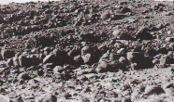
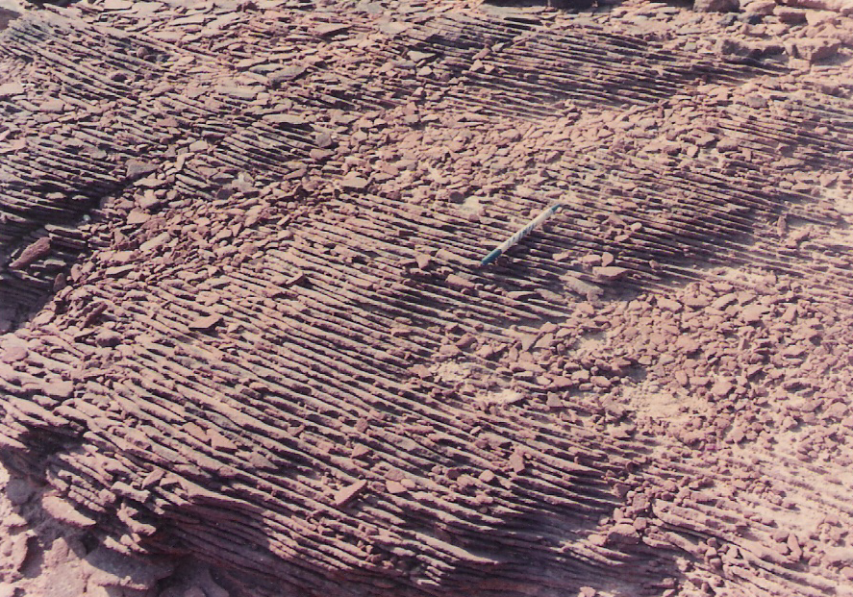
The basal Jodhpur Group starts
with Pokhran Boulder Bed
(local ~ 3 m thick heaps, restricted
to the southern fringe of the
Main Marwar Basin). Some author consider this as fluvio-glacial ensemble.
The overlying Jodhpur Group sequence occur creamish to brick red coloured, well-bedded sandstones Interlayered with shales, siltstone and chert and dolomite

Slide 27
Lithostratigraphic column
of the Jodhpur sandstones
indicating change of depositional environment with time from Deltaic to Beach and finally to Braided fluvial.
Based on palaeo-current data a northwesterly transport of siciclastic sediments drawn predominantly from the Aravalli Mountains is suggested.
The sedimentary ensemble has been described as the cratonic sheet sandstones

Slide 28
The Bilara Group overlying the Jodhpur Group typically represents a carbonate sequence.
Drill hole data indicate thinning of the rock group in northwesterly direction.
Carbon isotope profile shows marked oscillations with broadly negative δ¹³C values (ranging between <- 4.3 to -6.5 ⁰/₀₀ , PDB).
Several forms of stromatolites are reported from the Bilara carbonates.

Slide 29
Occurring only as sub-crops and considered coeval with
Bilara Group, Hansreran Evaporite Group is correlated with
similar succession in sub-Himalayan Pakistan.
Contains seven cycles of halite formation alternating with
carbonate and/ or anhydrite.
Presence of reddish and purple-brown clay beds with evaporite suggests arid, oxidising shallow water environment.
By contrast, repeated presence of halite-free stromatolitic carbonate is indicative of influx of water in the basin.
Though considered coeval, Hanseran Evaporite Group possibly post-date main transgressive facies of Bilara carbonates in the south.

Slide 30
Overlying the Bilara Group in the south of the Main Marwar Basin, occurs the Nagaur Group comprising dominantly of red and brick-red coloured mottled sandstone interlayerd with clay- and siltstones.
Dominance of sandstones in Naugar Group is indicative of a return of shallow water depositional environment after the deposition of Bilara carbonates.

Slide 31
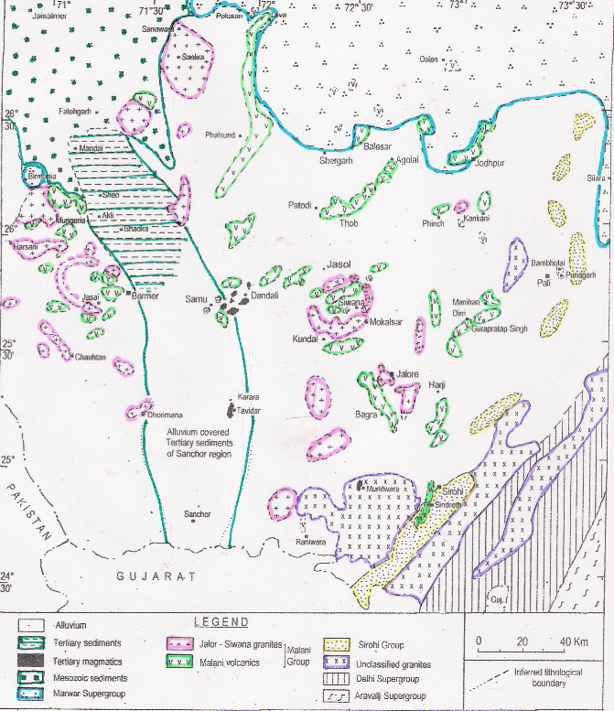
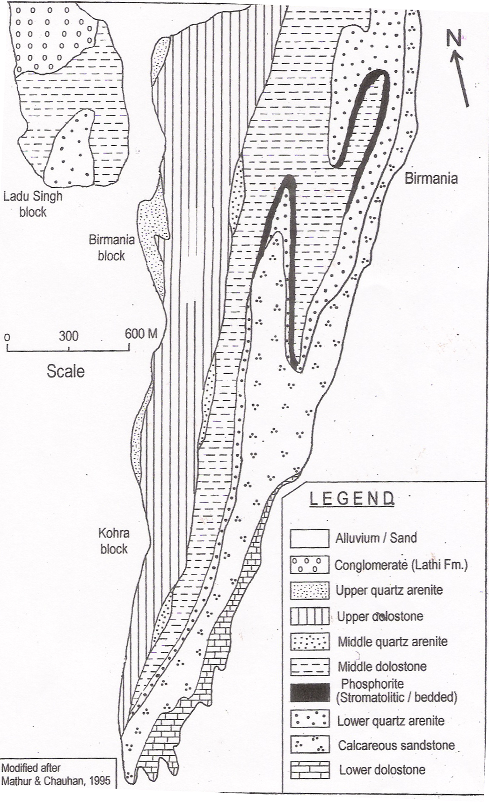
JAISALMER
MARWAR SUPERGROUP
Mesozoics
JODHPUR
BIRMANIA BASIN
SIWANA
Tertiaries
JALORE
SIROHI
Delhi Supergroup
40 km
Geological Map of
BIRMANIA BASIN
Granites
Sirohi Group
Volcanics
Erinpura & other granites

Slide 32
The isolated Birmania basin with
~ 3 km thick succession having
distinctive lithology with
phosphorite bearing horizon.
Characterised by deformation
features like doubly plunging
upright and locally
recumbent folds.
Exclusive presence of such
folds in Birmania rocks, not in
rocks below and above, is
indicative of cratonic deformation.
Lithostratigraphic column of the Birmania Basin

Slide 33
AGE OF THE MARWAR SUPERGOUP
There is no isotopic control over the age of the Marwar Supergroup. However, assuming Pokhran Boulder Bed as glaciogenic sequence like Blaini Formation in the Himalayas, an age corresponding to Marinoan glaciation at ca. 635 Ma has been suggested for opening of Marwar basins.
In absence of any definite Palaeozoic fossils in the Marwar rocks, the inversion of the Marwar basins may be linked with the major stratigraphic break at 543 Ma marking the Pc-C boundary

Slide 34
Precambrian Geochronological framework of Aravalli Mountains and neighbourhood → → → → → → → → → → → → → →
Marwar Supergroup 650-540 (?) Ma
Malani Group {=Sindreth Group} 780-766 Ma
Erinpura granite ca 850 Ma
Sirohi Group
Synorogenic granites in Delhi Fold belts ca 1450 Ma
Delhi Supergroup
Granulite exhumation in Sandmata complex 1725-1645 Ma
Darwal Granite {=AF1} ca 1900 Ma
Aravalli Supergroup
Basement Gneisses 2500 Ma to 3300 Ma
& granites

