Slide 1
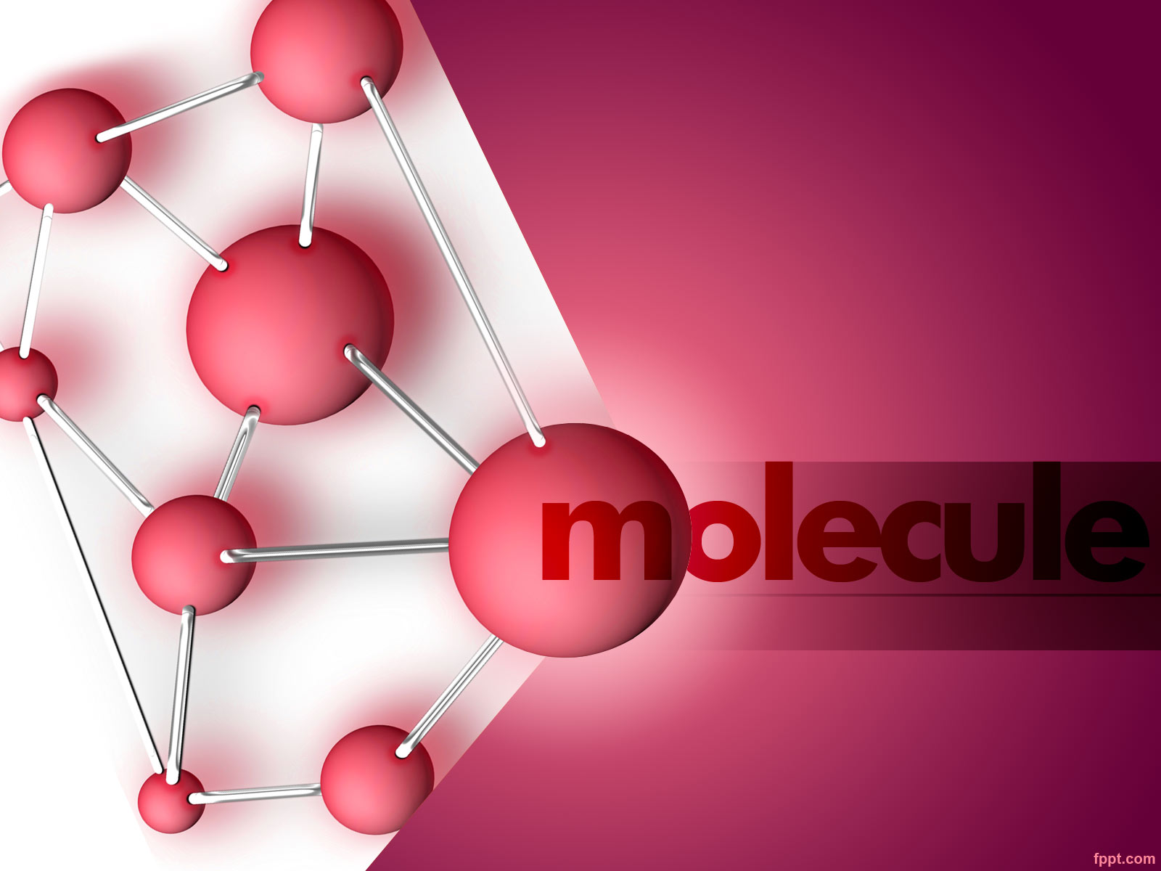
UNIT – 1
INTRODUCTION TO
POLYMERS
BY:
SUDHA JOSHI

Slide 2
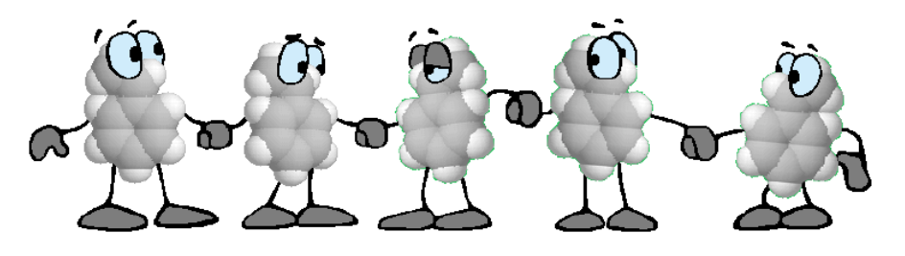
INTRODUCTION
The word polymer is derived from Greek word “Poly” means “many” & “Mers” means “parts”.
The basic unit is known as monomer.
Polymer is composed molecule with large molecule mass, composed of repeating structural units or monomers connected by covalent chemical bonds.
The process used for this is known as “polymerization”.

Slide 3
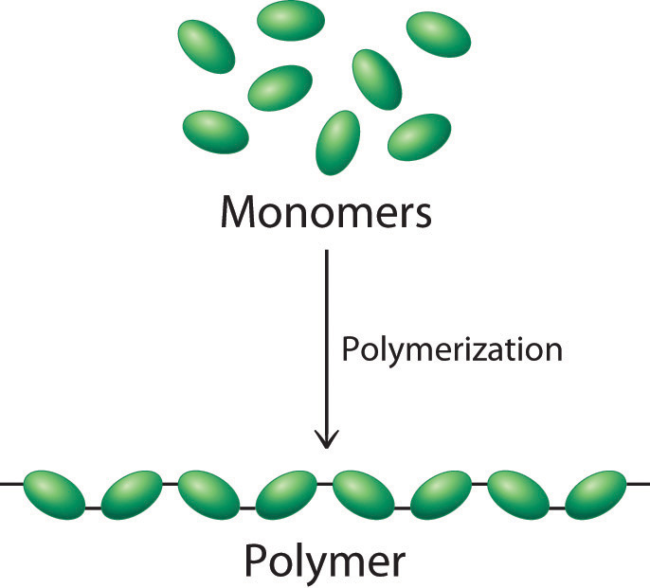
POLYMERIZATION

Slide 4
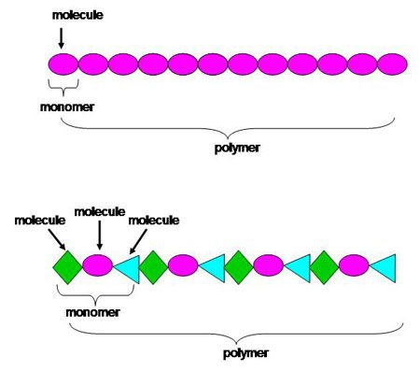

Slide 5
HOW POLYMERS ARE DIFFERENT FROM OTHER COMPOUNDS ?????
S.NO. | PROPERTY | POLYMERS | OTHER COMPOUNDS
1. | Molecular Weight | High Mol. Wt. Can change for same compound if synthesis process changes. | Mol. Wt. is relatively low. It always remains same.
2. | Viscosity | Shows very high viscosity even in dilute form. | Viscosity is similar or even less than water.
3. | Smell | Do not have any smell or odor. | Common compounds have characteristic smell.
4. | Melting Point | Do not have sharp melting points. | Have sharp melting points.
5. | Solubility | Polymers first swell and then dissolve in solution. | Compound can easily dissolved in the solution.

Slide 6
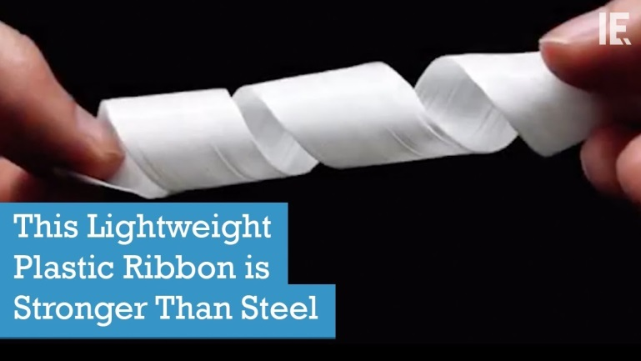
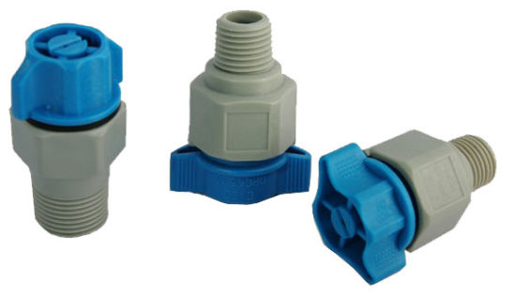
WHY WE NEED POLYMERS?????
Light Weight
Low Cost
Available In Variety Of Colors
Easy Process Ability
Easy Assembly Of Parts To Get Final Product
Low Co-efficient Of Friction
Self – Lubricating
Corrosion Resistant
Modification Of Polymer Properties With Additives Can Be Easily Achievable.

Slide 7
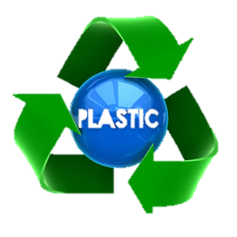
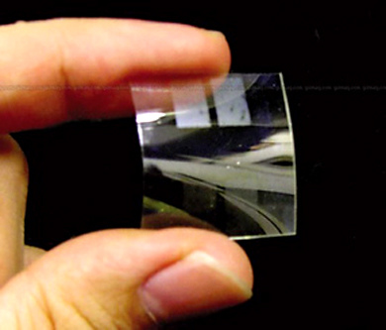
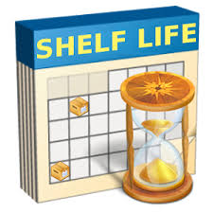
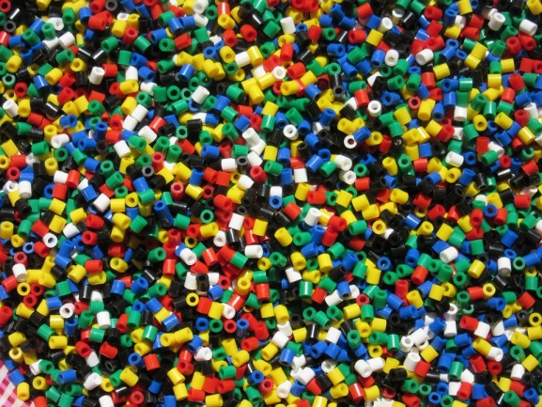
WHY WE NEED POLYMERS?????
Less electricity requirement.
They are available in flexible, semi – rigid & rigid form.
These are available in transparent/ translucent/ opaque form.
They have very long shelf life of product.
They are recyclable.

Slide 8
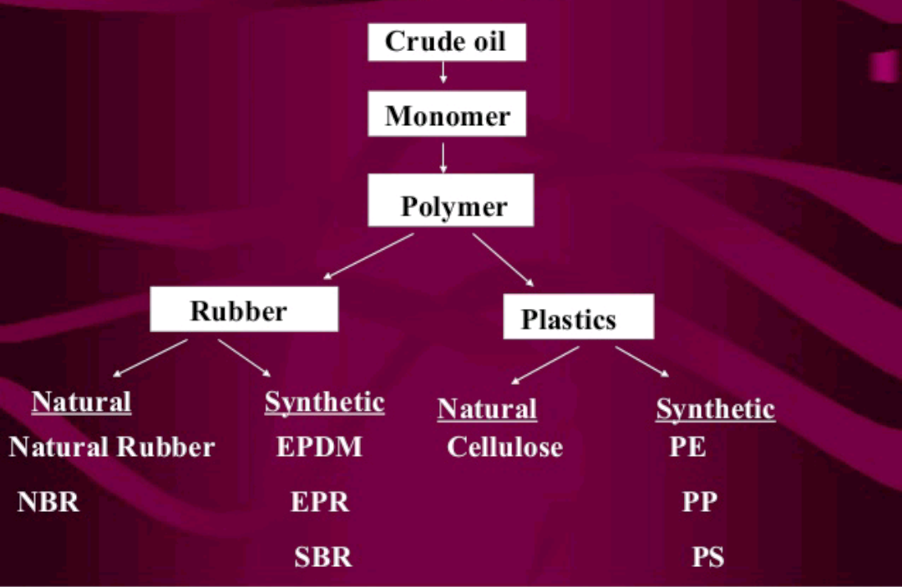
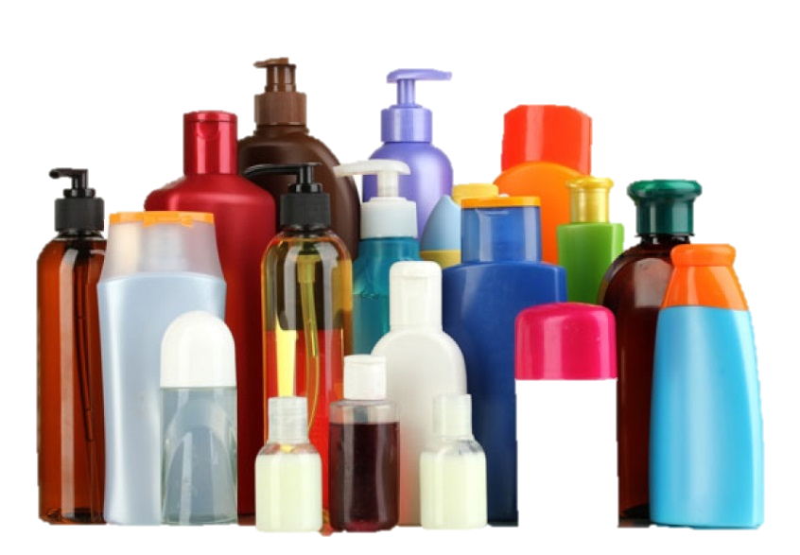
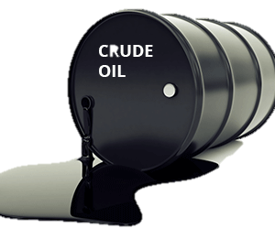
RAW MATERIAL FOR POLYMERS

Slide 9
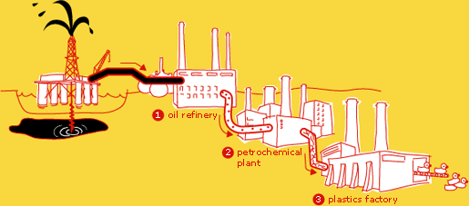
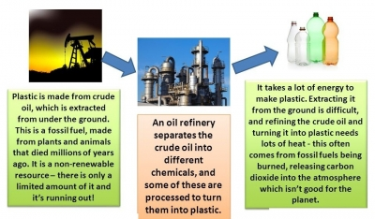

Slide 10

POLYMERS
HISTORY OF

Slide 11
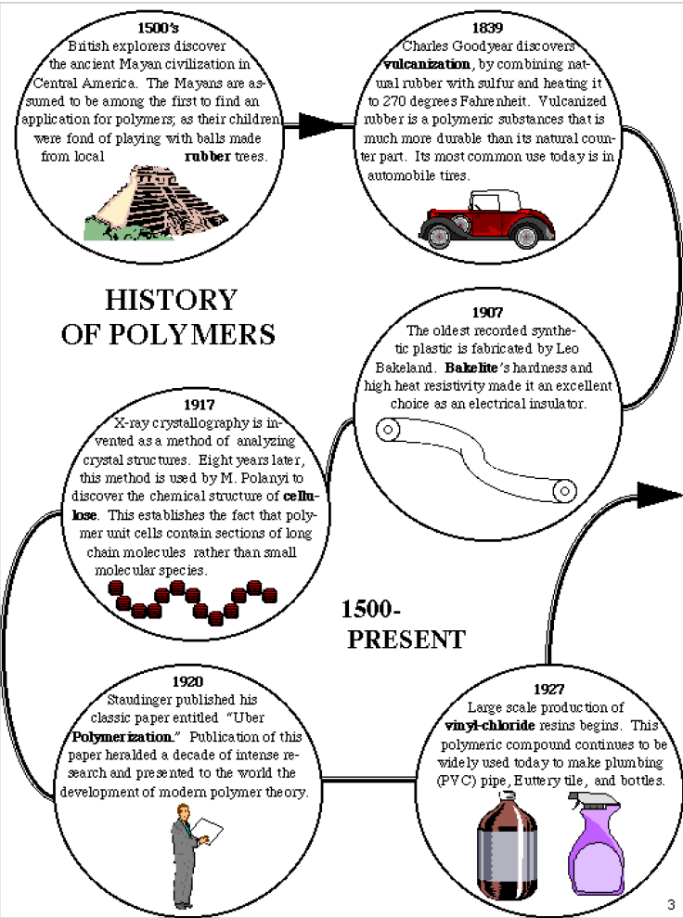

Slide 13
In 1770, Joseph Priestly gives the term natural rubber to the extrudate of a solid mass of ‘weeping wood’ tree which can be used to rub off pencil marks.
2. First semi – synthetic polymer ever made was Guncotton (Cellulose Nitrate) by Christian F. Schonbein in 1845.
3. In 1872, Bakelite, a strong & durable synthetic polymer based on phenol & formaldehyde was invented by Leo Baekeland.
4. Other important synthetic polymers were invented later includes:
(i) Polyethylene [PE] – 1933 by Karl Ziegler
(ii) Poly(vinyl chloride) [PVC] – 1933 by Eugen Baumann
(iii Polystyrene [PS] – 1933 by Eduard Simon
(iv) Polyamide – 1933 by Wallace Hume (W.H.) Carothers
(v) Teflon – 1938 by Roy J. Plunkett
(vi) Synthetic Vulcanized rubber – 1839 by Charles Goodyear.
(viii) Cellulose – 1838 by Anselme Payen.

Slide 14


NOMENCLATURE
OF
POLYMERS

Slide 15
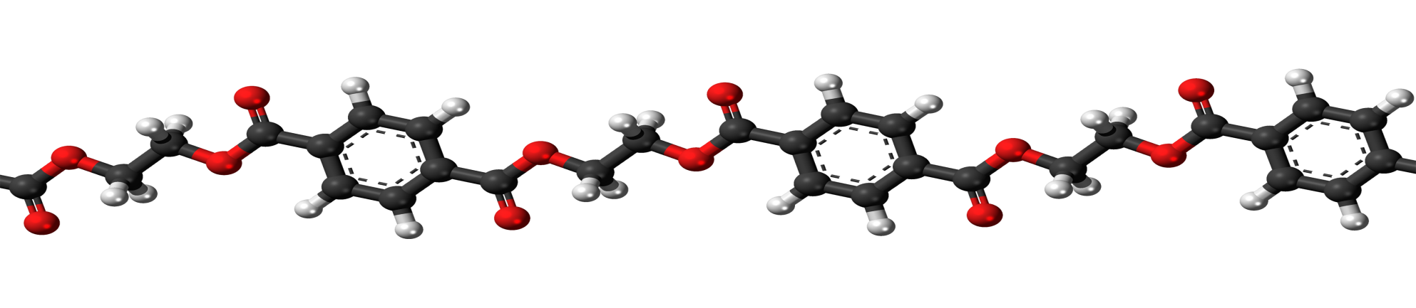
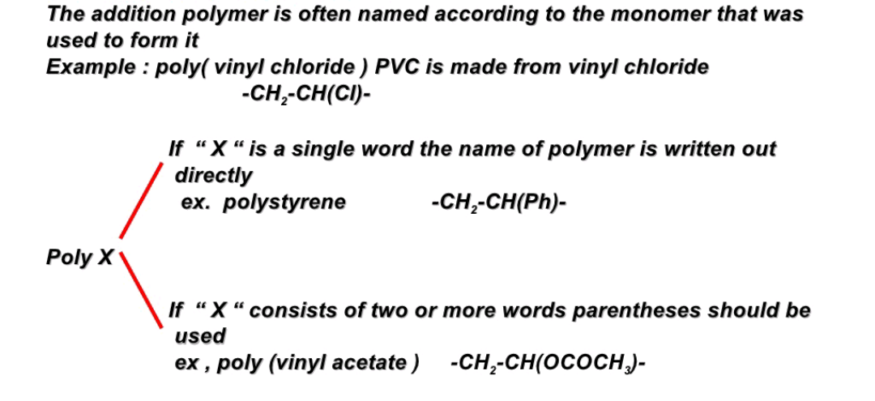
1. If Monomer Unit Is Same

Slide 16
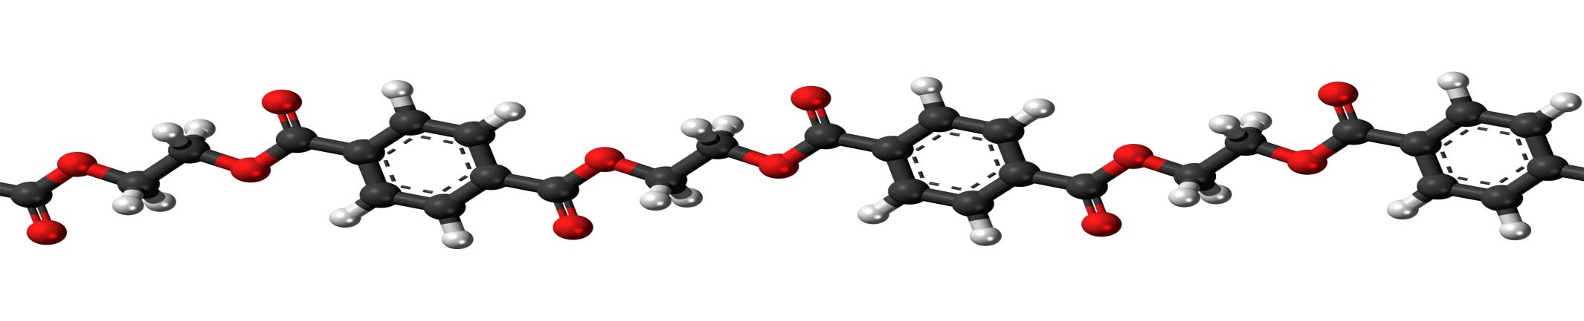
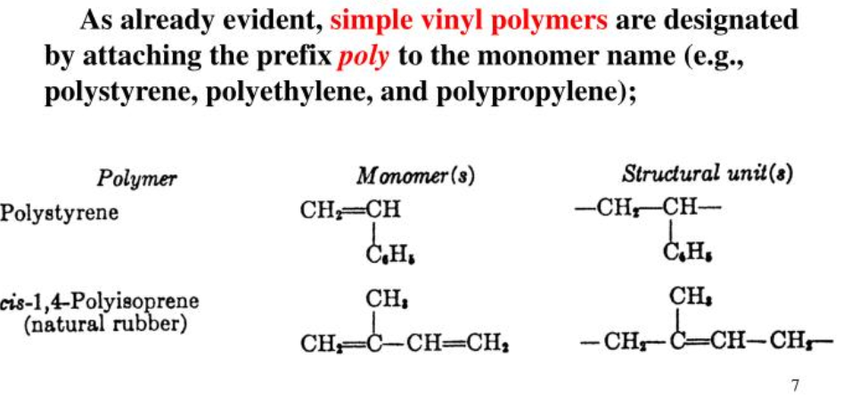

Slide 17

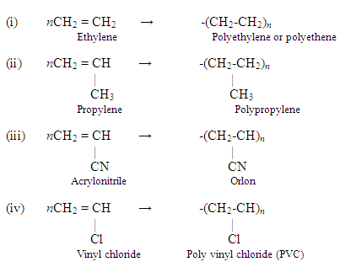

Slide 18
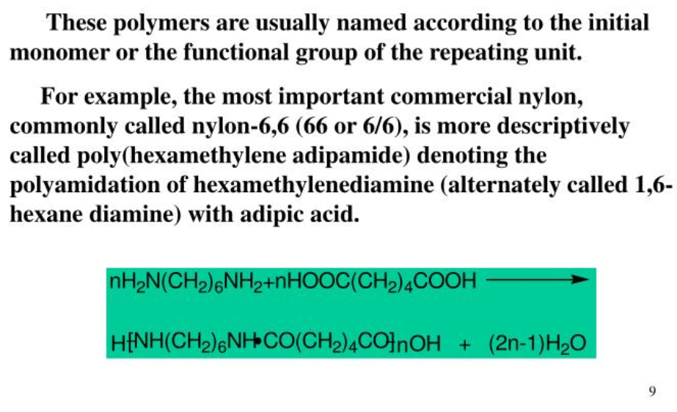
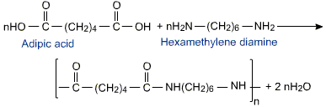
2. If Two or More Monomers are used then:
Poly(hexamethyleneadipamide)
OR
Nylon -6,6

Slide 19
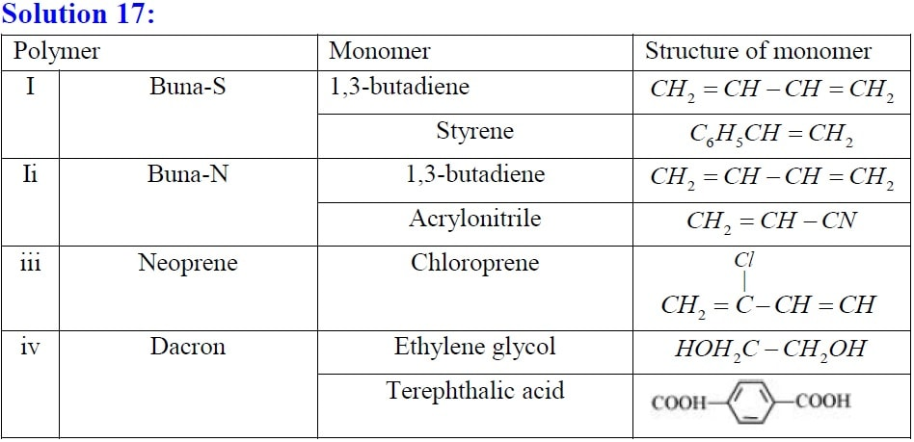
Commercial Name of
IUPAC Name of Polymer
Styrene – Butadiene
rubber
Acrylonitrile –Butadiene
rubber
Poly (2-Chlorobuta-
1,3-diene)
Poly (ethylene terephthalate)

Slide 20
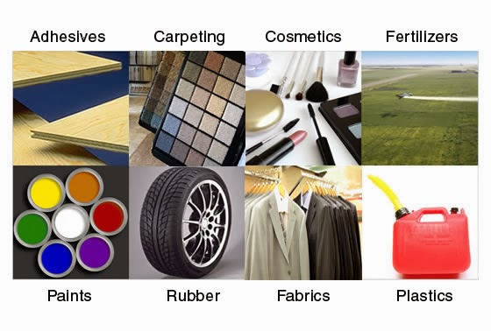
Applications of Polymers

Slide 21


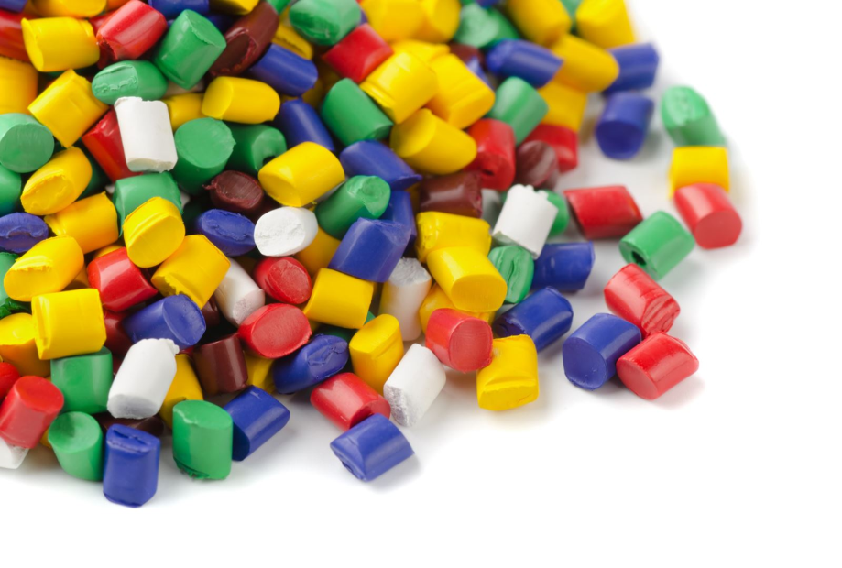
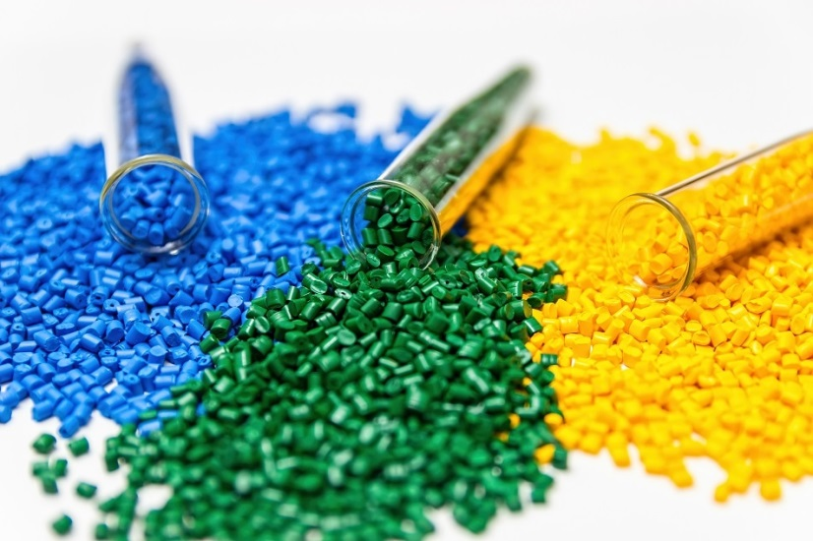
CLASSIFICATION OF
POLYMERS

Slide 22
1.
2.
4.
5.
7.
8.
6.
9.
ON THE BASIS OF ORIGIN
ON THE BASIS OF MODE OF FORMATION
ON THE BASIS OF TYPES OF MONOMERS
3.
ON THE BASIS OF LINE STRUCTURE
ON THE BASIS OF CRYSTALLINITY
ON THE BASIS OF TACTICITY
ON THE BASIS OF THERMAL RESPONSE
ON THE BASIS OF TYPE OF BACKBONE CHAIN
ON THE BASIS OF COMMERCIAL APPLICATIONS
ON THE BASIS OF PRESENCE OF CARBON IN POLYMER

Slide 23
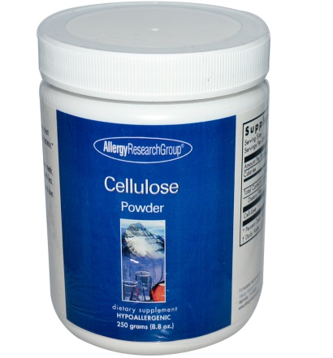
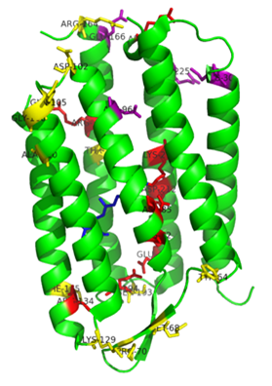
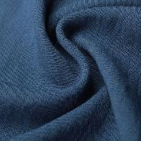
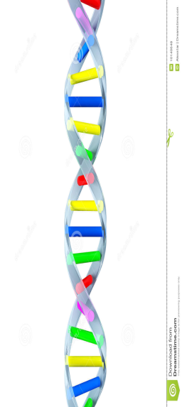
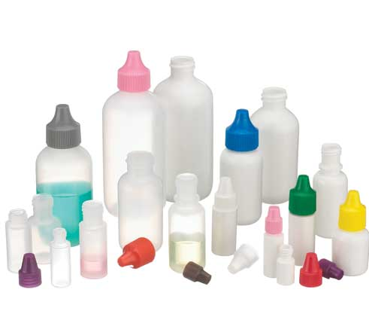
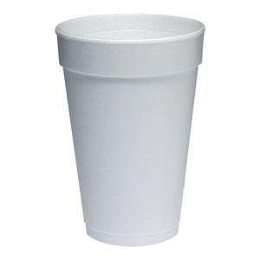
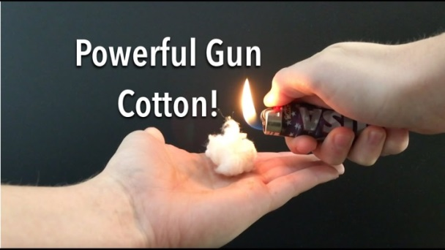
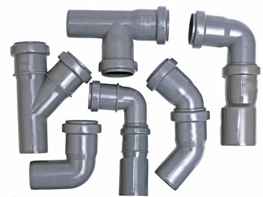
1. ORIGIN
NATURAL POLYMERS
PROTEINS
SYNTHETIC POLYMERS
POLYETHYLENE
CELLULOSE
RAYON
SEMI-SYNTHETIC POLYMERS
NITROCELLULOSE/ GUN COTTON
POLY VINYL CHLORIDE (PVC)

Slide 24
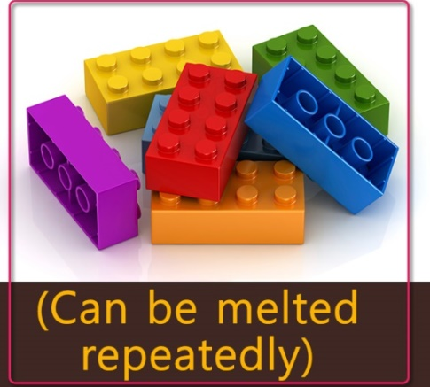

2. THERMAL RESPONSE
THERMOPLASTIC
THERMOSETTING

Slide 25
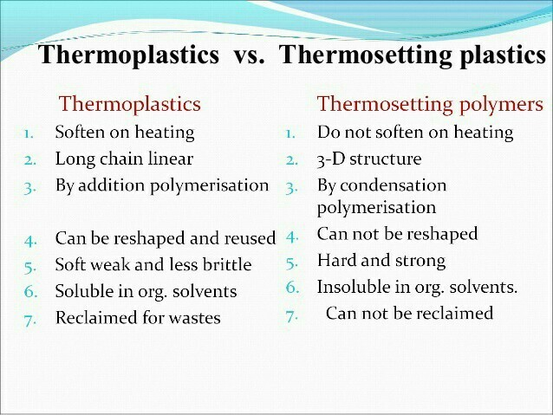
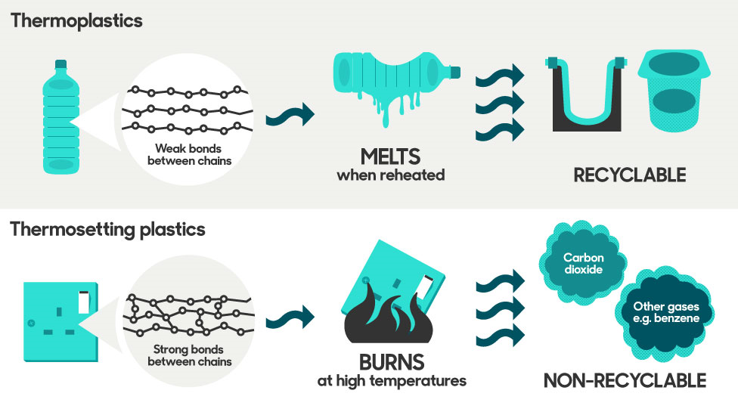

Slide 26
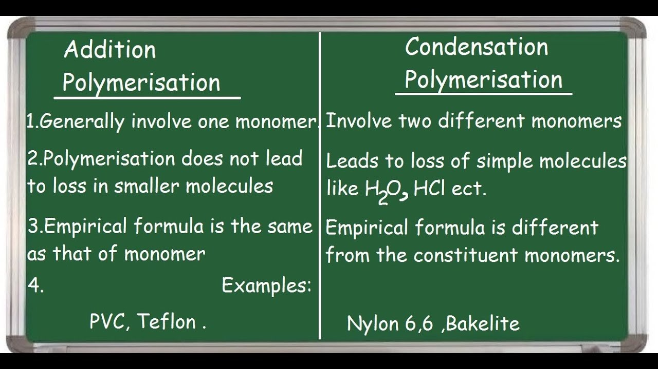
3. MODE OF FORMATION

Slide 27
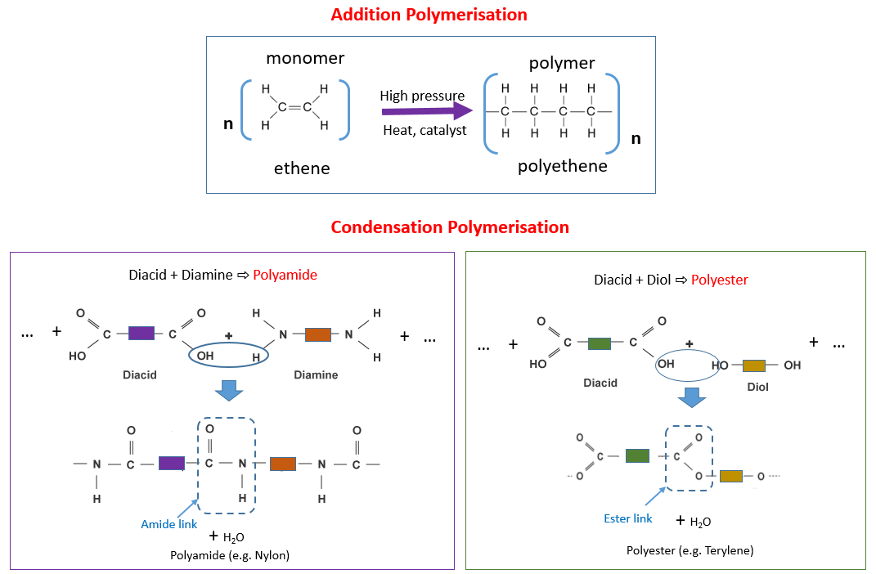

Slide 28
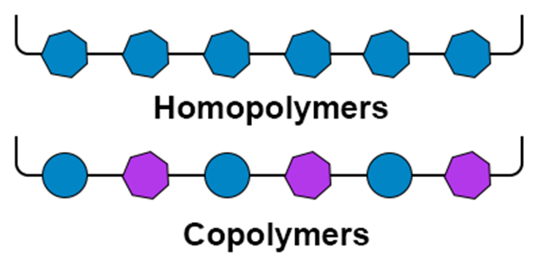
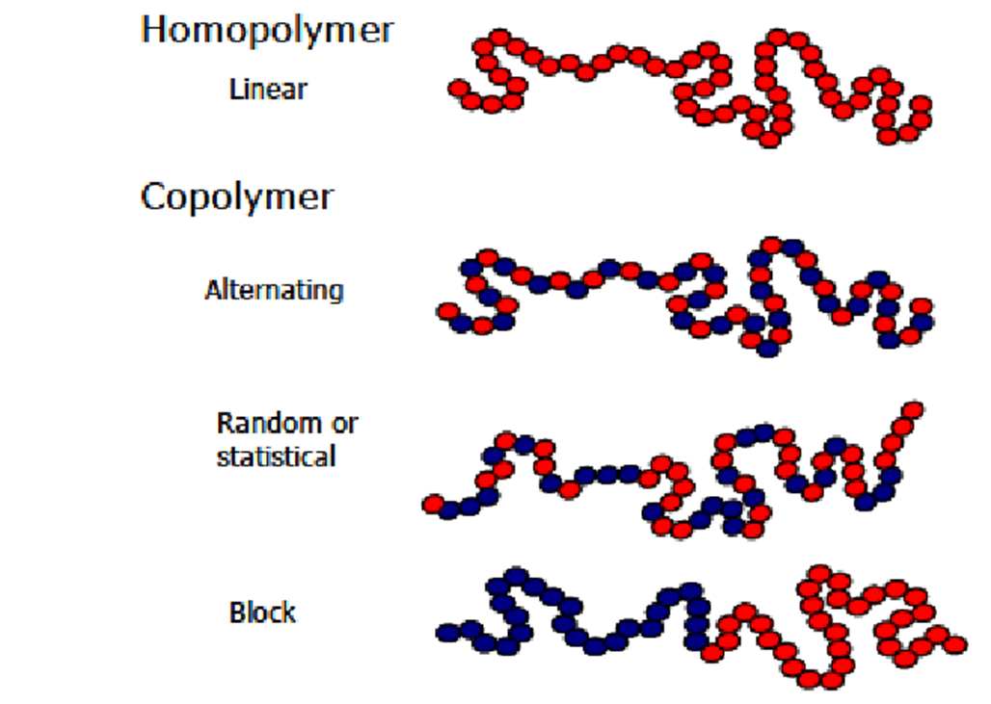
4. BASED ON COMPOSITION
HOMOPOLYMERS
COPOLYMERS
GRAFT COPOLYMERS
RANDOM
COPOLYMERS
ALTERNATE
COPOLYMERS

Slide 29
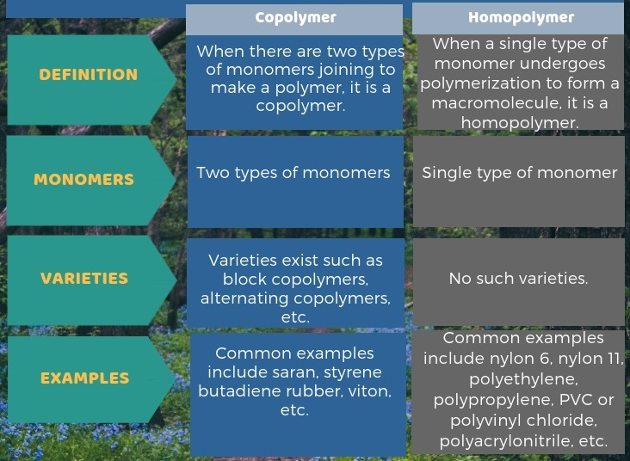

Slide 30
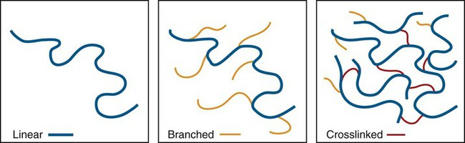
5. LINE STRUCTURE
LINEAR POLYMERS
CROSS-LINKED POLYMERS
BRANCHED POLYMERS
POLYSTYRENE
PVC
HIPS
LDPE
VULCANISED RUBBER
BAKELITE

Slide 31
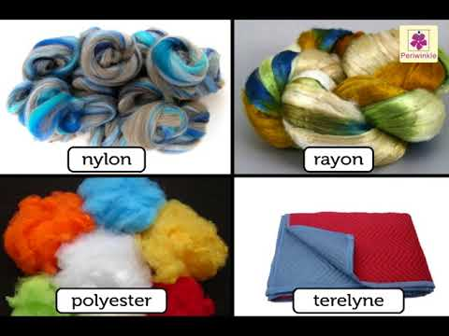
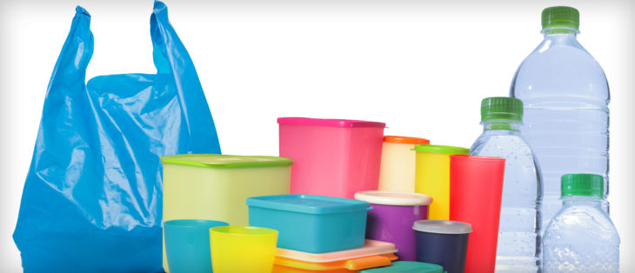
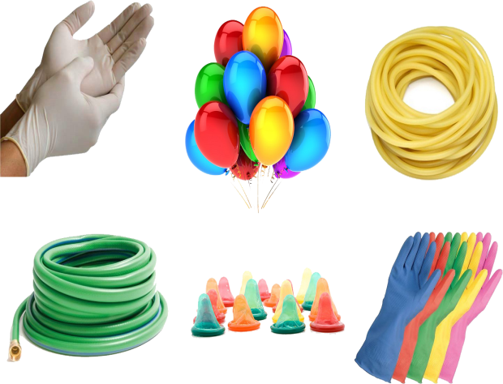
6. COMMERCIAL APPLICATION AND PHYSICAL PROPERTIES
RUBBERS
FIBRES
PLASTICS

Slide 32
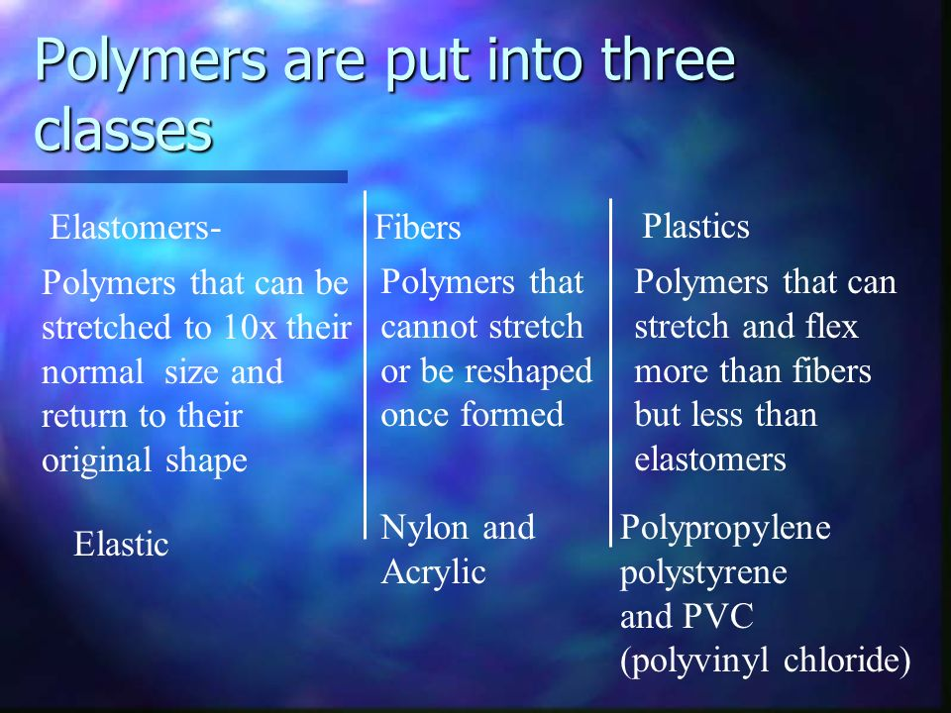

Slide 33
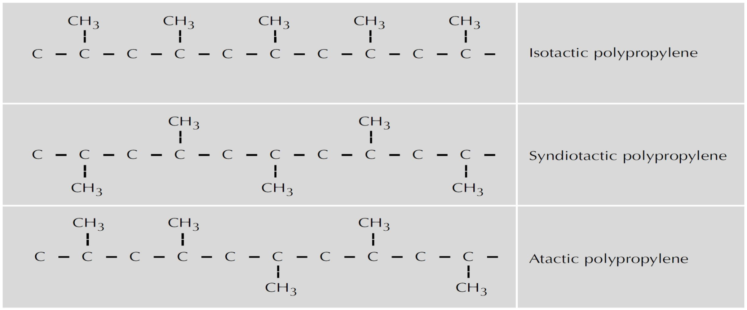
7. TACTICITY
SYNDIOTACTIC
ATACTIC
ISOTACTIC

Slide 34
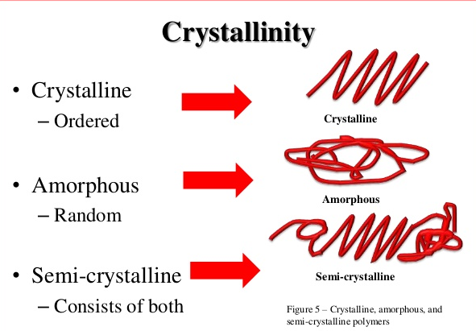
8. CRYSTALLINITY
CRYSTALLINE
POLYMERS
AMORPHOUS POLYMERS
SEMI - CRYSTALLINE POLYMERS
Isotactic PP HDPE
PS PC PMMA ATACTIC PP
SYNDIOTACTIC PP PET POLYAMIDE

Slide 35



9. BASED ON PRESENCE OF CARBON CHAIN

Slide 36


Slide 37


10. BASED ON POLARITY
IONIC POLYMERS
NON -IONIC POLYMERS

Slide 38

BONDING IN POLYMERS

Slide 39


