Slide 1
UNIT - 3
CO-ORDINATION POLYMERIZATION

Slide 7
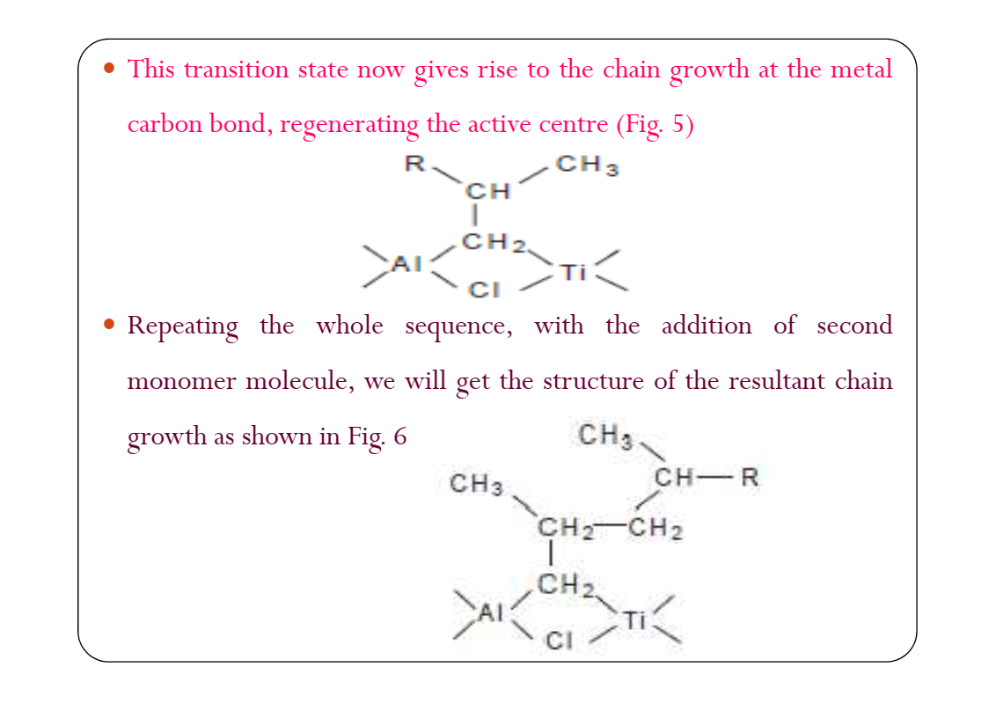

Slide 23
1. ISOTATCTIC POLYMERS
2. SYNDIOTATCTIC POLYMERS
e.g. Isotactic PP
e.g. Syndiotactic PP

Slide 24
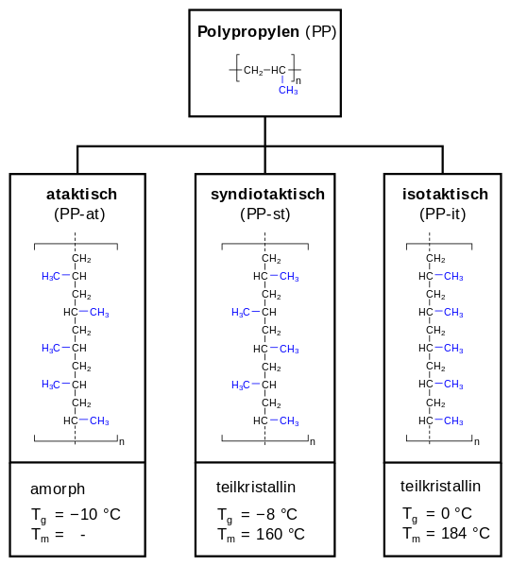
3. ATACTIC POLYMERS
e.g. Atactic PP

Slide 25
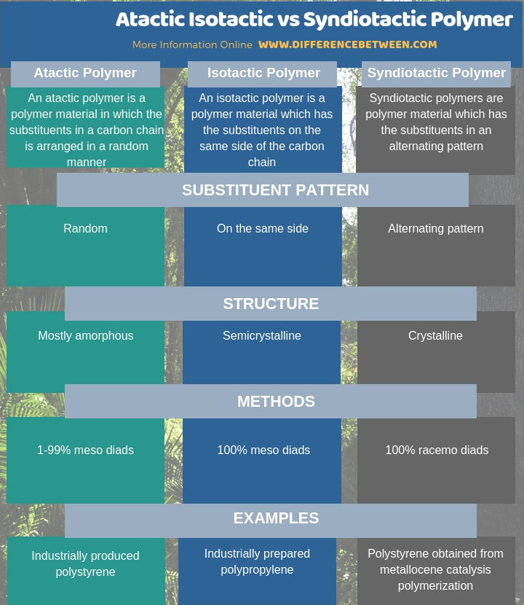

Slide 26
Condensation Polymerization is also known as “Step Growth Polymerization”, while Addition Polymerization is also known as “Chain Growth Polymerization”.

Slide 27
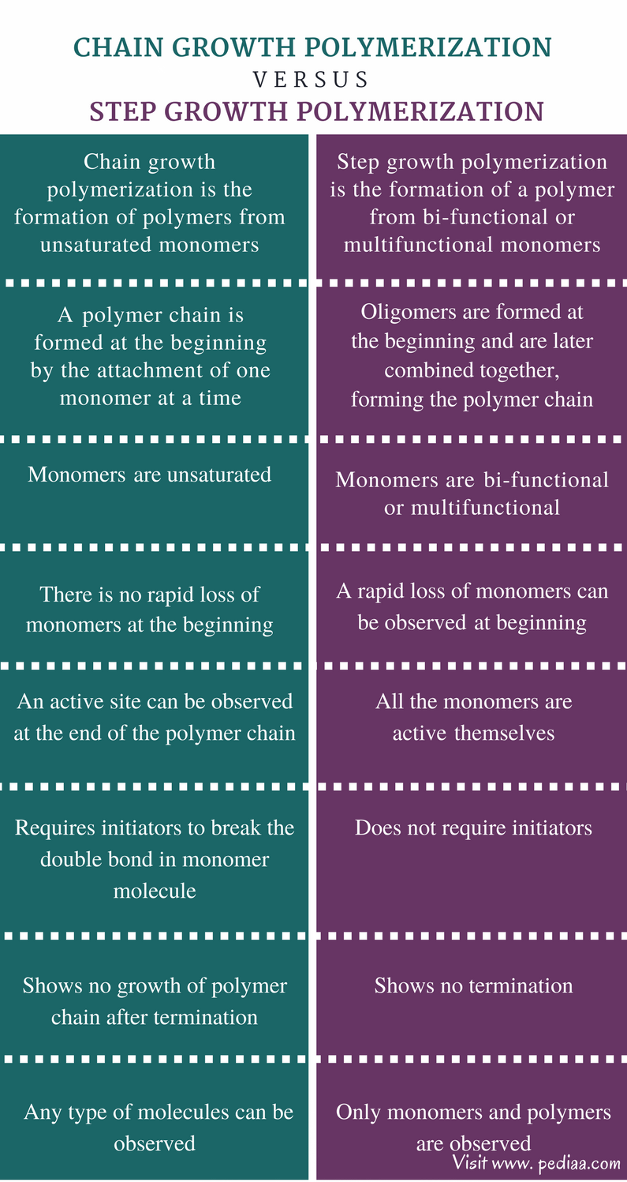

Slide 28
Kinetics of Step Growth Polymerization

