Slide 1
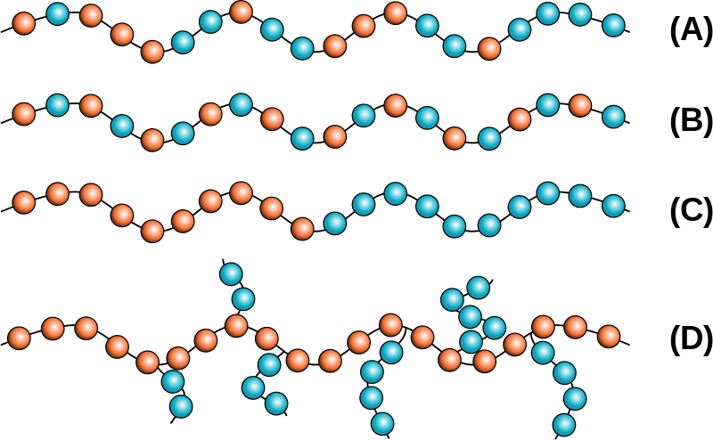
UNIT - 4
COPOLYMERIZATION

Slide 4
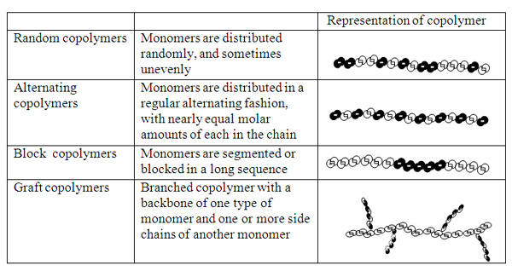
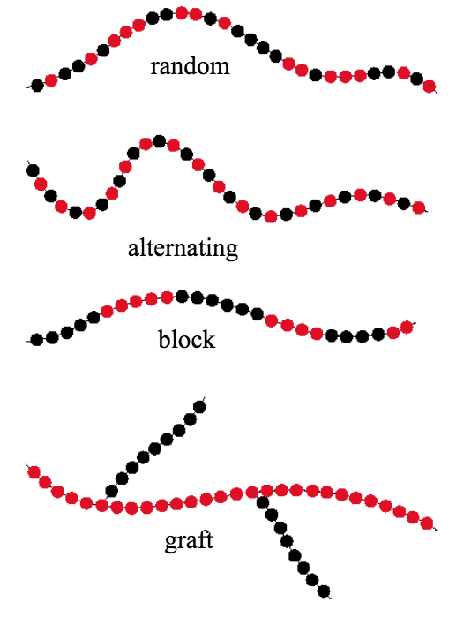
TYPES OF COPOLYMERS

Slide 5
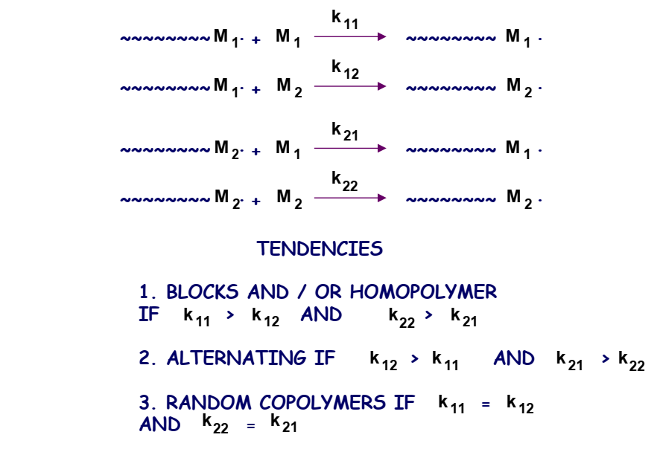
Reactivity ratios definition
The ratios of the monomers used during the copolymerization reaction mechanism i.e. K₁₁, K₁₂, K₂₁, and K₂₂ are known as their reactivity ratios

Slide 6
Mechanism of copolymerization

Slide 7
Kinetics of copolymerization

Slide 8
Kinetics of copolymerization

Slide 9
Kinetics of copolymerization

Slide 10
Kinetics of copolymerization

Slide 11
CASES Of reactivity ratios

Slide 12
CASES Of reactivity ratios

Slide 13
CASES Of reactivity ratios

Slide 14
REACTIVITY RATIO CONCLUSION

Slide 15
REACTIVITY RATIO VALUE CHART

Slide 16
Azeotropic copolymerization

