Slide 1
UNIT – 5 POLYMERIZATION TECHNIQUES

Slide 2
POLYMERIZATION TECHNIQUES
1. Addition polymerization
Bulk polymerization
Solution polymerization
Suspension polymerization
Emulsion polymerization
2. Condensation polymerization
Interfacial Polymerization
Melt polycondensation
Solution polycondensation

Slide 3
1. BULK POLYMERIZATION
Mass or block polymerization: Polymerization of the
undiluted monomer.
carried out by adding a soluble initiator to pure monomer (in liquid state).
•
The mixture is constantly agitated & heated to polymerization temperature.
Once the reaction starts, heating is stopped as the reaction is exothermic.
The heat generated is dissipated by circulating water jacket.
Viscosity increases dramatically during conversion.
•
•
•

Slide 4
BULK POLYMERIZATION
The method is used for the polymerization of liquid state monomers.
It is usually adopted to produce polystyrene, polyvinyl chloride, polymethyl methacrylate and low density polyethylene.

Slide 5
Advantages
Disadvantages
The system is simple and requires thermal insulation.
The polymer is obtained pure.
Large castings may be prepared directly.
Molecular weight distribution can be easily changed with the use of a chain transfer agent.
Heat transfer and mixing become difficult as the viscosity of reaction mass increases.
Highly exothermic.
The polymerization is obtained with a broad molecular weight distribution due to the high viscosity and lack of good heat transfer.
Very low molecular weights are obtained.

Slide 6
2. SOLUTION POLYMERIZATION
′ Some disadvantages of bulk polymerization are eliminated in solution polymerization.
′ Monomer along with initiator dissolved in solvent, formed polymer stays dissolved.
′ The mixture is kept at polymerizaion temperature & constantly agitated.
′ Depending on concentration of monomer the viscosity of solution does not increase.

Slide 7
SOLUTION POLYMERIZATION
′ After the reaction is over, the polymer is used as such in the form of polymer solution or the polymer is isolated by evaporating the solvent.
′ Polymer so formed can be used for surface coating.
′ It is used for the production of Polyacrylonitrile, PVC, Polyacrylic acid, Polyacrylamide, Polyvinyl alcohol, PMMA, Polybutadiene, etc

Slide 9
Advantages
The solvent acts as a diluent & helps in facilitating continuous transfer of heat of polymerization. Therefore temperature control is easy.
•
The solvent allows easy stirring as it decreases the viscosity of reaction mixture.
Solvent also facilitates the ease of removal of polymer from the reactor.
Viscosity build up is negligible.
•
•

Slide 10
Disadvantages
To get pure polymer, evaporation of solvent is required additional technology, so it is essential to separate & recover the solvent.
The method is costly since it uses costly solvents. Polymers of high molecular weight polymers cannot be
formed as the solvent molecules may act as chain terminators.
The technique gives a smaller yield of polymer per reactor volume, as the solvent waste the reactor space.
The purity of product is also not as high as that of bulk polymerization. Removal of last traces of solvent is difficult.
•
•
•
•

Slide 11
3. SUSPENSION POLYMERIZATION
′ Liquid or dissolved monomer suspended in liquid
phase like water.
′ Initiators used are monomer soluble e.g. dibenzoyl peroxide.
′ Thus, polymer is produced in heterogeneous medium.
′ Initiator
′ The size of monomer droplets is 50-200 µm in diameter.
′ The dispersion is maintained by continuous agitation and the droplets are prevented to coalesce (unite or merge) by adding small quantity of stabilizers.

Slide 12
SUSPENSION POLYMERIZATION
′ The stabilizers used are PVA, gelatin, cellulose are used along with inorganic stabilizers such as kaolin, magnesium silicate, aluminum hydroxide, calcium/magnesium phosphate, etc if necessary.
′ As it concerns with droplets, each droplet is tiny bulk reactor. The polymerization takes place inside the droplet & product formed being insoluble in water.
′ The product separated out in the form of spherical pearls or beads of polymer.
′ Hence the technique is also known as Pearl polymerization / Granular polymerization / Bead polymerization.

Slide 13
SUSPENSION POLYMERIZATION
′ The products are small uniform spheres. They can be used directly for some applications as precursors of ion exchange resins otherwise they can be extruded & chopped to form larger, easily moulded pallets.
′ They can be dissolved in a suitable medium for use as adhesives & coatings.
′ This technique is used to form PVC, acetate, Polystyrene, Styrene-divinyl
Polyvinyl benzene
copolymer beads (used for ion exchange) etc.

Slide 14
SUSPENSION POLYMERIZATION

Slide 15
Advantages
The process is comparatively cheap as it involves only water instead of solvents.
Viscosity increase is negligible.
Agitation & temperature control is easy.
Product isolation is easy since the product is insoluble in water.

Slide 16
Disadvantages
The method can be adopted only for water insoluble monomers.
It is difficult to control polymer size.
Polymer purity is low due to the presence of suspending & stabilizing additives that are difficult to remove completely.
Suspension polymerization reaction is highly agitation sensitive.
Larger volume of reactor is taken up by water.
The method cannot be used for tacky polymers such as elastomers because of the tendency for agglomeration of polymer particles.
•
•
•
•
•

Slide 17
4. EMULSION POLYMERIZATION
′ The technique is used for the production of large number of commercial plastics & elastomers.
′ The system consists of water insoluble monomer, dispersion medium & emulsifying agents or surfactants (soaps and detergents) and a water soluble initiator (potassium persulphate / H₂O₂, etc).
′ The monomer is dispersed in the aqueous phase, not as a discrete droplets, but as a uniform emulsion.
′ The size of monomer droplet is around 0.5 to 10 μm in diameter depending upon the polymerization temperature & rate of agitation.

Slide 18
EMULSION POLYMERIZATION
′ The emulsion of monomer in water is stabilized by a surfactant.
′ A surfactant has a hydrophilic and hydrophobic end in its structure.
′ When it is put into a water, the surfactant molecules gather together into aggregates called micelles.
′ The hydrocarbon tails (hydrophobic) orient inwards & heads (hydrophilic) orient outwards into water.
′ The monomer molecules diffuse from monomer droplets to water & from water to the hydrocarbon centre of micelles.

Slide 19
EMULSION POLYMERIZATION

Slide 20
EMULSION POLYMERIZATION

Slide 21
EMULSION POLYMERIZATION
•
Water Monomer Surfactant
•
•
Main components of emulsion polymerization
Examples:
Synthetic rubber-styrene-butadiene (SBR), Polybutadiene, Polychloroprene.
Plastics-PVC, polystyrene, Acrylonitrile-butadiene-styrene terpolymer (ABS).
Dispersions-polyvinyl acetate, polyvinyl acetate copolymers, latex acrylic paint, Styrene-butadiene, VAE

Slide 22
Advantages
Disadvantages
′ Surfactants and polymerization adjuvants -difficult to remove
′ For dry (isolated) polymers, water removal is an energy- intensive process
′ Designed to operate at high conversion of monomer to polymer. This can result in significant chain transfer to polymer.
′ Can not be used for condensation, ionic or Ziegler- Natta polymerization.
′ High molecular weight polymers
′ fast polymerization rates.
′ allows removal of heat from the system.
viscosity remains close to that of water and is not dependent on molecular weight.
′ The final product can be used as such ,does not need to be altered or processed
′

Slide 24
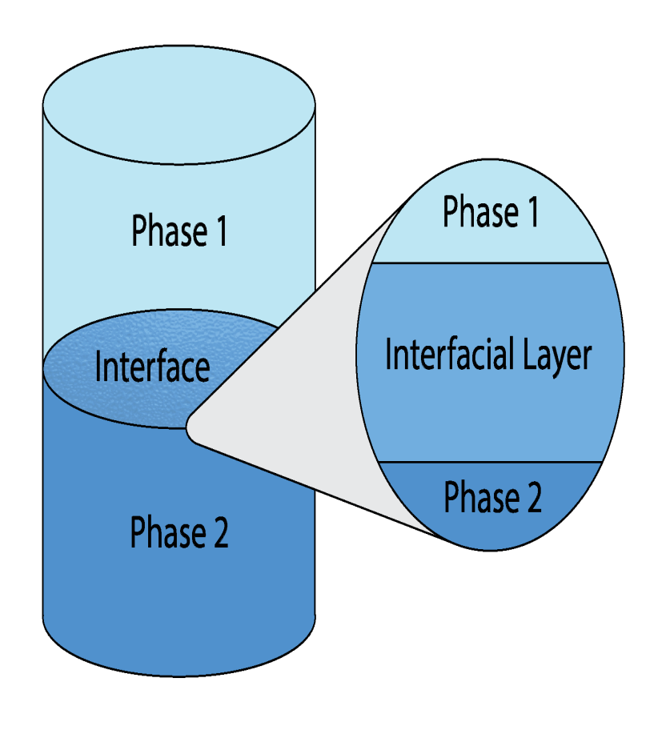

Slide 25
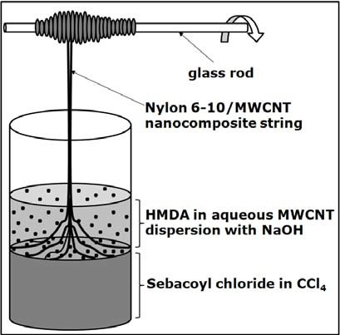
Interfacial Polymerization of Nylon 6,10

