Slide 1
Rasa Theory
Pradeep Trikha
MLS University
Udaipur

Slide 2
Introduction
Bharatmuni’s Natyasastra is an encyclopaedia of Sanskrit literature is one of the earliest works on dramaturgy
‘Bhava’ & ‘Rasa’ :- Where the hand goes, the gaze follows. Where the eyes turn, there goes the mind. Where the mind goes, there comes Bhava. And where the Bhava comes, there also will be Rasa.
Rasa is derived from the root ‘rasa’ it means ‘juice’. It also denotes ‘interest.’
Rasa means ‘khato, kharo, turo, tikho, kadvo, mitho etc .
The denotative meaning of Rasa is Pleasure (Ananda).

Slide 3
Representative Disciplines & Texts
Darasana (Philosophy)
Dharamshastra(Social & individual life)
Ayurveda(Medicine)
Vyakarana (Grammar)
Niti (Polity)
Kavya-shastra (Poetry)
Itihasa Purana (History)
1. Sutras- mimansa, vedanta, nayaya,vesisika, samakhya, yoga, Buddhist & Jain thought
2. Manusamriti ; Prasar Samhita
3. Caraka Sanhita & Susruta Samhita
4. Astadhyayi, Vakyapada
5. Arthashastra
6. Natyashastra, Rasagangadhara
7. Mahabharata & Puranas
Notes:
Tradition of Continuity and cumulativeness by thinkers

Slide 4
Classification of Literary Theories
Principles of Figurativeness (Alamkara); Principles of Deviation (Vakrokti)
Style of Compositional Value- Guna & Dosh i.e. excellence and faults, riti i.e. mode of expression and aucitya i.e. propriety
Verbal Symbolism i.e. Dhvani
Aesthetic Experience i.e. Rasa
Narrative e.g. mahakavya
Discourse Analysis i.e. Arthashastra
Comprehensive analysis i.e. Kavyamimansa

Slide 5
Major Schools, Thinkers & Texts
Rasa
Alamkara
Riti
Bharata; Dhanika- Dhananjaya
Bhamaha, Dandin, Udbhata, Rudrata
Vamana
Natyashastra ( 2nd century B.C.)
Dasarupaka (10th century A.D.)
Kavyalankara (6th Century A.D.)
Kavyadarasa ( 7th Century A.D.)
Kavyalankarasarasamgraha ( 9th Century A.D.)
Kavyalankara (9th Century A.D.)
Kavyalankarasutra (9th Century A.D.)

Slide 6
Major Schools, Thinkers & Texts
4. Dhavani
5. Vakrokti
6. Guna- Dosh
7. Aucitya
4. Anandvardhan, Abhinavgupta,
Mahimabhatta
5. Kuntaka
6. Dandain
Bhamaha
7. Ksemendra
Dhavanuyaloka (9th Century)
Abhinavbharati (11th Century also Rasa)
Vyaktiviveka (11th Century)
Vakroktijivita (11th Century)
Kavyadarasa ( 7th Century)
Kavyalankara ( 9th Century)
Aucityavicharkarka (11th Century)

Slide 7
Introduction(I))
How we get pleasure from literary works and drama, acting (Abhinaya):-
1. Angik Abhinaya - movement or acting through the body, it’s called Angik Abhinaya.
2. Vachik Abhinaya–we passed message through speaking words with stress etc
3. Ahariya Abhinaya- we shows our identity of character through wearing cloth or costumes.
4. Satvik Abhinaya- Through this we can understand and enjoy the drama. This enjoyment creates Bhava in our mind. Natyashastra mentions three types of Bhava.
“VibhavanubhavavyabhichrisanyogatRasanishpatti”

Slide 8
Definition
Formulated by Bharata and later explicated and enriched by Anandavardhana and Abhinavagupta constitutes the Central Tradition in Indian aesthetics.
Poetry is a multidimensional phenomenon which cuts across many levels of human experience.
A correct understanding of the theory of rasa enables us to keep all these dimensions and levels simultaneously in view.
It means ‘artistic’ and ‘aesthetic’ experiencing at one time
‘Artistic’ experience is related to the poet & ‘aesthetic’ to the perceiver

Slide 9
Rasa Theory
Bharat Muni
Natyasastra

Slide 10
Rasa
‘RASAH’
Flavour
Juice
Relish
Sap

Slide 11
RAS SUTRA
"vibhavanubhavavyabhicharisanyo gatRASAnishpattih."

Slide 12
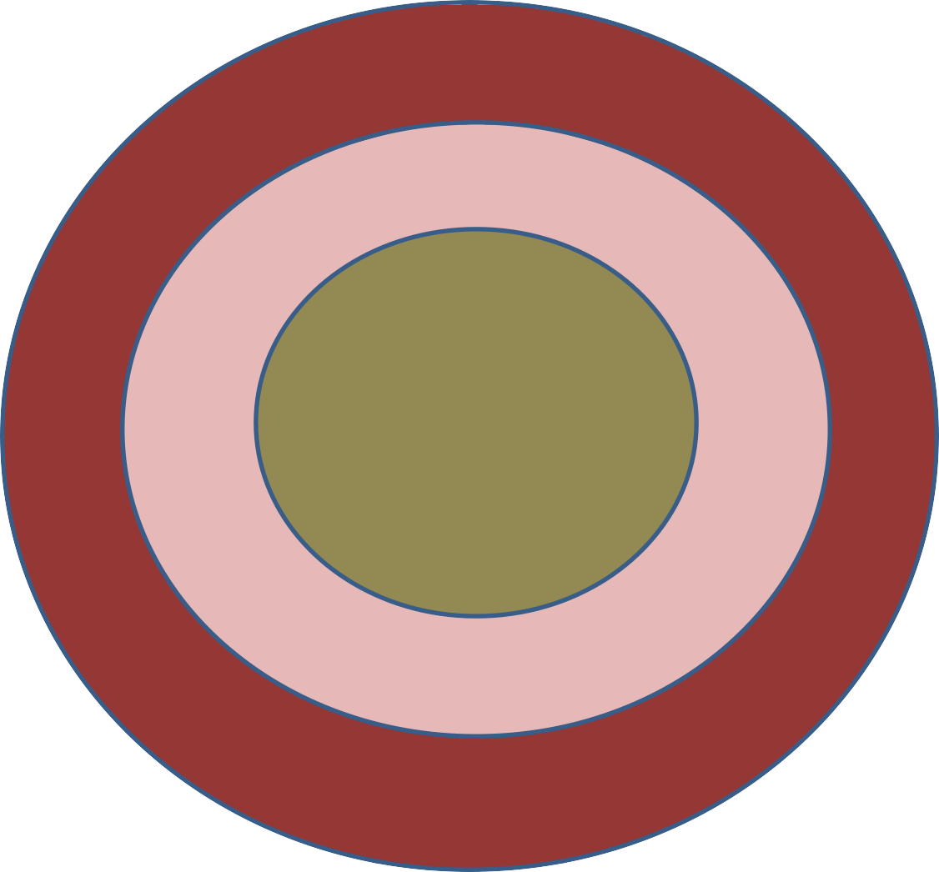
Three stages of NATYARASA
combination of the determinants
Vibhava
consequents
Anubhava
Vyabhicharibhava
transitory states or fleeting emotions

Slide 13
Vibhava(determinants or catalysts)
By which an emotion is activated
Types:
Alambhana Vibhava –the person or the object in respect of whom the emotion is experienced and who’s appearance is directly responsible for the bringing forth of the emotion.
Uddipana Vibhava, it means the situation in the environment in which that person or object is placed and which is helpful in intensifying the emotional experience.

Slide 14
Anubhava (consequences)
The outward manifestations brought forth as a result of the Vibhavas are known as the Anubhavas.
Types:
Vacika- Expressed by words (vac-“speech”)
Angika - Expressed by bodily, expression.
Example: Anubhava communicate to the audience, the emotions being felt by the characters on stage.

Slide 15
Anubhava- 1
There also “involuntary emotions” known as Sattvikabhava:
Stambha: paralysis
Sveta : sweating
Romance : hair standing on end
Svarabheda: changes in one’s tone of voice
Vepathu: trembling
Vaivarnya: change in the colour of one’s face. Asru: becoming tearful
Pralaya: fainting.

Slide 16
33 Vyabhicharibhava (complementary states)
Sthayibhava (permanent mood) is a major emotion which is developed by a number of minor feelings referred to as Vyabhicharibhava.
Nirveda (disintrest)
  Glani (tiredness)
  Sanaka (apprehension)
  Asuya (insecurity)
  Mada (intoxication)
  Srama (exhaustion )
  Alasya (lethargy)
  Dainya (pity)
  Cinta (anxiety)
  Moho (delusion)
  Smrti (recollection)
  Dhriti (steadfastness)
  Vrida (shame)

Slide 17
33 Vyabhicharibhava - 1
Capalata (impulsiveness)
Harasa (sudden delight)
Avega (excitement)
Jadata (stupor)
Grava (arrogance)
Visada (depression)
Autsuka (longing)
Nindra (sleep)
Apusmara (epilepsy)
Supta (dreaming)
Vibodha (awakening)
Amarsa (restrained anger)
Avahittha (deception)
Ugrata (ferociousness)

Slide 18
33 Vyabhicharibhava - 2
Mati (analysis)
Vyadhi (sickness)
Unmada (temporary insanity)
Marana (death)
Trasa (panic)
Vitarka (argumentativeness).

Slide 19
Examples
The erotic Rasa arises from the Alambhana Vibhava-presence of the lover and beloved
the Uddipana Vibhava’s – the atmosphere of place where the two meet, the call of night birds; a gentle breeze, the moon, etc.
it gives rise to the Anubhavas-how the lovers express themselves to each other to holding hands and etc.
it produces involuntary bodily responses (the Sattvikabhavas) and may give rise to complementary or transitory emotional states- the Vyabicharibhavas.

Slide 20
Stages
Every human being is born with a set of inherited instinctual propensities. His thoughts, actions, and experiences constantly generate impressions which sink back into the subconscious mind ready to be revived on the conscious level.
These impressions, which are called samskaras in Indian philosophy and psychology, governed around emotions.
The emotions are related to typical and universal situations and generate definable patterns of action known as sthayibhava, permanent emotions, because they always remain embedded in human organism and character.
Indian aestheticians have grouped the instinctual propensities and impressions around nine basic emotions: delight, sorrow, anger, etc. Apart from these clearly organized basic emotions there are innumerable transient feelings and moods which accompany the former in any experience. They do not attain the intensity of the basic emotions nor do they last long.

Slide 21
Stages(I)
They are concomitant feelings, vyabhicharins, which rise with well- defined emotions and subside with them. Anxiety, exultation, bashfulness, langour, etc., are examples.
Thirty-three such accessory feelings are recognized though the list does not exhaust the variety of human feelings.
In life some stimuli are necessary to cause emotional response in us. It could be material, existing in the environment, or ideal, existing in the mind.
These human and environmental stimuli when depicted in poetry are called vibhavas. They are the characters and situations which determine and define the feeling-complex to be evoked in the reader

Slide 22
Stages(II)
For Eliot they are the "objective correlatives." The ancient mariner, his shipmates, the albatross, the sea, the moon, the slimy things in the sea, etc.-they are the vibhavas.
The special mode in which the poetic characters exist and are apprehended is indicated by the term alaukika, non-ordinary.
In life our reactions to persons and objects can be described in terms of attraction, repulsion, or indifference. Men and things directly and indirectly impinge on our life and on its practical interests. Therefore our responses are governed by positive or negative interests. The poem exists only for our perception; it exists dissociated from our everyday existence; hence our response to the poem is called alaukika

Slide 23
Notions of Poetry
For Plato poetry fed and watered passions.
For Indian theorists rasas like karuna, the pathetic, evokes sorrow in the mind of the reader.
The feelings evoked in poetic experience are alaukika, non-ordinary, and therefore there is no question of sorrow.
Drama always gives delight to the spectator, never sorrow.
Bharatamuni devised music and dance to remove such personal feelings as may arise in the minds of untrained and uncultivated spectators. As poetic feelings are evoked within a frame of detachment from our immediate egoistic interests, the question of why the depiction of suffering causes delight is irrelevant.
In aesthetic experience there is a sense of visranti, rest or composure.

Slide 24
Notions of Poetry (I)
The apparent evocation of sorrow and other feelings is only a coloration (anuranjana), or resonance of the non- ordinary feelings embodied in the poem.
The Indian theorists do not believe in the notions of romantic or classical poetry
Poetry is objective because poet objectifies feelings in terms of images, characters, action, etc.
The poet's own experiences can be the subject matter of his poetry
The personal experience of the poet becomes the transpersonal experience potentially accessible to all mankind.
This twin process of objectification and universalization is comprehended by the term sddhdranikarana, transpersonalization
This doctrine implies the elevation of the consciousness of the poet and the reader from the plane of their private everyday world

Slide 25
Notions of Poetry (II)
The concept of sddhdranikarana does not imply that we deindividualize and de- particularize the characters and their feelings.
Rasa is manifested by poetic language that is abhivyakti;
Connotation of abhiviyakti is individuality.
The antithetical concepts involved in the doctrine are not general and particular but personal and transpersonal.
In poetry it is not enough to name feelings; it is necessary to give them a local habitation. The ancient mariner's sense of guilt and his expiation through love and repentance are no doubt instances of guilt and expiation but they have a peculiar ring which marks them off from other such instances.
Aesthetic response is transpersonal does not mean that it is a cold and unemotional response.
Though the feelings are evoked in the framework of transpersonalization yet they retain all their human qualities

Slide 26



