Slide 1
Aristotelian Catharsis
PRADEEP TRIKHA
Dept of English
MLS University, Udaipur
Notes:
1

Slide 2
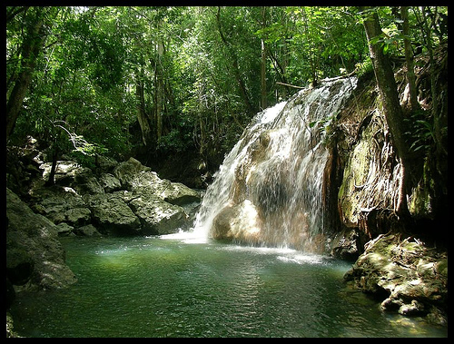
Catharsis – κάθαρσις
Medicine - Purgation, especially for the digestive system.
A purifying or figurative cleansing of the emotions, especially pity and fear, described by Aristotle as an effect of tragic drama on its audience.
A release of emotional tension, as after an overwhelming experience, that restores or refreshes the spirit.
Notes:
2

Slide 3
Catharsis – Interpretations
Medical Interpretation
Miltonic Interpretation
Poetic Interpretation (19th Century European)
Twentieth century Interpretation
Notes:
3

Slide 4
Catharsis – Interpretations
Medical Interpretation(Alopatheic)
Removal or Cleansing (kenosis): In the Hippocratic writings denotes the entire removal of surplus humours or afflictions or excesses. As for malignancy surgery is necessary, similarly catharsis offers an outlet to the malignant emotions
Notes:
4

Slide 5
Catharsis – Interpretations
Miltonic Interpretation: More like Homeopathic Treatment
Poetic Interpretation (19th Century European)
Tragic catharsis like musical catharsis restores normally healthy emotional state, were not so wrong
Notes:
5

Slide 6
Catharsis – Interpretations
Twentieth century Interpretation
Gerald Else points out that catharsis lies in the actions of the hero because his sense of remorse makes the hero eligible to the spectators' pity, and this pity along with the hero's remorse proves that the act of transgression was actually a pure act.
Thus catharsis is the process of proving purity.
Notes:
6

Slide 7
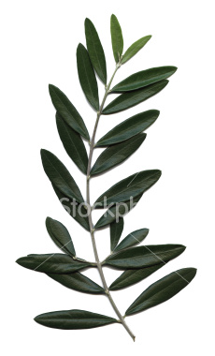
Ancient κάθαρσις - Lustration
Ritual cleansing with water
Burnt offerings – purification through smoke
Purges individuals or whole cities of crimes
Notes:
7

Slide 8
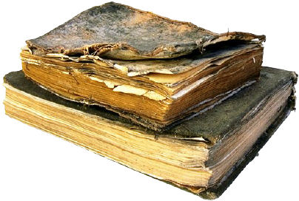
Aristotle's Catharsis
Briefly touched on in Poetics
Stirring up pity and fear, then dispelling them is the function of tragedy
Promised a fuller explanation, but was probably lost to history with his book on Comedy.
Notes:
8

Slide 9
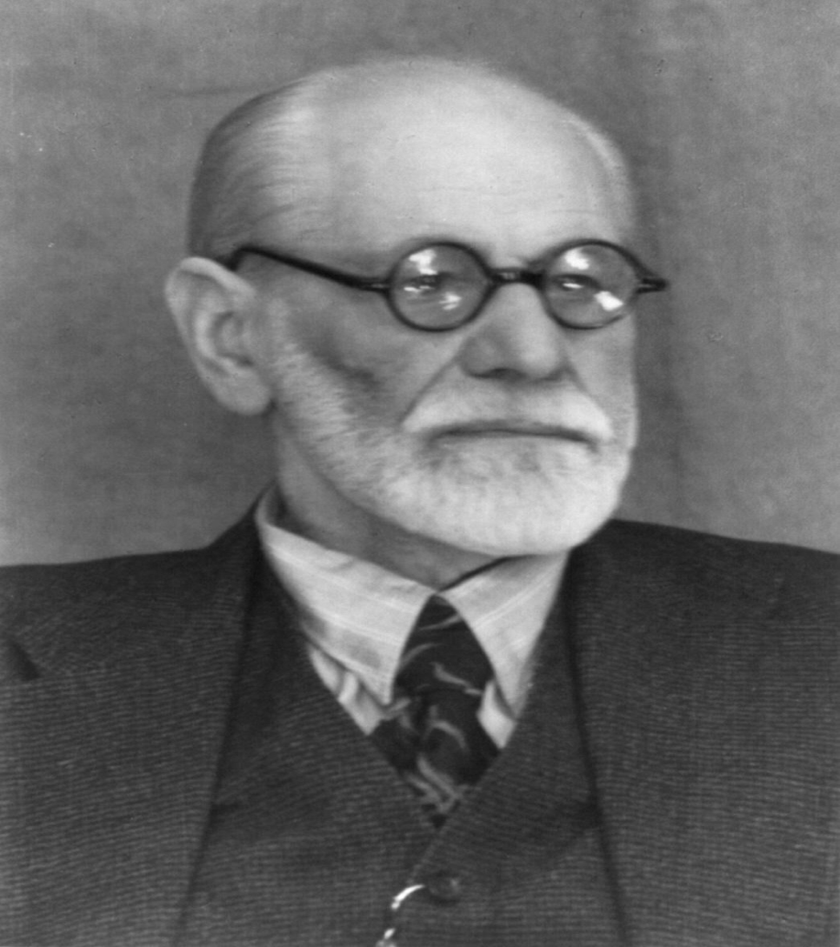
Jakob Bernays – Uncle of Sigmund Freud
Classical interpretation comes from Bernays
We build up undesirable emotions which are evoked and released through tragedy.
These emotions are inherently negative.
Notes:
9

Slide 10
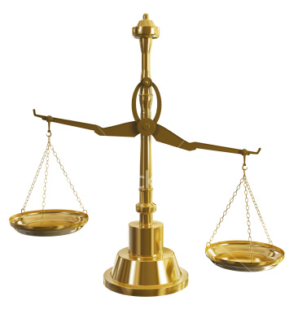
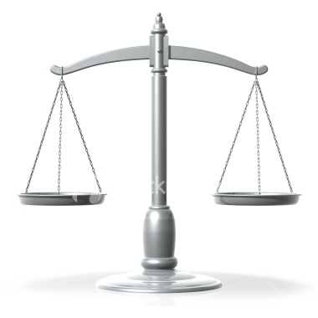
Another Interpretation…
Aristotle believed emotions important for decision-making and character (Ethics)‏
Example: Too much fear = cowardly, too little fear = foolhardy
Catharsis is not, then, elimination; it is the reduction of these emotions from excess to balance.
Notes:
10

Slide 11
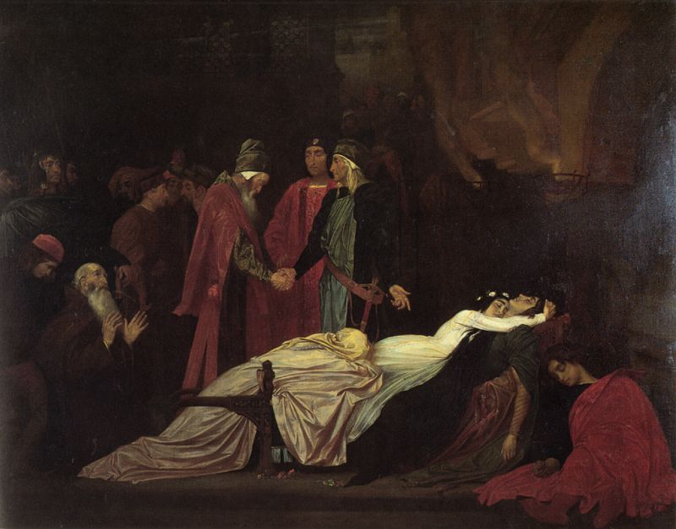
Cathartic Relief in Literature
“Agamemnon” ends with its namesake, his daughter, and his wife dead in a series of murders by one another.
In Miller's All My Sons, Joe Keller, the father, commits suicide to relieve the burden he brought on his family.
The Shakespeare's couple, Romeo and Juliet, lay dead in the end of their play.
Notes:
11

Slide 12
Works Cited
Engelman, Edmund. "Sigmund Freud." Online Image. The Library of Congress Prints & Photographs Online Catalog. Nov 15 1998. Sep 6 2008 <http://www.loc.gov/rr/print/catalog.html>.
Genius, Lisa. "Item # 002: Mary N.'s Book-Shaped Air Freshener." Online Image. Gouger Library Supplies. Jan 11 2007. Sep 6 2008 <http://gougerlibrarysupplies.blogspot.com/2007_01_01_archive.html>.
Holman, Geoffrey. "Scale." Online Image. iStockphoto. March 6 2008. Sep 6 2008 <http://www.istockphoto.com/file_closeup/industry/law-enforcement-and-crime/5548316-scale.php?id=5548316>.
Janko, Richard. CATHARSIS. 1987. Sep 6 2008 <http://www.echonyc.com/~janedoe/classes/actreal/readings/catharsis.html>.
Nehring, Nancy. "olive branch, Olea europaea." Online Image. iStockphoto. Aug 16 2007. Sep 6 2008 <http://www.istockphoto.com/file_closeup/nature/nature-symbols-metaphors/4024057-olive-branch-olea-europaea.php?id=4024057>.
Lord Leighton, Frederic . "The Reconciliation of the Montagues and Capulets over the Dead Bodies of Romeo and Juliet." Online Image. Museum Syndicate. No date. Sep 9 2008 <http://www.museumsyndicate.com/item.php?item=11992>.
Rossetti, Francesco. "Balance." Online Image. iStockphoto. May 12 2008. Sep 6 2008 <http://www.istockphoto.com/file_closeup/isolated-objects/isolated-background-objects/6109207-balance.php?id=6109207>.
Slammer, Justin. "Agua Caliente, Finca El Paraíso, Guatemala ." Online Image. flickr. Sep 30 2006. Sep 6 2008 <http://www.flickr.com/photos/justinslammer/256532493/>.
Notes:
12

