Slide 1

Aristotle on Plot
PRADEEP TRIKHA
4 AUGUST 2018

Slide 2
Constituent Parts of Tragedy
Plot
Character
Diction
Thought
Spectacle
Song

Slide 3
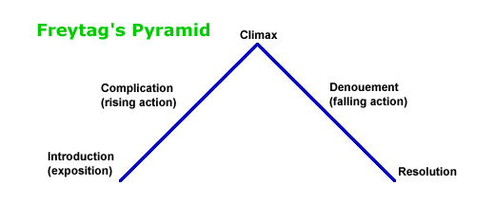
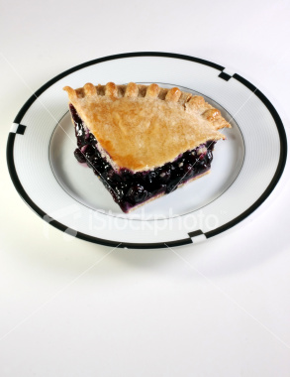
Structure of Plot
Retrospective (Prologue)
Rising Action
Climax
Falling Action
Catastrophe (Epilogue)

Slide 4

Types of Plot
Simple
Unified construct of necessary and probable actions to change future
Complex
peripeteia or reversal
Anagnorsis or recognition
Hamartia
The best way of presenting tragic pleasure

Slide 5

Characteristics of Plot
Unity of Action
  Necessity and probability
Unity of Time
  Time by action understood by audience

Slide 6
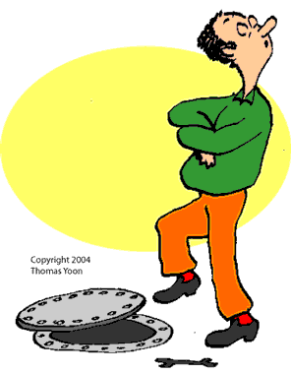
Aristotle’s Definition of Plot
“The change of fortune from good to bad should come about as a result, not of vice, but some great error of frailty in character.”

Slide 7
Works Cited
www.cnr.edu/home/bmcmanus/poetics.html
www.english-literature.org/essays/aristotle_poetics.html
http://www.cartoon-web.com/illus/proverbs/pro16-18.gif
http://www.istockphoto.com/file_closeup/isolated-objects/isolated-background-objects/5663100-clock.php?id=5663100
http://www.istockphoto.com/file_closeup/food-and-drink/baking/5948598-blueberry-pie.php?id=5948598
http://www.istockphoto.com/file_closeup/arts-and-entertainment/arts-abstract/5203110-blue-energy.php?id=5203110
Notes:
7

