Slide 1
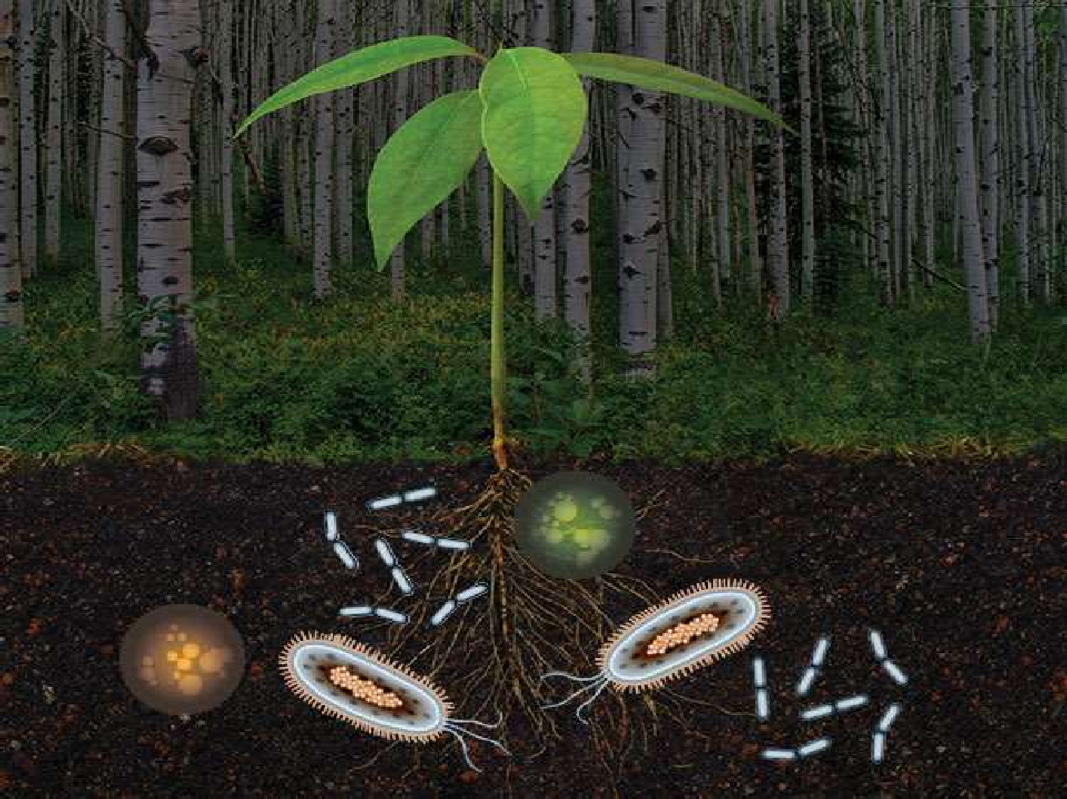
Microbe - Plant Interaction

Slide 2

Introduction
Atmospheric nitrogen reduced to ammonia by microorganisms.
The rhizosphere is an environment where microbial activities contribute to plant growth.
Microorganisms can be used as biocontrol agents to control agriculture pests and pathogens.

Slide 3
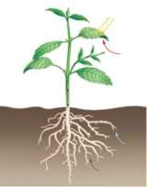
Phyllosphere
Rhizosphere

Slide 4

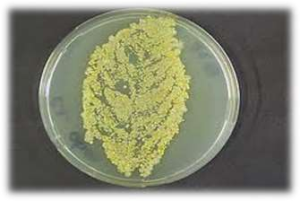
Epiphytic = organisms growing on the surface of
photosynthetic organisms
Phylloplane = leaf surface
Phyllosphere = area surrounding the leaf
Rhizoplane = root surface
Rhizosphere = area surrounding the root

Slide 5

Bacteria – Fungi-
Pseudomonas, Bejerinckia,etc,.
Aspergillus sp,Alternaria, Cladosporium
Yeast - Candida albicancs, Saccharomyces cerevissiae
Phylloplane consist of several types of saprotrophs,symbionts and pathogens

Slide 6

Interaction of Microbes in Rhizosphere (Roots)
Plant roots provides suitable habitats for the growth of microorganisms surrounding plant roots.
Satisfy the nutritional requirements for both plant and associated microbes.
Two regions in interaction of Microorganisms with Plant roots (Campbell & Rovira 1973)
  Rhizoplanes
  Rhizosphere

Slide 7
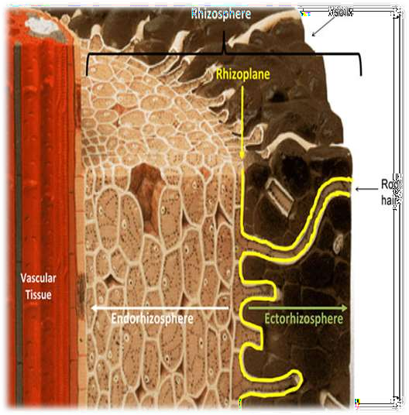
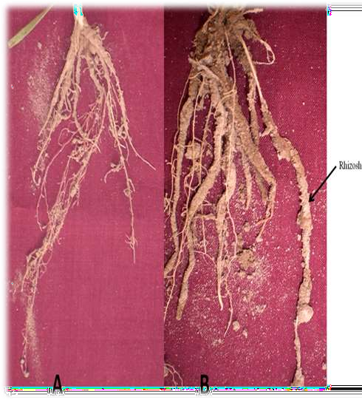
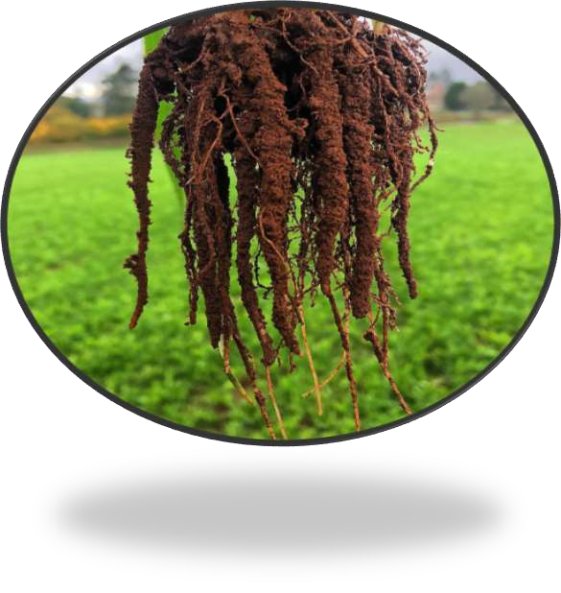
Rhizosphere & Rhizoplane
Rhizosheaths

Slide 8
RHIZOSPHERE EFFECT
Compared to non-rooted bulk soil , the rhizospheric soil around the plant root contains much larger population of microorganism.
A stimulation that can be put on a quantitative basis by the use of the R：S ratio
R：S ratio = number of microorganisms in the rhizosphere soil：number of microorganisms in the non-rhizosphere soil.
R/S > 1, good stimulation R/S = 1, no stimulation R/S < 1, inhibition
○
○
○

Slide 9
Plant affects the rhizosphere microorganisms through the
release of root exudates
What is root exudate?
Small molecules that are released from plant roots, which include sugars, amino acids, organic acids and
amides. These molecules influence soil nutrient availability both directly and indirectly by stimulating the activities of certain microbial and fungal components of the soil biota.

Slide 10
ORGANIC COMPOUND RELEASED BY
PLANT ROOT
Sugars and Polysaccharides. Amino Acids.
Organic Acids. Fatty Acids.
Sterols.
Growth factors. Enzymes.
Flavonones and Nucleotides.

Slide 11
Effects of Plant Roots on Microbial Populations
Plant roots modifies the soil environment.
Plant roots direct influence on Composition and density of Soil Microorganisms called ‘Rhizosphere Effect’.
According to study of Rhizosphere Effect shows -
  High Proportion of Gram Negative, rod shaped bacteria than Gram Positive rods, cocci & Pleomorphic.
  Higher proportion of Motile organisms in rhizosphere than
elsewhere in soil.
  Few substances inhibit Microbial growth but Most stimulates microbial growth.
  Microorganisms in rhizhosphere may undergoes Successional Changes as plant grows from Seed Germination to

Slide 12

Effects of Rhizospheric Microbes on Plant
Microorganisms in Rhizosphere have marked influence on growth of plant by variety of ways –
Positive Effects -
Increases availability of mineral nutrients to the plants by Chelation or Solubalization Examples - PO4, Ca, Zn, Fe, Mn.
Synthesis of Vit., Amino acids, Auxins, Cytokines, GA.
Compete with other Pathogenic or Harmful organisms.
Production of Antibiotics to restrict plant pathogens.
Negative Effects -
Immobilize of Zn & Oxidation of Mn causes deficiency for Plants.
Immobilize limiting Nitrogen, make unavailable to plant.
PSB sometimes causes Mineralization of Phosphates to make unavailable to plants.

Slide 13
A. Bacteria:
The greater rhizosphere effect is observed with bacteria (R: S values
ranging from 10-20 or more) than with actinomycetes and fungi.
Gram-negative, rod shaped, non-sporulating bacteria which respond to root exudates are predominant in the rhizosphere (Pseudomonas, Agrobacterium). While Gram-positive, rods, Cocci and aerobic spore forming (Bacillus, Clostridium) are comparatively rare in the rhizosphere.
The most common
Arthrobacter,
genera of bacteria are: Pseudomonas,
Azotobacter,
Agrobacterium, Alcaligenes,
Mycobacterium, Flavobacter, Cellulomonas, Micrococcus and others have been reported to be either abundant or sparse in the rhizosphere.
The bacterial population in the rhizosphere is enormous in the ranging form 10^8 to 10^9 per gram of rhizosphere soil.

Slide 14
B. Fungi:
In contrast to their effects on bacteria, plant roots do not alter / enhance the total count of fungi in the rhizosphere.
However, rhizosphere effect is selective and significant on specific fungal genera (Fusarium, Verticillium, Aspergillus and Penicillium) which are stimulated.
The R:S ratio of fungal population is believed to be narrow in most of the plants, usually not exceeding to 10.

Slide 15
C. Actinomycetes, Protozoa and Algae:
As rule actinomycetes, protozoa and algae are not significantly influenced by their proximity to the plant roots and their R: S ratios rarely exceed 2 to 3: 1 and around roots of plants,
R: S ratio for these microorganisms may go to high. Because of large bacterial community, an increase in the number or activity of protozoa is expected in the rhizosphere. Flagellates and amoebae are dominant and ciliates are rare in the region.

Slide 16





The leaf – surface is termed as phylloplane and the zone on leaves inhabited by the micro-orgagisms is called phyllosphere.
The phyllosphere is a term used in microbiology to refer to the total above-ground portions of plants as habitat for microorganisms.
  The term phyllosphere was coined by the Dutch microbiologist,Ruinen.J.1961 from her observations on indonesian forest vegetation where thick microbial epiphytic associations exits on leaves. In puerto Rico,

Slide 17















Nitrogen –fixing Bacteria
Azotobacter
Rhizobium
Pseudomonas
Pseudobacterium
Phytomonas
Erwinia and
Sarcina
Nitrogen –fixing Blue Green Algae
Anabaena
Calothrix
Nostoc
Scytonema and
Tolypothrix

Slide 18
Symbiotic Nitrogen Fixation
1. Nitrogen Fixation Between Legumes & Rhizobium
It is Mutualastic relationship between Rhizobium and Legume plant involves invasion of bacteria inside plant roots resulting in formation of tumerlike growth called ‘Nodule’.
Within the nodule bacteria able to convert atmospheric nitrogen to ammonia.
Until recently, all nodulating and nitrogen fixing bacteria placed into single genus Rhizobium.
Now two additional genera discovered Azorhizobium & Bradyrhizobium

Slide 19
SCIENTIFIC CLASSIFICATION
Kingdom: Bacteria Phylum: Proteobacteria Class: Alphaproteobacteria Order: Rhizobiales
Family: Rhizobiaceae Genus: Rhizobium (Frank 1889)
On the basis of Growth Rate
a) Slow Growers (8-10 days)
R. lupini ; R. japonicum Bradyrhizobium
b) Fast Growers (3-5 days)
R. leguminosarum ; R. phaseoli
R. meliloti ; R. trifolii

Slide 20
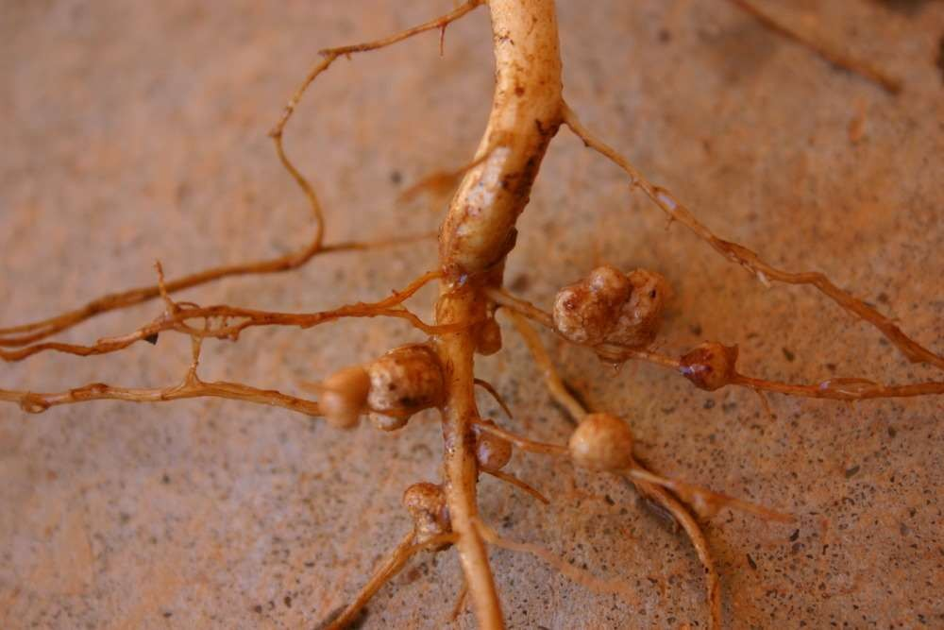
ROOT NODULE FORMATION BY RHIZOBIUM
Legume plants forms Flavonoides (Sec. Met.)
Rhizobium chemically attracted.
Rhizobium produces Nod Metabolites (Lip-oligosaccharide).
Leg. Plants produces Lectin like protein for binding of Rhizobium.
Rhizobium produces Rhicadesins protein for penetration in root hairs.
Thus Rhizobium causes infection called “Infection Thread”
Due to this Cortical cells of root hair damages & formation of new cells
(Nodule)
Sci. Crook first time studied the structure so also called “Shepherd Crook”

Slide 21

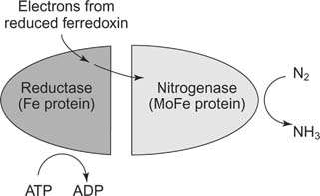
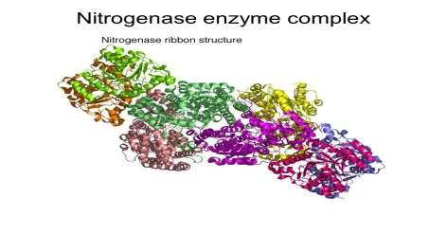
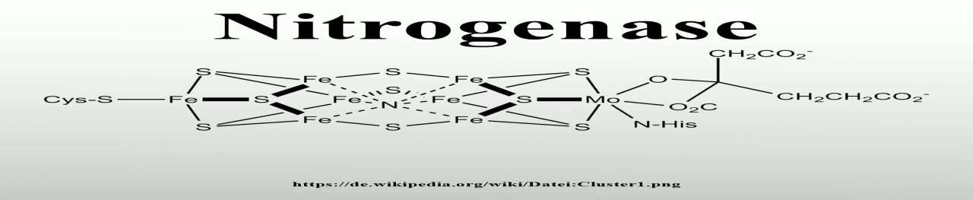
Nitrogen Fixation by Rhizobium
Requirements :
  Enzyme Nitrogenase :

Slide 22
2. Non – Leguminous Nitrogen Fixation
Non-Legumious plants and bacterial relationship also result in formation of Root Nodules.
Cynobacteria, Some genera of Actinomycets shows symbiotic association with non legume plants.
In Frankia, a part of the hyphae becomes differentiated into specialized nitrogen fixing cells called ‘Vesicles’
It also capable to fix nitrogen when it is living free of plant.

Slide 23
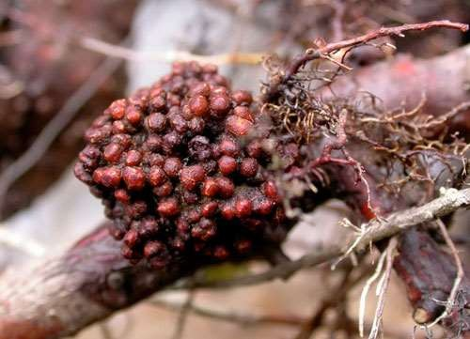
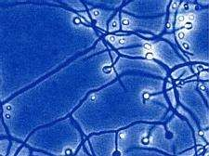
Frankia alni is the only named species in this genus, but a great many strains are specific to different plant species.
The bacteria are filamentous and convert atmospheric nitrogen into ammonia via the enzyme Nitrogenase.
All genera of Rhamnaceae , Myricaceae ,Rosaceae, Coriariaceae are symbiont with Frankia.

Slide 24
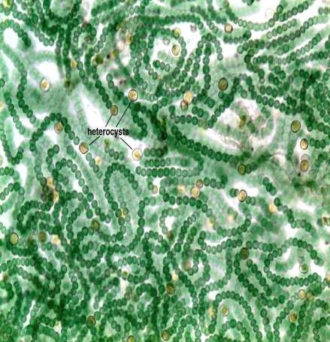
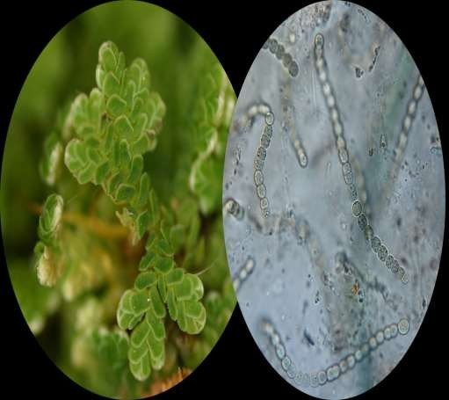
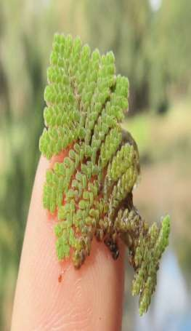
Other Genera of Non-Leguminous Symbiotic Nitrogen Fixers
Nostoc
Anabaena

Slide 25
