Slide 1
Alcoholic Beverages- Beer and Wine

Slide 2
ALCOHOLIC BEVERAGES
An alcoholic beverage is a drink that typically contains 3%–60%
ethanol, commonly known as alcohol. Alcoholic beverages are
divided into three classes: beers, wines, and spirits (distilled
beverages).
They are legally consumed in most countries around the world. More than 100 countries have laws regulating their production, sale, and consumption.

Slide 4
FERMENTATION PROCESS
Fermentation is a metabolic process that converts sugar to acids, gases and/or alcohol.
YEAST
SUGAR
ALCOHOL + CO2
The dominant types of yeast used to make beer are Saccharomyces cerevisiae, known as ale yeast, and Saccharomyces uvarum, known as lager yeast.

Slide 5
BEER
Beer is an alcoholic beverage produced by the saccharification of starch and fermentation of the resulting sugar.
The starch and saccharification enzymes are often derived from malted cereal grains, most commonly malted barley and malted wheat.
Most beer is also flavored with hops (female flowers of Humulus lupulus) , which add bitterness and act as a natural preservative,
The preparation of beer is called brewing.
The strength of beer is usually around 4% to 6% alcohol by volume although it may vary between 0.5% (de-alcoholized) and 20%,

Slide 6
THE BREWING PROCESS
Four different raw materials are required for beer brewing:
Water
Malt
Hops
Yeast
Malt
Malt is being produced from grain, mostly barley.
First of all, the barley from the fields is being thoroughly cleansed.
Now, the barley is ready for germination in warm and humid air lasting until the malt sprouts reach about the same length as the grain itself. During this process, valuable enzymes and malt sugar are being generated.

Slide 7
For long durability, the grain is being dried over hot air on the called ”kiln“. The higher the kiln temperature the more malt sugar is converted into caramel.
The more sugar is converted into caramel, the darker the malt and the brewed beer made out of it.
The alcoholic content of beer only depends on the blend ratio of malt
and water not on the color - light or dark - of the beer.
Brewing water
For the beer production it is of main importance that the brewing water is clean and free of impurities.

Slide 8
Hops
Besides the convenient flavor, the hops performs further important tasks during beer production.
Due to its natural content of essential oils (as to be found in remedy herbs like camomile and eucalyptus), the hops protects the beer against deterioration.
Basically, one differentiates between aroma hops and bitter hops, the latter mainly being used due to its considerably lower price even though aroma hops is of higher quality.
Yeast
In the course of fermentation, the purpose of the yeast is to convert the malt sugar which has dissolved during mixing of malt and water in the brew house into alcohol and CO2

Slide 9
There are two major yeast types, the top fermented and the bottom fermented yeast.
During fermentation, the top fermented yeast ascends to the beer surface and forms a thick foam layer (hence the name). The optimum fermentation temperature for top fermented yeast is approximately 20 C.
The bottom fermented yeast deposes during fermentation on the bottom (hence the name). The optimum fermentation temperature for bottom fermented yeast is approximately 10 C being used for almost any common beer.
The main difference between the beers produced from either yeast variety is that top fermented beers bear a flowery and fruity taste.

Slide 10
THE BEER PRODUCTION
The beer production consist of 9 steps:
Grinding
Mashing
Lautering
Wort boiling
Cooling
Fermentation
Storage
Filtration
Filling

Slide 11
Step 1: Milling the grain
Different types of malt are crushed together to break up the grain kernels in order to extract fermentable sugars to produce a milled product called grist.

Slide 12
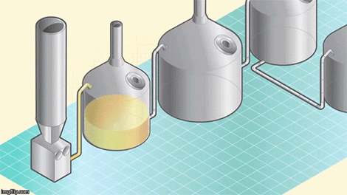
Step 2: Mash Conversion
The grist is then transferred into a mash tun, where it is mixed with heated water in a process called mash conversion. The conversion process uses natural enzymes in the malt to break the malt’s starch down into sugars.

Slide 13
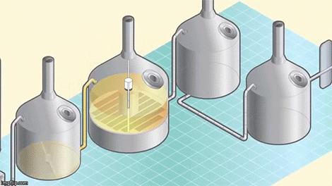
Step 3: Lautering
The mash is then pumped into the lauter Step 3: Lautering
tun, where a sweet liquid (known as wort) is separated from the grain husks.

Slide 14
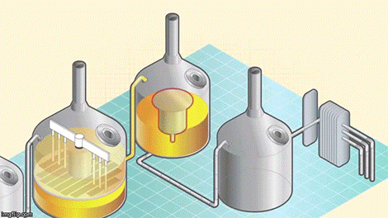
Step 4 Boil
The wort is then collected in a vessel called a kettle, where it is brought to a controlled boil before the hops are added.

Slide 15
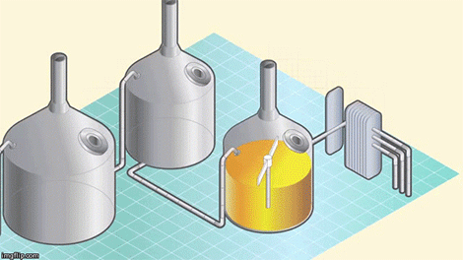
Step 5: Wort separation and cooling
After boiling, the wort is transferred into a whirlpool for the wort separation stage. During this stage, any malt or hop particles are removed to leave a liquid that is ready to be cooled and fermented.

Slide 16
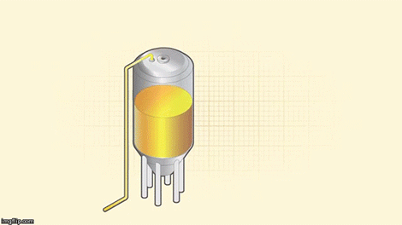
Step 6 Fermentation
To start the fermentation, yeast is added during the filling of the vessel. Yeast converts the sugary wort into beer by producing alcohol, a wide range of flavors, and carbon dioxide (used later in the process to give the beer its sparkle).

Slide 17
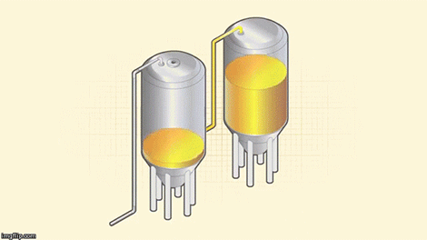
Step 7- Maturation
After fermentation, the young “green” beer needs to be matured in order to allow both a full development of flavors and a smooth finish.

Slide 18
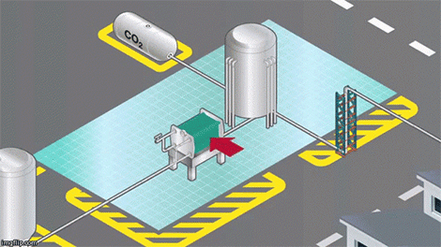
Step 8: Filtration, carbonation, and cellaring
After reaching its full potential, the beer is filtered, carbonated, and transferred to the bright beer tank, where it goes through a cellaring process that takes 3-4 weeks to complete. Once completed, the beer is ready to be packaged

Slide 19
TYPES OF BEER
ALE
Ale is a type of beer brewed from malted barley using a warm fermentation with a strain of brewers' yeast. The yeast
will ferment the beer quickly, giving it a sweet, full bodied and fruity taste. Most ales contain hops, which help preserve the beer and impart a bitter herbal flavor that balances the sweetness of the malt.
LAGER
Lager is a type of beer that is fermented and conditioned at low temperatures. Pale lager is the most widely consumed and commercially available style of beer in the
world. Bock, Pilsner and Märzen are all styles of lager. There are also dark lagers, such as Dunkel and Schwarzbier.

Slide 20
WINE
Wine is an alcoholic beverage made from fermented grapes or other fruits. The natural chemical balance of grapes lets them ferment without the addition of sugars, acids, enzymes, water, or
other nutrients. Yeast consumes the sugars in the grapes and converts them into alcohol and carbon dioxide.
Wines made from produce besides grapes are usually named after the
product from which they are produced (for example, rice
wine, pomegranate wine, apple wine and elderberry wine) and are generically called fruit wine.

Slide 21
RED WINE
Red wine is a type of wine made from dark-colored (black) grape varieties. The actual color of the wine can range from intense violet, typical of young wines, through to brick red for mature wines and brown for older red wines.
The juice from most black grapes is greenish-white; the red color comes from anthocyan pigments present in the skin of the grape; exceptions are the relatively uncommon teinturier varieties, which produce a red colored juice. Much of the red-wine production process therefore involves extraction of color and flavor components from the grape skin.

Slide 22
WHITE WINE
White wine is a wine whose color can be straw-yellow, yellow-green, or yellow-gold colored.
It is produced by the alcoholic fermentation of the non-
colored pulp of grapes which may have a white or black skin. It is treated so as to maintain a yellow transparent color in the final product. The wide variety of white wines comes from the large number of varieties, methods of winemaking, and also the ratio of residual sugar.
The white grapes from which white wine is mainly produced are green or yellow of which there are many so that white wine can be produced anywhere that grapes can be grown. Some varieties are well-known such as the Chardonnay , Sauvignon, and Riesling

Slide 23
5 Basic Wine Characteristics
Sweetness
Acidity
Tannin
Fruit
Body
SWEETNESS
Our human perception of sweet starts at the tip of our tongue. Often, the very first impression of a wine is its level of sweetness. To taste sweet, focus your attention on the taste buds on the tip of your tongue. Believe it or not, many dry wines can have a hint of sweetness to carry a larger impression of Body.

Slide 24
ACIDITY
Tasting acidity is often confused with the taste of higher Alcohol. It is
common for wines grown in cooler vintages to have higher acidity.
Wines with higher acidity feel lighter weight because they come
across as „spritzy.‟ If you prefer a wine that is more rich and round, you enjoy slightly less acidity.
TANNIN
Tannin in wine is the presence of phenolic compounds that add bitterness to a wine. Phenolics are found in the skins and seeds of wine grapes and can also be added to a wine with the use of aging in wood (oak).
FRUIT
Wines are often characterized by their main fruit flavors. Tasting for fruit flavors in a wine can help you better define your preferences.

Slide 25
Additionally, the level of fruitiness that you taste in a wine leads to very different growing regions.
BODY
Body is the result of many factors – from wine variety, where it‟s from, vintage, alcohol level and how it‟s made. Body is a snapshot of the overall impression of a wine. A high alcohol wine typically tastes fuller bodied than a light-alcohol wine.

Slide 26
DISTILLATION PROCESS
Distillation is a process of separating component substances from liquid mixtures through vaporization and condensation, based on different volatility of components in the mixture. Distillation is a unit operation, or a physical separation process, and not a chemical reaction.
Distilled spirits are all alcoholic beverages in which the concentration of ethyl alcohol has been increased above that of the original fermented mixture by a method called distillation. The principle of alcoholic distillation is based upon the different boiling points of alcohol (78.5 C, or 173.3 F) and water (100 C, or 212 F). If a liquid containing ethyl alcohol is heated to a temperature above 78.5 C but below 100 C and the vapor coming off the liquid is condensed, the condensate will have a higher alcohol concentration, or strength.

Slide 27
POT STILL DISTILLATION
A pot still is a type of still used in distilling spirits such as whisky or brandy. Heat is applied directly to the pot containing
the wash (for whisky) or wine (for brandy). This is called a batch
distillation.
In the pot still, the alcohol and water vapor combine with esters and flow from the still through the condensing coil. There they condense into the first distillation liquid, the so-called "low wines". The low wines have a strength of about 25-35% alcohol by volume, and flow into a second still. It is then distilled a second time to produce the colorless spirit, collected at about 70% alcohol by volume.

