Slide 1




Slide 2

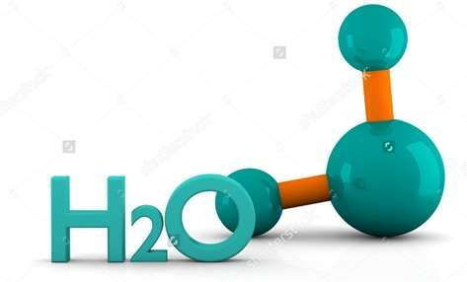
Water:
Water is transparent fluid which forms the worlds streams , lakes ,oceans and rain. It is major constituent of fluid of living organisms . It covers the 71% of earth surface

Slide 3

Importance of water
Water is the medium of life.
All organisms are composed primarily of water.
Liquid water is the medium in which all cellular chemical reactions occur.
Essential for survival and growth of organism.

Slide 4

Water Microbiology
Definition:
The study of microorganisms- (viruses, bacteria, algae , protozoa and microscopic fungi)- and their activities in fresh , estuarine and marine waters including springs , lakes, rivers and seas which inhabits these natural waters.

Slide 5

The aquatic environment:
The microbial population in a body of natural water is to a large extent determined by physical and chemical conditions. These condition vary over a wide extremes when one compares streams, estuaries and open seas.
Some conditions are following:-
Temperature:
Temperature of surface water varies from near 0 ̊C in polar region to 30-40 ̊C in equatorial region.
More than 90% marine environment temp. is below 5 ̊C (psychrophilic microorganisms)
Microorganisms do occur in hot springs ranges from 75-80 ̊C.
i.e. Thermus aquaticus (optimum temp. 70-72 ̊C)
Some microorganisms associated with geothermal vents in Pacific Ocean are capable of growing at 250 ̊C.
•
•
•

Slide 6
Light:
Most forms of aquatic life depend directly or indirectly upon the metabolic products of photosynthetic organisms . In most aquatic habitats these primary producers are algae and their growth is restricted to the upper layer of water through which the light can penetrate.
Salinity:
  The degree of salinity in natural water ranges from zero in fresh water to saturation in the salt lakes.
  Concentration of salt varies between 33 and 37 g/kg.The major salts of sea waters are Chlorides,Sulphates and Carbonates of Na,K,Ca and Mg.
  Most marine microorganisms are halophilic .They grow best at salt conc. Of 2.5-4% whereas those from lakes and rivers are salt sensitive and don't grow at salt conc. Of more than 1%.

Slide 7

Turbidity:
  There is a mark variation in the clarity of surface waters
  The Adriatic sea is clear at great depth whereas some near
shore rivers are often turbid.
  The suspended material responsible for turbidity includes:-
Particles of mineral materials which originate from land.
Detritus predominantly particulates organic materials such as cellulose, hemicellulose and chitin fragments.
Suspended microorganisms.
Turbidity of water influences the penetration of light which in turn affects the photosynthetic zone.

Slide 8

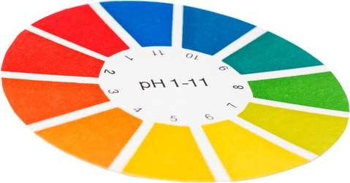
Hydrogen ion concentration (pH):
  Aquatic microorganisms in general can be grown at pH at 6.5-8.5.
  The pH of sea is 7.5-8.5.
  Optimum growth of most Marine species is obtain on the media at just to pH 7.2-7.6.
  Lakes and rivers may show a wider range in pH depending
upon local conditions

Slide 9
Aquatic microorganisms:
The microbiology of fresh waters constitute a part of science of limnology (Study of Flora and conditions for life in Lake ,pond and streams)
Lakes and ponds:
  Lakes and ponds have characteristics zones:
i)Littoral zone
ii) Limnetic zone
iii)Profundal zone
Iv)Benthic zone

Slide 10
Littoral zone:
  Littoral zone is situated along the shore which has considerable rooted vegetation and include the regions where light penetrates to the bottom
Limnetic zone:
Limnetic zone is situated in open area after littoral zone, which is determined by light compensation level (depth of effective light penetration).
Profundal zone:
Profundal zone present beneath the limnetic zone in the deeper region of the open waters where the photosynthesis decrease progressively due poor penetration of light
Benthic zone:
The benthic zone is the deepest zone composed of soft mud at bottom of ponds and lakes

Slide 11

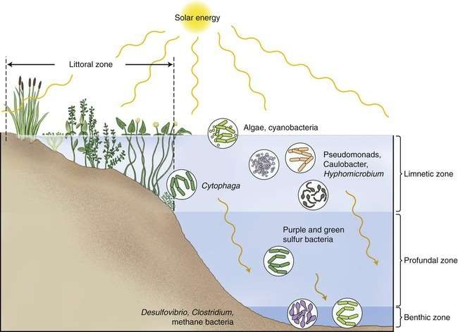
.

Slide 12
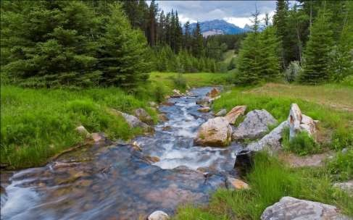
Streams:
  Streams obtain majority of nutrients from the flow of inorganic and organic material from the surrounding terrestrial system or lakes or ponds.
  To major extent the microbial flora reflects the immediate terrestrial conditions including the effects of agriculture and industrial practices.

Slide 13

The sea:
  Microorganisms are at all depth and at all latitudes in the sea water .
  They occur as plankton and in sediments of ocean.
  The great volume of open sea provides an environment with less variations in conditions than other aquatic environment.
Marine Plankton
The phytoplankton population comprises numerous species of Diatoms(algae),cyanobacteria(blue green- algae) ,dinoflagellates(flagellate protist)
sillicoflagellates(unicellular algae) etc.
This group of microorganism is chiefly responsible for the conversion of radiant energy to the chemical energy.
Protozoa are present in large number in the region inhabited by phytoplankton . The zoo plankton feed upon phytoplankton organisms , bacteria or detritus .

Slide 14


Benthic population:
  Offshore sediments are inhabited by protozoa and bacteria.
  Large number are present at mud-water interface, the bacterial population may range from a few hundreds to the millions per mm.
  The count in sediments are as high as 10^8 bacteria per gram.
  Many bacteria are facultative or strict anaerobes.

Slide 15
Water born diseases
H₂O can act as a vector for the transmission of bacterial, viral and protozoan agents which cause a variety of diseases (mainly intestinal)
It can also be linked to viral/protozoan diseases transmitted by insects (aquatic hosts or insect breeding in H₂O - indirect)
Water is responsible for, by some estimates, approximately 80% of all infectious disease not just waterborne diseases, but any disease where water plays a role.

Slide 16

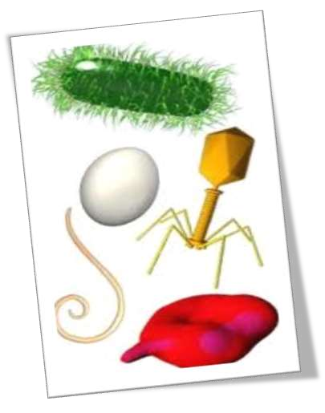
Water contains a variety of microbes
including:
Viruses Bacteria Protozoa
Fungi

Slide 17

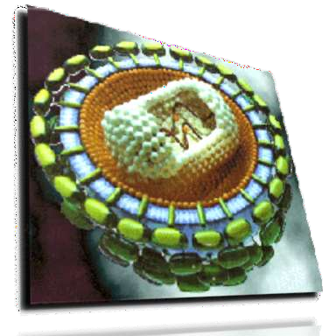
VIRUS
Virus is microscopic entity consisting of a single nucleic acid surrounded by a protein coat and capable of replication only within the living cells of bacteria, animals or plants.
Viruses that infect bacteria is called Bacteriophage.
Viral diseases and their pathogen:
Diseases:
Enteritis, diarrhea, and dysentery
Causative agent:
  Rotavirus
Symptoms:
severe vomiting

Slide 18
Diseases:
Hepatitis A
Causative agent: HAV
Hepatitis E
Causative agent: HEV
Symptoms:
Inflammation of liver ,vomiting ,Jaundice ,Nausea etc.
Treatment: Liver transplantation
Polio:
Causative agent: Polio virus
Symptoms:
Fever ,Sore throat ,Neck stiffness ,Pain in legs & arms etc.
Treatment: Polio vaccine.

Slide 19
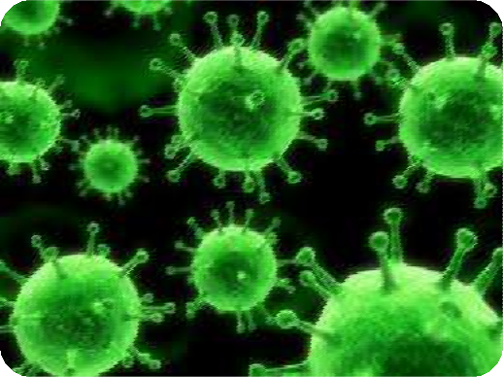

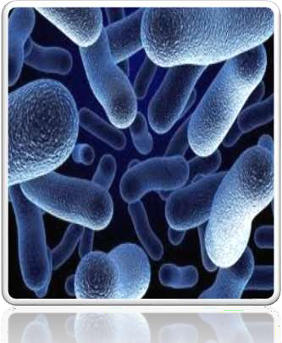
BACTERIA
Bacteria vary in their shapes like
bacteria (bacillus)
have spherical(cocci), rod and spiral (spirillum) shaped
arrangement and are organized in specific
cellular shape.
Bacterial diseases & their pathogen:
Diseases:
Enteritis & diarrhea
Causative agents:
  E.coli
Symptoms: Vomiting , Fever ,Nausea.
Enteric fever
Causative agent : Salmonella typhi, Salmonella paratyphi
Symptoms: Poor appetite ,Headache etc

Slide 20
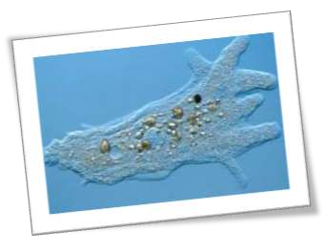

Protozoa
These are unicellular organisms with diameters in the range of 2-100 μm.
Protozoan infection & their pathogen :
Diseases:
Malaria: Plasmodium
Symptoms : Fever ,Fatigue ,vomiting etc.
African sleeping sickness: Tsetse fly
Symptoms : Headache ,fever , Joint’s pain.

Slide 21
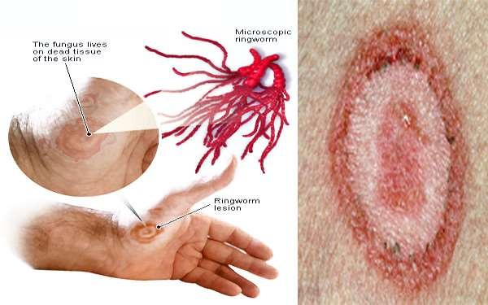
FUNGI
Fungi are serve as decomposers, absorbing nutrients from dead leaves or other organic matter in soil and water
Fungi are found in very less quantity/numbers in water. This is due to their competition with other heterotrophic organisms like some bacteria and archae for food intake. their low abundance is an indicator for their loss during competition.
Fungal disease
Ringworm:
The fungi that cause ringworm can live on surfaces, particularly in damp areas like public showers.
Causative agent: Trichophyton (fungi)

Slide 22
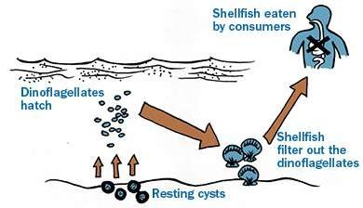
Algae
Algae may
produce toxins in sea food which can cause illness
to human beings by using contaminated seafood.
Algal disease:
Amnesic Shellfish Poisoning (ASP):
Causative agent:
Pseudo-nitzschia sp.(Diatom)
Symptoms:
Short terms memory loss , Brain damage etc.

Slide 23
SPREAD AND SYMPTOMS OF DISEASE
A person may be infected by direct drinking contaminated water.
By coming in contact with contaminated water.
Common symptoms
Abdominal pain
Fever
Diarrhea
Condition are more severe in peoples with weakened immune system.

Slide 24

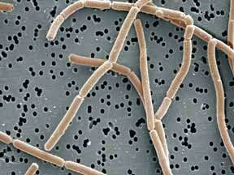
Microbiological Examination of Water
•
Individual pathogen numbers may be too low to detect in a reasonable sized water sample. Isolation and detection of some pathogens can take several days, weeks, or months.

Slide 25

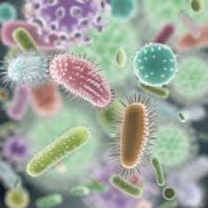
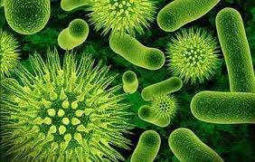
Indicator Microorganisms:
Indicator microorganisms are used to indicate an increased risk of pathogen contamination due to fecal contact. They are not dangerous to human health but are used to indicate the presence of a health risk.

Slide 26
Characteristics of a Useful Indicator:
Always present when pathogens are present
Not present in the absence of the
pathogen
Correlated with degree of pollution
More easily detectable than a pathogen
Non-pathogenic in nature.

Slide 27


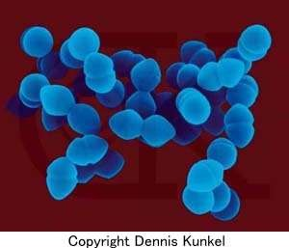
Bacterial-Indicator Organisms
Common Groups:
Coli forms
  Total coli forms
  Fecal coli forms
Streptococci
  fecal streptococci
  enterococci
Spore Formers
  Clostridium perfringens

Slide 28
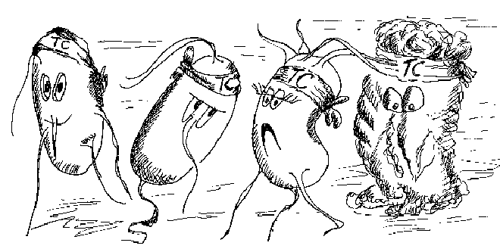
Coliform Bacteria:
Coliform bacteria (E. coli-like) are the most often used indicator bacteria for water quality assessment in the U.S.

Slide 29

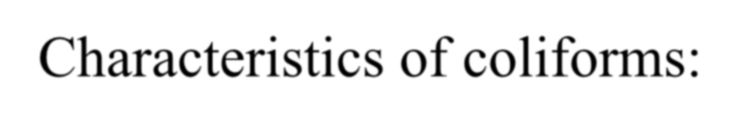
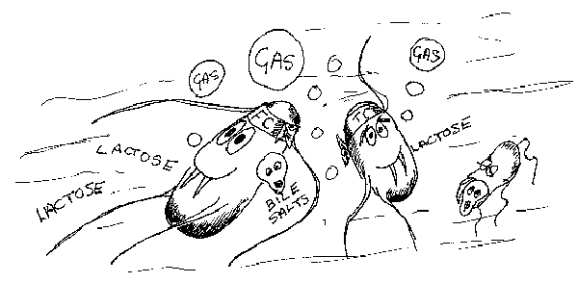


Characteristics of coliforms:
Aerobic or facultative,
Gram-negative,
Non-spore forming,
Bacilli,
Which ferments Lactose to form acid and/or gas with in 24 hours at 35ºC

Slide 30
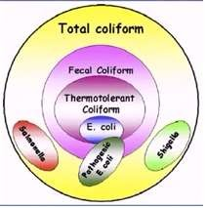
Coliform groups
Total coliforms – indicate water in contact with plant or animal life (universally present)
Fecal coliforms – mammal or bird feces in water

Slide 31
Factors Affecting Ratio of Indicator Organisms to Pathogens:
All treatment methods and environmental conditions affect pathogens and indicators differently.
Chlorinated water may have zero indicators and pathogens, but loaded with viruses.
The ratio of indictors to actual pathogens is not fixed

Slide 32

Water Quality
Feces from human populations with higher infection rates are of greater concern.
Microbes are filtered from water that percolates into groundwater.
Some pathogens are transmitted to human in drinking and recreational water.
It involves variety of steps which depend upon the type of impurities in the raw water source.

Slide 33

Most Probable Number & Membrane Filter methods

Slide 34
Most Probable Number OR Multiple tubes method:
The Most Probable Number method is used to check potability (if water is safe enough to be drinking water) of water.
The MPN method looks for the presence of potential pathogenic bacteria that may be in the water due to contamination of the water supply.
Water supplies are generally derived from ground sources and have to be checked for safety levels of bacterial- contamination.

Slide 35
MPN method enumerates the enteric bacteria called coliforms, specifically fecal coliforms (E. coli)
Coliforms are Gram negative bacilli that have the ability to ferment lactose with the production of acid and gas.

Slide 36

MPN test includes 3 levels of testing:
Presumptive Test
Confirmatory Test
Completed Test

Slide 37
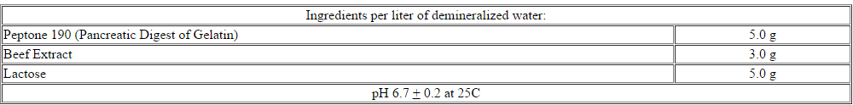
1-Presumptive Test:
The presumptive test looks for presence of coliforms
in the water sample by inoculating lactose broths with the
water sample.
Composition of lactose broth:
Procedure:
Took three sets of test tubes (with Durham tube) containing lactose broths(2ml) are inoculated with varying dilution of the sample:-

Slide 38
first set of 5 tubes inoculated with 10ml of sample;
second set of 5 tubes inoculated with 1ml of sample;
third set of 5 tubes inoculated with 0.1ml of sample
Then all test tubes incubate at 35 ̊C for 24 hours.
Those tubes that show presence of acid and gas are marked as +ve and those with no acid/gas as -ve.
Then count the +ve marked tubes from all sets.
The combination of positives in the 3 sets is used to figure out
the MPN /100ml of water using the table provided.

Slide 39
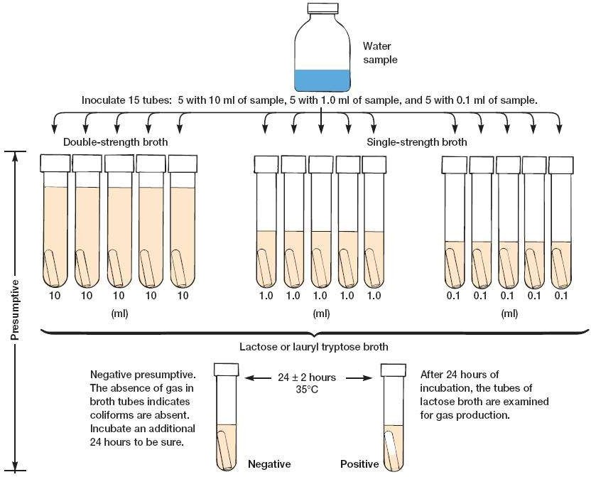

Slide 40
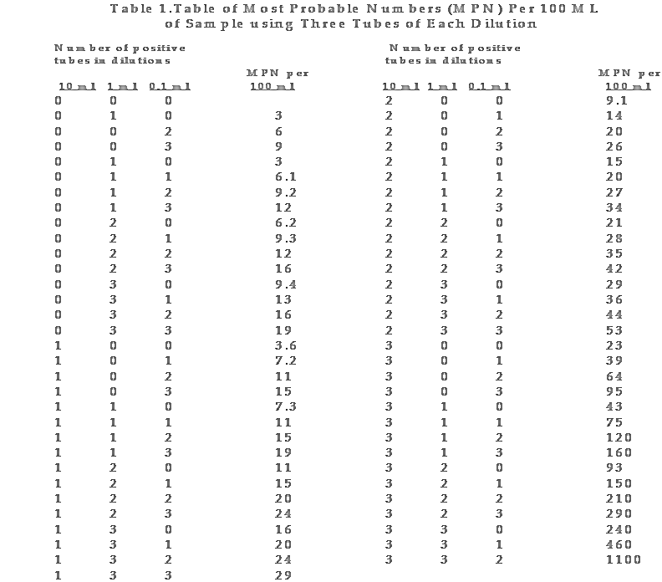
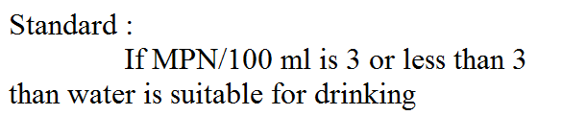
Table 1.Table of Most Probable Numbers (MPN) Per 100 ML of Sample using Three Tubes of Each Dilution
Number of positive tubes in dilutions |  |  |  | Number of positive tubes in dilutions
10 ml 1 ml 0.1 ml |  |  | MPN per 100 ml | 10 ml 1 ml 0.1 ml |  |  | MPN per 100 ml
0 | 0 | 0 |  | 2 | 0 | 0 | 9.1
0 | 1 | 0 | 3 | 2 | 0 | 1 | 14
0 |  |  |  |  |  |  | 20
0 |  |  |  |  |  |  | 26
0 |  |  |  |  |  |  | 15
0 |  |  |  |  |  |  | 20
0 |  |  |  |  |  |  | 27
0 |  |  |  |  |  |  | 34
0 | 2 | 0 | 6.2 | 2 | 2 | 0 | 21
0 | 2 | 1 | 9.3 | 2 | 2 | 1 | 28
0 | 2 | 2 | 12 | 2 | 2 | 2 | 35
0 | 2 | 3 | 16 | 2 | 2 | 3 | 42
0 | 3 | 0 | 9.4 | 2 | 3 | 0 | 29
0 | 3 | 1 | 13 | 2 | 3 | 1 | 36
0 | 3 | 2 | 16 | 2 | 3 | 2 | 44
0 | 3 | 3 | 19 | 2 | 3 | 3 | 53
1 | 0 | 0 | 3.6 | 3 | 0 | 0 | 23
1 | 0 | 1 | 7.2 | 3 | 0 | 1 | 39
1 | 0 | 2 | 11 | 3 | 0 | 2 | 64
1 | 0 | 3 | 15 | 3 | 0 | 3 | 95
1 | 1 | 0 | 7.3 | 3 | 1 | 0 | 43
1 | 1 | 1 | 11 | 3 | 1 | 1 | 75
1 | 1 | 2 | 15 | 3 | 1 | 2 | 120
1 | 1 | 3 | 19 | 3 | 1 | 3 | 160
1 | 2 | 0 | 11 | 3 | 2 | 0 | 93
1 | 2 | 1 | 15 | 3 | 2 | 1 | 150
1 | 2 | 2 | 20 | 3 | 2 | 2 | 210
1 | 2 | 3 | 24 | 3 | 2 | 3 | 290
1 | 3 | 0 | 16 | 3 | 3 | 0 | 240
1 | 3 | 1 | 20 | 3 | 3 | 1 | 460
1 | 3 | 2 | 24 | 3 | 3 | 2 | 1100
1 | 3 | 3 | 29
0 2 6 2 0 2
0 3 9 2 0 3
1 0 3 2 1 0
1 1 6.1 2 1 1
1 2 9.2 2 1 2
1 3 12 2 1 3

Slide 41
Confirmed test:
Some spore forming bacteria give false positive test in presumptive test.
Confirmed test is done to determine that the coliforms are of fecal origin or
not. And they are E. coli or not.
Procedure:
Transfer the lactose broth with gas into two following media:-
Brilliant green lactose bile broth (BGLB): this medium inhibit growth of lactose fermenter other than coliforms; thus gas formation in BGLB medium confirmed that coliforms are present.
Eosin Methylene Blue (EMB) agar: Indicator produce characteristic colonies
E.coli : small colonies ,dark ,almost black centers with greenish metallic
sheen
Enterobacter : large pinkish colonies ,dark centers ,rarely show metallic sheen

Slide 42

Co
mpleted test :
st typical colonies are selected from culated into :-
se broth : coliform produce gas lant : gram staining performed
r & bacilli shape observed under mi
mination gram negative bacte ent.
liform is gram negative bacteria
So , it is confirmed that given sam g coliform.
The mo and ino
EMB plate
Lacto
Agar s colou exa pres
co
Result:
red
croscopic ria
❑
ple
containin

Slide 43
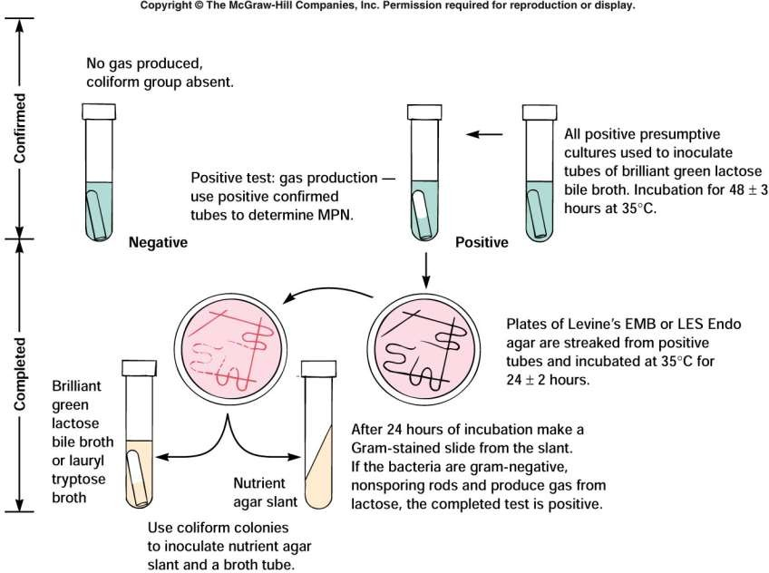
Flow chart of Confirmed and Completed MPN

Slide 44

Disadvantages:
labor intensive ,Large amount of glassware is required
Its lack of precision, large errors
still requires survival and culture of organisms in lab

Slide 45

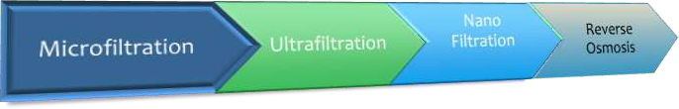
Membrane Filtration

Slide 46
Membrane Filtration
Categorized into four processes based on membrane pore size;
A. Microfiltration
B. Ultrafiltration
C. Nano filtration
D. Reverse Osmosis

Slide 47
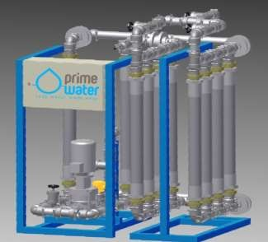
Microfiltration
Size: 0.1-10 microns
Removes Sand, Silt, Clays, Giardia-lambia(flagellated protozoan parasite),Algae, some bacterial species and oil Emulsions.
It does not remove viruses.

Slide 48
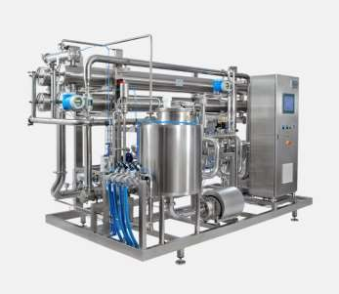
…microfiltration
Used in :
  purification of juices and beverages.
  cold sterilization of pharmaceuticals.
  separation of oil and water emulsions.
  pre treatment of nano filtration or reverse osmosis

Slide 49
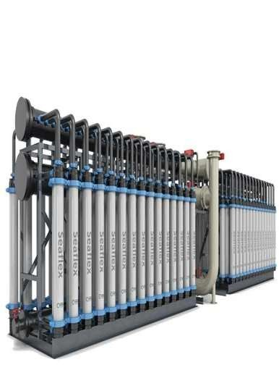
Ultra Filtration
0.003 to 0.1 microns
Removes: Soluble organic materials, protozoa, bacteria, most viruses

Slide 50
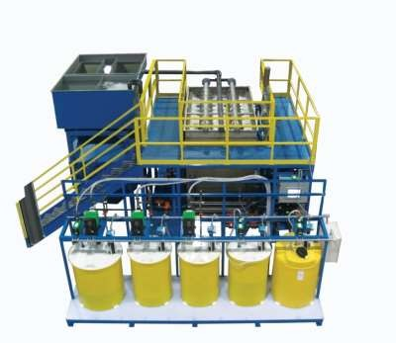
…ultrafiltration
Used in :
  dairy (milk and cheese)
  food, metal and textile industry
  pre treatment of Nano filtration and Reverse Osmosis.

Slide 51
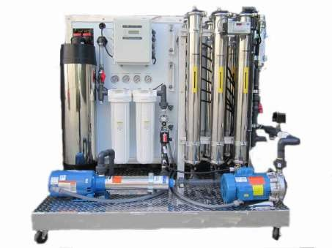
Nano Filtration
Size: 0.001 microns
Pressure driven filtration process.
600 to 1000 kilopascal pressure required.
Removes
micro-molecular organic compounds,
microorganisms, hardness of water, demineralization, Colour removal
Used in desalination.

Slide 52
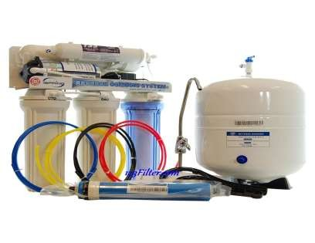
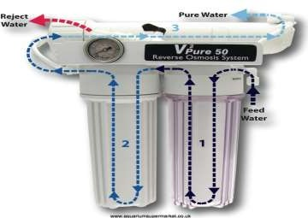
Reverse Osmosis
0.0001 microns
Removes: Natural organic substances, pesticides, cysts, bacteria, viruses
Used in desalination

Slide 53
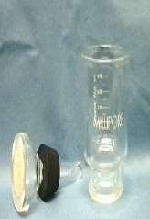
Membrane Filter Methods
Filter water through a membrane filter(Bacterial cells can not pass
through)
Place membrane on selective media(EMB)
Incubate
* 35 ̊C
Count colonies

Slide 54
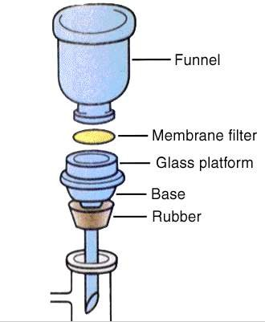
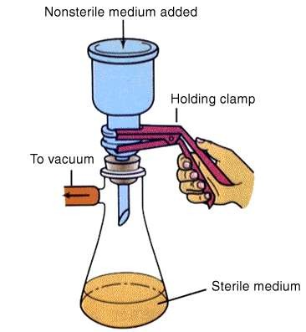
MF method

Slide 55
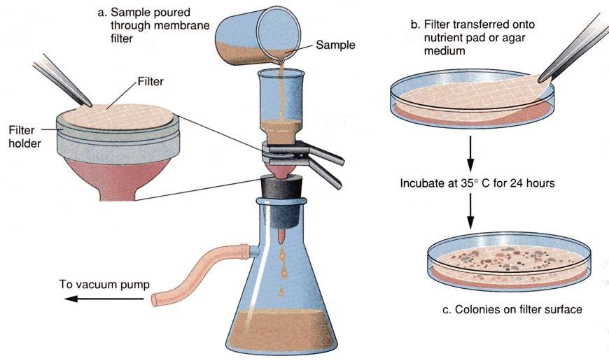
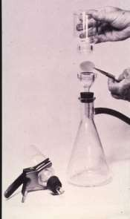
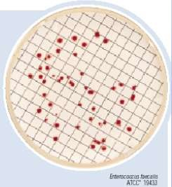

Slide 56

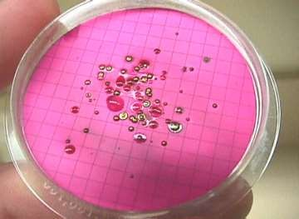
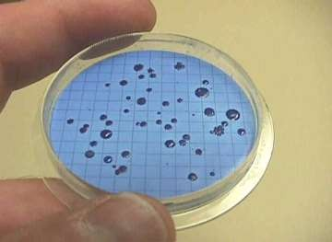
Membrane filtration method
Results:
Coliform bacteria produce colonies with a characteristic
"metallic green sheen"

Slide 57
Membrane filtration method Advantages
More than 100ml samples can be tested
Effective and acceptable technique. Used to monitor drinking water in government laboratories.
Rapid
Lower chance of contamination esp. on low scale
More accurate
Disadvantage:
Not suitable for turbid or waste water.

Slide 58



THANK YOU!!!

