Slide 1
Topics: : Rate laws expressions, order determination
Chemical Kinetics BSc III year, UNIT - V

Slide 2
Concentration and Rate
Each reaction has its own equation that expresses its rate as a function of the concentrations of the involved species (e.g., reactants, products, catalysts).
This is called its Rate Law

Slide 3
Rate Law
In general, rates of reactions increase as concentrations increase since there are more collisions occurring between reactants.
The overall concentration dependence of reaction rate is given in a rate law or rate expression.
For reactions follow simple rate laws:
v = k [A]^{m} [B]^{n}…
- [A], [B]: reactant concentrations
- The exponents m and n: reaction order (w.r.t. specific reactant)
- The constant k: rate constant
- The overall reaction order is the sum of the reaction orders:
m + n

Slide 4
Rate Laws
Rate laws, rate constants, and orders are determined experimentally.
The order of a reactant is NOT generally related to its stoichiometric coefficient in a balanced chemical equation.
F₂ (g) + 2ClO₂ (g) 2FClO₂ (g)
v = k [F₂][ClO₂]
1

Slide 5
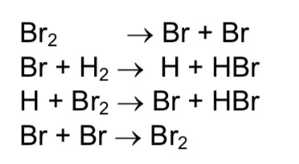
Simple and complex rate laws
Reactions with simple rate laws:
Reactions with complex rate laws*:
* imply multi-step reactions (sequence of elementary steps)
however, the overall rate cannot involve intermediate species

Slide 6
Elementary reactions
Always follow simple rate laws
Reactant order reflects molecularity (activemolecules involved in reaction)
More on this later…

Slide 7
Rate Law Example
Consider the following reaction:
NH₄⁺(aq) + NO₂⁻(aq) → N₂(g) + 2H₂O(l)
Let’s say that the following observations from several experiments were made…
as [NH₄⁺] doubles the rate doubles with [NO₂⁻] constant.
as [NO₂⁻] doubles the rate doubles with [NH₄⁺] constant.
The rate of this reaction would be expressed as….
Rate = k[NH₄⁺][NO₂⁻]
The reaction is said to be “first order” with respect to [NH₄⁺] and “first order” with respect to [NO₂⁻].
But the overall order of the reaction is said to be “second order.”
Reaction rates come from experiment data, not stoichiometry!

Slide 8
Concentration and Rate
This equation is called the rate law, and k is the rate constant.

