Slide 1
Chemical Kinetics
UNIT V, BSc III year
Topics : Molecularity, order, first order kinetics

Slide 4
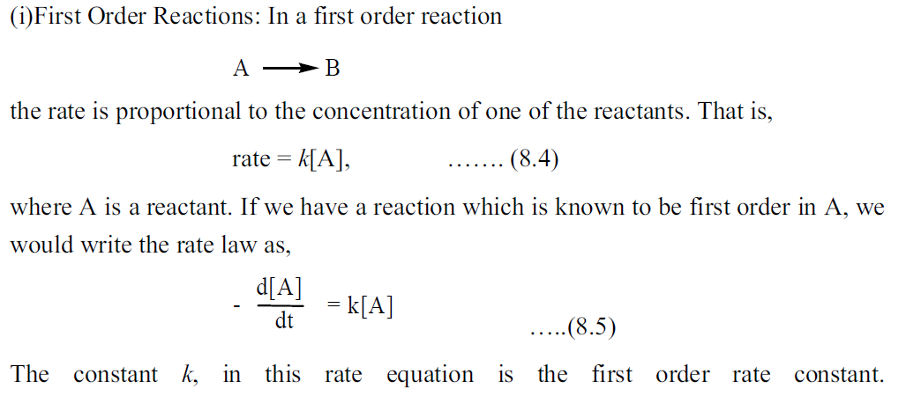

Slide 5
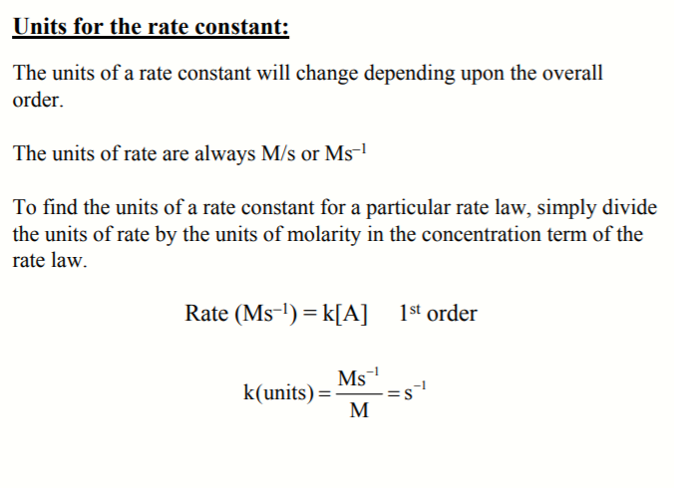

Slide 8
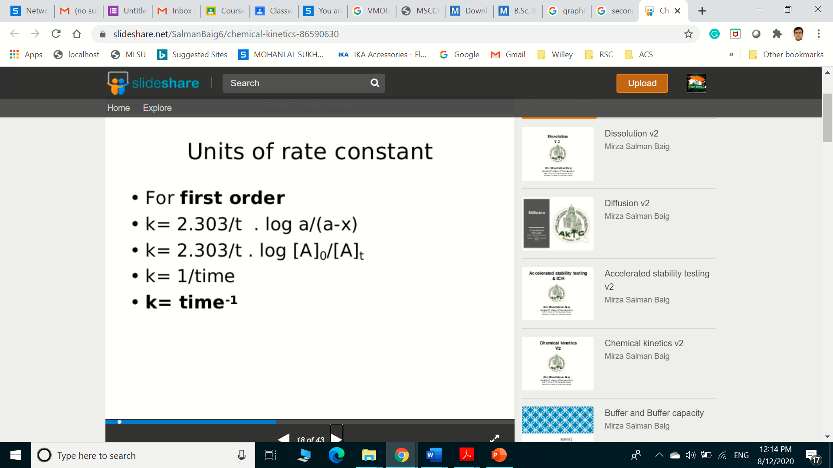

Slide 9
Graphical presentation of First-order Reaction
For 1st order reactions: ln[a-x] = −kt + ln[a]
log[a-x] = −(k/2.303)t + log[a]
where [a-x]= concentration of reactant after some time, t
k= reaction rate constant in units of s⁻¹
t= time in seconds
[a] = initial concentration of reactant
This equation has the general form for a straight line, y=mx+b, so a plot of log[a-x] vs. time is a straight line with slope (-k/2.303) and intercept ln[a].
log[a-x]
(slope= − k/2.303)
Time (s)

Slide 10
Example of first order reactions
1) Inversion of cane sugar (sucrose)
C₁₂ H₂₂O₁₁ + H₂O C₆H₁₂O₆ + C₆H₁₂O₆
Glucose fructose
2) CH₃COOC₂H₅ + H₂O CH₃COOH +C₂H₅OH
3)Decomposition of N₂O₅
N₂O₅ 2 NO₂ + ½ O₂
H⁺
H⁺
4) All nuclear reactions
5) Decomposition of H₂O₂ in Aqueous Solution
Pt
H₂O₂ H₂O + [O]

