Slide 1
Chemical Kinetics
UNIT V, BSc III year
Topics : Pseudo order, zero order kinetics with expressions, half life of a reaction, summary..

Slide 2
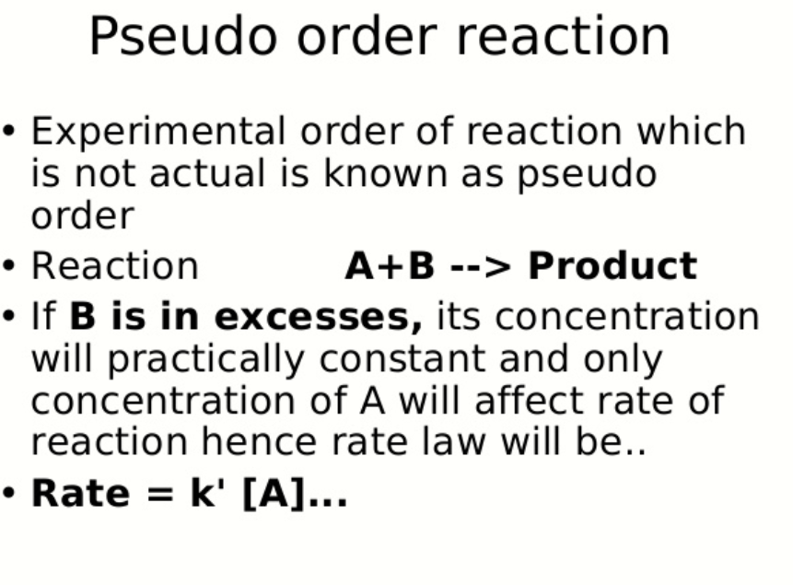
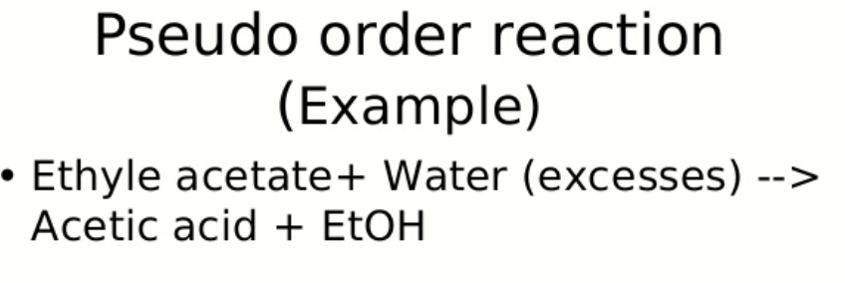

Slide 4
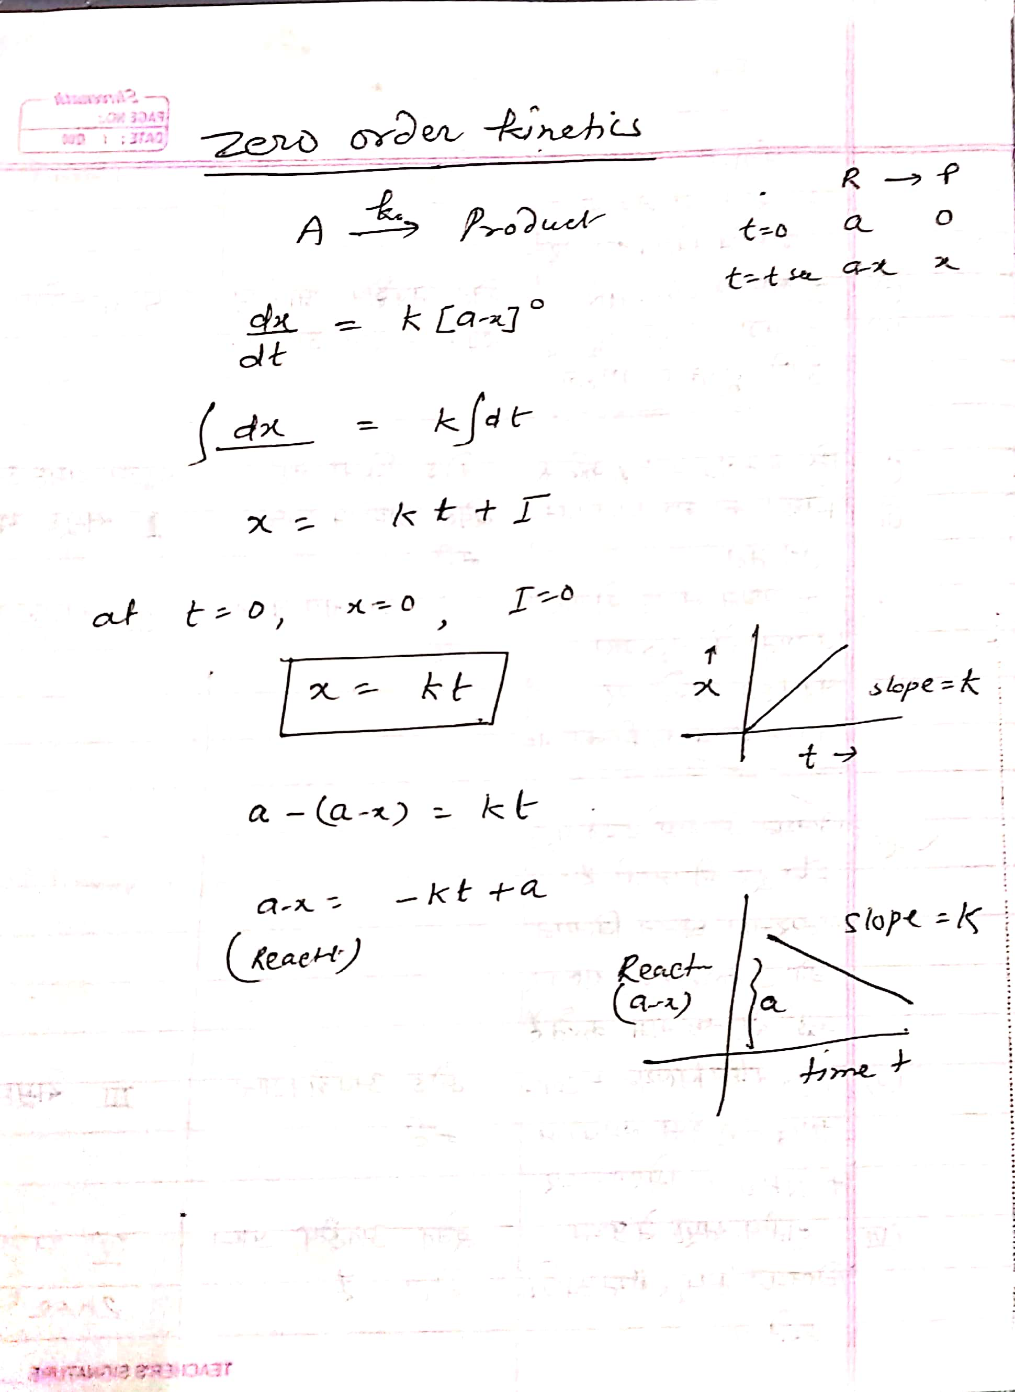

Slide 8
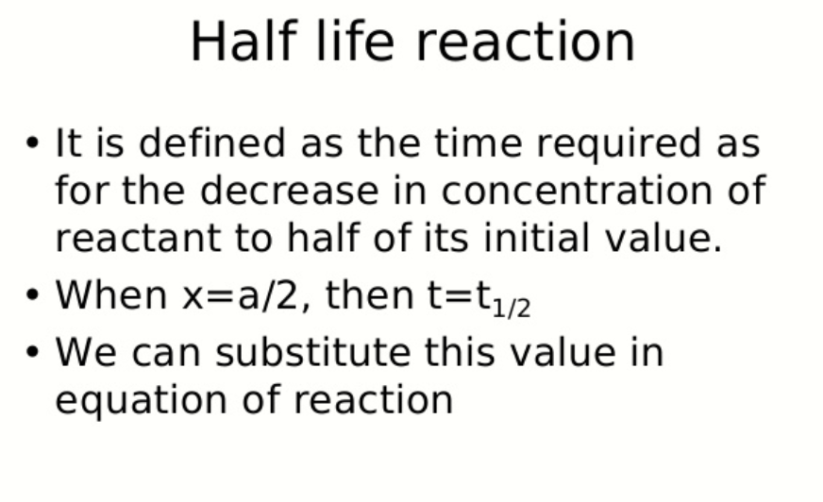

Slide 9
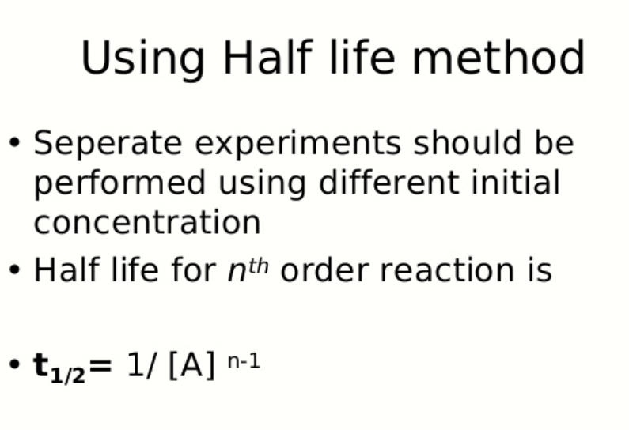

Slide 12
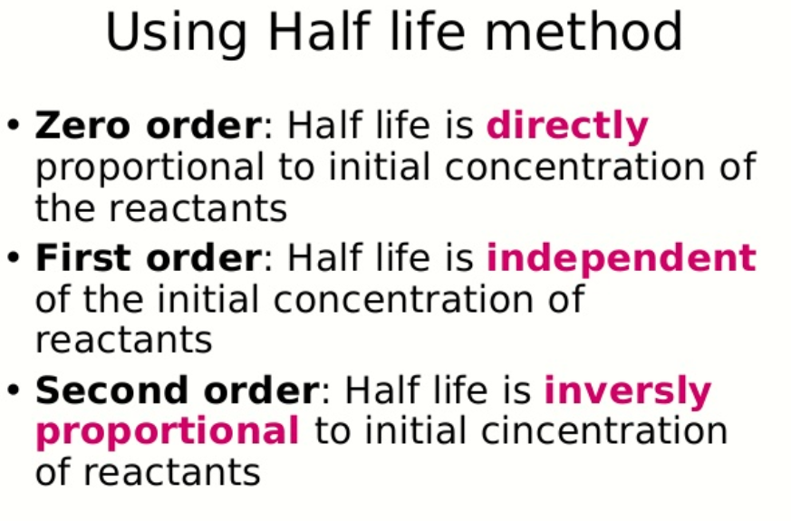

Slide 13
