Slide 1
Flight adaptation

Slide 2
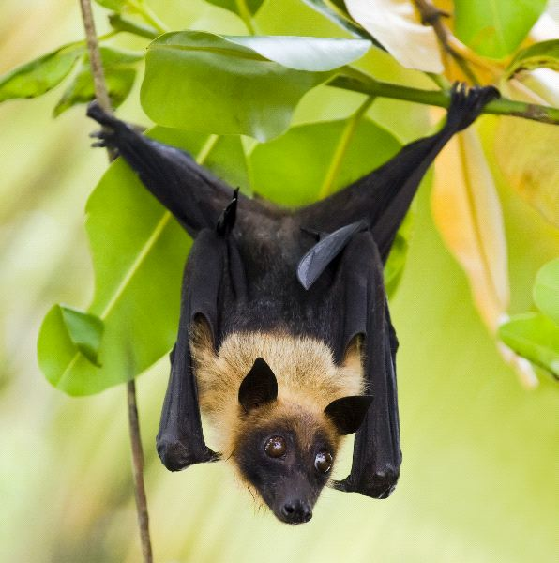
Pteropus
Kingdom: | Animalia
Phylum: | Chordata
Class: | Mammalia
Order: | Chiroptera
Family: | Pteropodidae
Genus: | Pteropus

Slide 3
Flying fox
Commonly called Fruit bat or Flying fox and in Hindi Chamgadar.
They are the only flying mammals

Slide 4
Habit and habitat :
Adapted for arboreal and aerial mode of life.
Live in groups and feed on fruits (fruigivorous) and often damage orchards.
They sleep by day on tree branches.

Slide 5
Flying fox
It is capable of true flight.
The forelimbs are modified into wings.
Each wing formed by a fold of skin or patagium supported by elongated forelimb and 2nd to 5th fingers.

Slide 6
Only 1st and 2nd fingers bear claws.
Hind limbs and tail also included in patagium.
Before patagium is prepatagium.
Hind feet small with sharp and curved claws

Slide 7
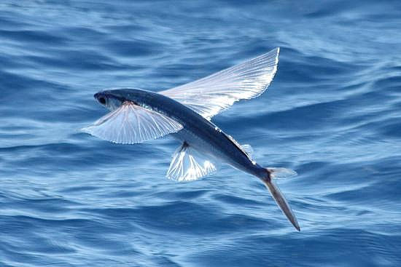
Exocoetus
Kingdom: | Animalia
Phylum: | Chordata
Class: | Actinopterygii
Order: | Beloniformes
Superfamily: | Exocoetoidea
Family: | Exocoetidae
Subfamily: | Exocoetinae Risso, 1827
Genus: | Exocoetus

Slide 8
Flying Fish
Habit and habitat :
Exocoetus is found in sea, often skittering near the boats.
It is pelagic and feeding on prawns and young fishes and their eggs.
Small fishes live in sandy shoal-places near the coast.

Slide 9
Flying Fish
Pectoral fins are exceptionally large, spread like wings and make gliding flights.
Ventral fin well developed and adapted to life the body.

Slide 10
The caudal is bilobed.
Lower lobe larger than upper lobe.
By powerful stroke of the caudal fin the fish is able to leave water with force.

Slide 11
Flying Fish
Exocoetus is not a true flying fish.
Specially in warm seas, it emerges to glide over the water.
Pectorals act as wings.
It also leaves water to escape from larger fishes, such as Tunas and Mackerels.
The fish can glide over the surface of the water for about 400 metres.

Slide 12
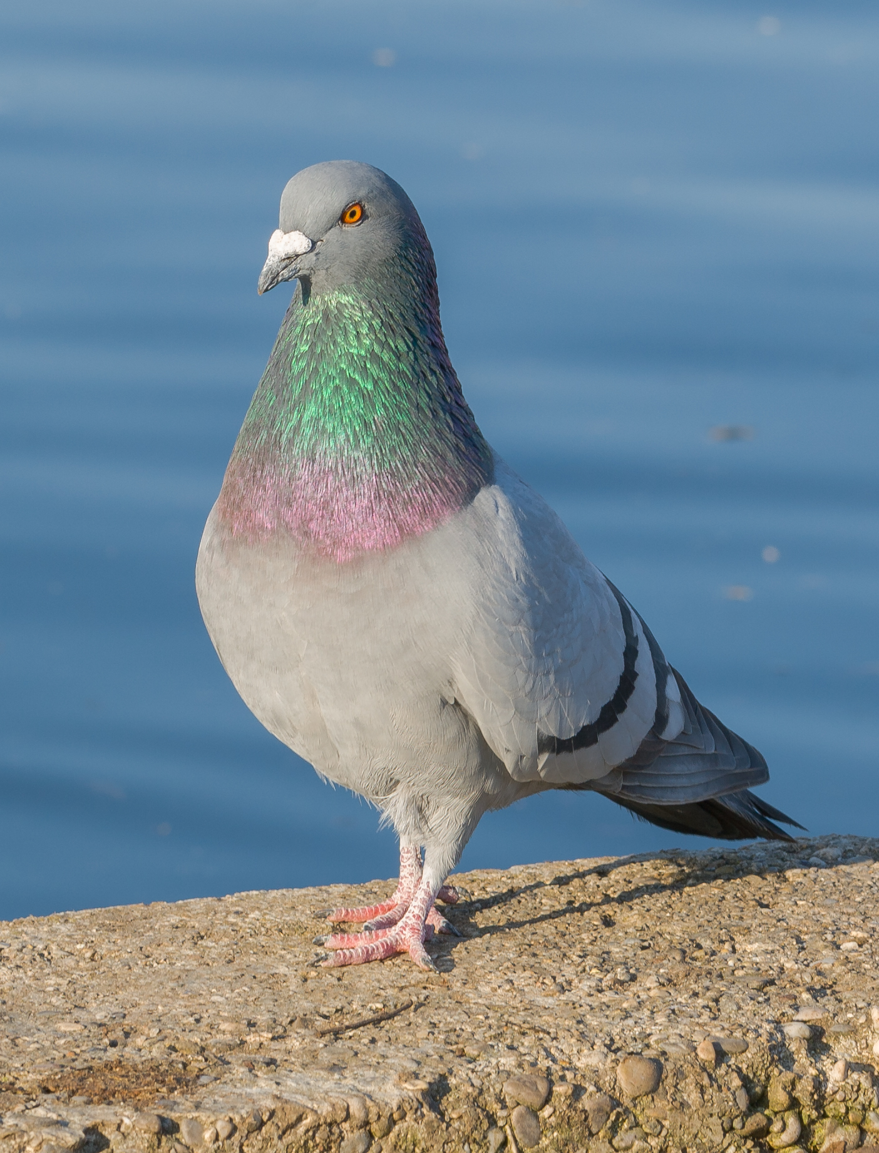
Columba livia : Pigeon
Kingdom: | Animalia
Phylum: | Chordata
Class: | Aves
Order: | Columbiformes
Family: | Columbidae
Genus: | Columba
Species: | C. livia

Slide 13
Columba livia : Pigeon
Habit and habitat :
Columba livia is the most common and familiar bird around man, nesting in buildings, old houses, warehouses, sheds and railway stations.
Their flight is swift and strong.
Breeding continues throughout the year.

Slide 14
Pigeon
Forelimbs are modified into wings which contain besides skeleton flight feathers called as remiges.
Feet are covered with epidermal scutes formed by the fusion of several reptilian epidermal scales.

Slide 15
Hind limbs are modified for bipedal locomotion.
Tarsus usually shorter than toes.
Wing feathers, tail feathers present.
Other structures seen are neck, breast, abdomen and black bars on wings.

Slide 16
Thank you

