Slide 1
Flight adaptation of specimens

Slide 2
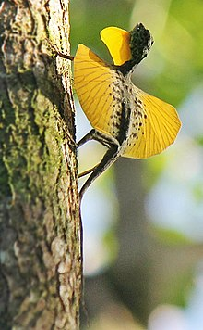
Draco
Kingdom: | Animalia
Phylum: | Chordata
Class: | Reptilia
Order: | Squamata
Suborder: | Iguania
Family: | Agamidae
Subfamily: | Draconinae
Genus: | Draco

Slide 3
Draco
Draco is a genus of agamid lizards that are also known as flying lizards, flying dragons or gliding lizards.
These lizards are capable of gliding flight; their ribs and their connecting membrane may be extended to create "wings" (patagia), the hindlimbs are flattened and wing-like in cross-section, and a flap on the neck (the gular flag) serves as a horizontal stabilizer and are sometimes used in warning to others.
Draco are arboreal insectivores.

Slide 4
Draco
While not capable of powered flight they often obtain lift in the course of their gliding flights.
Glides as long as 60 m (200 ft) have been recorded, over which the animal loses only 10 m (33 ft) in height, which is quite some distance, considering that one lizard is only around 20 cm (7.9 in) in total length, tail included

Slide 5
Draco
The lizards are well known for their "display structures" and ability to glide long distances using their wing-like, patagial membranes supported by elongated thoracic ribs to generate lift forces.
The India flying lizard is capable of gliding from tree to tree found in the Western Ghats and hill forests of southern India.
The flying dragon lizard avoids danger by opening two large winglike flaps of skin and steers, brakes with its tail.

Slide 6
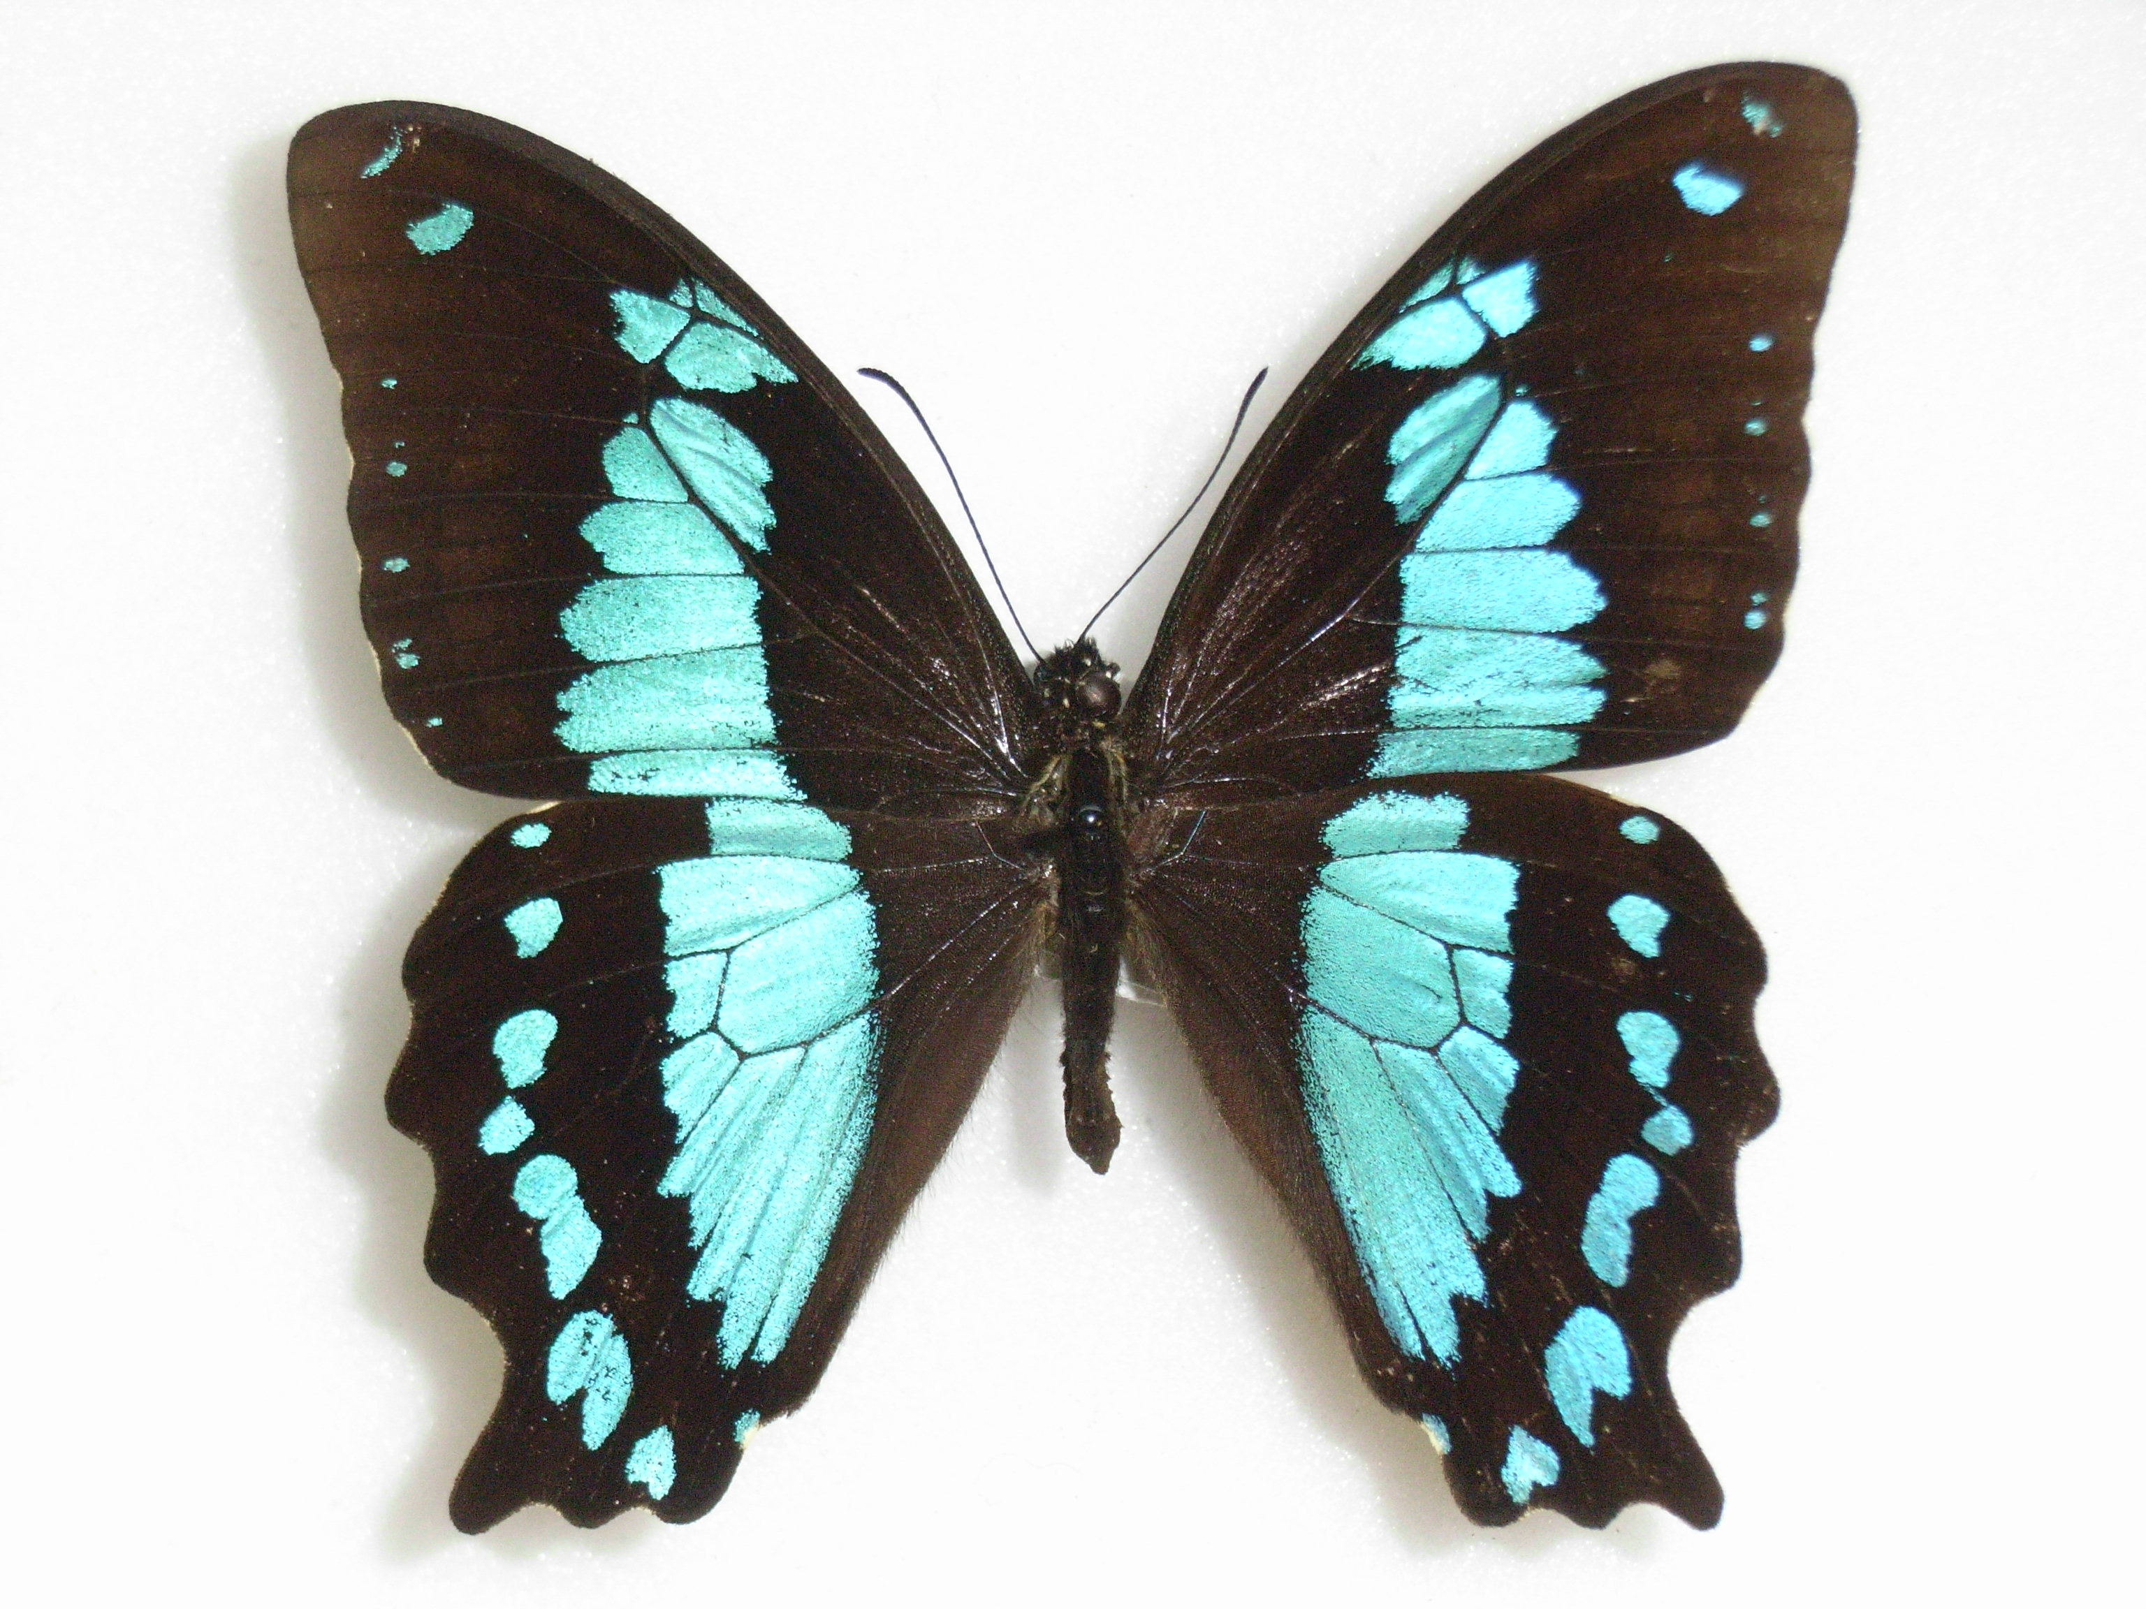
Papilio
Kingdom: | Animalia
Phylum: | Arthropoda
Class: | Insecta
Order: | Lepidoptera
Family: | Papilionidae
Tribe: | Papilionini
Genus: | Papilio

Slide 7
Papilio
Papilio is a genus in the swallowtail butterfly family, Papilionidae, as well as the only representative of the tribe Papilionini.
The word papilio is Latin for butterfly.
Butterflies use a complicated flight mechanism consisting of numerous interrelating “flow control devices” which comprises of flexibility, surface markings and scales on the wings.

Slide 8
Some adaptations of butterflies include wing colorings that mimic the colorings of toxic species, clear membranes that allow butterflies to fly even after the scales of their wings have been rubbed off.
Butterflies also move to shaded areas when the temperature is hot.

Slide 9
Thank you

