Slide 1
Arboreal Adaptation of animals

Slide 2
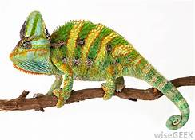
Chamaeleon
Kingdom: | Animalia
Phylum: | Chordata
Class: | Reptilia
Order: | Squamata
Suborder: | Iguania
Clade: | Acrodonta
Family: | Chamaeleonidae

Slide 3
Chamaeleon
Chameleons are arboreal, meaning they spend the majority of their time up in the trees.
They are perfectly adapted to this lifestyle.

Slide 4
Chameleons’ feet split at nearly a 180 degree angle allowing for a superior grip on the branches where they live.
Another great climbing adaptation is the tail.
It is very long and used to balance the body during locomotion.

Slide 5
Chameleon
Chameleon, (family Chamaeleonidae), any of a group of primarily arboreal (tree-dwelling) Old World lizards best known for their ability to change body colour.
Other characteristics of chameleons include zygodactylous feet (with toes fused into opposed bundles of two and three), acrodont dentition (with the teeth attached to the edge of the jaw), eyes that move independently, atrophied venom glands that produce harmless trace amounts of venom, and a long, slender projectile tongue.

Slide 6
Contd.
Protrusible tongue
Long protrusible tongue makes them easy to catch the prey.
Changeable body colour
Can change their body colour.
Protect the animals to hide from the enemies.
Phenomenon is called mimicry.

Slide 7
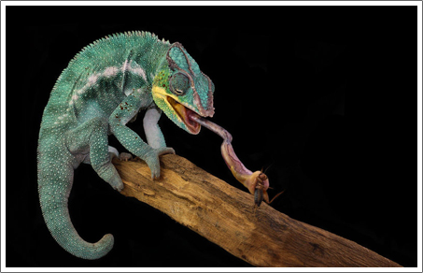
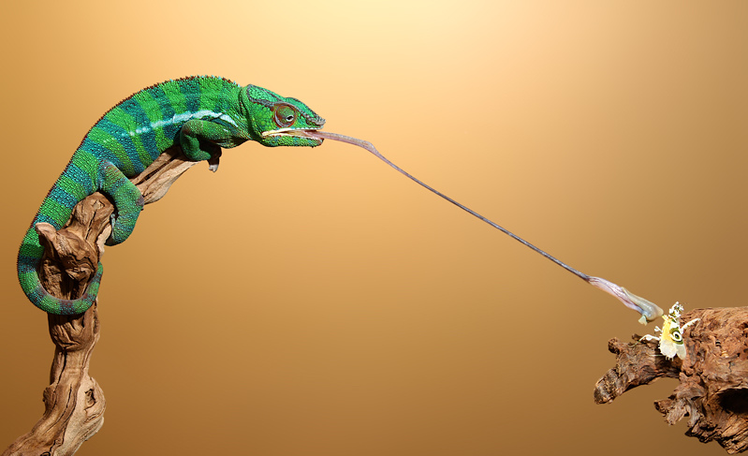

Slide 8
Claws
Digits are with sharp and well developed claws.Help the animal in walking and climbing on branches of tree and other vertical surfaces.
Presence of neck
Neck helps to locate preys and enemies as it provides mobility to the head which enhances the efficiency of eyes.

Slide 9
Both forelimbs and hind limbs well developed. The claws are zygodactylus in which digits are found
in groups. The toes are opposed (2 versus 3) for grasping branches of trees.

Slide 10
Hyla
Kingdom: | Animalia
Phylum: | Chordata
Class: | Amphibia
Order: | Anura
Family: | Hylidae
Subfamily: | Hylinae
Genus: | Hyla

Slide 11
Hyla
Green treefrogs are frequently found in small ponds, large lakes, marshes, and streams.
They prefer habitats with plentiful floating vegetation, grasses.
Hyla is commonly distributed in India, China, United States, Africa and Canada.
Habit and habitat :
Hyla is arboreal in habit, living on trees and rocks.

Slide 12
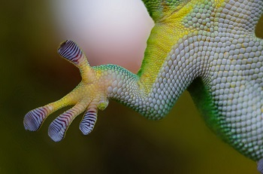
Forelimbs and hind limbs adapted for arboreal life. Terminal base of each digit is claw shaped and
toes contain expanded adhesive discs or cushions which are used to climb trees.

Slide 13
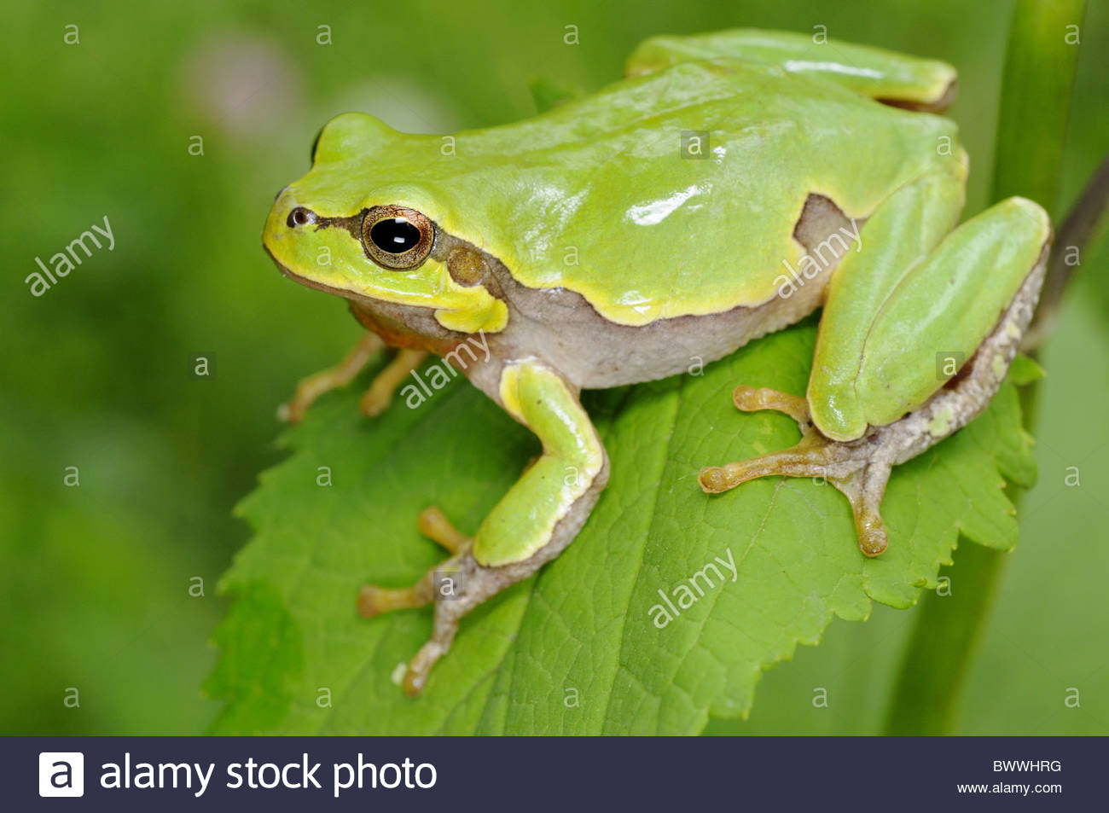
Skin of belly contains hygroscopic glands which help in adhering the frog with leaf, twigs or stem.

Slide 14
They also change their colour according to their environment and show camouflage or mimicry.
Hyla faber shows peculiar parental care.
It comes down from the tree.
Females dig up mud of shallow pond, make small nurseries, and eggs are laid in them.
The larvae hatch and go into submerged water.

Slide 15
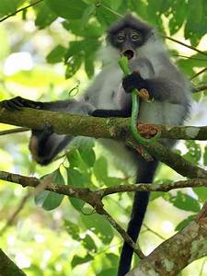
Preshytis
Kingdom: | Animalia
Phylum: | Chordata
Class: | Mammalia
Order: | Primates
Suborder: | Haplorhini
Infraorder: | Simiiformes
Family: | Cercopithecidae
Subfamily: | Colobinae
Genus: | Presbytis

Slide 16
Preshytis
The surilis are a group of Old World monkeys and make up the entirety of the genus Presbytis. They live in the Thai-Malay Peninsula, on Sumatra, Borneo, Java and smaller nearby islands.
Besides surili, the common names for the monkeys in the genus also sometimes use the terms "langur" or "leaf monkey."
Surilis are rather small, slimly built primates. Diurnal forest dwellers, they spend nearly their entire lives in the trees.

Slide 18
i) Strong chest and ribs
They have strong chest, ribs and limb girdles.
Thorax is sub-circular in shape and the ribs have greater curvature.
ii)Strong girdle bones
Pelvic and pectoral girdles are strong to support the body weight during climbing and hanging.
Ilium of pelvic girdle is very broad and it serves to support the viscera.
iii)Grasping type of feet

Slide 19
Thank you

