Slide 1
CURSORIAL ADAPTATIONS

Slide 2
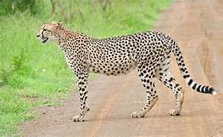
Acinonyx jubatus
Scientific classification
Kingdom: | Animalia
Phylum: | Chordata
Class: | Mammalia
Order: | Carnivora
Suborder: | Feliformia
Family: | Felidae
Subfamily: | Felinae
Genus: | Acinonyx
Species: | A. jubatus

Slide 3
Cheetah
Habit and habitat:
Live in grasslands.
Commonly called as Cheetah or Hunting leopard

Slide 4
Forelimb and hind limbs comparatively larger.
It walks on padded feet.
It preys on small birds and antelopes.
Cheetahs are fast runner, capable of running 60 miles per hour to overtake and pull down

Slide 5
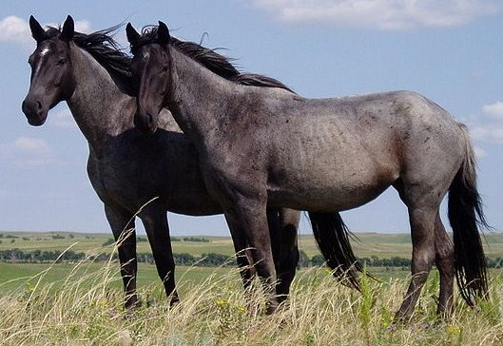
Equus caballus
Scientific classification
Kingdom: | Animalia
Phylum: | Chordata
Class: | Mammalia
Order: | Perissodactyla
Family: | Equidae
Genus: | Equus
Species: | E. ferus
Subspecies: | E. f. caballus

Slide 6
Horse
Habit and habitat: Horses live in herds in open plains and grasslands. Wild Przewalski's horses live in deserts between Mongolia and China.
Horses are domesticated.
One of the fastest running animals.

Slide 7
Commonly called as modern horse. Horses support their entire body weight on the third toe of each foot.
This is excellent adaptation for swift running on the open plains.

Slide 8
Each foot ends in a large hoof.
Metatarsals and tarsals fused.
Hind legs and fore legs well developed and adapted for fast running.

Slide 9
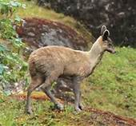
Moschus moschiferous
Scientific classification
Kingdom: | Animalia
Phylum: | Chordata
Class: | Mammalia
Order: | Artiodactyla
Family: | Moschidae
Genus: | Moschus
Species: | M. moschiferus

Slide 10
Habit and habitat :
Elusive, solitary and nocturnal, living very close to water.
Good swimmers.
Prefer to live in high mountain forests and bursh lands.
Shy animals, active mainly at dusk and dawn.

Slide 11
Commonly called as Musk deer.
Fore legs and hind legs well developed.
Even-toed ruminants.
Mature animals contain an abdominal musk gland which secretes a waxy substance, called as Kasturi, used in medicines and perfumes.

Slide 12
Thank you

