Slide 1
Parasitic Adaptation

Slide 2
What is adaptation? adaptation is the biological mechanism by which organisms adjust to new environments or to changes in their current environment.

Slide 3
Living things are adapted to the habitat they live in.
This is because they have special features that help them to survive.
The development of these special features is the result of evolution due to gene mutation. These mutations aid in the survival and reproduction and passes on from one generation to the other.

Slide 4
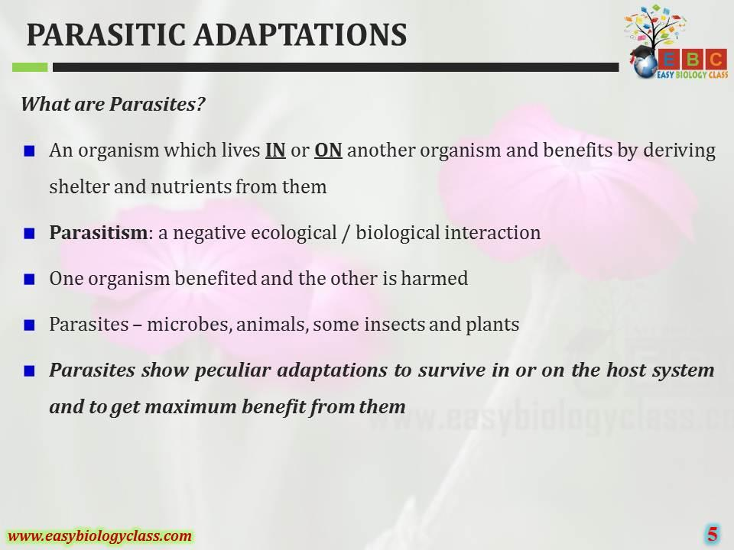

Slide 5
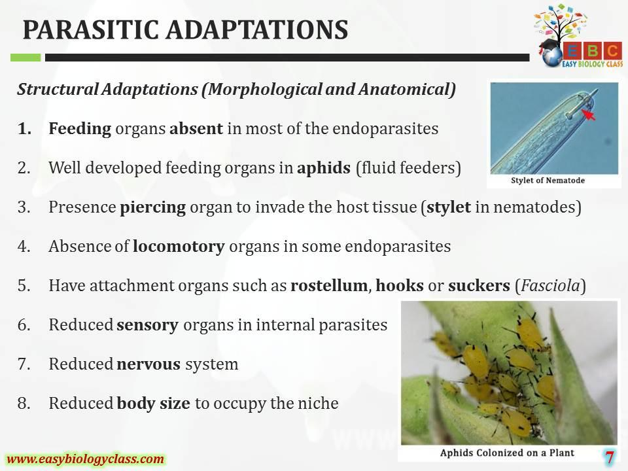

Slide 6
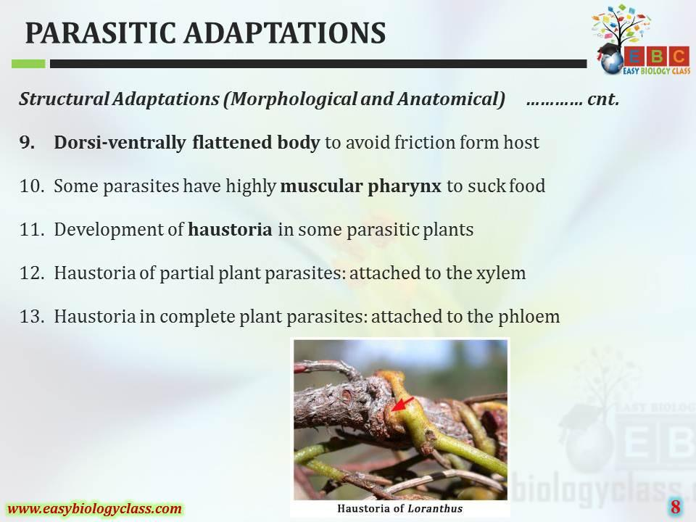

Slide 7
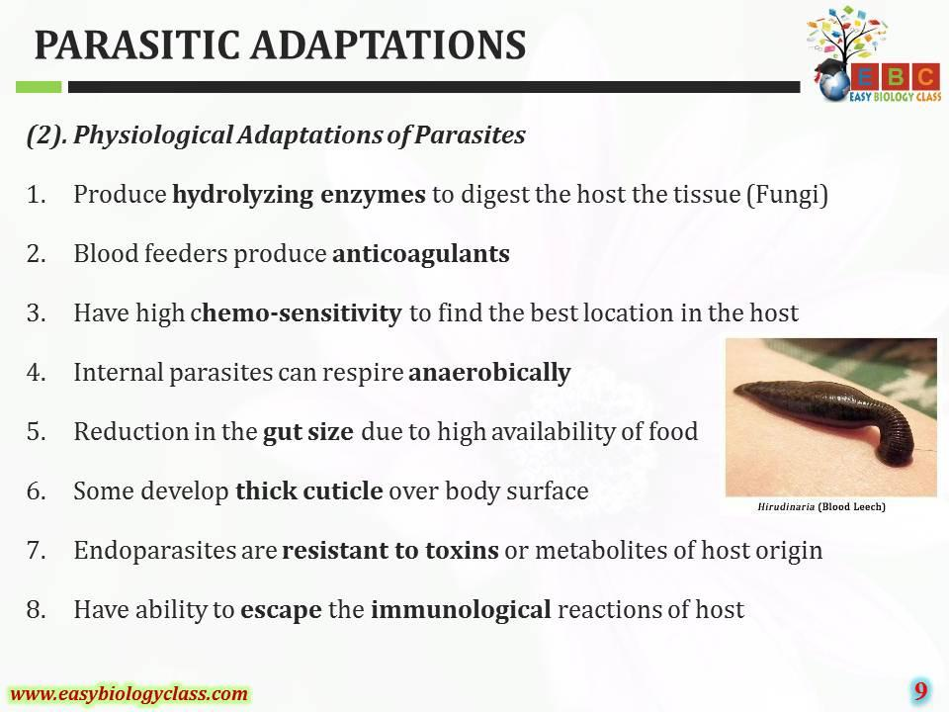

Slide 8
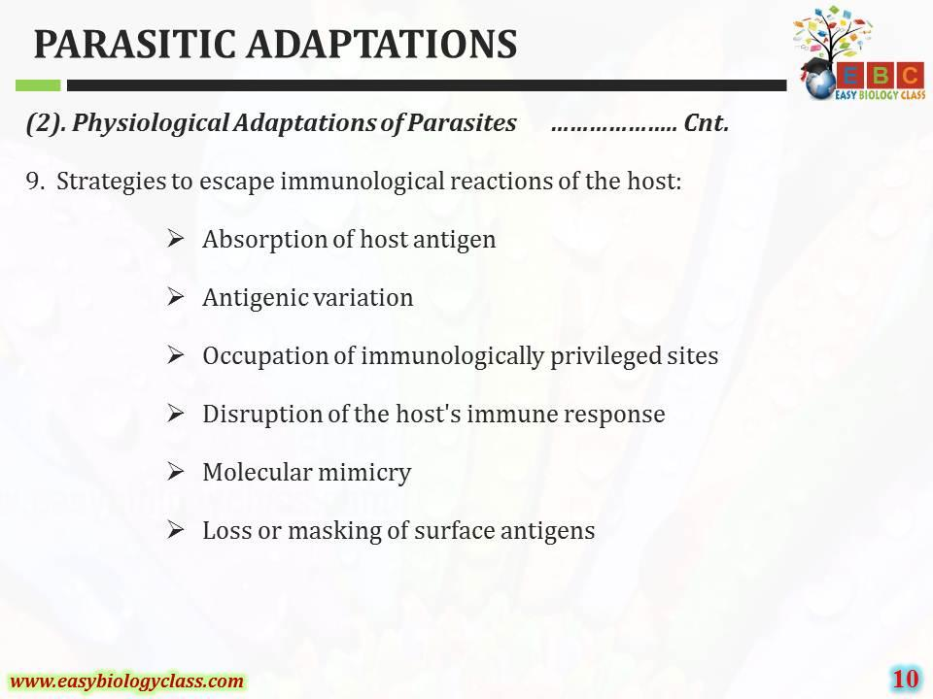

Slide 9
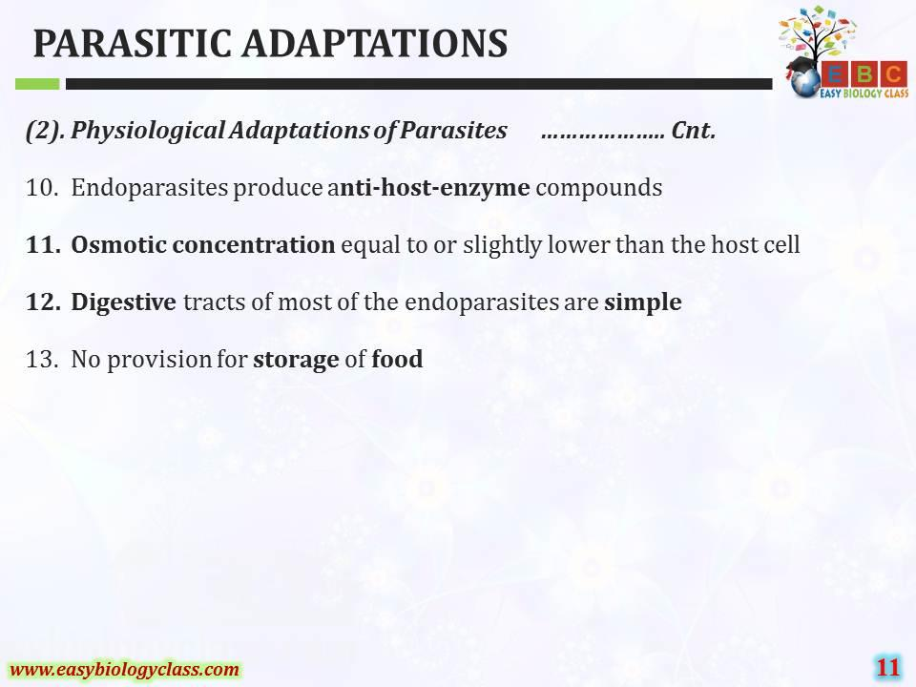

Slide 10
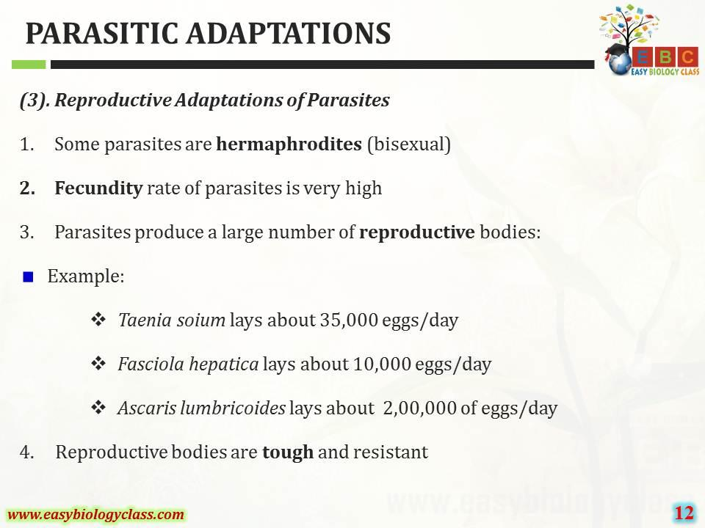

Slide 11
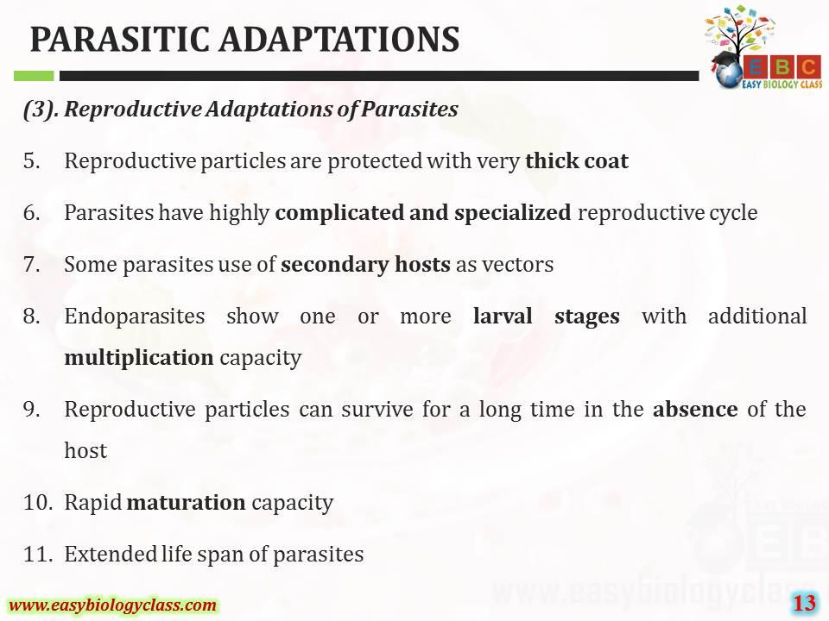

Slide 12
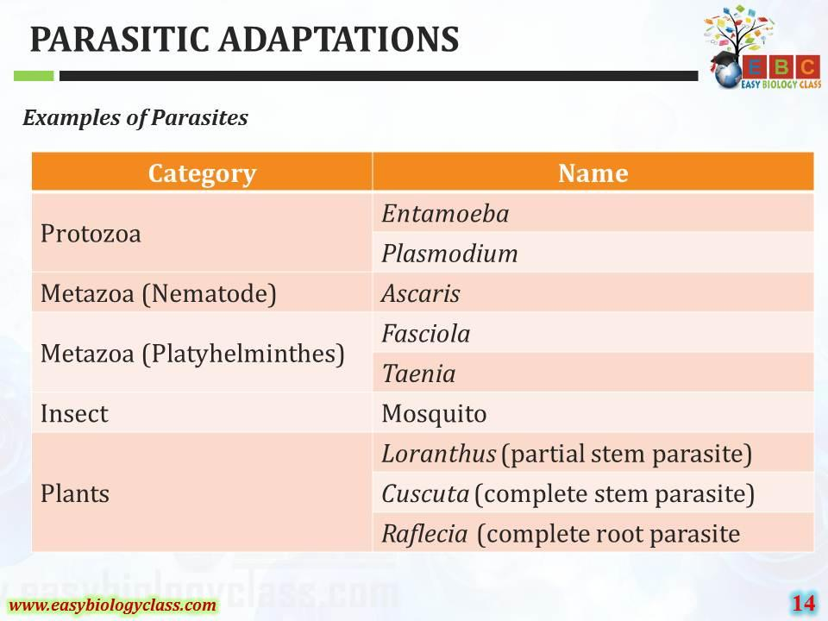

Slide 13
Thank you

