Slide 1
“Examination of Hemoglobin Percentage In Human Blood”
Class- B.Sc. III Year Practical
Time: 03:00-05:00PM
Presented by
Ashok Kumar
Department of Zoology
UCOS,MLSU, Udaipur.

Slide 2
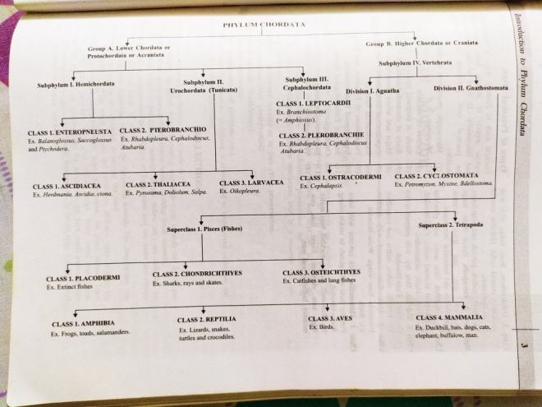
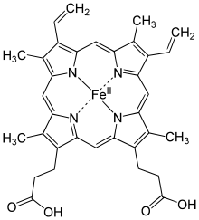
Hemoglobin
J.F. Engelhart (1825) discovered the hemoglobin in several species.
Gilbert confirmed Engelhart in 1925.
The oxygen-carrying property of hemoglobin was discovered by Hünefeld in 1840.
In 1959, Max Perutz and John Kendrew determined the molecular structure of hemoglobin by X-ray crystallography.
The role of hemoglobin in the blood was elucidated by French physiologist Claude Bernard.

Slide 3
Principle:-
Hemoglobin is a coloured pigment, found in the blood and provid red colour to the blood. It play an important role in the transportation of gases. When hemoglobin is treated with acid, it makes hamatin acid of brown or light pink coloured.

Slide 4
Estimation of Hemoglobin Percentage
Requirements- Haemoglobinometer and N/10 HCl, Blood Sample, Cotton, Spirit, Lancet or Needle
Procedure-
Sterilize middle finger tip with cotton soaked spirit
Prick the sterilized finger with a sterilized lancet or needle and discard the 1st drop of blood.
Suck the blood up to 0.2 ml mark in pipette.
Transfer the blood in tube containing small amount of N/10 HCl (experimental tube).
Now add the N/10 HCl drop by drop by comparing the color with adjacent colored tube of instrument (standard tubes).

Slide 5
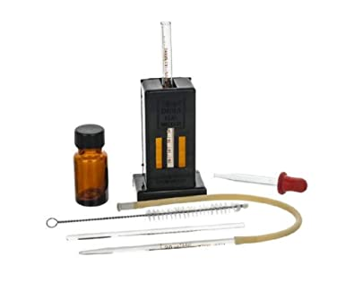
Observation- By continuing addition of N/10 HCl drop by drop we find the end point on which colour of both the coloured instrument tube is similar to experimental tube and now we evaluate % of Hb in given blood sample.

Slide 6
Thank You

