Slide 1



Topic
Drosophila : Life cycle and its culture.
MOHANLAL
SUKHADIYA
UNIVERSITY
UDAIPUR
Department of Zoology
B.Sc.-II-Year
Practical Zoology
By
SAHA DEV JAKHAR

Slide 2
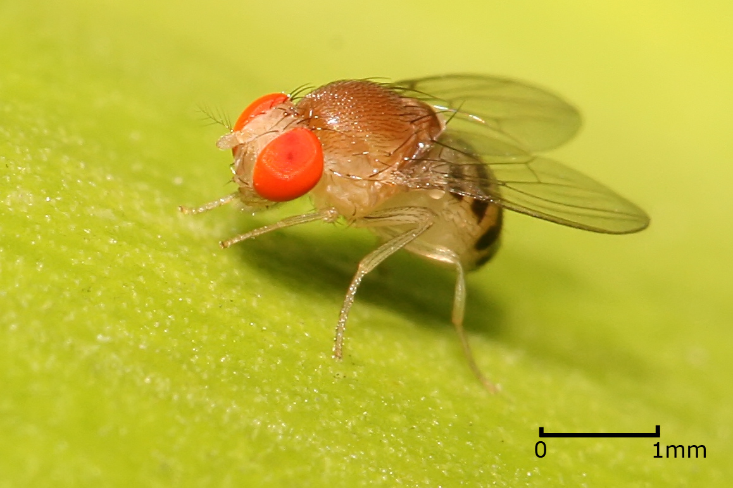

Slide 3
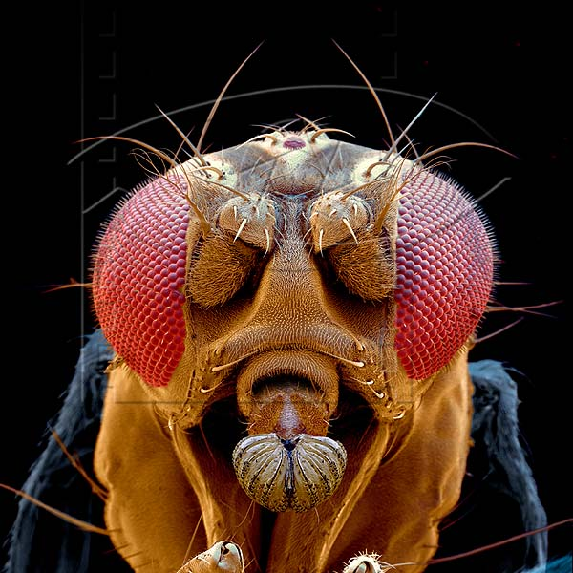

Slide 4
Classification
Kingdom: | Animalia
Phylum: | Arthropoda
Class: | Insecta
Order: | Diptera
Family: | Drosophilidae
Subfamily: | Drosophilinae
Genus: | Drosophila

Slide 5
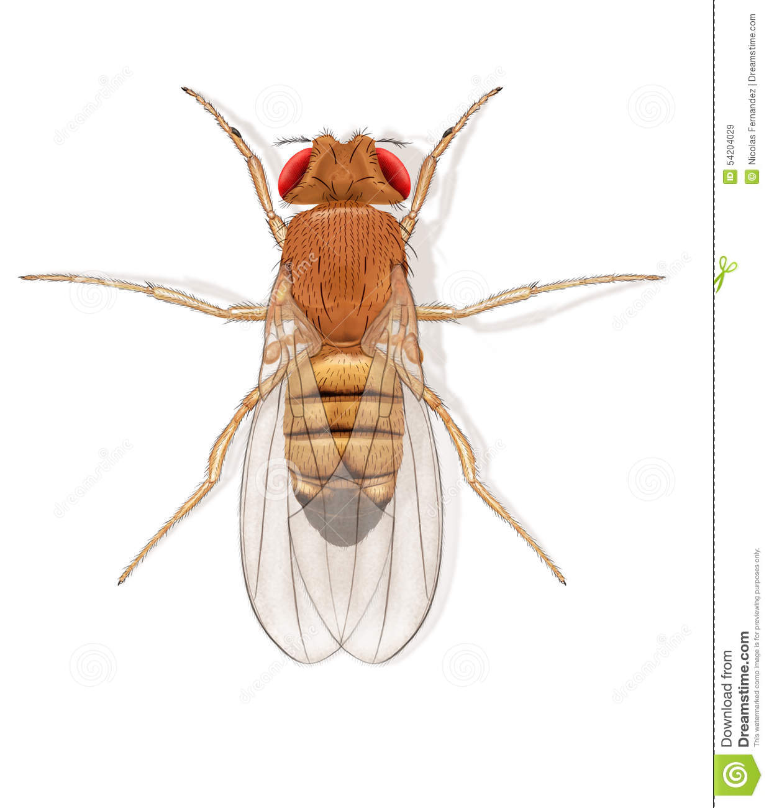
Drosophila melanogaster (fruit fly )

Slide 6
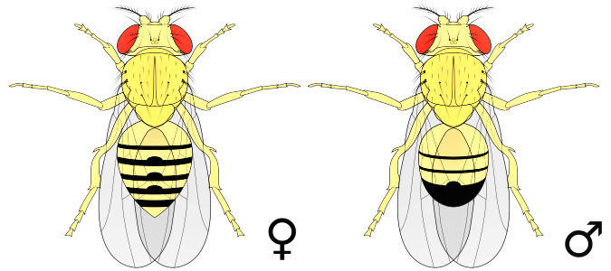
Differentiation Between Female and Male Drosophila
Female large in size
Female have light and pointed abdomen
Have more dark band on abdomen
Male small in size
Male have dark genitalia at the tip of abdomen
Have few dark band on abdomen

Slide 7
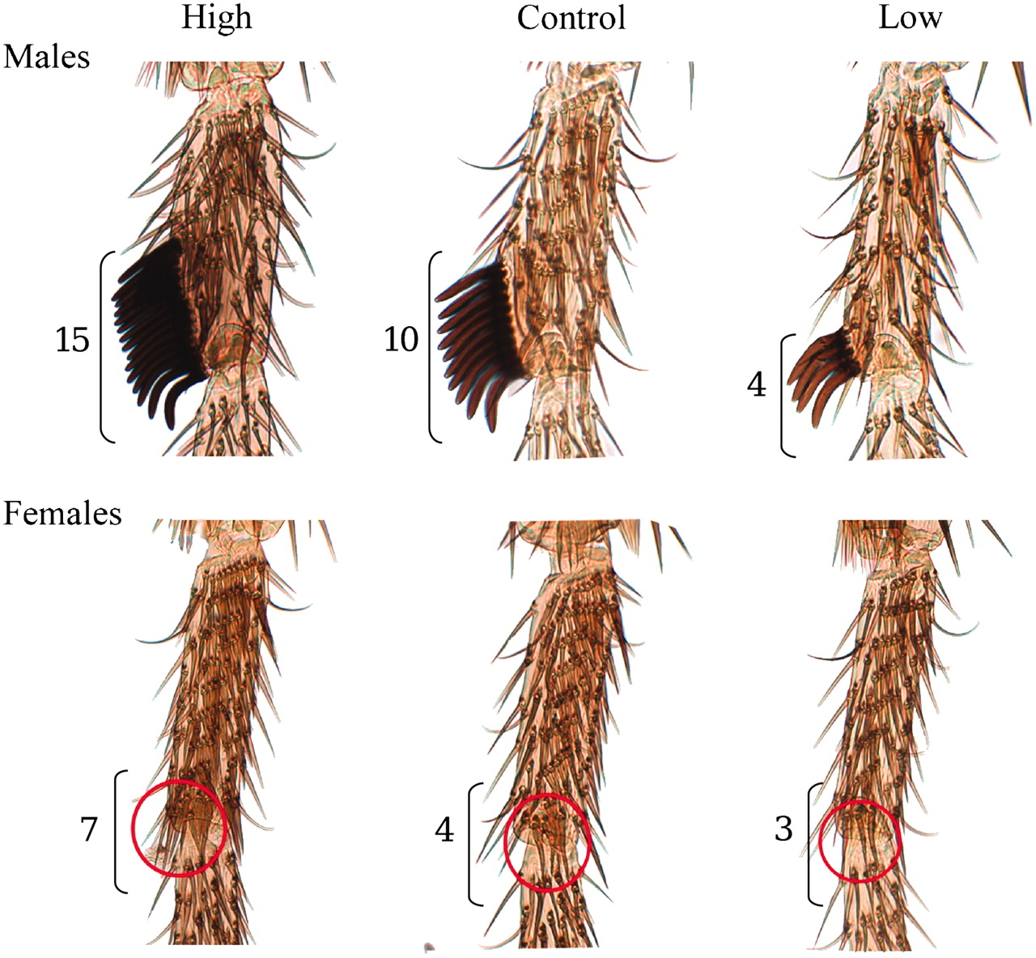
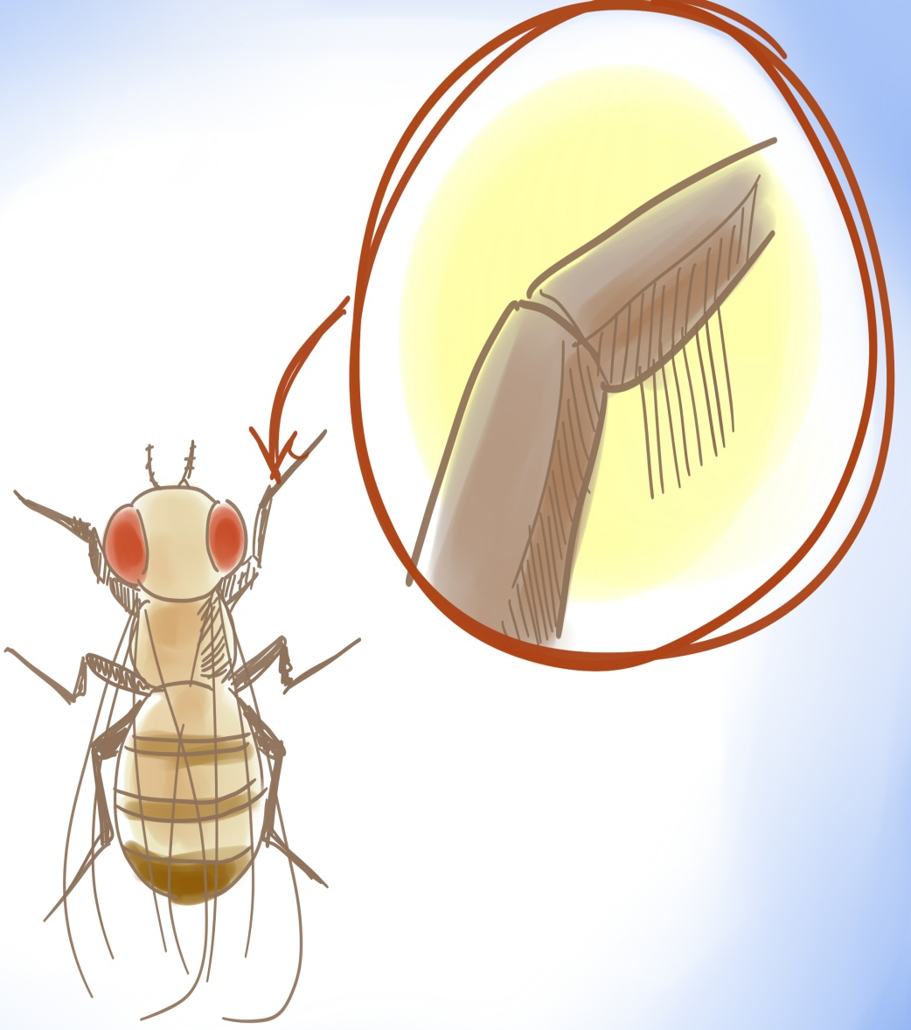
Male fly have SEX COMB on first leg tarsus
Female do not have sex comb

Slide 8
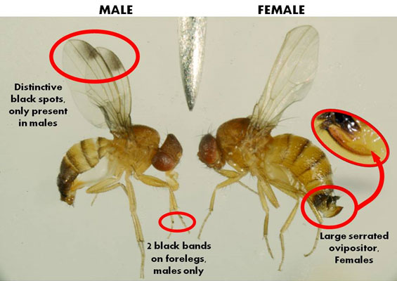
Female do not have black spot on wings

Slide 9
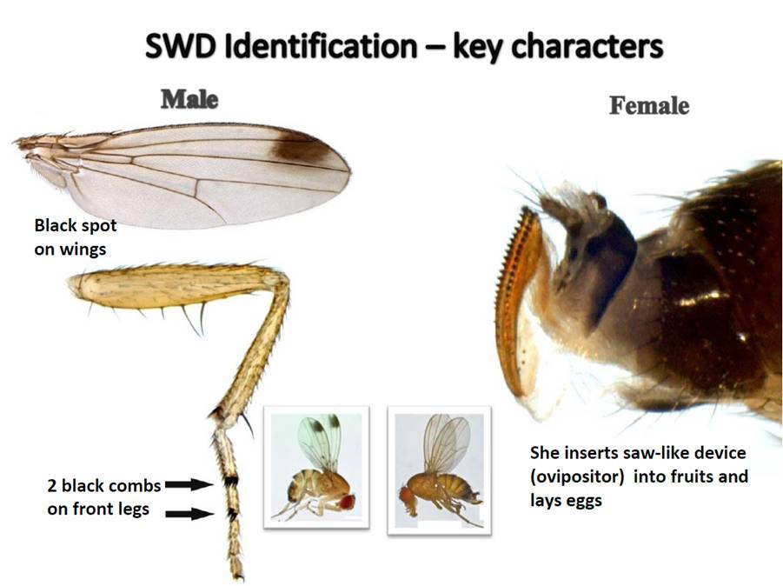

Slide 10
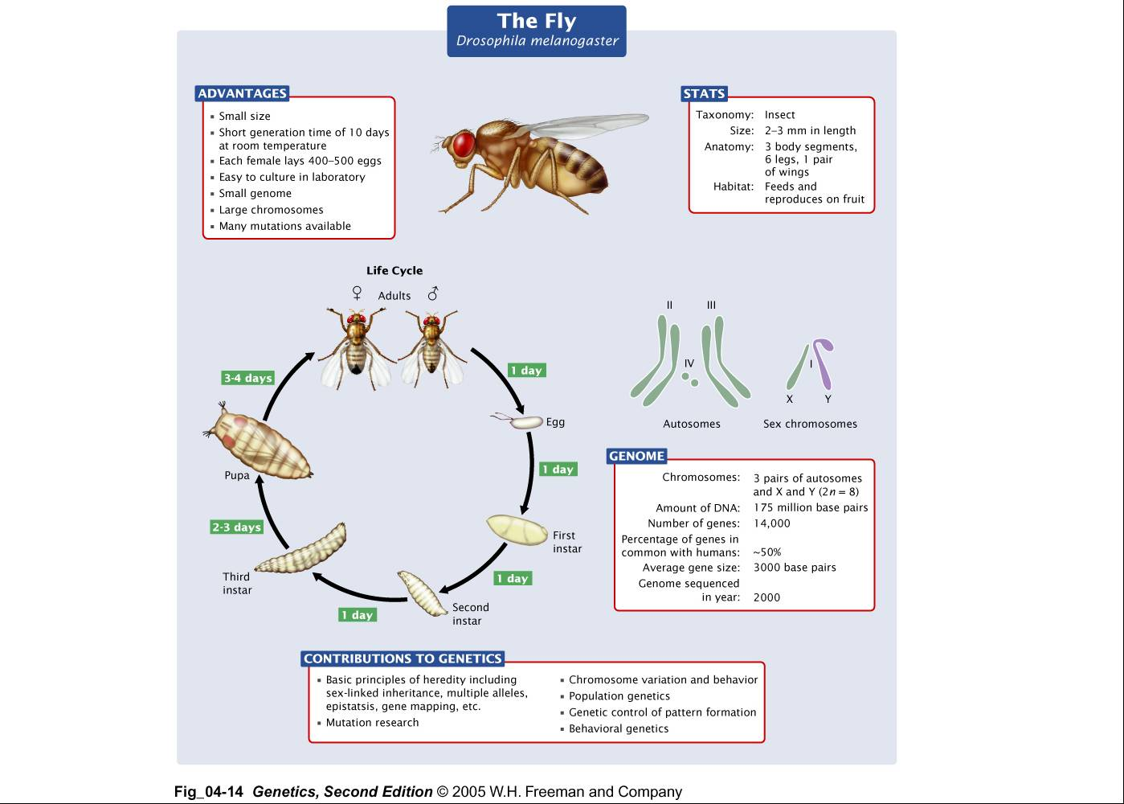
Holometabolous /complete metamorphosis
Egg, larvae ,pupa and adult present
Temperature dependent development (favorable temp.)
50 to 70 egg/ day (400 to 500)
egg covered by chorion
stalks = water wings present on egg which prevent egg from sinking
Micro pile
Tracheal breathing = spiracles
Molting
Jaw hook present
polygamy
About 2 week in favorable temperature (22-25 degree)

Slide 11
Culture medium:
1st CULTURE MEDIA
Add messed ripen fruit (high glucose present in ripen fruit which required for development)+ flatted rice (Poha) + tomato catchup or tomato + one or two pinch of sugar + add water for consistency maintain
Put it in wide mouth bottle
Cover bottle mouth with cotton cloth
Put bottle near washbasin or warmed place
Check after 2nd to 3rd day
Or
2nd CULTURE MEDIA
Add only meshed ripen fruit
Put it in wide mouth bottle
Cover bottle mouth with cotton cloth
Put bottle near washbasin or warmed place

Slide 12
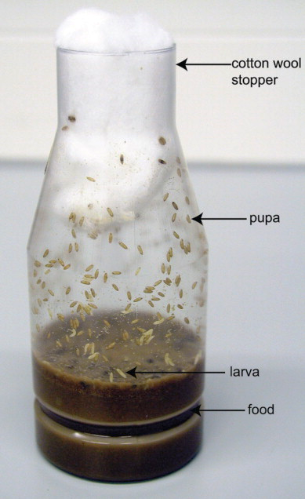
Drosophila Culture

Slide 13
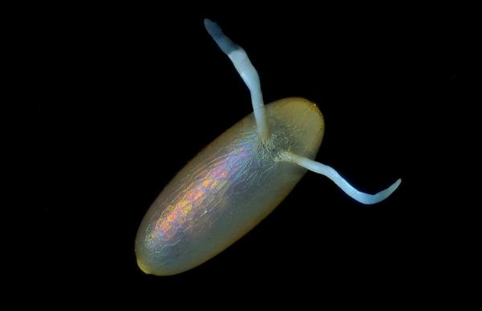
Egg of Drosophila
Stalk Present on Egg Which Prevent from Sinking

Slide 14
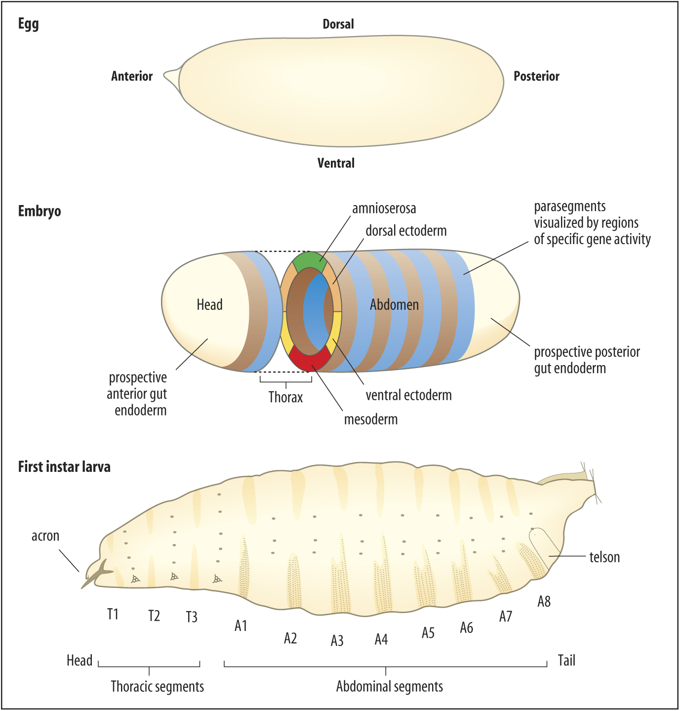

Slide 15
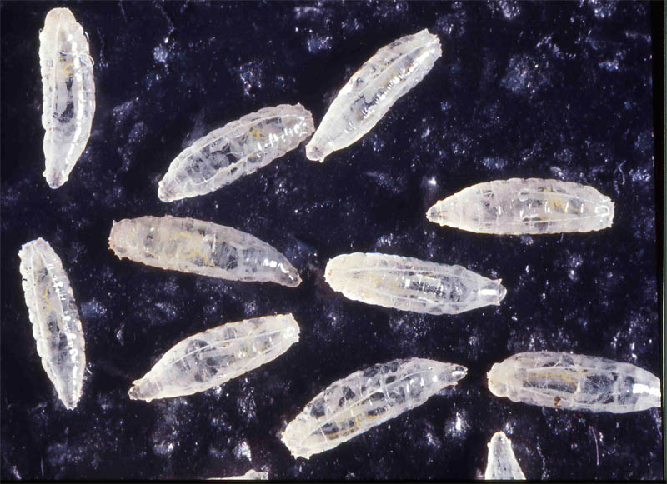
Larvae of Drosophila

Slide 16
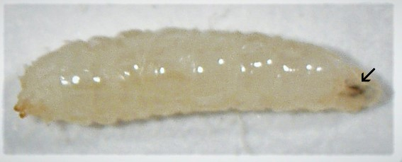
Larva of Drosophila
Light creamy color
voracious Feeder
Pointed portion is anterior region
Wide portion is posterior region

Slide 17
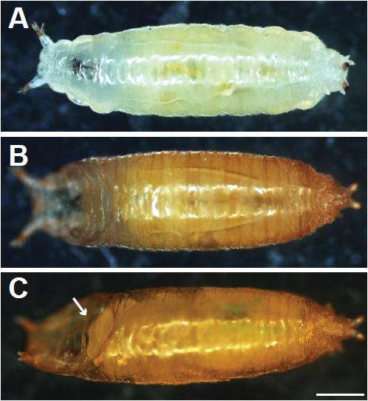
Pupa

Slide 18
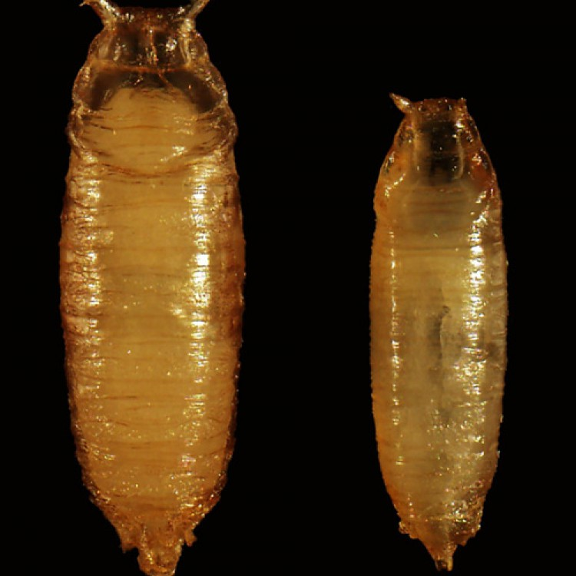
Pupa

Slide 19
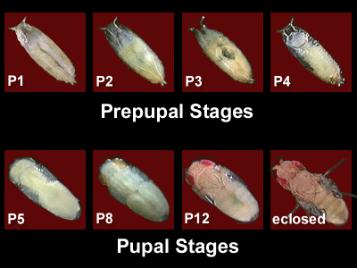

Slide 20
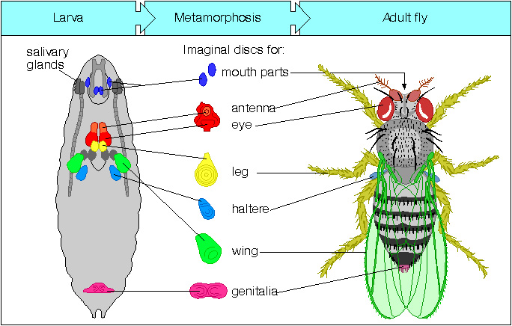

Slide 21
Thank You

