Slide 1
Topic
Drosophila : Different Types of Drosophila Mutant
MOHANLAL
SUKHADIYA
UNIVERSITY
UDAIPUR
Department of Zoology
B.Sc.-II-Year
Practical Zoology
By
SAHA DEV JAKHAR

Slide 2
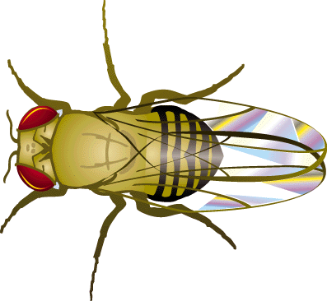
Wild type: normal available in nature

Slide 3
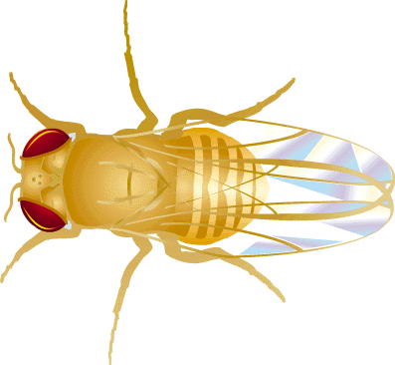
Yellow Type
Location: Sex-linked (X chromosome)
Mutations in the yellow gene produce flies with much paler bodies than wild type flies which look yellowish in color.

Slide 4
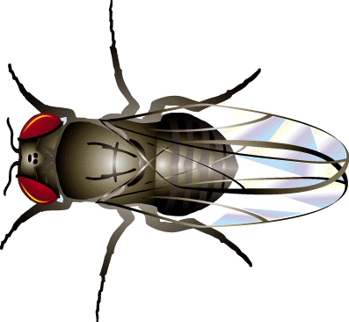
Ebony
Location: Autosomal (chromosome 3R)
A mutation in the ebony gene causes the body color of the flies to be much darker than in the wild type. The dark body phenotype is easily visible upon emergence, but will darken with age.

Slide 5
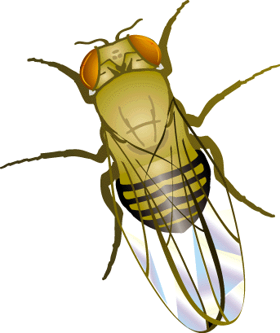
Orange-eye
Location: they have a defect in their "white" gene, which normally produces the red pigments in the eye.
In these flies, the white gene only works partially, producing fewer red pigments than it should.

Slide 6
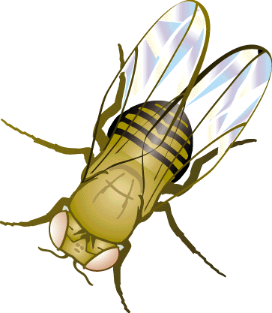
White Eye
Location : Sex-linked (X chromosome)
Mutations in the white gene lead to flies with white eyes instead of the normal wild type red eyes.

Slide 7
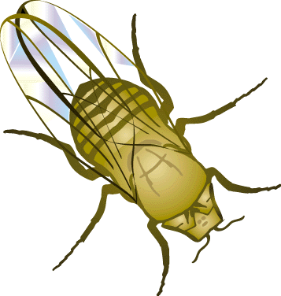
Eyes Absent
Location : Autosomal (chromosome 2L)
Mutations in the eyes absent gene lead to flies with missing eyes - a very easy phenotype to see.

Slide 8
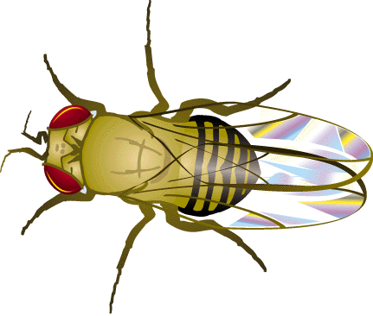
Leg-headed
Location: they have a defect in their "antennapedia" gene (Latin for "antenna-leg"), which normally instructs some body cells to become legs.
In these flies, the antennapedia gene falsely instructs cells that would normally form antenna to become legs instead.

Slide 9
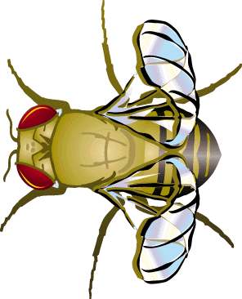
Curly wings
Location: Autosomal (chromosome 2L)
Flies with mutations in the curly gene will have wings that curl upwards and outwards. If kept in 18c, the flies will appear similar to wild type flies. The expression of the curly-winged phenotype will increase with temperature, making this a good trait to demonstrate genetic-environmental interactions.

Slide 10
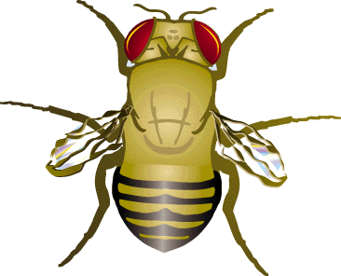
Vestigial Wings
Location: they have a defect in their "vestigial gene," on the second chromosome.
These flies have a recessive mutation. Of the pair of vestigial genes carried by each fly (one from each parent), both have to be altered to produce the abnormal wing shape. If only one is mutated, the healthy version can override the defect.

Slide 11
Thank You

