Slide 1



Topic
Honey bee : mouth parts and sting apparatus (Hymenoptera)
MOHANLAL
SUKHADIYA
UNIVERSITY
UDAIPUR
Department of Zoology
B.Sc.-II-Year
Practical Zoology
By
SAHA DEV JAKHAR

Slide 2
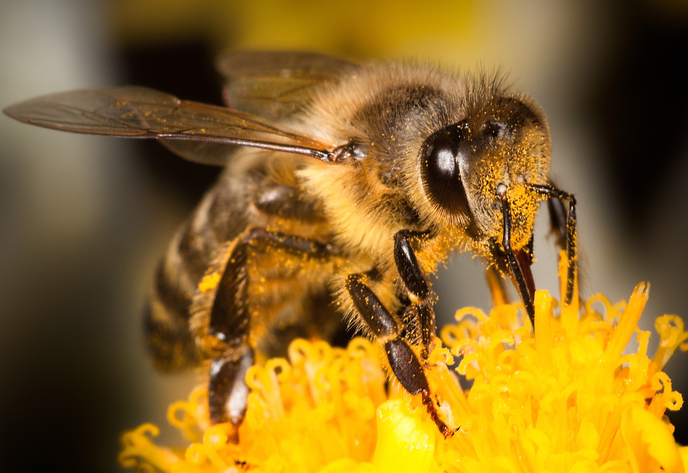

Slide 3
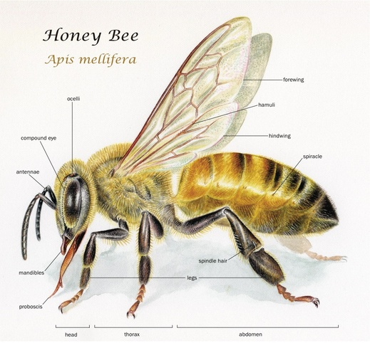

Slide 4
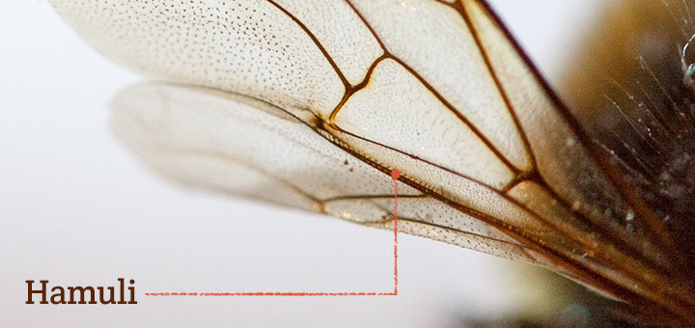

Slide 5
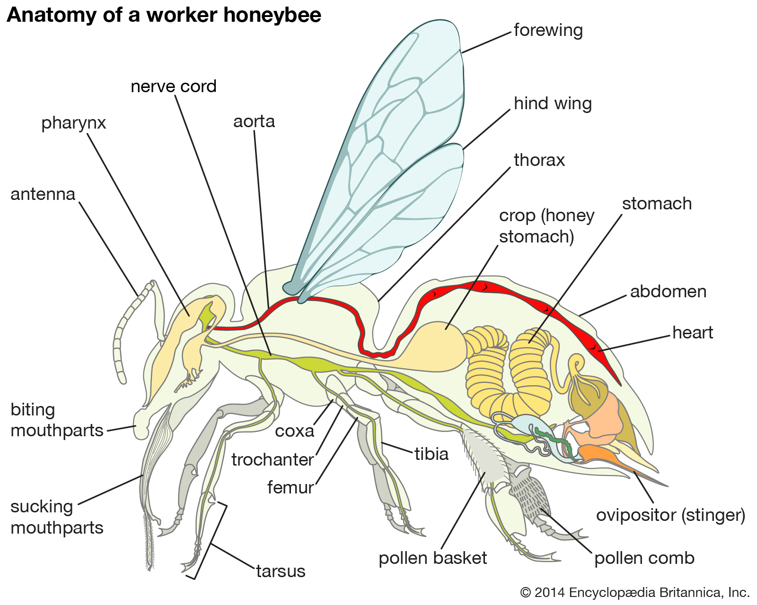

Slide 6
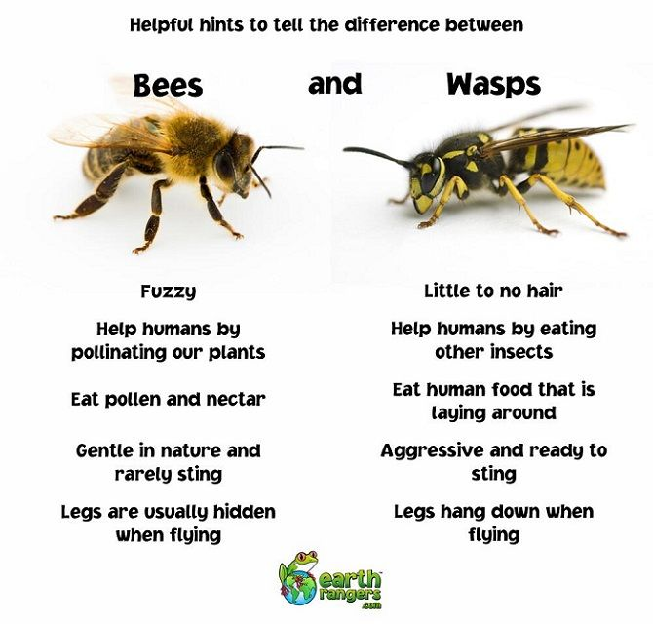

Slide 8
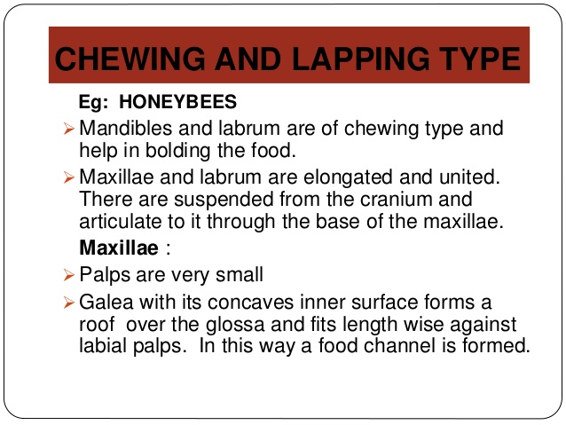

Slide 9
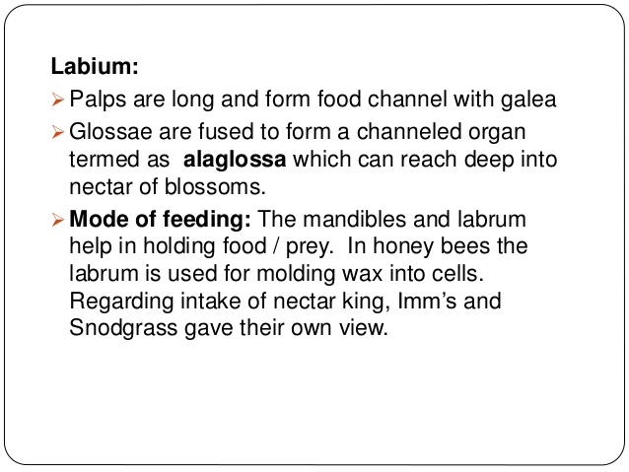

Slide 10
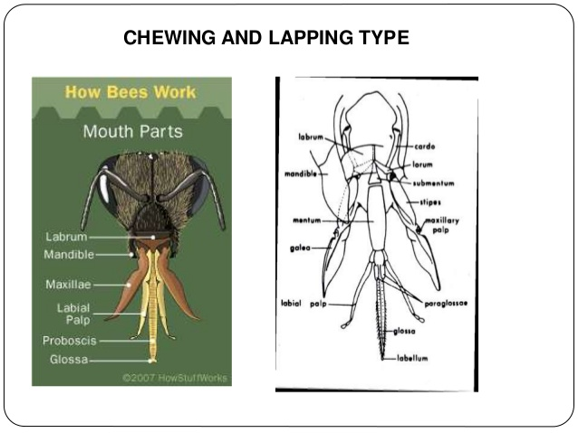

Slide 11
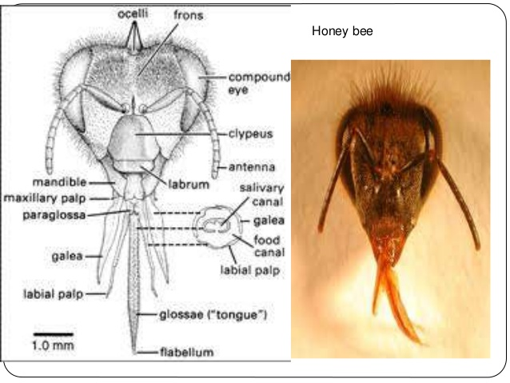

Slide 12
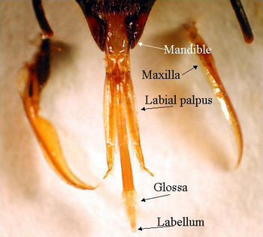

Slide 13
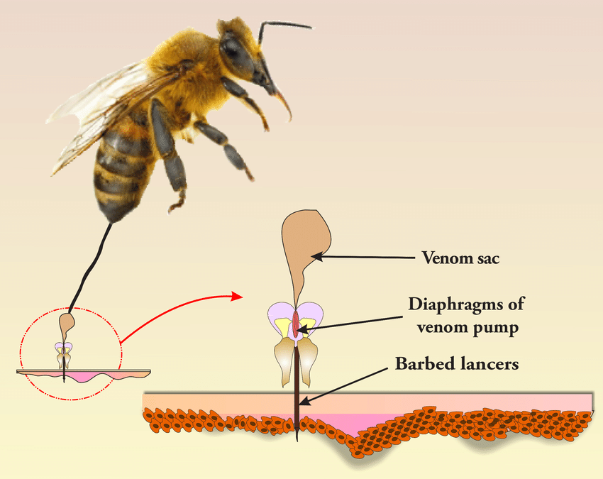

Slide 14
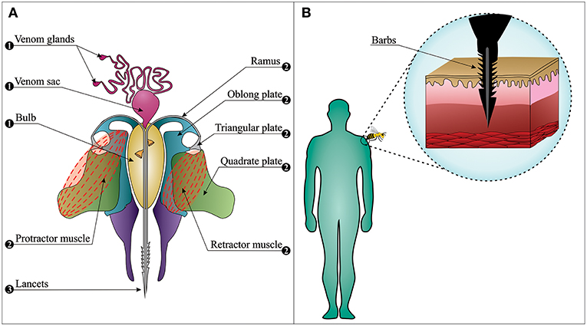

Slide 15
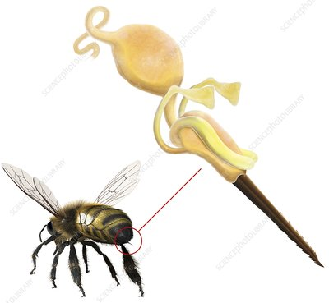

Slide 16
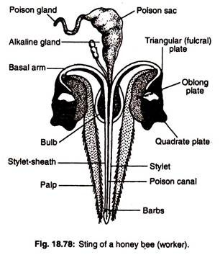

Slide 17
Separate organ or tissue Put it in 30% alcohol (for 5-10 min) Transfer it into 50%
Them after in 70%
If you required stain then put it 1-2 min in stain
Acid alcohol if required
DPX Xylene In 100% (absolute) alcohol Transfer to 90% alcohol
Slide Mounting Procedure

Slide 18
Thank You

