Slide 1


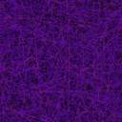
Topic
GRAM STAINING OF MICROBES
MOHANLAL
SUKHADIYA
UNIVERSITY
UDAIPUR
Department of Zoology
B.Sc.-II-Year
Practical Zoology
By
SAHA DEV JAKHAR

Slide 2
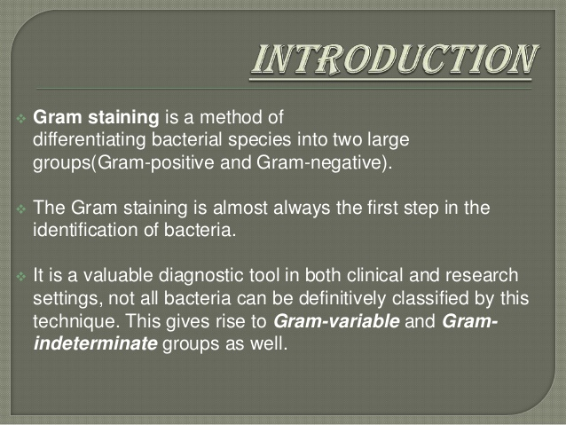

Slide 3
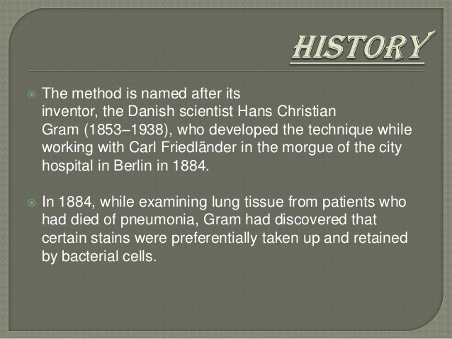

Slide 4
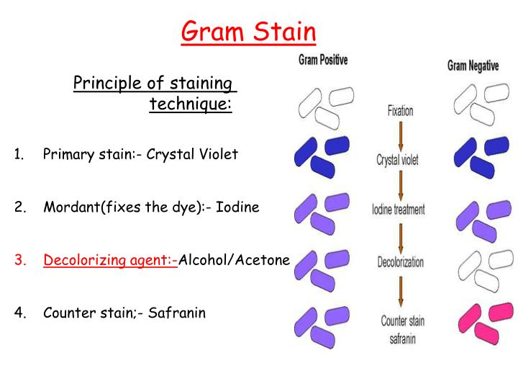

Slide 5
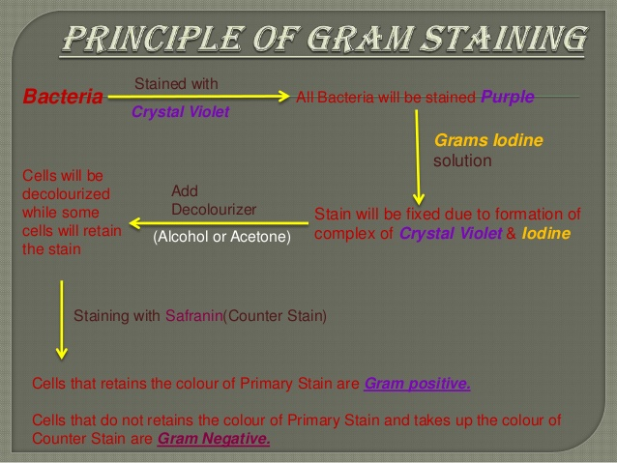

Slide 6
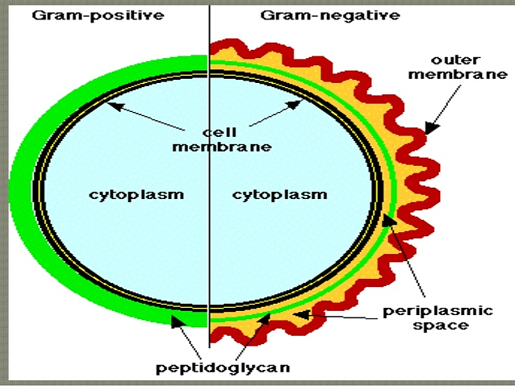

Slide 7
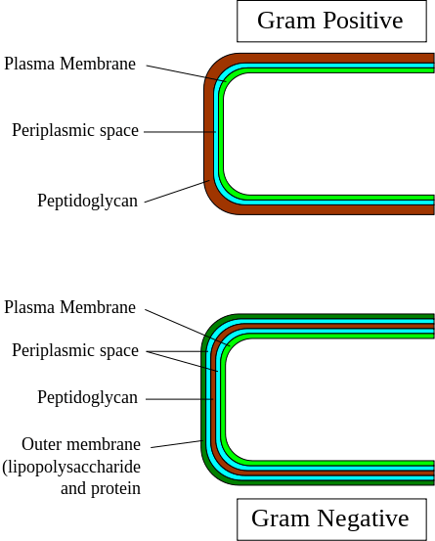

Slide 8
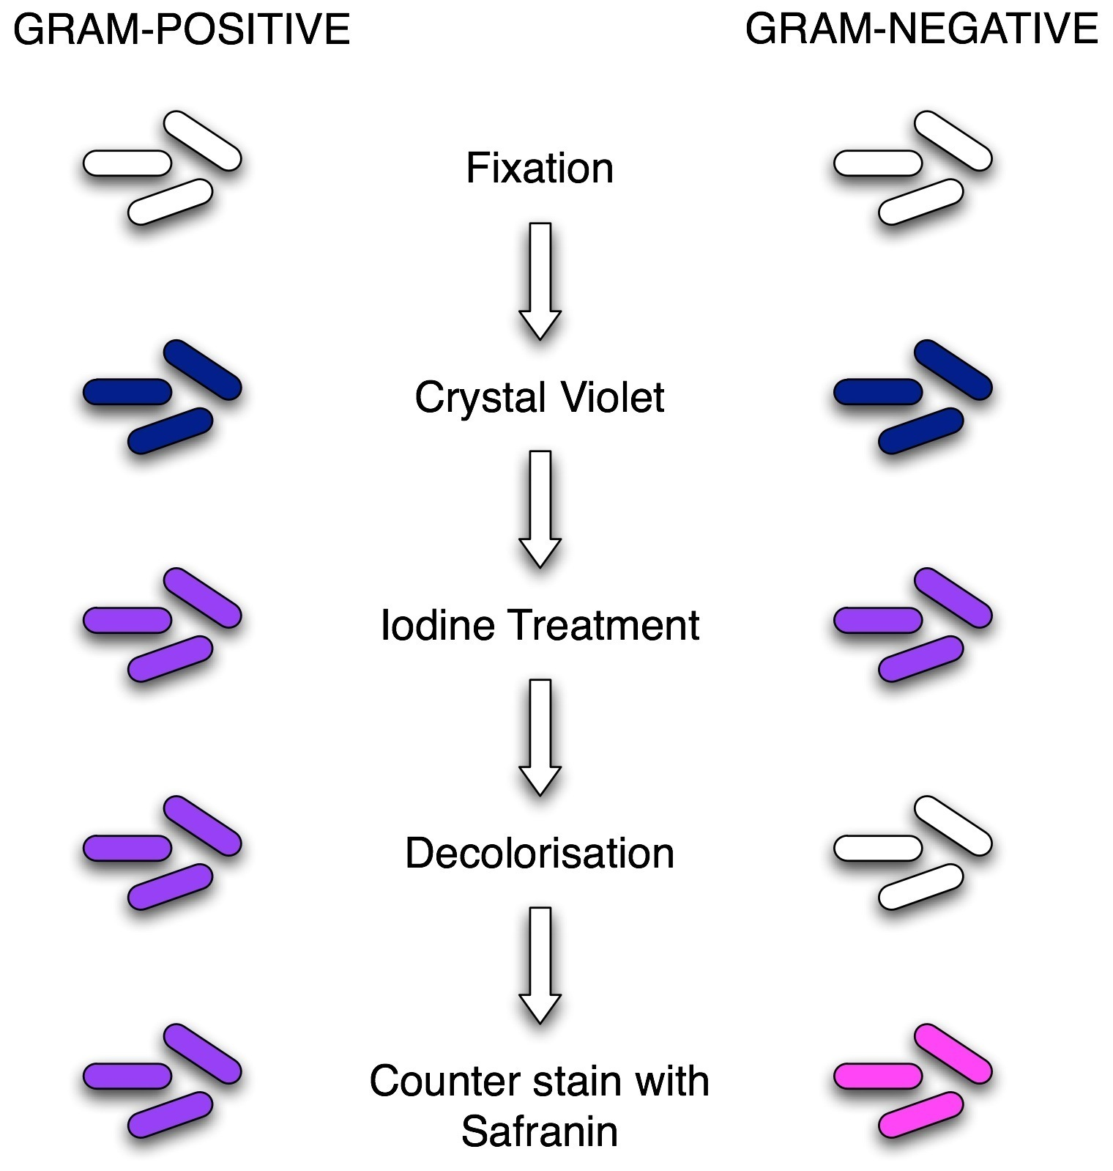
Thin layer
About 1 min.
About 1 min.
About 10 sec.
About 30 sec.-1 min.

Slide 9
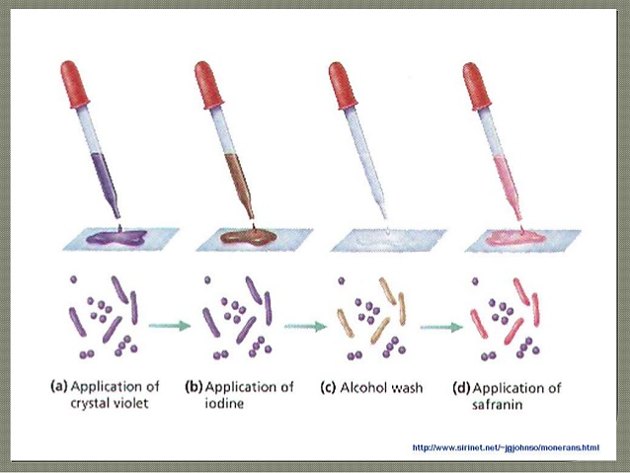

Slide 10
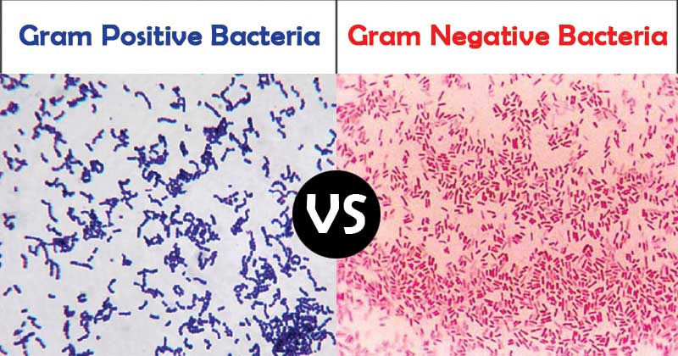

Slide 11
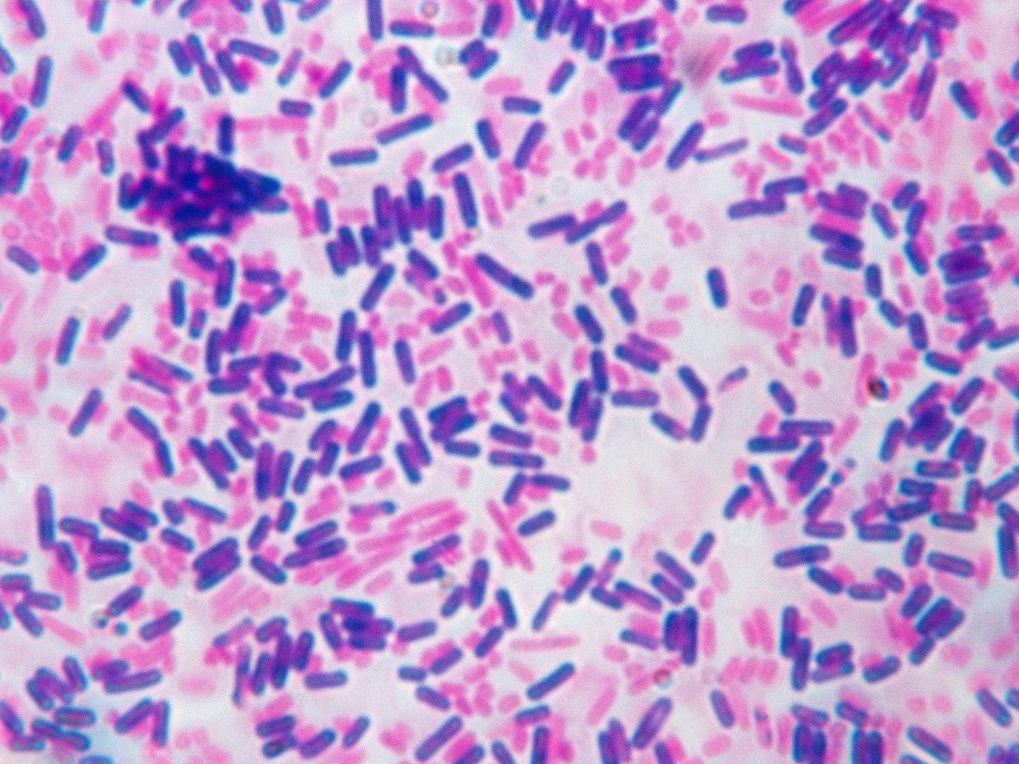

Slide 12
GRAM STAIN PROCEDURE
1. Gently flood the smear with crystal violet and leave for 1 minute. Tilt the slide slightly and gently rinse with tap water or distilled water.
Crystal violet is a water-soluble dye which enters the peptidoglycan layer in the bacterial cell wall.
2. Gently flood the smear with Gram’s iodine and leave for 1 minute. Tilt the slide slightly and gently rinse with tap water or distilled water. The smear will now appear purple.
Gram's iodine solution (iodine and potassium iodide) is added to form a complex with the crystal violet, which is much larger and is insoluble in water.
3. Decolorize the smear using 95 % ethyl alcohol or acetone. Tilt the slide slightly and apply the alcohol drop by drop until the alcohol runs almost clear (5-10 seconds). Immediately rinse with water to avoid over-decolorizing.
Decolorizer dehydrates the peptidoglycan layer, shrinking and tightening it. In Gram positive bacteria, the large crystal violet-iodine complexes are then unable to penetrate and escape the thick peptidoglycan layer, resulting in purple stained cells. However, in Gram negative bacteria, the outer membrane is degraded, the thin peptidoglycan layer is unable to retain the crystal violet-iodine complexes and the color is lost.
4. Gently flood with safranin counterstain and leave for 45 seconds. Tilt the slide slightly and gently rinse with tap water or distilled water.
Safranin is weakly water soluble and will stain bacterial cells a light red, enabling visualization of Gram negative cells without interfering with the observation of the purple of the Gram positive cells.
5. Blot the slide dry on filter paper then view the smear using a light-microscope under oil-immersion.

Slide 13
GRAM POSITIVE VS GRAM NEGATIVE COLOR
Gram positive bacteria
Gram positive bacteria have a distinctive purple appearance when observed under a light microscope following Gram staining. This is due to retention of the purple crystal violet stain in the thick peptidoglycan layer of the cell wall. Examples of Gram positive bacteria include all staphylococci, all streptococci and some listeria species.
Gram negative bacteria
Gram negative bacteria appear a pale reddish color when observed under a light microscope following Gram staining. This is because the structure of their cell wall is unable to retain the crystal violet stain so are colored only by the safranin counterstain. Examples of Gram negative bacteria include enterococci, salmonella species and pseudomonas species.

Slide 14
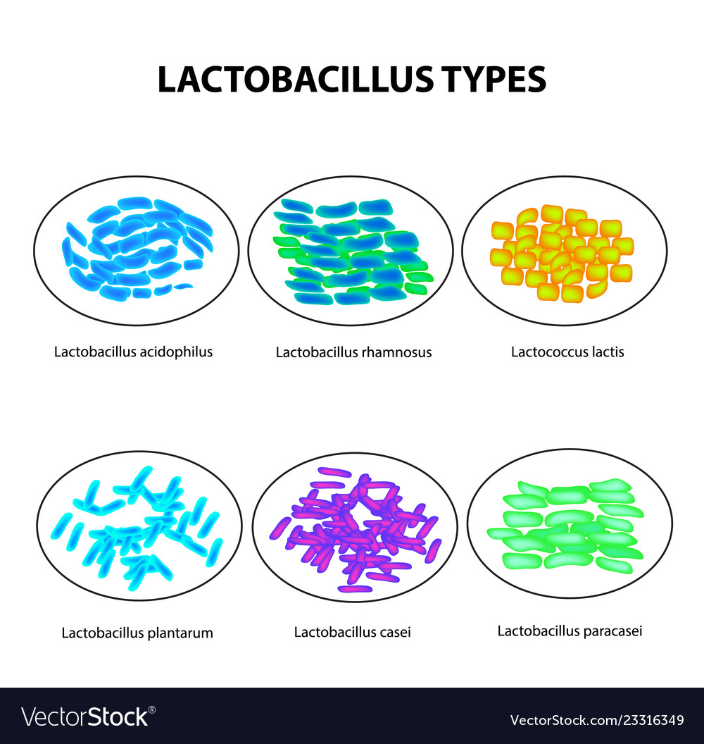

Slide 15
Thank You

