Slide 1
“Enumerate the total RBC count of Blood”
Class- B.Sc. III Year Practical
Presented by
Ashok Kumar
Department of Zoology
UCoS,MLSU, Udaipur.

Slide 2
Principle:-
RBC stands Red Blood Corpules. Rbcs are major cells of blood component, which make a great part of blood. These play an important role in gases exchange in body. The normal ranges of Rbcs: In male- 4.7 to 6.1 million cells/ mcL. In Female- 4.2 to 5.4 million cells/ mcL.
The increased and decreased number of Rbcs gives many interpretations about diseases as well as deficiencies.

Slide 3
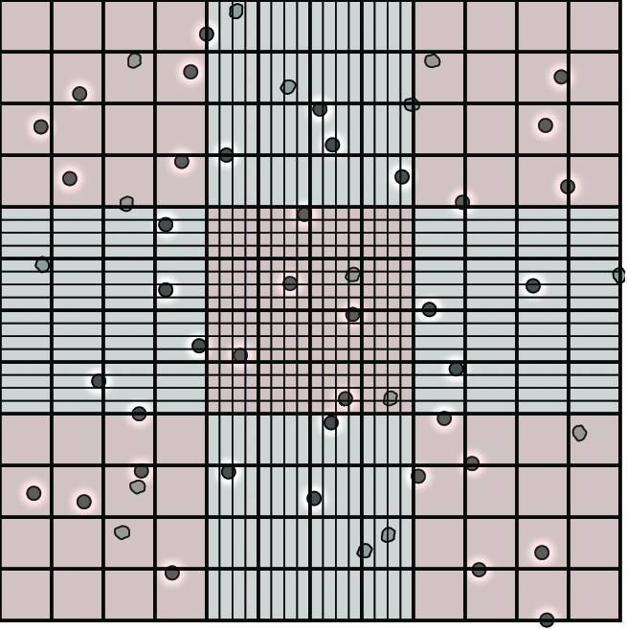
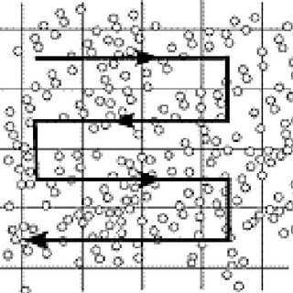
Haemocytometer

Slide 4
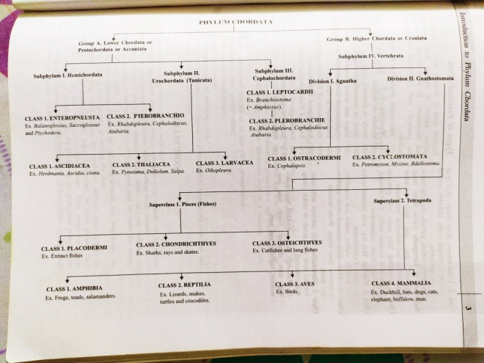
Estimation of RBC
Requirements-Haemocytometer, sterilized pricking needle, Rbc counting Pipette, Compound microscope and Hayem’s diluting fluid (NaCl-1% , Na2SO4-2.5% and HgCl2-2.5%), coverslip etc.
Procedure-
Clean and the mixing pipette.
Sterilized your middle finger and Prick the finger and blood flows freely, Don’t squeeze.
Suck the blood in pipette up to 0.5 ml mark and immediately mix it with Hayem’s diluting fluid by sucking it up to 101 mark.
Bring counting scale into the focus under objective under microscope.
Count cells in 16 squares in five different part of the field.

Slide 5
Calculation- These may be done in the following manner-
No. of RBC per cubic mm- Number of cells counted x Dilution x 400
No. of small squares counted x Depth of chamber
Suppose, five smaller square or 80 smallest contain A+B+C+D+E RBCs
One cubic mm of blood will contain=
A+B+C+D+E x 400 x 10 x 200
80
Or A+B+C+D+E x 10000 RBC.

Slide 6
Thank You

