Slide 1
“Virtual Dissection of Scoliodon Cranial Nerves and Brain”
Class- B.Sc. III Year Practical
Date: 11.09.2020
Time: 03:00 -05:00 PM
Presented by
Manoj Joshi
Department of Zoology
UCOS,MLSU, Udaipur.

Slide 2
Out Line of Practical:
S No. | Exercise | Regular | Ex- Students
1 | Dissection | 18 | 25
2 | Ecology/Ethology | 09 | 12
3 | Physiological and Biochemical | 08 | 08
4 | Spots (1-10) | 20 | 20
5 | Viva-voice | 10 | 10
6 | Record | 10 | -

Slide 3
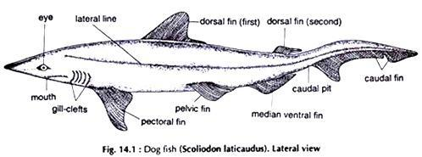
Scoliodon

Slide 4
Scoliodon: Classification
Phylum: Chordata- Dorsal tubular nerve cord, notochord and gills present.
Group: Craniata- Cranium Present
Subphylum: Vertibrata- Vertebral column present
Division: Ganothostomata- Jaws and paired appendage present
Super class: Pisces- Paired fins, gills and skin with scales
Class: Chondrichthyes- Cartilaginous endoskeleton, Scales are placoids,
Sub Class: Selachi- Sharks and rays
Order: Plurotrematra- gill slits lateral
Family: Scyllidae
Genus: Scoliodon (Dog Fish)

Slide 5
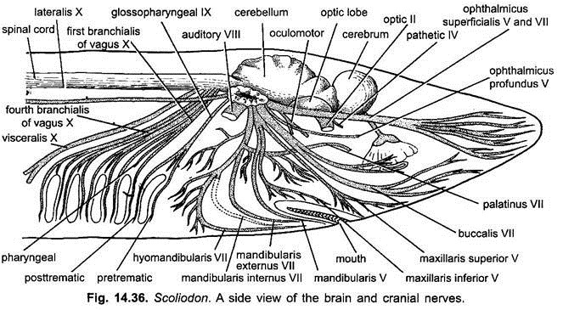
Scoliodon: Cranial Nerves and Brain

Slide 6
S Nr | Name of the Nerve | Origin | Nature | Innervations
1 | Olfactory | Olfactory lobe | Sensory | Nose epithelium
2 | Optic | Optic thalamus | Sensory | Retina
3 | Oculomotor | Ventral surface of mid-brain | Motor | Eye muscles
4 | Pathetic | Dorso-lateral side of mid brain | Motor | Superior oblique of eye
5 | Trigeminal (5 branches) | Side of medulla | Mixed | -
6 | Abducens | Ventral side of medulla | Motor | Posterior and external rectum muscles
7 | Facial (3 branches) | Cranium | - | -
8 | Auditory | Side of Medulla | Sensory | Internal Ear

Slide 7
S Nr | Name of the Nerve | Origin | Nature | Innervations
9 | Glossopharyngeal (2 Branches) | Venrto-lateral Side of medulla | - | -
10. | Vagus (3 Branches) | Side of Medulla | - | -
5. Trigeminal: 5 Branches-
a. Opthatlmicus profundus- olfactory capsule and dorsal skin of snout
b. Opthalmicus superficialis- skin of snout
c. Maxillaris superior – skin of upper jaw
d. Maxillaris inferior- Posterior part of lower jaw
e. Mandibularis- Muscles of lower jow

Slide 8
7. Facial : 3 Branches-
a. Opthalmicus superficialis- sense organs of snout
b. Ramus buccalis- Infera orbital lateral line organ
c. Ramus hyomandibularis- 3 branches
i. Mandibulari externus- Mandibular canal
ii. Mandibulari internus- Mucous membrane of buccal floor
iii. Hyoidean- Roof of buccal and pharyngeal cavity.
9. Glossopharyngeal : 2 Branches-
a. Pre-trematic- mucous membrane of 1st gill
b. Post-trematic- muscles of pharynx
10. Vagus : 3 Branches-
a. Branchialis- gills
b. Visceralis- Visceral oragan
c. Lateralis- Lateral line trunk

Slide 9
Thank You

