Slide 1
“Adaptive Modification of Feet or Claws in Birds”
Class- B.Sc. III Year Practical
Date: 12.09.2020
Time: 03:00-05:00PM
Presented by
Manoj Joshi
Department of Zoology
UCOS,MLSU, Udaipur.

Slide 2
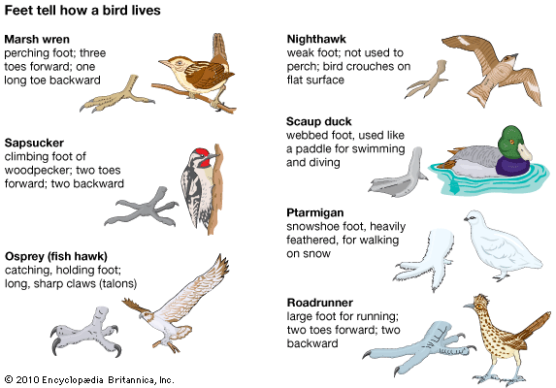
Type of Feet or Claws in Birds

Slide 3
S No. | Type | Example
1 | Cursorial or Running Feet | Ostrich
2 | Perching Feet | Sparrows
3 | Scratching Feet | Fowls
4 | Raptorial Feet | Eagles
5 | Wading Feet | Herons
6 | Swimming Feet | Ducks
7 | Climbing Feet | Parrots
8 | Clinging Feet | Swifts

Slide 4
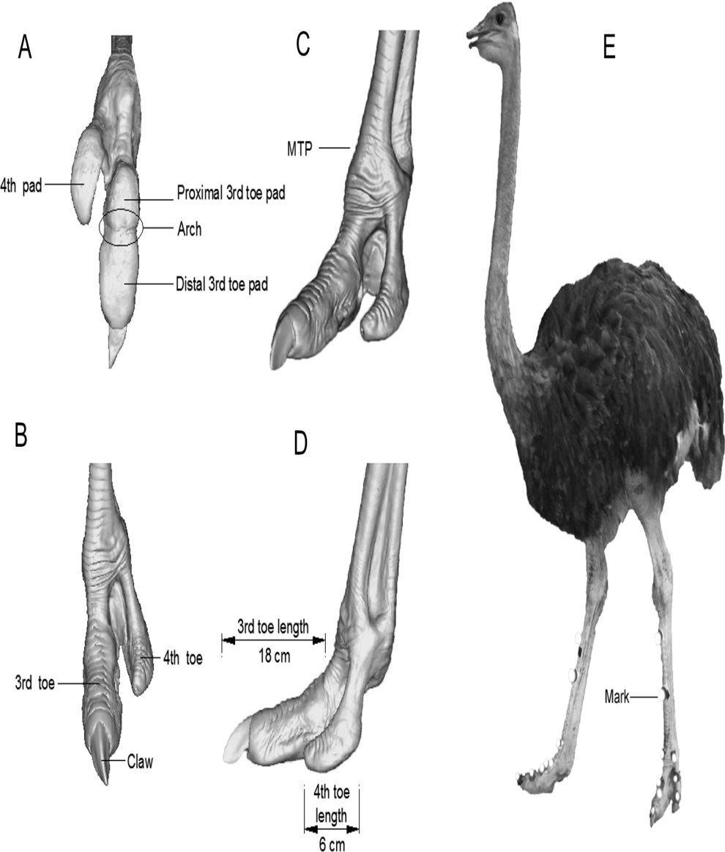
Cursorial Feet
Also known as running feet.
Find in running Birds.
Legs are powerful and number of toe is reduced.
Hind toe may be elevated/ reduced/ absent.
In Ratites like Emu, Rhea only 3 toe directed in forward direction.
Ostrich has only 2 toe of which the outer one is smaller and without nail.

Slide 5
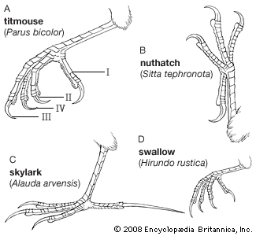
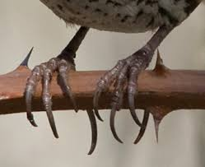
Perching Feet
Majority of birds belong to the category
Find in Perching or finches birds.
Toe are anterior and slender, while one toe or hallux is posterior , strongly built and apposable so that they can securely fasten the foot to a branch or a perch.

Slide 6
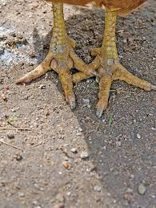
Scratching Feet
Strongly developed claws and well adapted for running as well as scratching the earth
Foot of male bird is usually provided with pointed bony spur of offence and defence.
Ex. Fowls, Quails.

Slide 7
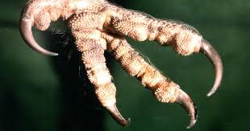
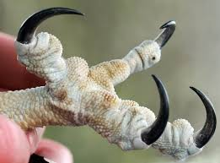
Raptorial Feet
Predatory or Carnivores Birds.
Strongly taloned feet for striking and grasping their prey.
Toes have strongly developed, sharp and curved claws.
Large and fleshy bulbs called Tylari.
Tylori found on undersurface of toes.(Ex. Owl)
Some time tylori absent and spines are present.( Ex. Ospery)

Slide 8
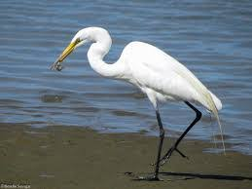
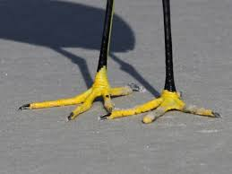
Wading Feet
Wading or Marshy Birds
Legs and toes are exceptionally long and slender.
These serve to walk over aquatic vegetation or marshes
Web is absent or feebly developed.
Ex. Herones, snipes, Jacana.

Slide 9
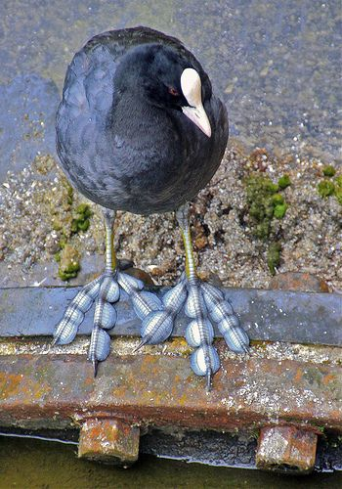
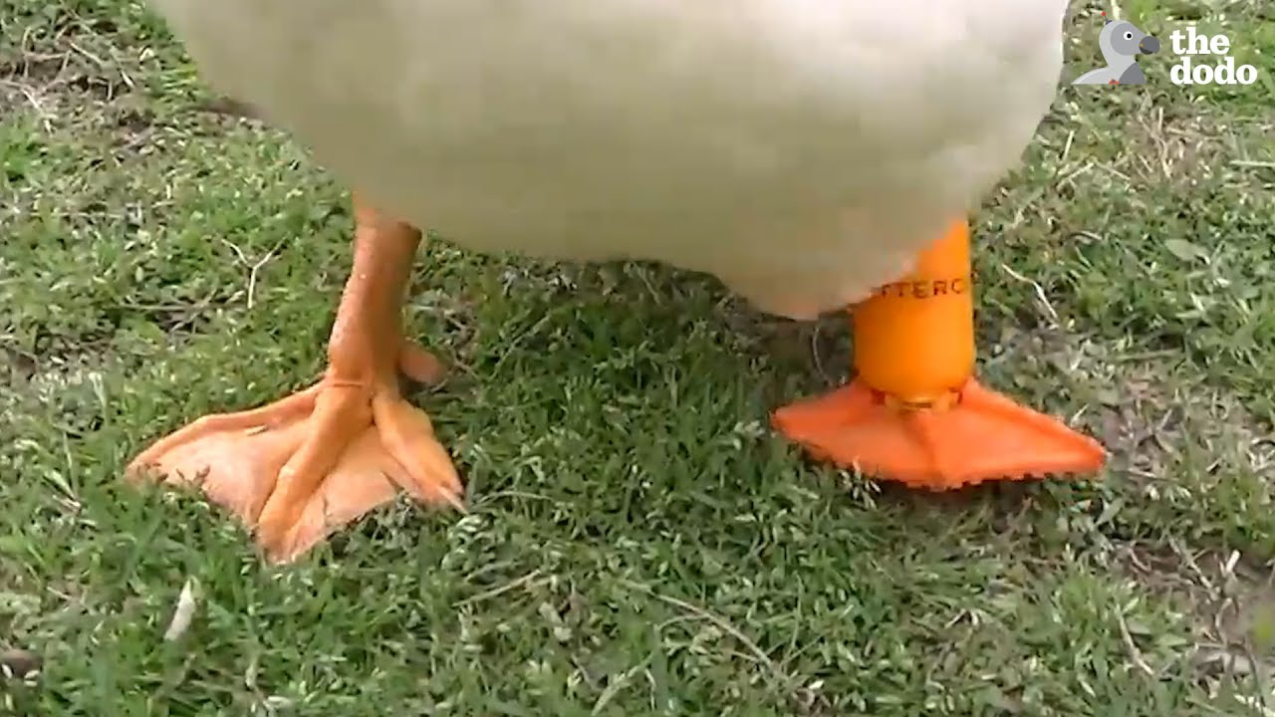
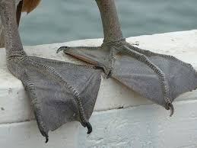
Swimming Feet
Toes are webbed partially or completely.
In diving birds web is lobated and toes are free. (Ex. Coot and grebs)
In swimming and paddling birds only the anterior 3 toes are united in a web.(Ex. Ducks)
In pelican and Cormorant all the 4 toes are enclosed in the web.

Slide 10
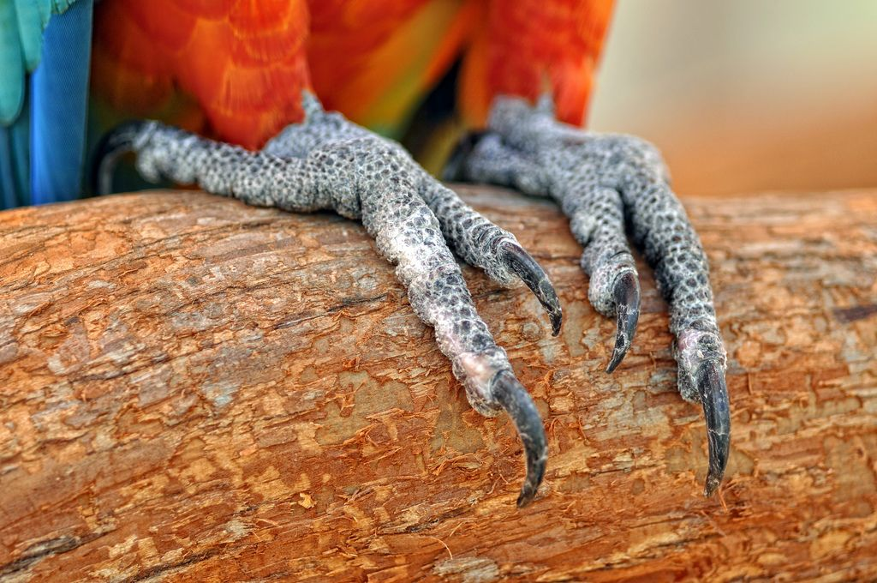
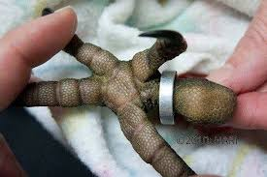
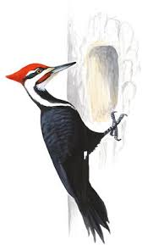
Climbing Feet
Feet are used as grasping organs
Especially adapted for climbing vertical surface.
2nd and 3rd toes point in front, while 1st and 4th toes point in backwards.
Ex. Parrots and Woodpeckers.

Slide 11
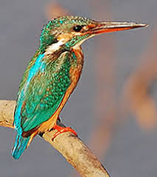
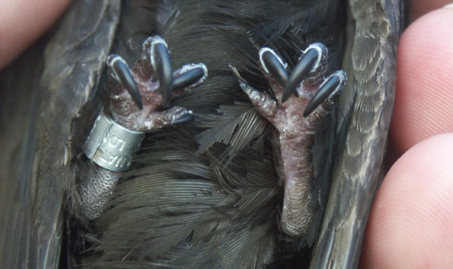
Clinging Feet
All 4 toes point forwarded and serve to cling to steep faces of cliffs or under caves of houses etc.
Ex. Swifts, King fisher.

Slide 12
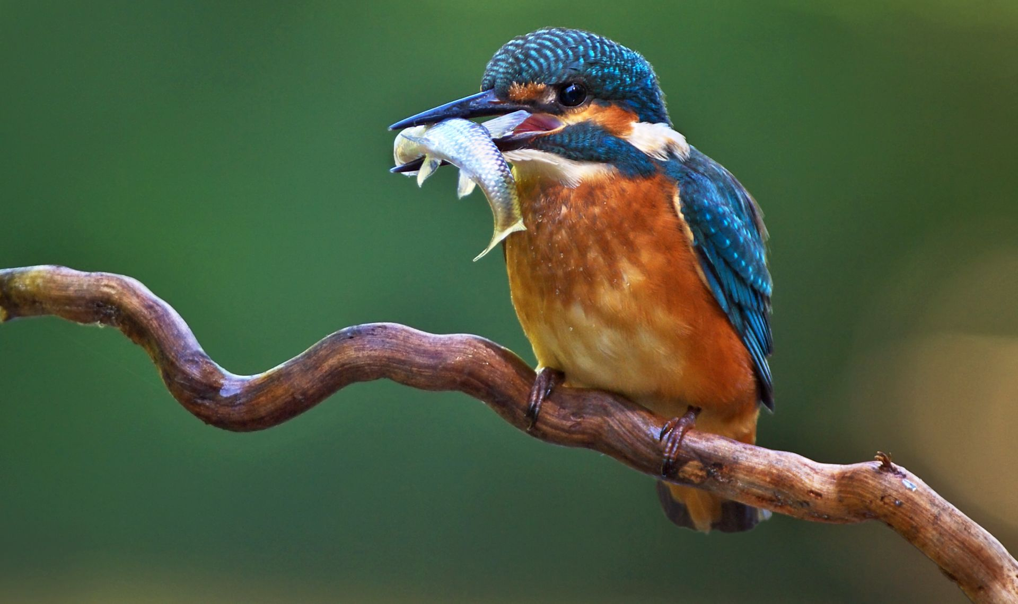
Thank You

