Slide 1
“Adaptive Modification in the beak of Birds”
Class- B.Sc. III Year Practical
Date: 17.09.2020
Time: 03:00-05:00PM
Presented by
Manoj Joshi
Department of Zoology
UCOS,MLSU, Udaipur.

Slide 2
Introduction
Absence of Teeth
Beak or Bill:- The upper and lower jaw bones become elongated to form a peculiar beak or bill covered by horny sheath called as Rhamphotheca.
The modification of fore limbs into wings deprived birds of some of their normal function.
Beak as mouth and hand.
The diversity of form of beak is mainly related to the type of food eaten and to the manner of feeding.
Birds exhibit almost indefinite variation in shape, size and structure of beak.

Slide 3
Type of Beaks in Birds
S. No. | Type | Example
1 | Seed Eating Beak | Sparrow
2 | Cutting Beak | Crow
3 | Fruit Eating Beak | Parrots
4 | Insectivorous Beak | Swallows Robin
5 | Wood Chiseling Beak | Woodpeckers
6 | Tearing and Piercing Beak | Vultures
7 | Mud Probing Beak | Sand Piper

Slide 4
Type of Beaks in Birds
S. No. | Type | Example
8 | Water and mud straining Beak | Ducks
9 | Fish Catching Beak | Kingfishers
10 | Spatulate Beak | Spoonbill
11 | Pouched Beak | Pelicans
12 | Flower Probing Beak | Humming Birds

Slide 5
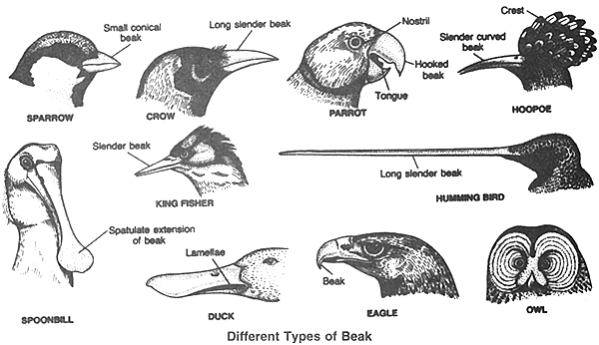
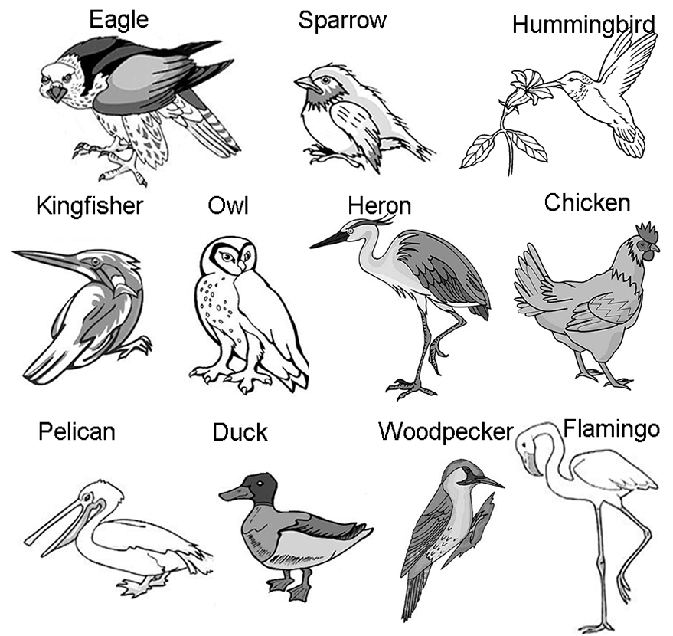
Type of Beaks in Birds

Slide 6
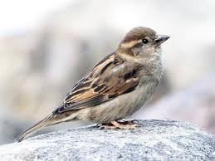
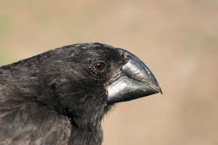
Seed Eating Beak
Short, Stout, Peg like and Conical Beaks
Grainivorous or Seed eating
The weaker beaks are used for Piercing up small seeds
Powerful beaks are meant for curshing large and hard-shelled seeds and fruit stones.
Ex.- Sparrow, Finches and Cardinals.

Slide 7
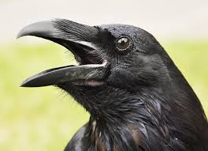
Cutting Beak
Long and Slender beak with cutting edges
Ex.- Crows.

Slide 8
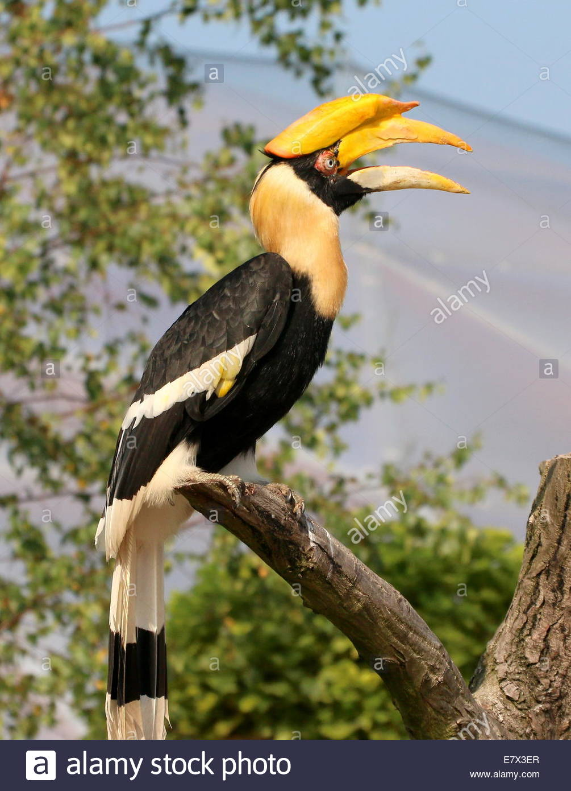
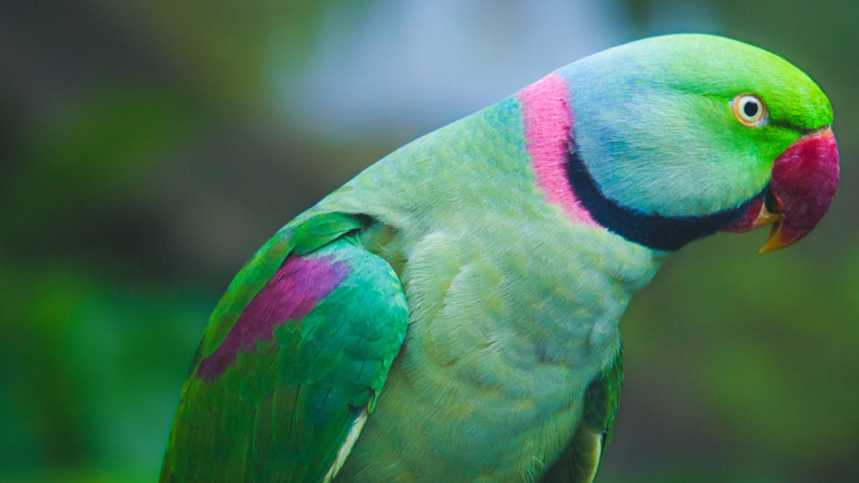
Fruit Eating Beak
Sharp, massive, deeply hooked and extremely strong
Well adapted for gnawing or breaking, open hard seed and nuts.
In Hornbills, enormous beak present looking so heavy and cumbersome, is quite light as its interior is of cellular structure. It is suggested that these cells act as resonator, thus enable the birds to produce its exceptionally loud cry.
Ex. Parrots.

Slide 9
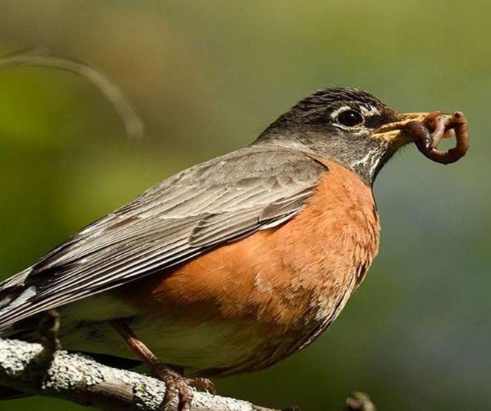
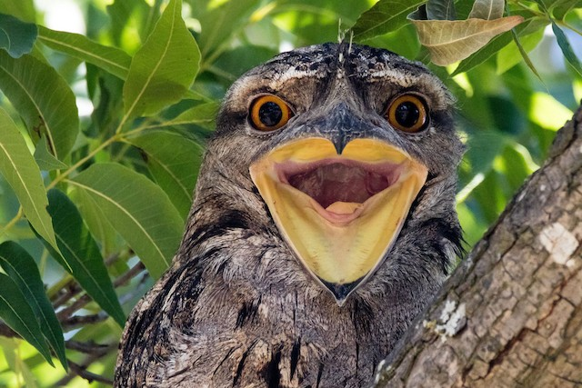
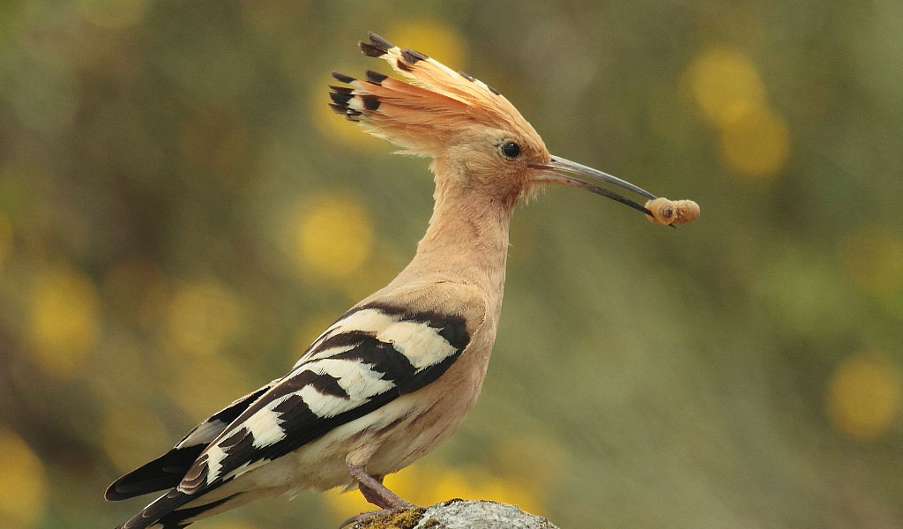
Insectivorous Beak
Small, Wide and delicate to Scoop up their living insect prey.
In fly catchers, the beak is short but strong, with mendilbles notoches at the tip and beset with numerous rictal bristles at the base.
Ex. Swallows Robin, Frog mouth.
In Hoopoe, the beak is long , slender and slightly curved and meant for turning leaves or probing into soil for insect grubs and pupae etc.

Slide 10
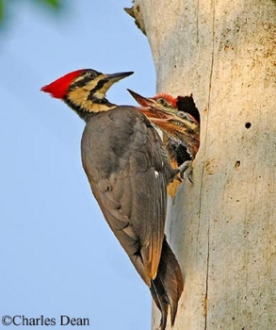
Wood Chiseling Beak
Elongated, straight and stout, Chisel like beak for drilling into barks or wood for insect/larvae or for nest constructions.
Having thickened, shock- absorbent skull bones, strong neck muscles to make such pounding feasible.
Ex. Woodpeckers.

Slide 11
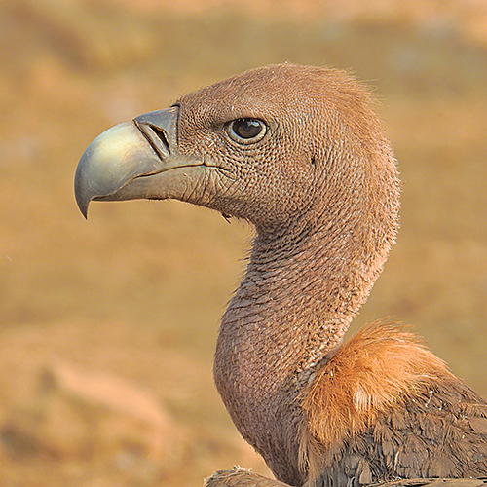
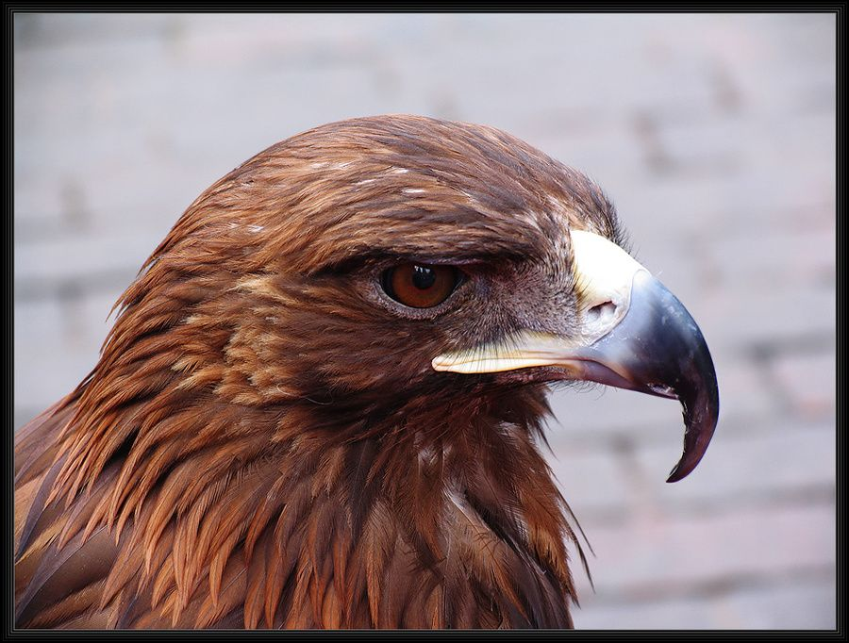
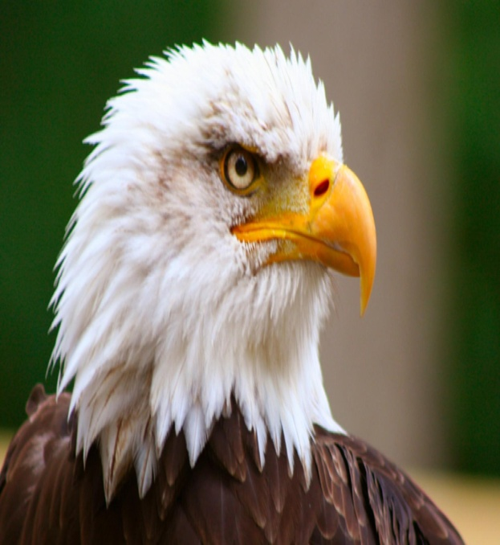
Tearing and piercing Beak
Short Pointed, Sharp Edged and powerful, hooked beaks for tearing flesh and opening by well developed mandibular muscles.
Ex. Carrion feeding and flesh eating birds like Vultures, Hawks and Eagles.

Slide 12
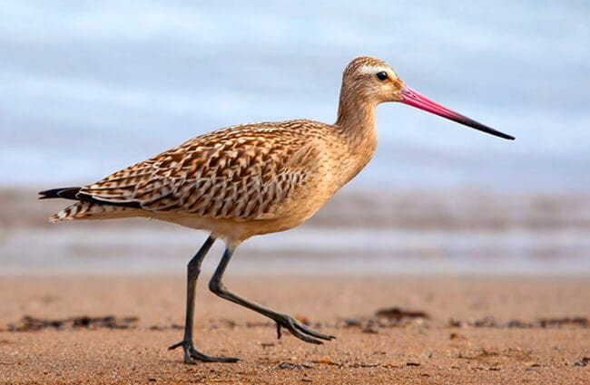
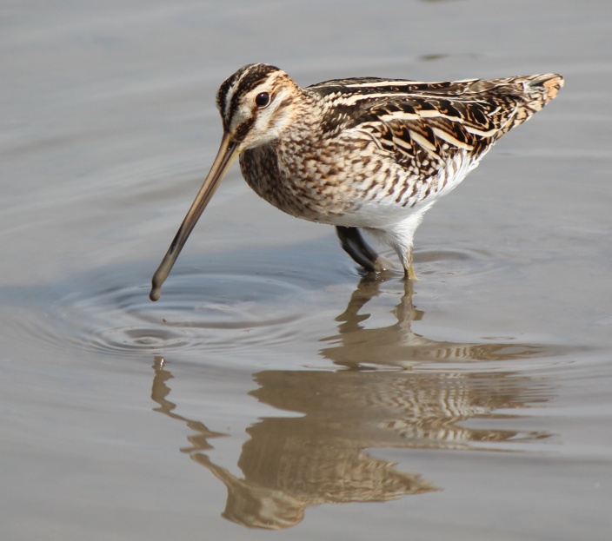
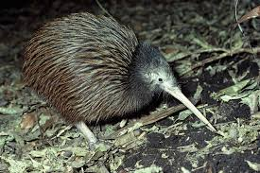
Mud Probling Beak
Extremely long and slender
Used as a probe for thrusting for down into water and mud in search of worms and larvae.
Some of these birds are remarkable for the slenderness and extreme length their beaks.
Ex.- Sand piper, Snipe Kiwi.

Slide 13
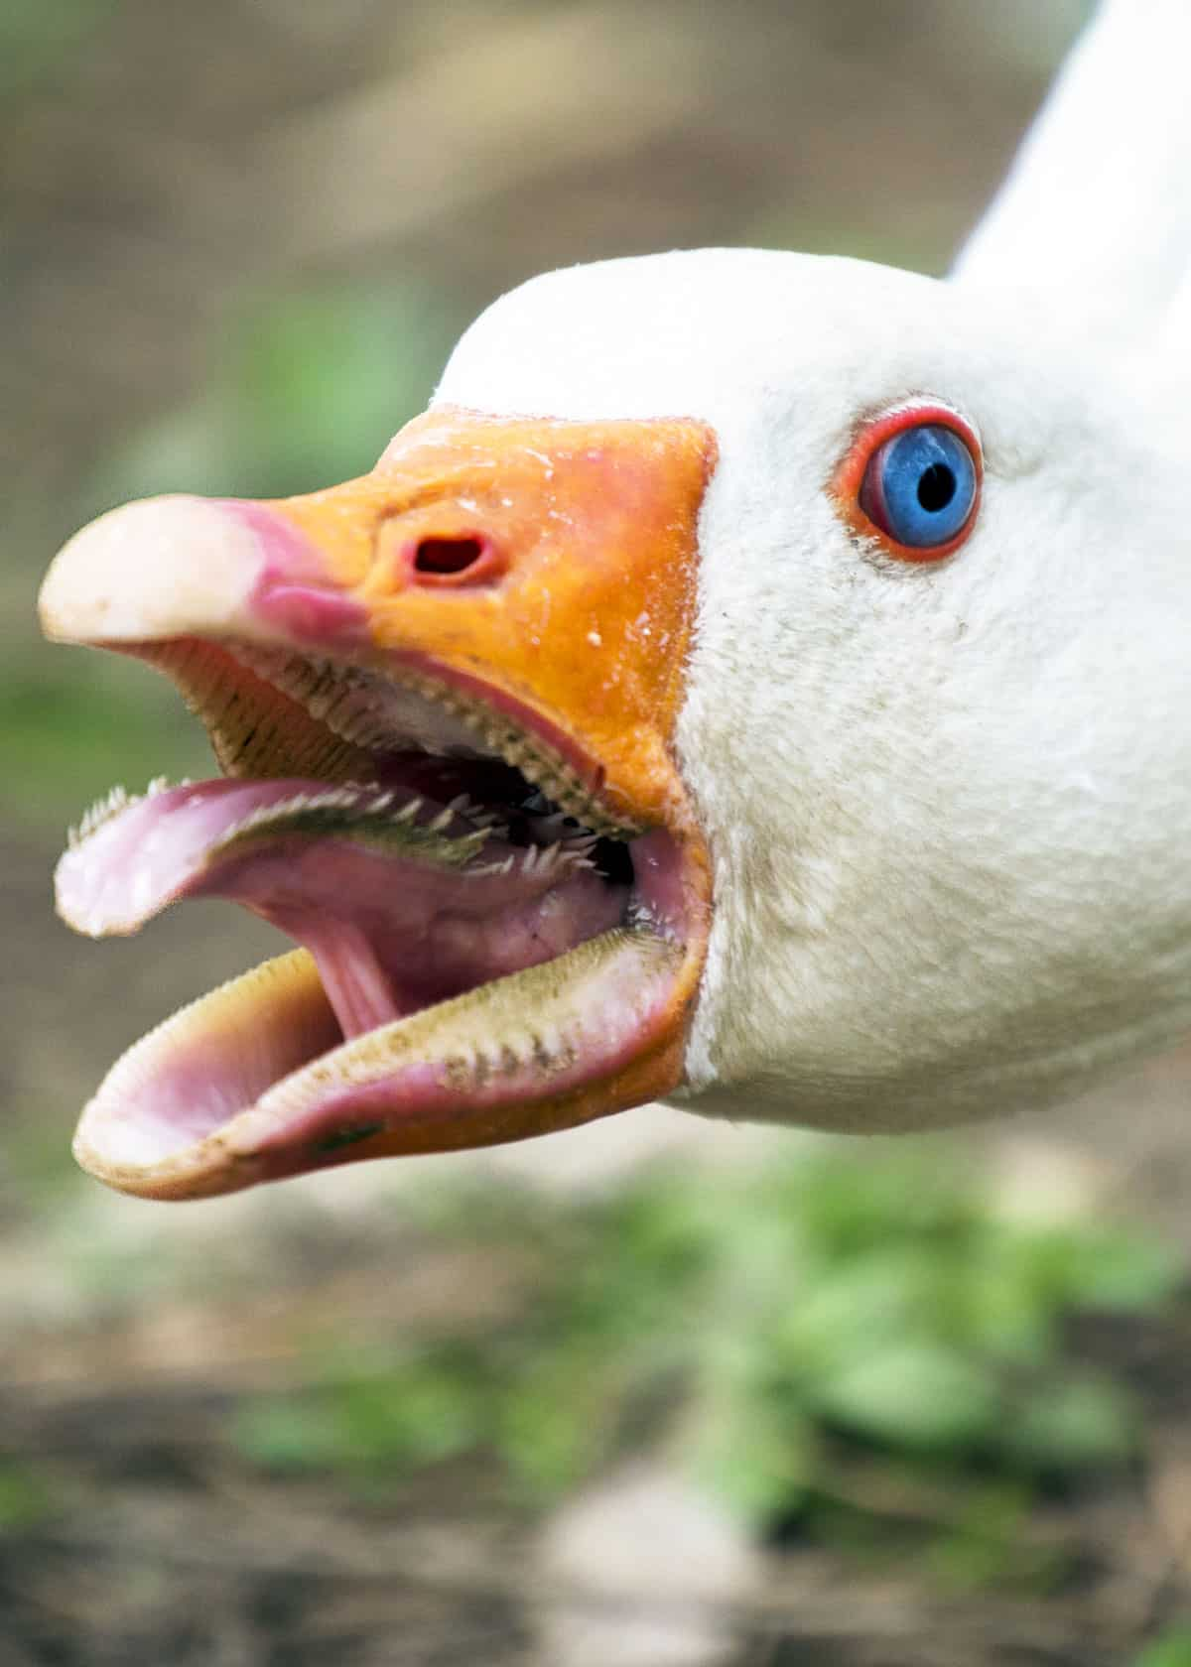
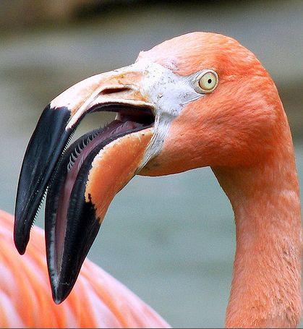
Water and Mud Starning Beak
Broad and Flat Beak, Edges of the jaws are furnished with horny serrations or transverse lamellae, which act as a sieve or strainer, letting the water and mud pass out while retaining the food in the mouth.
In Flamingoes, the beak is distally curved downwards and likewise furnished with shifiting lamellae.
Ex.- Geese, Flamingoes

Slide 14
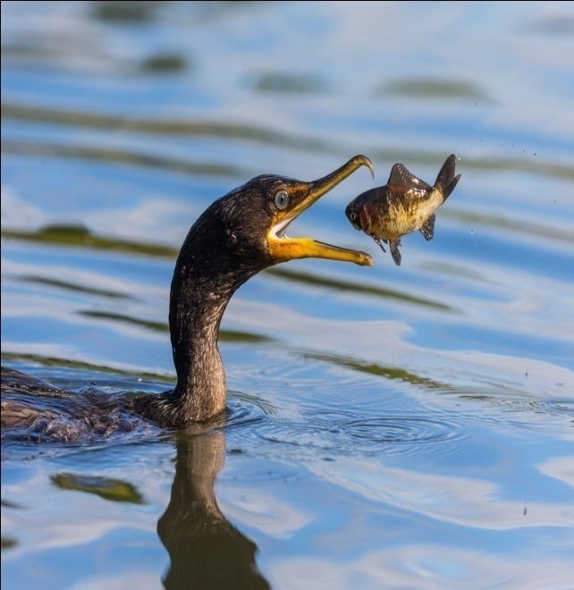
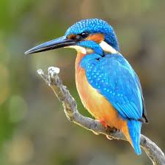
Fish Catching Beak
Long, Powerful and Sharply pointed spearing beaks to capture fish.
Cormorants have long and narrow beaks, tooth like processes meant for capture of fish.
In Snake birds or Indian darters these serrations take the form of fine needle like points.
Ex.- Kingfishers, Cormorants, India darters.

Slide 15
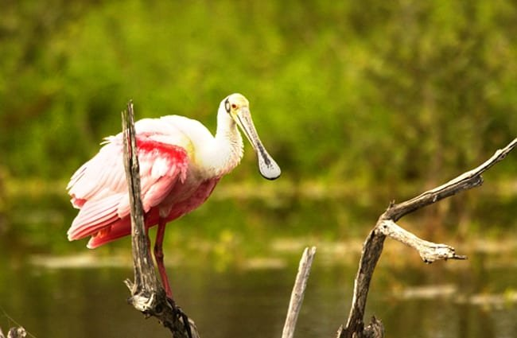
Spatualte Beak
A Very specialized form of beak Spoonbill.
Speculate or Spoon like expansion meant for splashing in water and mud in search of insects, worms fish etc.

Slide 16
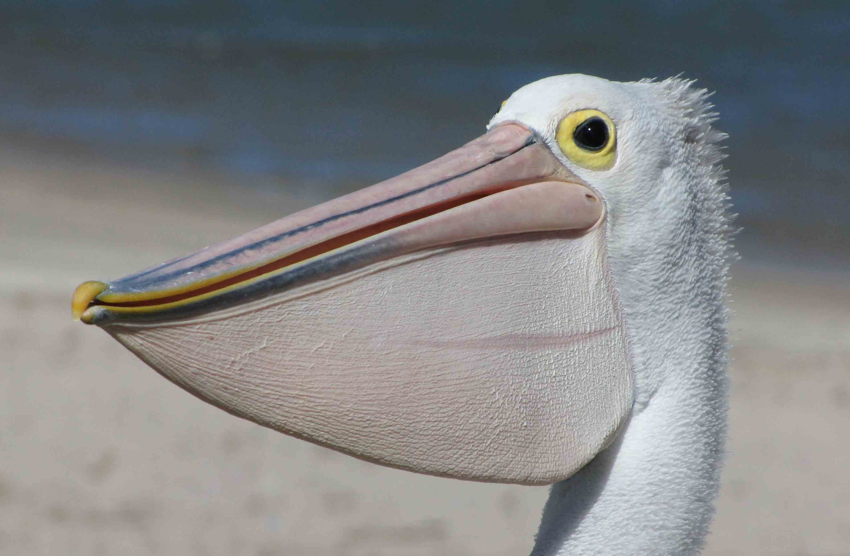
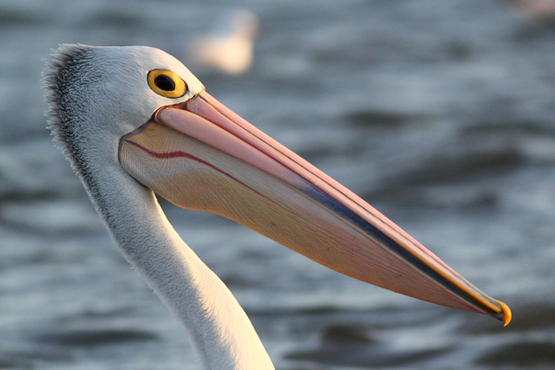
Pouched Beak
Large, with capacious Gular pouch of extensile skin attached to the lower mandible and serving as a fishing net.
Ex.- Pelicans.

Slide 17
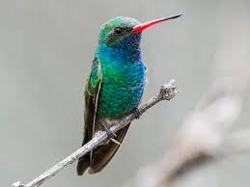
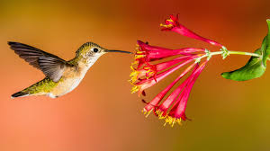
Flower probing Beak
Long, Pointed and rapier-like probing beak of tropical Humming Birds, dive down the corollas of flowers for sucking honey and insects.
They suspend themselves in mid air before the flowers while they extract their honey and insects.

Slide 18
Thank You

