Slide 1

“Enumerate The Total RBC Count of Blood”
Class- B.Sc. III Year Practical
Date: 30.09.2020
Time: 03:00-05:00PM
Presented by
Manoj Joshi
Department of Zoology
UCoS,MLSU, Udaipur.

Slide 2
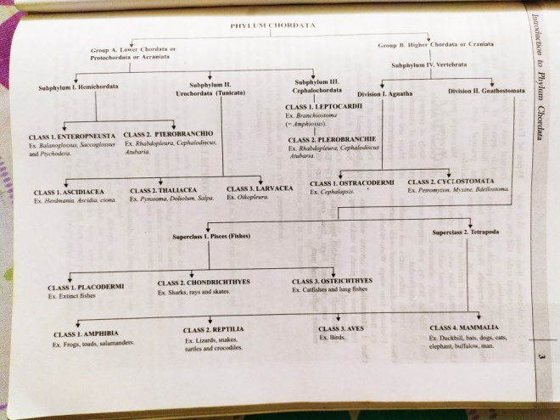
Red Blood Cells (RBC) or Erythrocytes

Slide 3
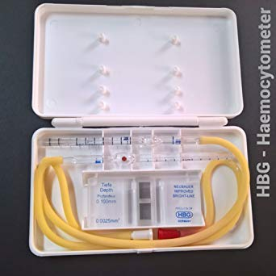
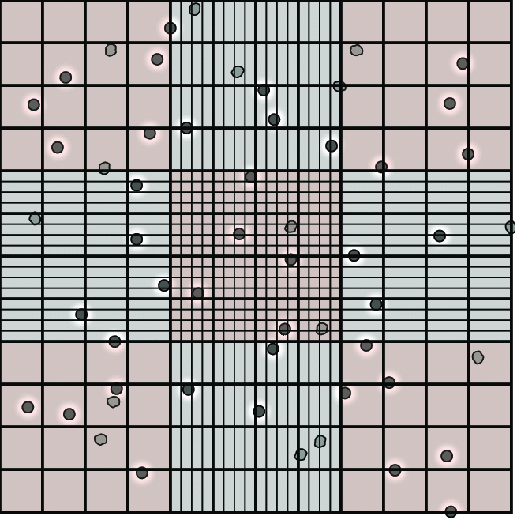
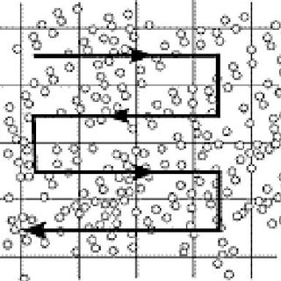
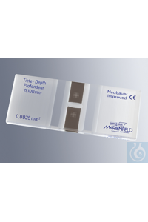

Slide 4
Estimation of RBC
Requirements-Haemocytometer, sterilized pricking needle, RBC Pipette, Compound 2.microscope and Hayem’s diluting fluid (NaCl-1% , Na2SO4-2.5% and HgCl2-2.5%
Procedure-
Clean and the mixing pipette.
Sterilized your middle finger and Prick the finger and blood flows freely, Don’t squeeze.
Suck the blood in pipette up to 0.5 ml mark and immediately mix it with Hayem’s diluting fluid by sucking it up to 101 mark.
Bring counting scale into the focus under objective under microscope.
Count cells in 16 squares in five different part of the field.

Slide 5
Calculation- These may be done in the following manner-
No. of RBC per cubic mm- Number of cells counted x Dilution x 400
No. of small squares counted
Suppose, five smaller square or 80 smallest contain A+B+C+D+E RBCs
One cubic mm of blood will contain=
A+B+C+D+E x 400 x 10 x 200
80
Or A+B+C+D+E x 10000 RBC.

Slide 6
Thank You

