Slide 1
“Enumerate The Total WBC Count of Blood”
Class- B.Sc. III Year Practical
Date: 01.10. 2020
Time: 03:00-05:00PM
Presented by
Manoj Joshi
Department of Zoology
UCoS,MLSU, Udaipur.

Slide 2
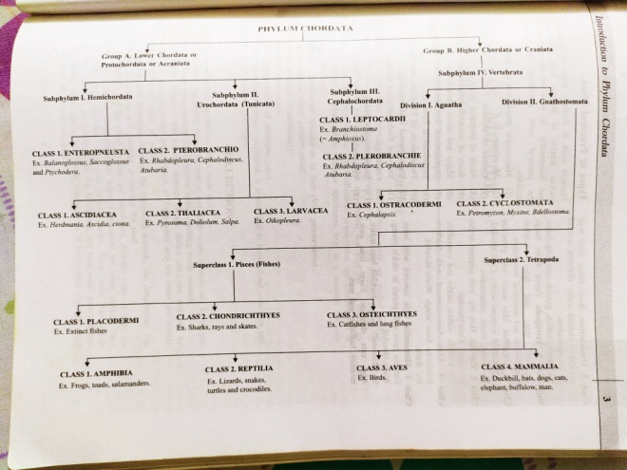
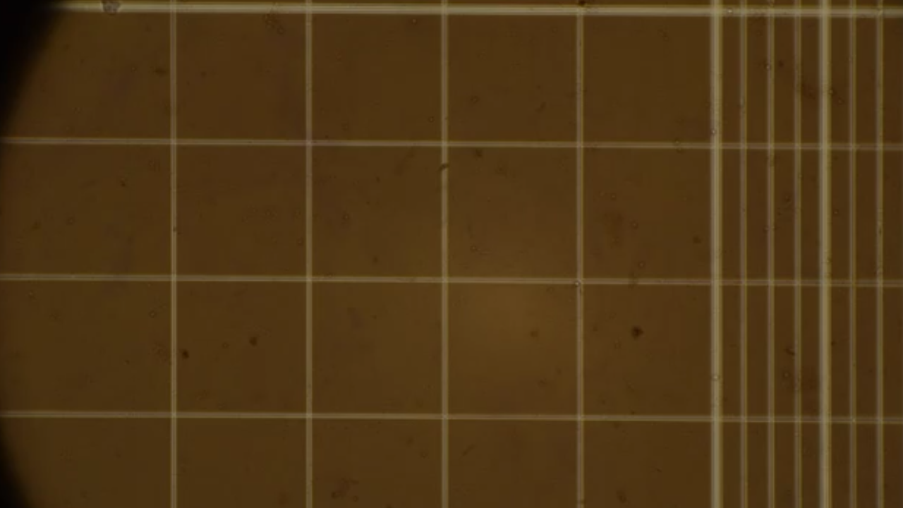
White Blood Cells (WBC) or Leucocytes

Slide 3
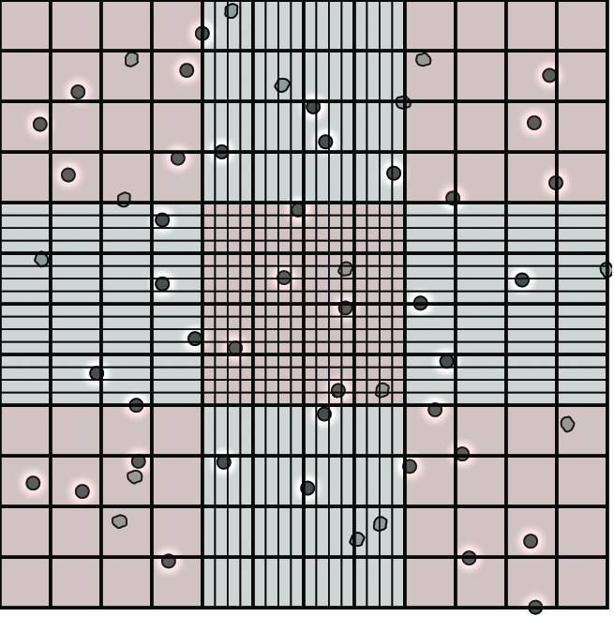
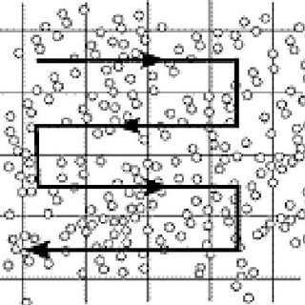

Slide 4
Estimation of WBC
Requirements-Haemocytometer, sterilized pricking needle, WBC Pipette, Compound 2.microscope and Hayem’s diluting fluid.
Procedure-
Clean and the mixing pipette.
Sterilized your middle finger and Prick the finger and blood flows freely, Don’t squeeze.
Suck the blood in pipette up to 0.5 ml mark and immediately mix it with Hayem’s diluting fluid by sucking it up to 11 mark.
Bring counting scale into the focus under objective under microscope.
Count cells in 16 squares in five different part of the field.

Slide 5
Calculation- These may be done in the following manner-
No. of WBC per cubic mm- Number of cells counted x Dilution x 10
No. of small squares counted
Suppose, four medium sized square contain A+B+C+D WBCs.
One cubic mm of blood will contain=
A+B+C+D x20 x 10
16

Slide 6
Thank You

