Slide 1
THYROID GLAND-part 1
DR. SHEETAL JAIN

Slide 2
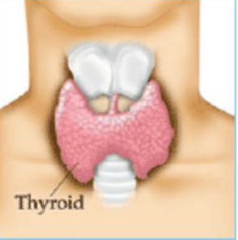
Thyroid gland
THYROID GLAND
Consists of two lobes located on the ventral surface of the trachea.
Produces two iodine-containing hormones, triiodothyronine (T3)
and thyroxine (T4)

Slide 3
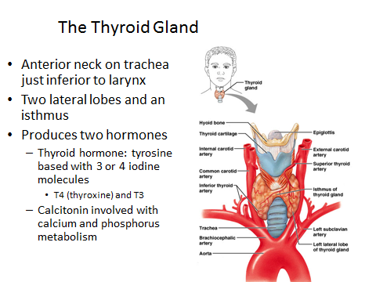

Slide 4
Located in the neck, inferior to the larynx
The largest pure endocrine gland in the body
Has two lobes that are subdivided into follicles
o Follicle walls are formed by cuboidal or squamous epithelial cells called follicle cells
Follicle cells produce thyroglobulin
The central cavity of the follicle stores colloid
Colloid = an amber, viscous glycoprotein consisting of thyroglobulin attached to iodine atoms
Parafollicular cells (C cells)
Not apart of the follicle; produce calcitonin

Slide 5
Thyroid hormone is derived from the iodinated thyroglobulin
Thyroid hormone (TH)
Thyroxine (T4) and triiodothyronine (T3)
T4 = the major hormone secreted by thyroid follicles
T3 = formed at target tissues
Targets all tissues of the body except the adult brain, spleen, testes, uterus, and the thyroid gland itself.

Slide 6
Stimulates enzymes involved glucose oxidation
Increase the basal metabolic rate and body heat production calorigenic effect
Enhances protein synthesis and lipid breakdown
Maintains blood pressure
Regulator of tissue growth and development
Critical for normal skeletal and nervous system growth and development
and reproductive capabilities

Slide 7
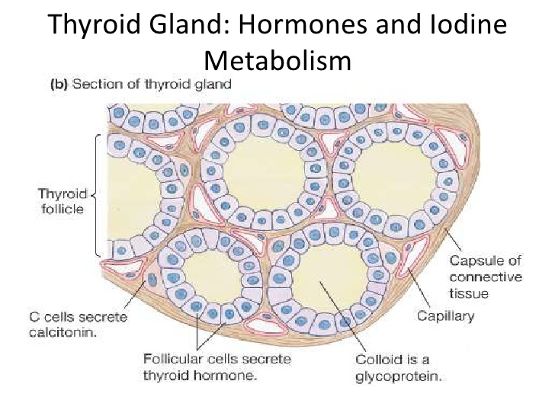
Thyroid Follicle: Functional unit
of the thyroid gland
Normal thyroid gland
illustrating the
histologic structure,
including colloid-filled
(C) follicles of varying
size lined by cuboidal
follicular cells

Slide 8
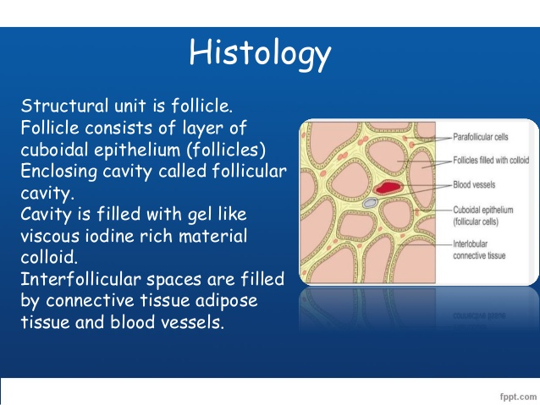

Slide 9
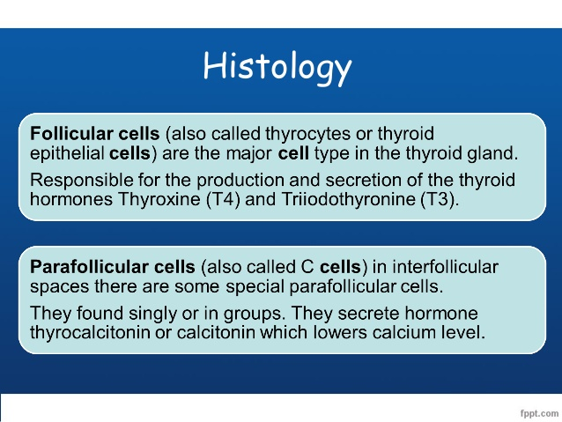

Slide 10
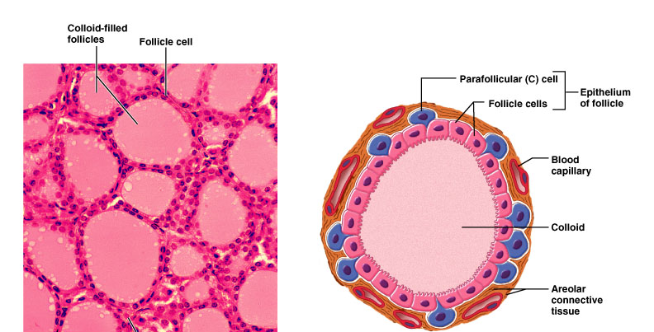
Thyroid is composed of spherical follicles
  Follicle cells: produce thyroglobulin, the precursor of thryoid hormone (thyroxin)
  Colloid lumen is of thyroglobulin
  Parafollicular “C” cells: produce calcitonin

Slide 11
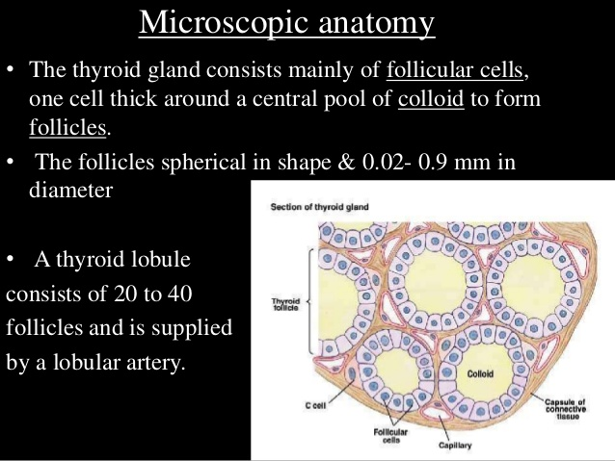

Slide 12
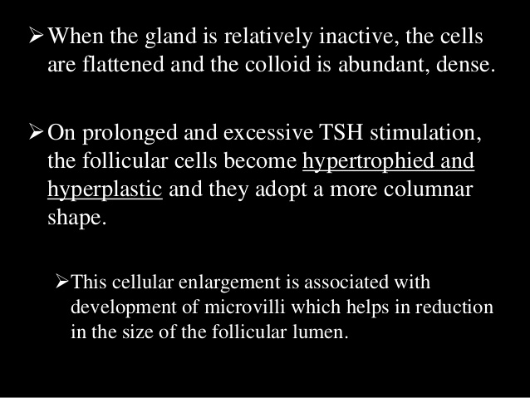

Slide 13
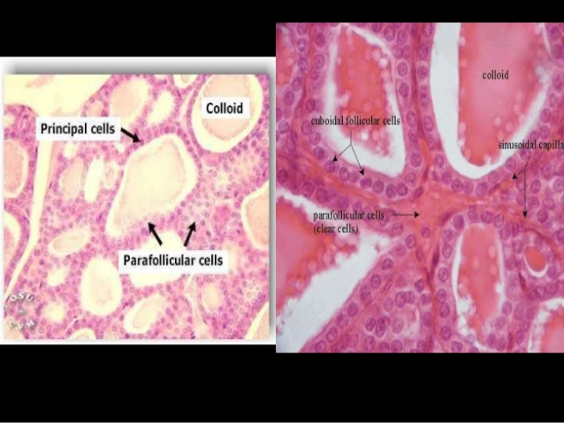

Slide 14
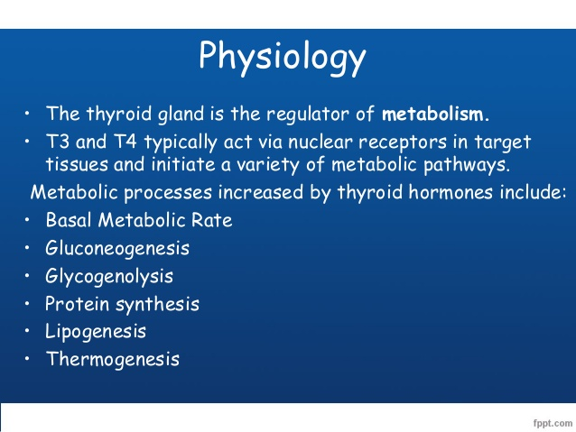

Slide 15
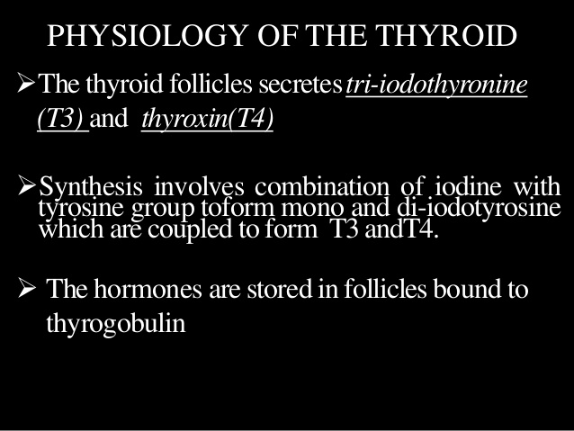

Slide 16
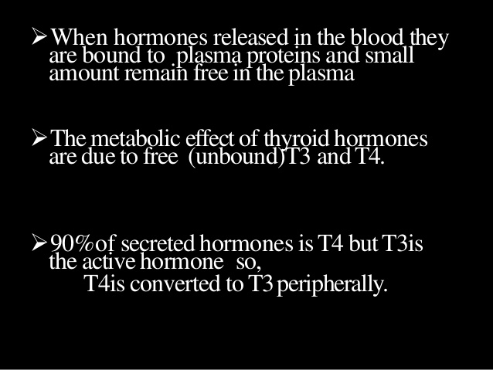

Slide 17
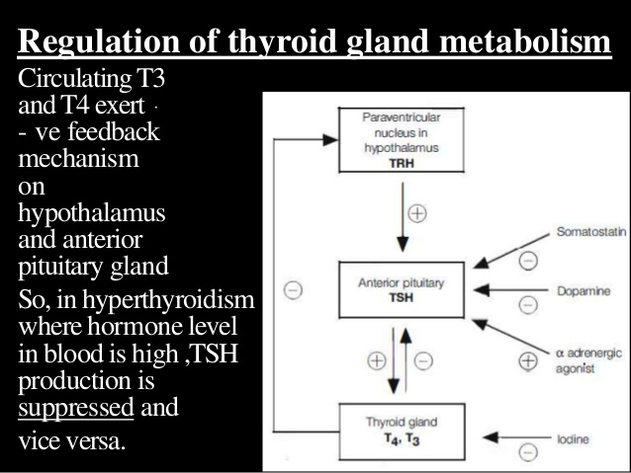

Slide 18
Cont.

