Slide 1
THYROID GLAND –part 2 functions
DR. SHEETAL JAIN

Slide 8
STORAGE

Slide 9
RELEASE

Slide 11
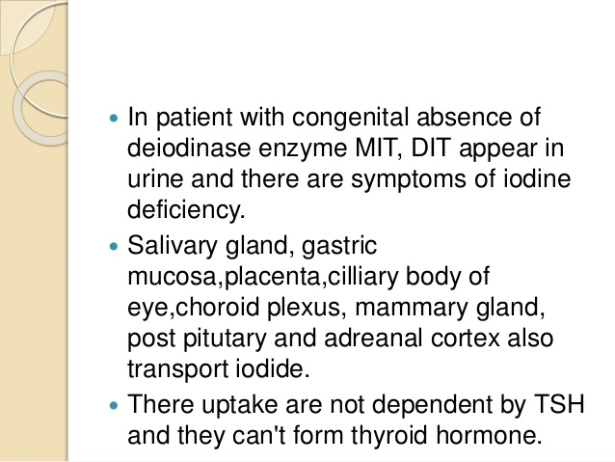

Slide 15
An example of a feedback loop
generic
particular example: thyroid hormone
A certain item in the blood decreases
A certain area of the brain senses this decrease
A certain hormone is released
This hormone stimulates the release of another hormone
This other hormone stimulates the release of the hormone which was sensed to be decreased in the first place, causing it to be increased to desired level
Thyroxine (thyroid hormone)
Hypothalamus
TRF from the hypothalamus
TSH from anterior pituitary
Thyroxine from the thyroid (TSH has caused cleavage of thryroglobulin into thyroxine)

Slide 18
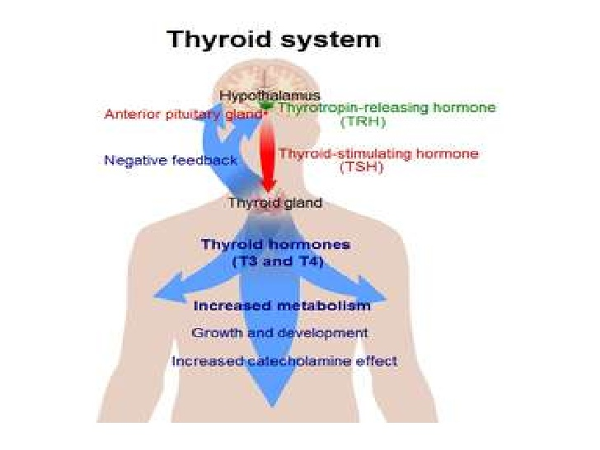

Slide 19
Some Effects of Thyroid Hormone (Thyroxine)
Increases the basal metabolic rate
The rate at which the body uses oxygen to transform nutrients (carbohydrates, fats and proteins) into energy
Affects many target cells throughout the body; some effects are
Protein synthesis
Bone growth
Neuronal maturation
Cell differentiation

Slide 20
The Effects of Calcitonin
Secreted from thyroid parafollicular (C) cells when blood calcium levels are high
Calcitonin lowers Ca++ by slowing the calcium-releasing activity of osteoclasts in bone and increasing calcium secretion by the kidney
Acts mostly during childhood

Slide 30
Con.

