Slide 1
PARATHYROID GLAND-2 DISORDERS
DR. SHEETAL JAIN

Slide 2
HORMONAL DYSFUNCTIONS:
Hypersecretion
• Rare; usually results from parathyroid gland tumor
• Calcium leached from bones; bones soften and deform
• Mineral salts are replaced by fibrous connective tissue
• Ex., osteitis cystica fibrosa = fragile bones, fracture spontaneously
• Depressed nervous system → weakness of skeletal muscles and abnormal reflexes
• Formation of kidney stones due to excess salts precipitating in the kidney tubules
• Deposition of calcium deposits in soft tissues of the body → metastatic calcification

Slide 3
HORMONAL DYSFUNCTIONS
Hyposecretion
• Results from parathyroid gland trauma or removal during thyroid surgery
• Can also be caused by an extended deficiency of dietary magenesium (function
parathyroidism)
• Excitability of neurons and tetany
• Loss of sensation, muscle twitches, and convulsions
• Can progress to respiratory paralysis and death

Slide 5
DISORDER

Slide 6
PATHOPHYSIOLOGY

Slide 7
HYPERPARATHYROIDISM

Slide 8
INCIDENCE

Slide 9
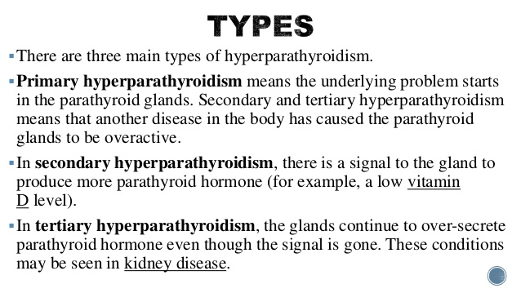
TYPES OF HYPERPARATHYROIDISM

Slide 10
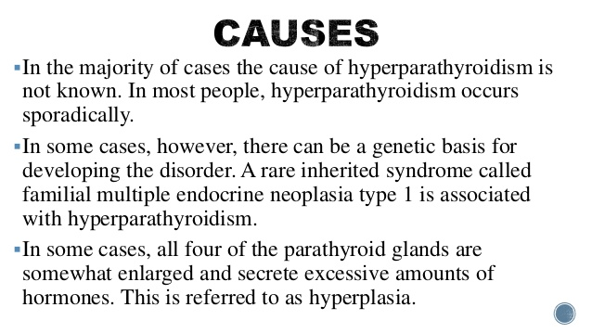
CAUSES

Slide 11
SYMPTOMS

Slide 12
HYPOPARATHYROIDISM

Slide 13
SYMPTOMS

Slide 14
DISORDER

Slide 15
DISORDER

Slide 16
THANKS

