Slide 1
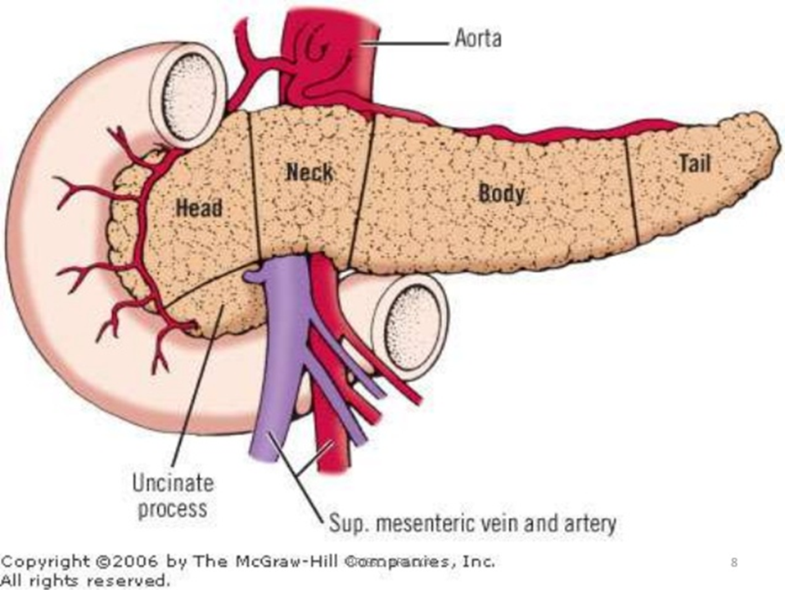
PANCREAS-1
DR. SHEETAL JAIN

Slide 2
PANCREAS

Slide 8
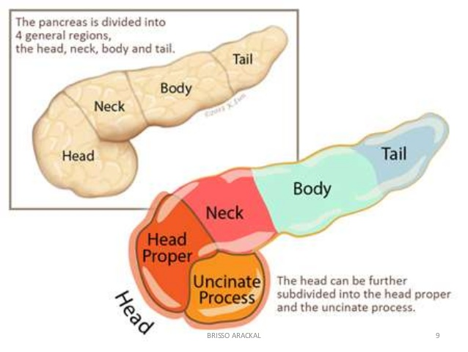

Slide 39
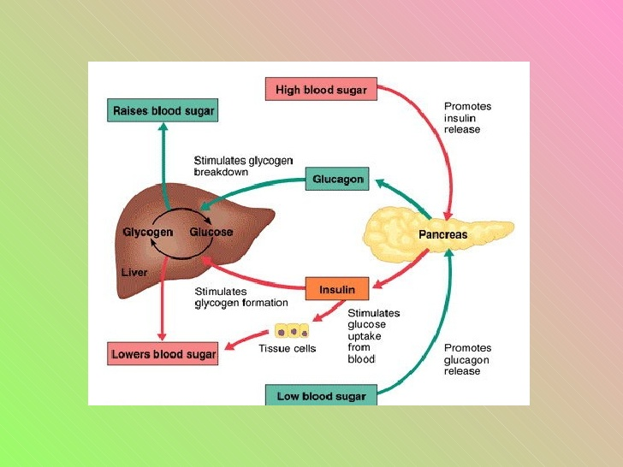

Slide 58
THANKS

