Slide 1
ADRENAL GLAND DISORDER
DR.SHEETAL JAIN

Slide 2
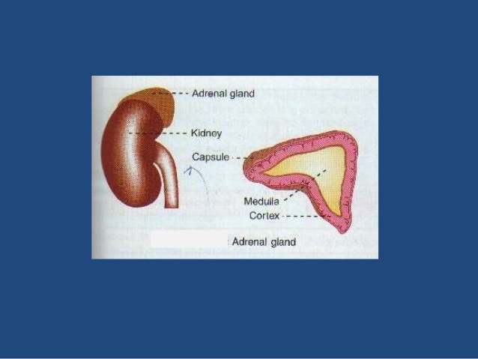
ADRENAL GLAND

Slide 3
ADRENAL GLAND

Slide 4
HORMONES

Slide 5
HORMONES

Slide 11
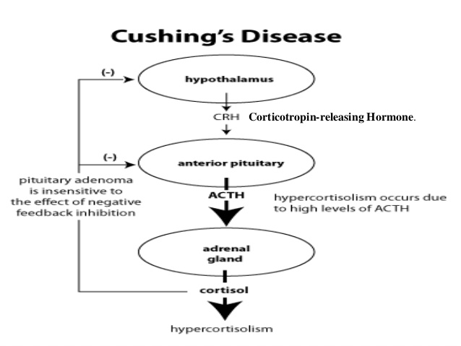

Slide 16
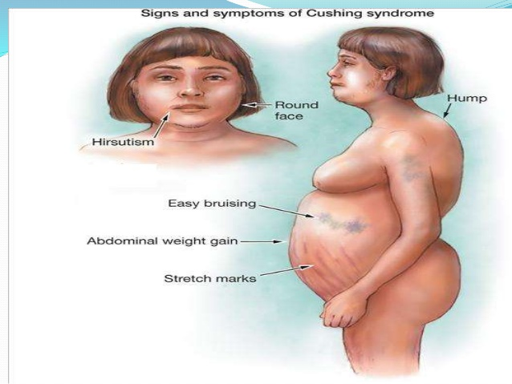

Slide 17
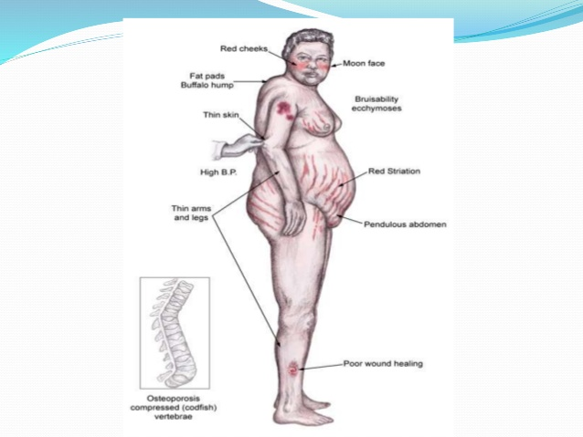

Slide 33
CUSHING SYNDROME CAUSE
Cushing syndrome is a rare disease that results from having too much cortisol hormone in the body. In some cases, Cushing syndrome develops from long-term or overuse of steroid medications(medicines that act like cortisol in the body). In other cases, the body itself produces too much cortisol. This overproduction can happen for several reasons, including the presence of tumors(abnormal growths) such as a:
Tumor of the pituitary gland (this is called Cushing disease)
Tumor of the adrenal gland (as explained above)
Tumor in another part of the body (these are called "ectopic" tumors and are more commonly found in the pancreas, lung, or the thyroid gland)

Slide 34
SYMPTOMS OF CUSHING SYNDROME
Common symptoms of Cushing's syndrome (due to an adrenal, pituitary, or ectopic tumor) can include:
Upper body obesity, round face and neck, and thinning arms and legs
Skin problems, such as acne or reddish-blue streaks on the abdomen or underarm area
High blood pressure
Muscle and bone weakness
Moodiness, irritability, or depression
High blood sugars
Slow growth rates in children
Women may also have increased growth of hair on their face and body and experience menstrual irregularities. Men may become less fertile and have a reduced or absent sex drive.

Slide 35
ADDISON DISEASE CAUSE
This rare disorder develops when the adrenal glands do not make enough cortisol. In most cases of Addison's disease, the body also doesn't make enough of the hormone aldosterone.
Addison's is an autoimmune disease—a condition in which the immune system, which is supposed to protect the body, mistakenly attacks the body's own tissues and cells. In the case of Addison's disease, this reaction results in damage to the adrenal glands.4 In the long term, this damage can get worse until eventually the adrenal glands aren't working at all.

Slide 36
ADDISEON DISEASE
Symptoms can vary, depending on what causes the disease. Symptoms typically include4,5:
Weight loss
Weakness
Extreme fatigue
Nausea and/or vomiting
Low blood pressure
Patches of darker skin
Craving for salt
Dizziness upon standing
Depression

Slide 37
FUNCTIONS OF ADRENAL

Slide 38
Adrenal Gland Function
One of the most well-known responses – the Fight or Flight Response is triggered by the release of stress hormones from the adrenal glands.
The adrenal glands produce a variety of hormones. These hormones are very crucial for the normal functioning of the body. For instance, the glands secrete cortisol, which has anti-inflammatory properties and aids the immune system.
The adrenal gland also helps to regulate metabolism and blood pressure through various other hormones.

Slide 39
Adrenal Gland Hormones
Epinephrine: Also called adrenaline, this hormone rapidly responds to stress by increasing the heart rate and raising blood glucose levels in the blood.
Norepinephrine: Also called noradrenaline, this hormone works with epinephrine in reacting to stress. Its primary function is to mobilize the body and brain for action.
Hydrocortisone: It is commonly known as cortisol or a steroid hormone. It is involved in regulating body functions like the conversion of fats, and carbohydrates to energy and also plays a vital role in other metabolic processes.
Corticosterone: This hormone works with hydrocortisone to control the immune response and prevents inflammatory reactions.

Slide 40
Adrenal Gland Disorders
Adrenal Gland disorders appear when not enough hormones or inadequate hormones are produced by the adrenal glands. Even abnormal growths or tumours can cause certain illness.
Cushing’s Syndrome is a condition where the cortisol levels in the body are very high. The cause can be a tumour in the adrenal gland or the pituitary gland.
Adrenocortical carcinoma is a cancerous tumour that usually develops in the outer layer of the adrenal gland. This type of tumour is typically found years after they have spread to other organs in the body.

Slide 41
Adrenal Gland Disorders
Congenital Adrenal Hyperplasia (CAH) is a genetic disorder characterized by very low levels of cortisol production. The people inflicted with this condition may also have other hormonal imbalances where their bodies may make very little aldosterone, but too much androgen.
Addison’s Disease is caused when adrenal glands produce insufficient cortisol or aldosterone. It results in weakness, fatigue, low blood pressure, nausea, etc. In 70% of cases, Addisone disease is caused due to autoimmune disorder, where the body mistakenly attacks the adrenal glands. As a result, the adrenal gland does not produce the hormone aldosterone in sufficient quantities.

Slide 44
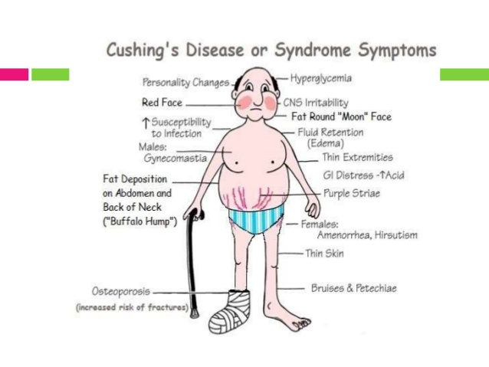

Slide 47
THANKS

