Slide 1
Sample Design

Slide 2
INTRODUCTION
Often we are interested in drawing valid conclusion about a large group of individual or object. This group of individuals under study is called population or universe.
Instead of examining the entire group of individual or population, which may be difficult or impossible to do, we may examine only a small part of this population, which is called sample.

Slide 3
Thus in statistics
Population: is an aggregate of objects, animate or inanimate, under study. The population may be finite or infinite.
For any statistical investigation complete enumeration of the population is not feasible and a very difficult task.
If the population is infinite, complete enumeration is not possible.

Slide 4
Sample: A finite subset of statistical individuals in a population is called a sample and the number of individuals in a sample is called the sample size.
For the purpose of determining population characteristics, instead of enumerating the entire population, the individuals in the sample only are observed. Then the sample characteristics are utilized to approximately determine or estimate the population.

Slide 5
The error involved in such approximation is known as sampling error and is inherent and unavoidable in any and every sampling scheme. But sampling results in considerable gains, especially in time and cost not only in respect of making observations of characteristics but also in the subsequent handling of the data.

Slide 6
The main objects of sampling are:
To obtain maximum information about the population with minimum effort; and
To state the accuracy of estimate based on sample.

Slide 7
Parameter & statistics
In simple words, a parameter is any numerical quantity that characterizes a given population or some aspect of it. This means the parameter tells us something about the whole population.
Statistics are numbers that summarize data from a sample.
For instance, suppose we selected a random sample of 100 students from a school with 1000 students. The average height of the sampled students would be an example of a statistic.

Slide 8
For each study, identify both the parameter and the statistic in the study.
A researcher wants to estimate the average height of women aged 20 years or older. From a simple random sample of 45 women, the researcher obtains a sample mean height of 63.9 inches.
Ans:
The parameter is the average height of all women aged 20 years or older.
The statistic is the average height of 63.9 inches from the sample of 45 women.

Slide 9
Eg.2
A nutritionist wants to estimate the mean amount of sodium consumed by children under the age of 10. From a random sample of 75 children under the age of 10, the nutritionist obtains a sample mean of 2993 milligrams of sodium consumed.
Ans:
The parameter is the mean amount of sodium consumed by children under the age of ten.
The statistic is the mean of 2993 milligrams of sodium obtained from the sample of 75 children.

Slide 10
Eg.3
A researcher wants to estimate the average farm size in Kansas. From a simple random sample of 40 farms, the researcher obtains a sample mean farm size of 731 acres.
Ans:
The parameter is the average farm size in Kansas.
The statistic is the mean farm size of 731 acres from the sample of 40 farms.

Slide 11
Eg.4
An energy official wants to estimate the average oil output per well in the United States. From a random sample of 50 wells throughout the United States, the official obtains a sample mean of 10.7 barrels per day.
Ans:
The parameter is the average oil output per well in the United States.
The statistic is the mean oil output of 10.7 barrels per day from the sample of 50 wells.

Slide 12
Eg.5
The International Dairy Foods Association (IDFA) wants to estimate the average amount of calcium male teenagers consume. From a random sample of 50 male teenagers, the IDFA obtained a sample mean of 1081 milligrams of calcium consumed.
Ans:
The parameter is the average amount of calcium that male teenagers consume.
The statistic is the mean of 1081 milligrams of calcium from the sample of 50 teenagers.

Slide 13
Eg.6
A school administrator wants to estimate the mean score on the verbal portion of the SAT for students whose first language is not English. From a simple random sample of 20 students whose first language is not English, the administrator obtains a sample mean SAT verbal score of 458.
Ans:
The parameter is the mean verbal SAT score for students whose first language is not English.
The statistic is the mean SAT verbal score of 458 from the sample of 20 students.

Slide 14

Sampling Distribution of a Statistic:
If we draw a sample of size n from a given finite population of size N, then the total number of possible samples is:
(say).

Slide 15
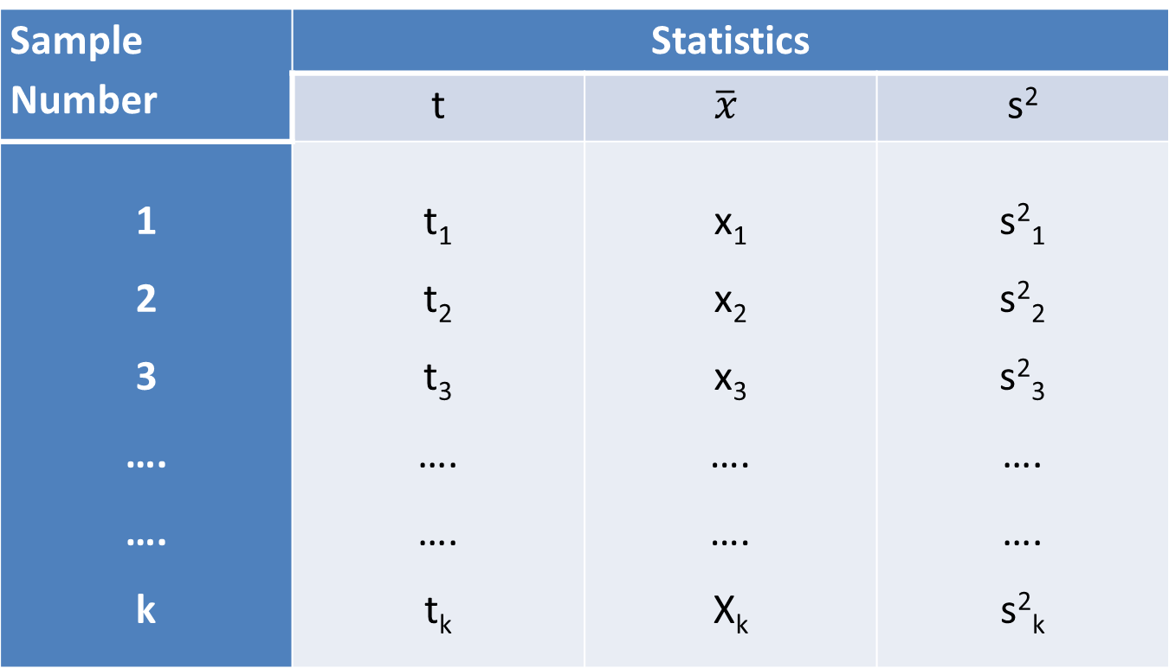

For each of these k samples we can compute some statistic t = t(x₁,x₂,... ,x_{n}), in particular the mean $\overline{x}$, the variance s²,etc., as given below:
Sample Number | Statistics
 | t | $$\overline{x}$$ | s²
1 2 3 …. …. k | t₁ t₂ t₃ …. …. t_{k} | x₁ x₂ x₃ …. …. X_{k} | s²₁ s²₂ s²₃ …. …. s²_{k}

Slide 16
The set of the values of the statistic so obtained, one for each sample, constitutes what is called the sampling distribution of the statistic.
For example the values t_{1,} t_{2,} t_{3,} ….…., t_{k} determine the sampling distribution of the statistic t.
In other words, statistic t may be regarded as a random variable which can take the values t_{1,} t_{2,} t_{3,} ….…., t_{k} and we can compute the various statistical constants like mean, variance, skewness, kurtosis etc., for its distribution.

Slide 17
Standard Error:
The standard deviation of the sampling distribution of a statistic is known as its Standard Error, abbreviated as (S.E.).
The standard error gives a measure of dispersion of the concerned statistic. It depends on the sample size n and goes on decreasing as the sample size increases.

Slide 18
The standard deviation (SD) measures the amount of variability, or dispersion, for a subject set of data from the mean, while the standard error of the mean (SEM) measures how far the sample mean of the data is likely to be from the true population mean.

Slide 19
Since the population standard deviation is seldom known, the standard error of the mean is usually estimated as the sample standard deviation divided by the square root of the sample size (assuming statistical independence of the values in the sample). n is the size (number of observations) of the sample.

Slide 20
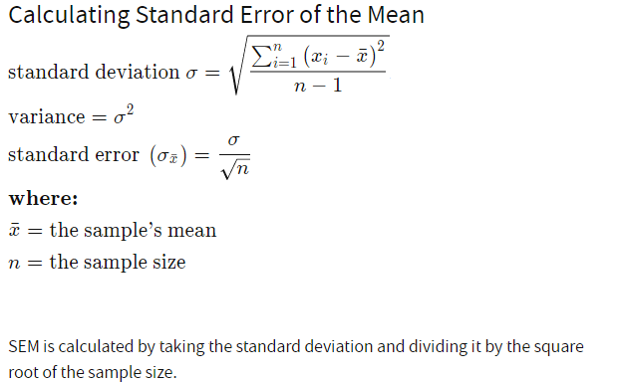

Slide 21
What is a finite population?
Finite Population Multiplier: A factor used to correct the standard error of the mean for studying a population of finite size that is small in relation to the size to the sample.
A population is an entire set of individuals or objects, which may be finite or infinite.
Examples of finite populations include the employees of a given company, the number of airplanes owned by an airline, or the potential consumers in a target market.

Slide 22
Finite Population Multiplier
A factor used to correct the standard error of the mean for studying a population of finite size that is small in relation to the size to the sample.

Slide 23
The standard errors of some of the well-known statistics, for large samples are given below, where n is the sample size, (σ²) the population variance, and P the population proportion, and Q = 1 – P, n₁ and n₂ represent, the sizes of two independent random samples respectively drawn from the given population(s).

Slide 24

THANK
YOU

