Slide 1
Random Variable & Distribution

Slide 2
Random Variables
Definition :
A random variable is function that assigns a real number X(s) to every elements sS where S is the sample space corresponding to a random experiment.
i.e. X: S → R
The function X(s)=x that maps the elements of the sample space into real numbers is called R.V.

Slide 3
Type of random variables
Discrete random variable
Continuous random variable.

Slide 4
Discrete random variable:
If X is a R. V. which can take a finite number or countably infinite number of values, X is called discrete random variable.
When a R.V. is discrete, the possible values of X may be assumed as
x₁, x₂, x₃, ……, x_{n}, ……….
In the finite case, the list of values terminates and in the countably infinite case, the list goes up to infinity.
Ex.

Slide 5
Probability mass function (p.m.f.)
If X is a R. V. which can take the values x₁, x₂, x₃, ……, x_{n}, ………. s.t. P(X = x_{i}) = p_{i,} then p_{i}
Is called probability mass function (p.m.f.) or point probability function, provided p_{i} (i=1, 2, …)
satisfy the following condition:
p_{i} ≥ 0 for all i, and
,
The collection of pairs {x_{i}, p_{i}}, I =1, 2, 3,….., is called the probability distribution of the R.V. X

Slide 6
Continuous random variable:
If X is a R. V. which can take all values (i.e., infinite number of values)in a certain interval, then x is called a continuous RV.
In other words a random variable is said to be continuous when its different values cannot be put in 1-1 correspondence with a set of positive integers.
A continuous random variable is a random variable that can be measured to any desired degree of accuracy. Examples of continuous random variables are age, height, weight etc.

Slide 7
Probability density function(p.d.f.):
If X is a continuous RV s.t.
f(x) dx represents the probability that X falls in the extremely small interval .
Then f(x) is called the probability density function of X, provided f(x) satisfies the following conditions:
.f(x) ≥0 for all xЄR_{x}, and
.

Slide 8
The probability for a variate value to lie in the interval dx is f(x) dx and hence the probability for a variate value to fall in the finite interval [a, b] is:
Important Remark.
In case of discrete random variable the probability at a point, i.e., P (x = c) is not zero for some fixed c.
However, in case of continuous random variables the probability at a point is always zero, i.e., P (x = c) = 0 for all possible values of c. This follows directly from (*) by taking a= b = c.

Slide 9
This property of continuous r.v., viz.,
P(X= c)= 0, for every c
leads us to the following important result :
i.e., in case of continuous R.V., it does matter whether we include the end points of the interval from a to b.

Slide 10
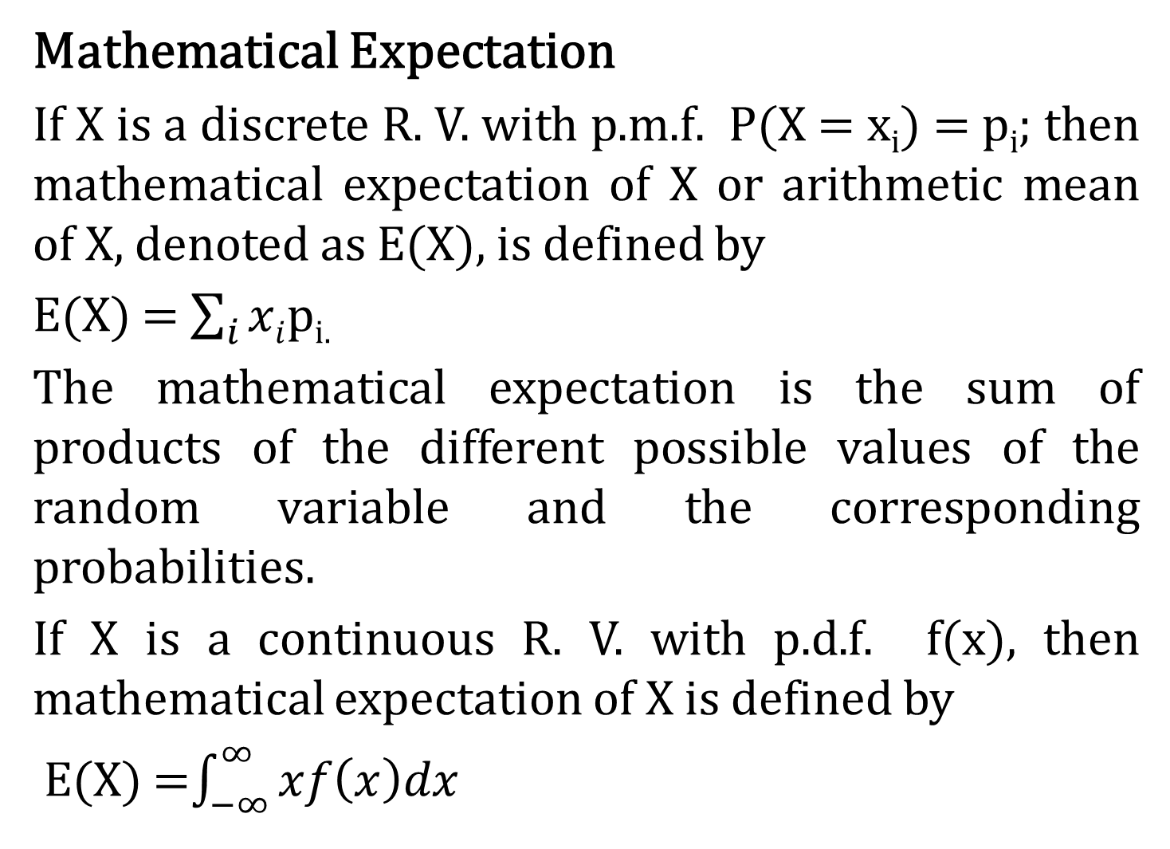
Mathematical Expectation
If X is a discrete R. V. with p.m.f. P(X = x_{i}) = p_{i}; then mathematical expectation of X or arithmetic mean of X, denoted as E(X), is defined by
E(X) = $\sum_{i}{xi}$p_{i.}
The mathematical expectation is the sum of products of the different possible values of the random variable and the corresponding probabilities.
If X is a continuous R. V. with p.d.f. f(x), then mathematical expectation of X is defined by
E(X) =$\int_{−∞}^{∞}{xf\left(x\right)dx}$

Slide 11
Properties of expected values:
E(X+Y) = E(X) + E(Y), provided all expectation exists.
If X and Y are independent random variables then E(XY) = E(X). E(Y).
In general, E(XY)  E(X). E(Y).

Slide 12
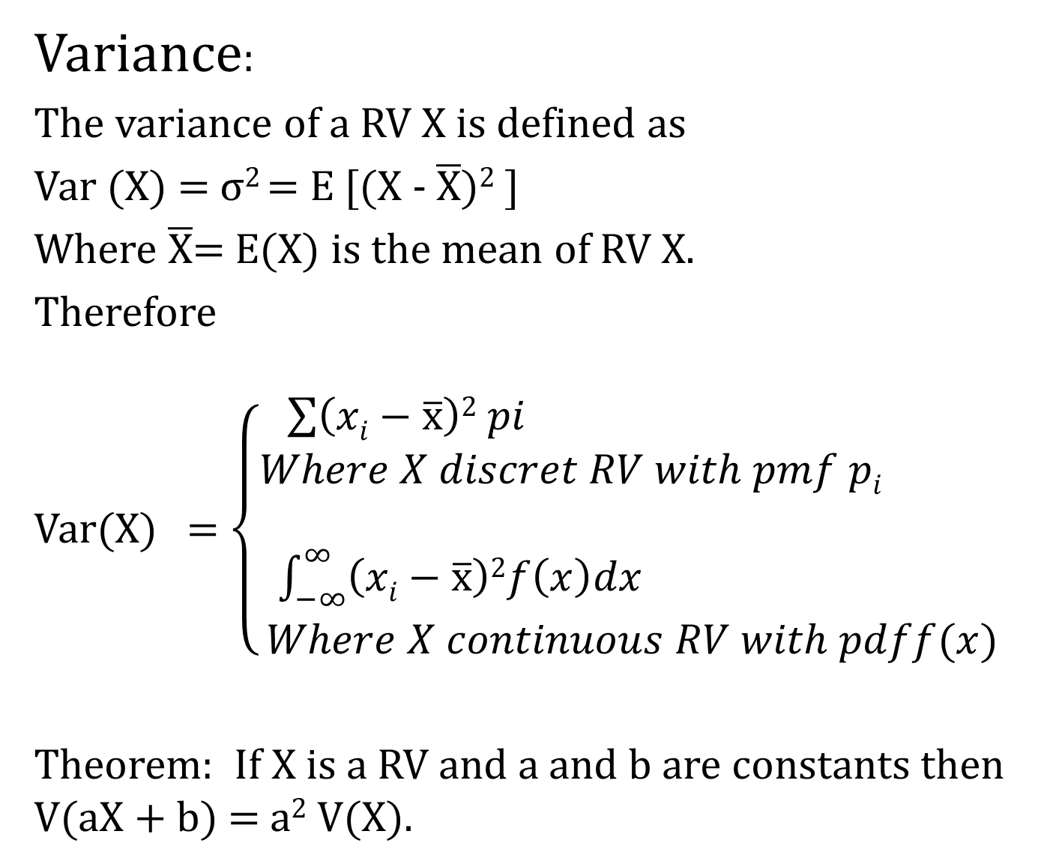
Variance:
The variance of a RV X is defined as
Var (X) = σ² = E [(X - $\overline{\text{X}}$)² ]
Where $\overline{\text{X}}$= E(X) is the mean of RV X.
Therefore
Var(X) = $\left\{\begin{aligned}\sum{\left(xi−\overline{\text{x}}\right)2 pi} \\ Where X discret RV with pmf pi \\ \\ \int_{−∞}^{∞}{\left(xi−\overline{\text{x}}\right)2f\left(x\right)dx} \\ Where X continuous RV with pdff(x)\end{aligned}\right.$
Theorem: If X is a RV and a and b are constants then V(aX + b) = a² V(X).

Slide 13
Discrete probability distribution
In this section we shall discuss some of the probability distributions that figure most prominently in statistical theory and application.
We shall also study their parameter and derivation of some of their important characteristics.
We shall introduce number of discrete probability distribution, that have been successfully applied in a wide variety of decision situations.
The purpose of this section is to show the type of situations in which these distributions can applied.

Slide 14
This section devoted to the study of univariate distributions like
Discrete uniform (rectangular) distribution
Binomial distribution
Poisson distribution
Geometric distribution &
Hypergeometric distribution
We have already defined distribution function, mathematical expectation and variance. This prepares us for a study of discrete theoretical probability distribution.

Slide 15
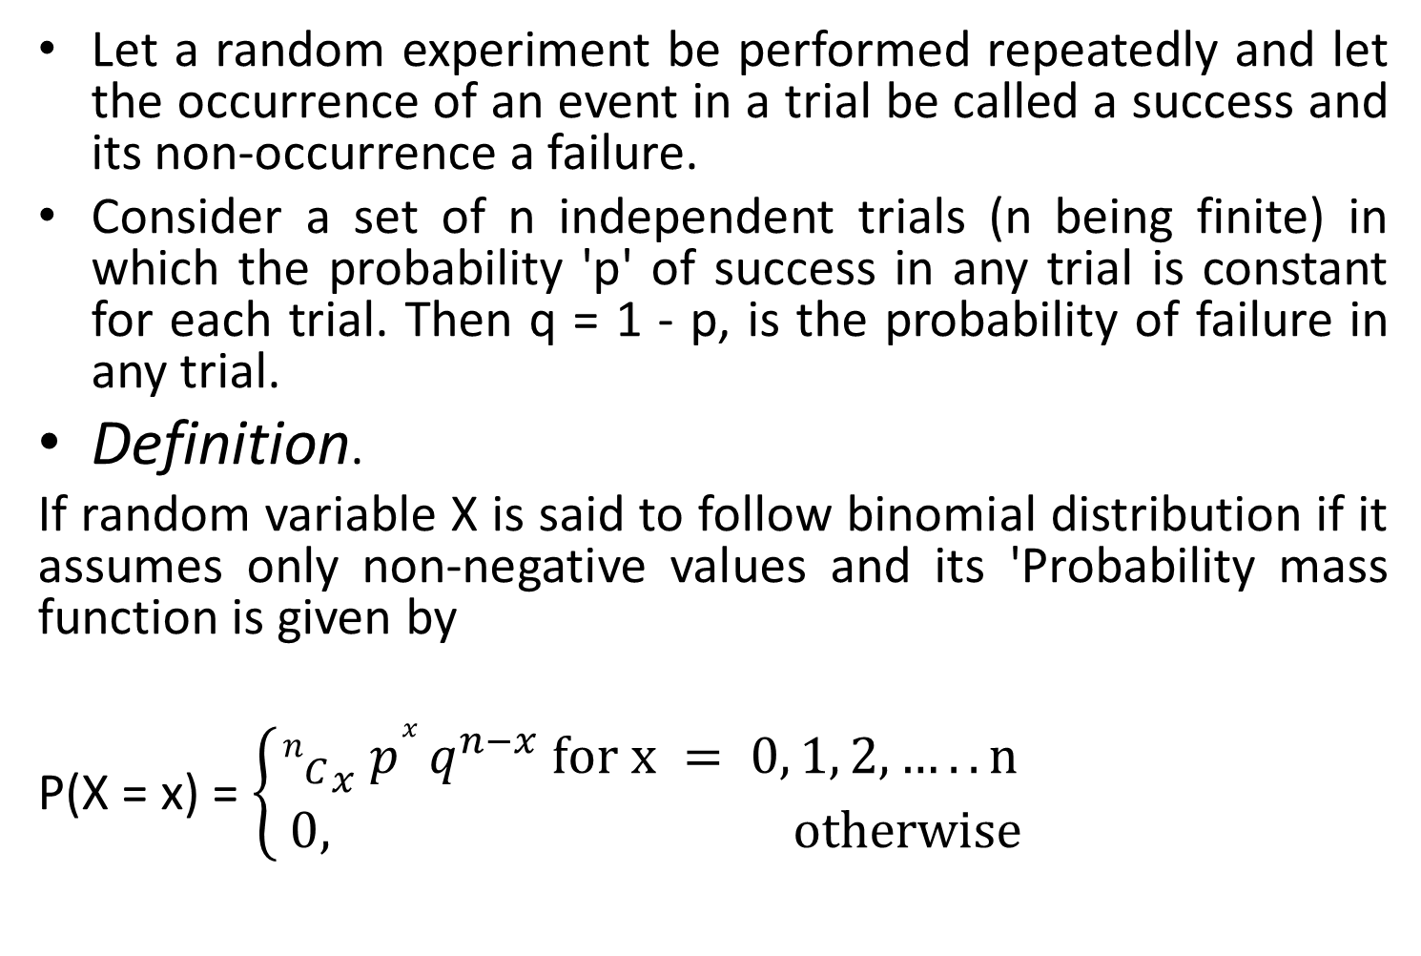
Binomial distribution
Let a random experiment be performed repeatedly and let the occurrence of an event in a trial be called a success and its non-occurrence a failure.
Consider a set of n independent trials (n being finite) in which the probability 'p' of success in any trial is constant for each trial. Then q = 1 - p, is the probability of failure in any trial.
Definition.
If random variable X is said to follow binomial distribution if it assumes only non-negative values and its 'Probability mass function is given by
P(X = x) = $\left\{\begin{aligned}{n_{C}}_{x} p^{x }q^{n−x} for x = 0, 1, 2, …..n \\ 0, otherwise\end{aligned}\right.$

Slide 16
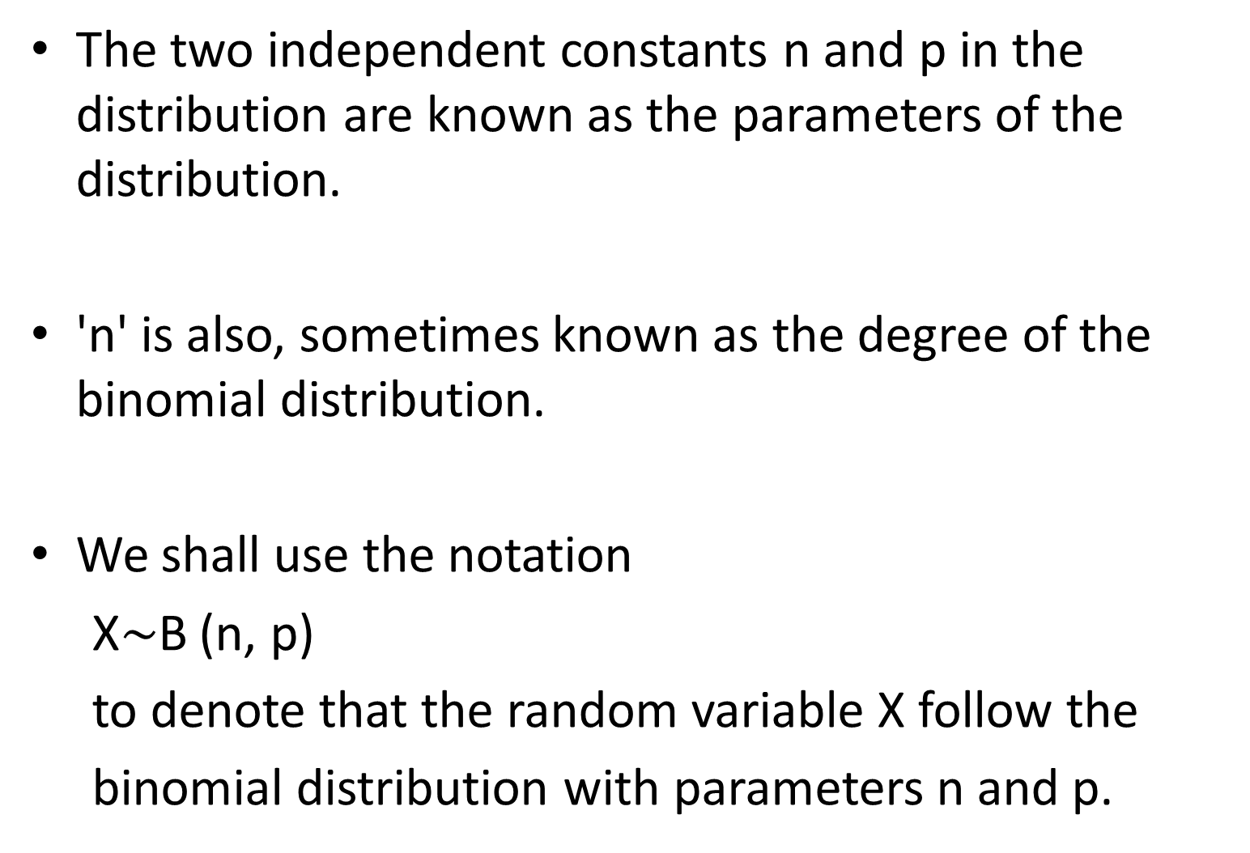
The two independent constants n and p in the distribution are known as the parameters of the distribution.
'n' is also, sometimes known as the degree of the binomial distribution.
We shall use the notation
X$\sim$B (n, p)
to denote that the random variable X follow the
binomial distribution with parameters n and p.

Slide 17
Physical conditions for Binomial Distribution.
We get the binomial distribution under the following experimental conditions.
Each trial results in two mutually disjoint outcomes termed as success and failure.
The number of trials ‘n' is finite.
The' trials are independent of each other.
The probability of success 'p’ is constant for-each trial.

Slide 18
Mean and variance of binomial distribution
Mean = E(X) = np
Var(X) = npq

Slide 19
Poisson Distribution
Poisson distribution is a distribution related to probabilities of events which are extremely rare, but which have a large number of independent opportunities for occurrence.
Following are some instances where Poisson distribution may be successfully employed
Number of deaths from a disease. Such as heart attack or cancer or due to snake bite.
Number of suicides reported in a particular city.
The number of defective material in a packing manufactured by a good concern.
Number of faulty blades in a packet of 100.
Number of air accidents in some unit of time.
Number of printing mistakes at each page of the book.
Number of cars passing a crossing per minute during the busy hours of a day.

Slide 20
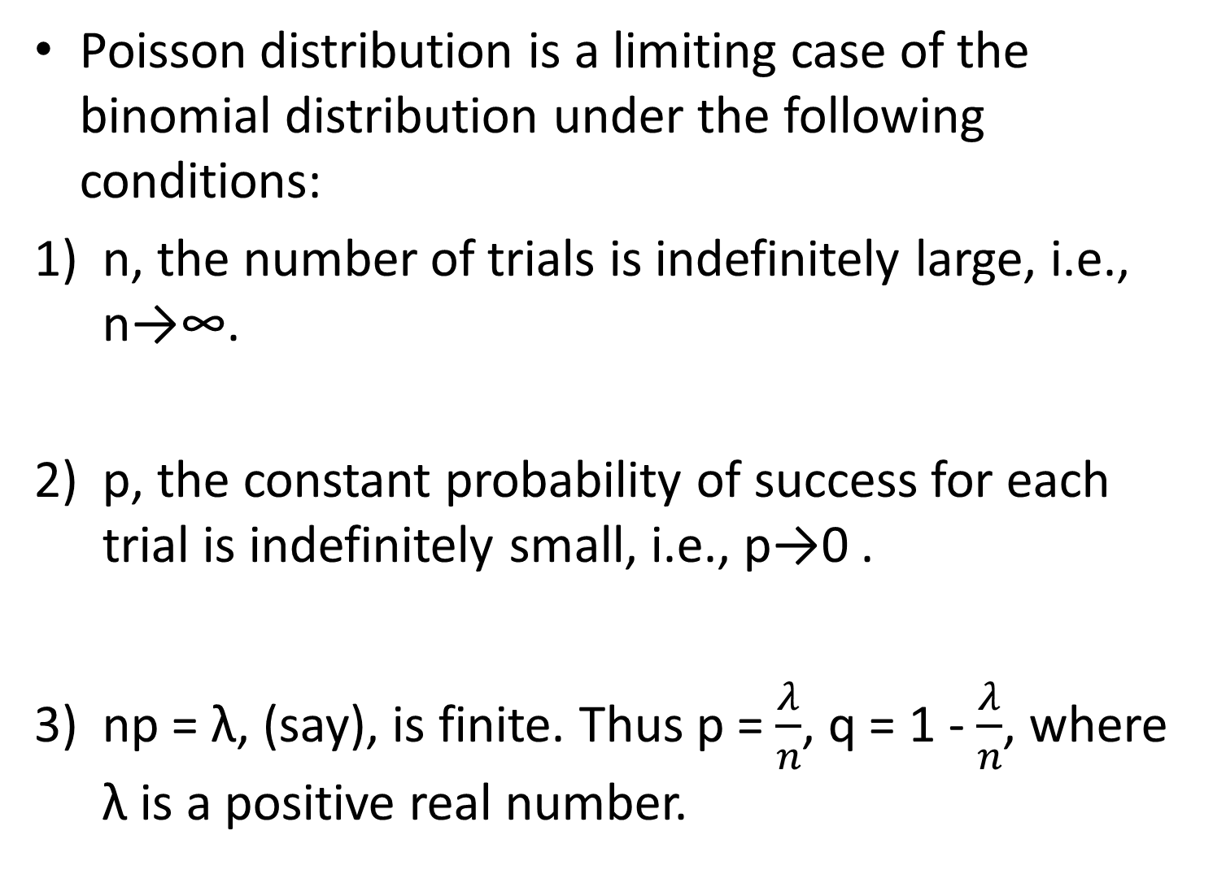
Poisson distribution is a limiting case of the binomial distribution under the following conditions:
n, the number of trials is indefinitely large, i.e., n→∞.
p, the constant probability of success for each trial is indefinitely small, i.e., p→0 .
np = λ, (say), is finite. Thus p = $\frac{λ}{n}$, q = 1 - $\frac{λ}{n}$, where λ is a positive real number.

Slide 21
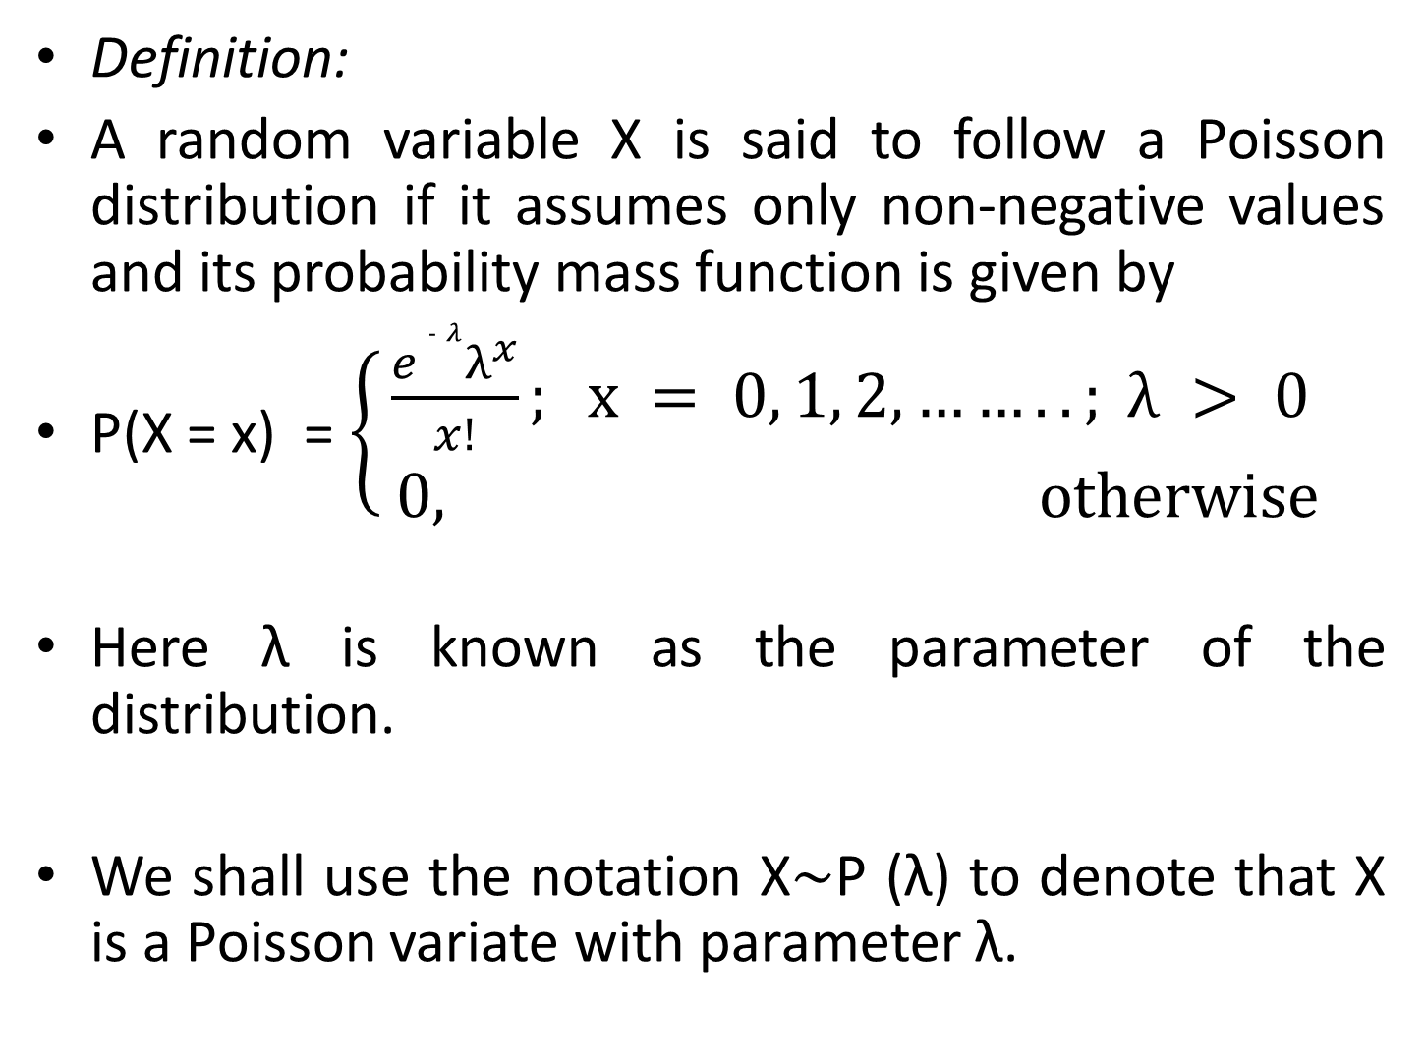
Definition:
A random variable X is said to follow a Poisson distribution if it assumes only non-negative values and its probability mass function is given by
P(X = x) =$\left\{\begin{aligned}\frac{{e }^{‑ λ}λ^{x}}{x!}; x = 0, 1, 2, ……..; λ > 0 \\ 0, otherwise\end{aligned}\right.$
Here λ is known as the parameter of the distribution.
We shall use the notation X$\sim$P (λ) to denote that X is a Poisson variate with parameter λ.

Slide 22
Mean and variance of Poisson distribution
Mean = E(X) = λ.
Var X = λ

Slide 23
Continuous probability distribution
In this section we shall discuss some of the probability distributions that figure most prominently in statistical theory and applications.
We shall also study their parameter and derivation of some of their important characteristics.
The purpose of this section is to show the type of situations in which these distributions can applied.

Slide 24
This section devoted to the study of univariate distributions like
Continuous uniform (rectangular) distribution
exponential distribution
Normal distribution
Chi square distribution
We have already defined distribution function, mathematical expectation, variance and m.g.f.
This prepares us for a study of continuous theoretical probability distribution.

Slide 25
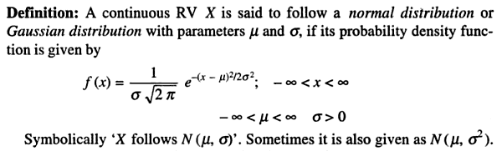
Normal (Gaussian) distribution

Slide 26
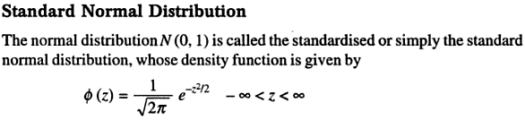

Slide 27
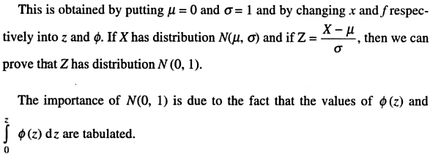

Slide 28
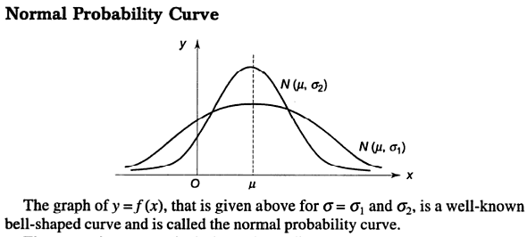

Slide 29
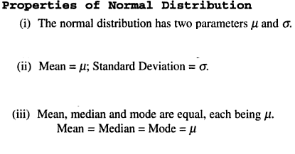

Slide 30
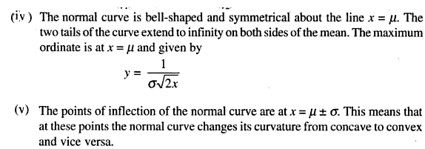

Slide 31
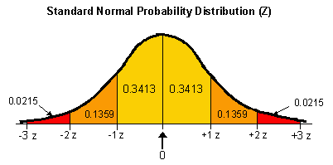
←------ 68.27%----→
←-----------------95.45% ------------------ →
←----------------------------- 99.73%---------------------------- →←
Area between z = ±1 is 68.27%
Area between z = ± 2 is 95.45%
Area between z = ± 3 is 99.73%

Slide 32


Slide 33

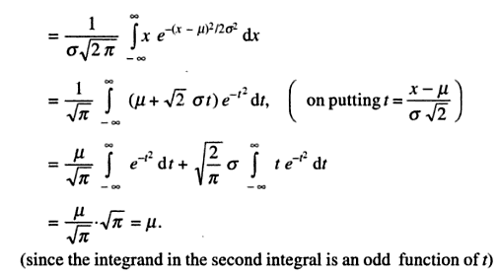
.

Slide 34
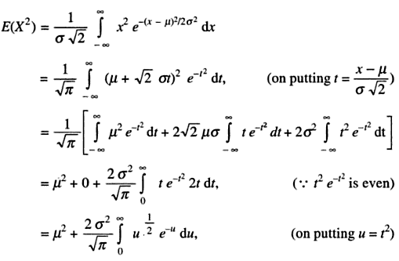

Slide 35
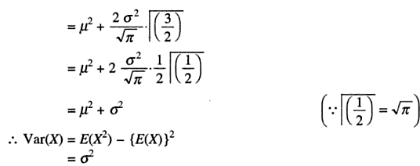
.

Slide 36
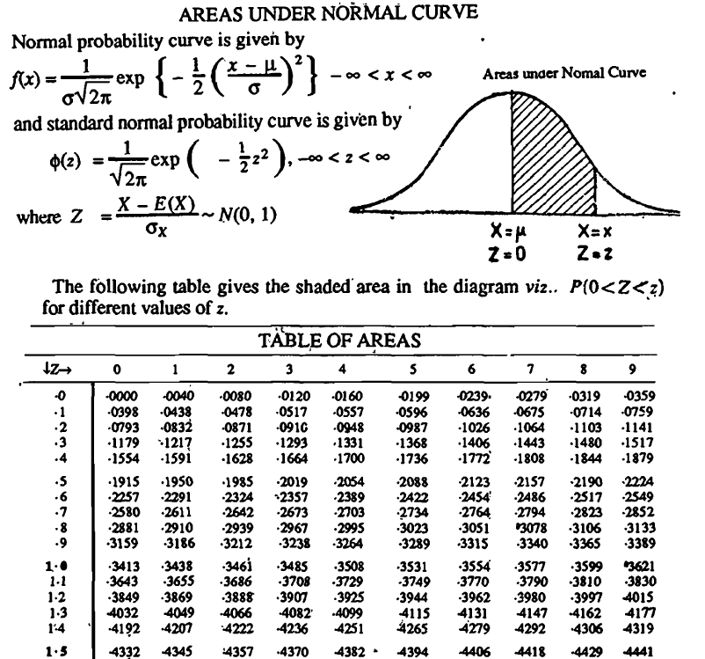
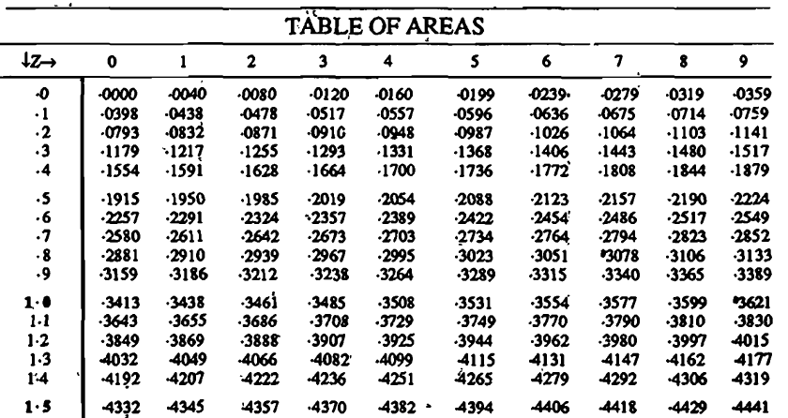

Slide 37

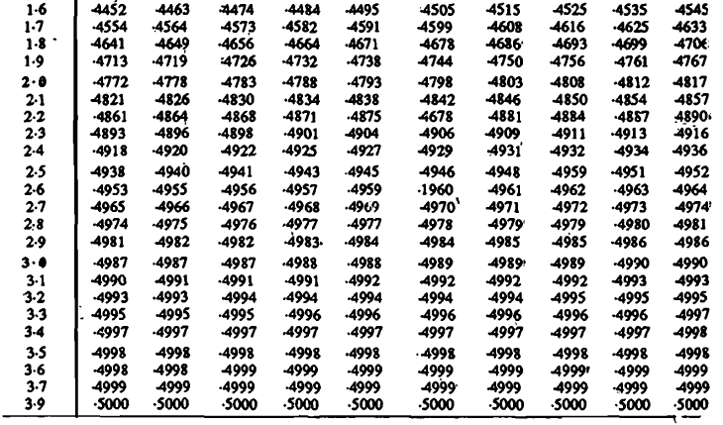

Slide 38
Importance of Normal Distribution.
Normal distribution plays a very important role in statistical theory because of the following reasons :
Most of the distributions occurring in practice, e.g., Binomial. Poisson, Hyper geometric, distributions. etc., can be approximated by normal distribution.
Moreover, many of the sampling distributions. e.g., Student's ‘t' , Snedecor's ‘F’, Chi-square distributions, etc., tend to normality for large samples.
Many 'of the distributions of sample statistic (e.g., the distributions of sample mean, sample variance, etc.) tend to normality for large samples and as such they can best be studied with the help of the normal curves.
The entire theory of small sample tests, viz., t, F, X² tests-etc. is based on the fundamental assumption that the parent populations from which the samples have been drawn follow normal distribution.
Theory of normal curves can be applied to the graduation of the curves which are not normal.
Normal distribution finds large applications in Statistical Quality Control in industry for setting control limits.

Slide 39
X is normally distributed and the mean of X is 12 and S.D. is 4. (a) Find out the probability of the following:
(a) (i). X ≥ 20, (ii) X ≤ 20 and, (iii) 0 ≤ X ≤ 12
(b) Find x', when P (X > x') = 0·24.
(c) Find x_{o}’ and x’₁ when P (x_{o}’< X < x₁’ ) = 0.50 and p(X > x₁') = 0.25

Slide 40
Assume the mean heights of soldier to be 68·22 inches with a variance of 10·8 (inch) ². How many soldier in a regiment of I,000.would you expect to be over 6 feet tall? "(Given that the area under the standard normal curve between x=0 and X=0·35 is 0.1368 and between X=0 and X= 1.15 is 0.3746).

Slide 41
In an intelligence test administered to 1,000 children, the average score is 42 and standard deviation 24.
(I) Find the number of children exceeding the score 60, and
(ii) Find the number of children with score lying between 20 and 40.

Slide 42
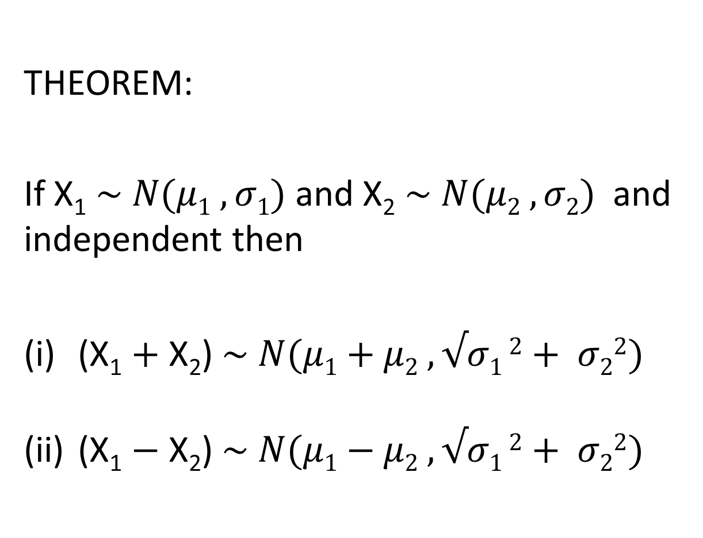
THEOREM:
If X₁ $\sim N(μ1 , σ1)$ and X₂ $\sim N(μ2 , σ2)$ and independent then
(X₁ $+ \text{X}\text{2}$) $\sim N(μ1+μ2 ,√σ1 2+ σ22)$
(X₁ $− \text{X}\text{2}$) $\sim N(μ1−μ2 ,√σ1 2+ σ22)$

Slide 43
Q.
The marks obtained by the students in mathematics, physics, and chemistry in an examination are normally distributed with mean 52 50 and 48with standard deviation 10, 8 and 6 resp. find the probability that a student selected at random has secured a total of
(i) 180 or above and
(ii) 135 or less.
Q.
If X and Y are independent RVs each following N(0, 3), what is the probability that the point(X, Y) lies between the line 3X + 4Y = 5 and 3X + 4Y = 10?

