Slide 1
Chi-Square Test

Slide 2
Chi-Square Test of Independence
Karl Pearson introduced Chi-Square (X²⁾ which is a statistical test used to determine whether your experimentally observed results are consistent with your hypothesis.
Test statistics measure the agreement between actual counts and expected counts assuming the null hypothesis. It is a non-parametric test.
The chi-square test of independence can be used for any variable; the group (independent) and the test variable (dependent) can be nominal, dichotomous, ordinal, or grouped interval.

Slide 3
Chi-square Test
Introduction
Characteristics of the test
Chi-square distribution
Application of Chi square test
Calculation of the Chi square test
Condition for the application of the test
Example
Limitations of the test

Slide 4
Important terms
Parametric test- The test in which the population constants like mean, std. deviation, std error, correlation coefficient, proportion etc. and data tend to follow one assumed or established distribution such as normal, binomial, poisson etc.
Non-parametric test- the test in which no constant of a population is used. Data do not follow any specific distribution and no assumption are made in these tests. Eg. To classify goods, better and best, we just allocate arbitrary numbers or marks to each category.
Hypothesis- It is a definite statement about the population parameters.

Slide 5
Key Hypothesis
H₀- states that no association exists between the two cross-tabulated variables in the population and therefore the variables are statistically independent e.g. If we wanna compare 2 methods, A & B for its superiority and if the population is that both methods are equally good, then this assumption is called as Null Hypothesis.
H₁- Proposes that two variables are related in the population. If we assume that from 2 methods A is superior than b method, then this assumption is called as Alternative Hypothesis

Slide 6
Degree of freedom
It denotes the extent of independence (freedom) enjoyed by a given set of observed frequencies. Suppose we are given set of observed frequencies which are subjected to k independent constant(restriction) then.
D.f.=(number of frequencies)-(number of independent constraints on them)
D.f.=)r-1) (c-1)

Slide 7
Assumptions of Chi-square
1 or more categories
Independent observations
A sample size of at least 10
Random sampling
All observations must be used
For the test to be accurate, the expected frequency should be at least 5

Slide 8
Chi-Square Limits & Problems
Implying cause rather than association
Overestimating the importance of a finding, especially with large sample sizes
Failure to recognize spurious relationships
Nominal variables only (both IV and DV)

Slide 9
Chi-Square Attributes
A chi-square analysis is not used to prove a hypothesis; it can, however, refute one.
As the chi-square value increases, the probability that the experimental outcome could occur by random chance decreases.
The results of a chi-square analysis tell you: Whether the difference between what you observe and the level of difference is due to sampling error.
The greater the deviation of what we observe to what we would expect by chance, the greater the probability that the difference is NOT due to chance.

Slide 10
Critical Chi-Square Values
Critical values for chi-square are found on tables, sorted by degrees of freedom and probability levels. Be sure to use p < 0.05.
If your calculated chi-square value is greater than the critical value calculated, you“reject the null hypothesis.”
If your chi-square value is less than the critical value, you“fail to reject” the null hypothesis

Slide 11
Hypothesis Testing with X²
To test the null hypothesis, compare the frequencies which were observed with the frequencies we expect to observe if the null hypothesis is true
If the differences between the observed and the expected are small, that supports the null hypothesis
If the differences between the observed and the expected are large, we will be inclined to reject the null hypothesis

Slide 12
Chi-Square Use Assumptions
Normally requires sufficiently large sample size:
  In general N > 20.
  No one accepted cutoff – the general rules are
    No cells with observed frequency = 0
    No cells with the expected frequency < 5
    Applying chi-square to very small samples exposes the researcher to an unacceptable rate of Type II errors.
  Note: chi-square must be calculated on actual count data, not substituting percentages, which would have the effect of pretending the sample size is 100.

Slide 13
Using SPSS for Calculating X²
Conceptually, the chi-square test of independence statistic is computed by summing the difference between the expected and observed frequencies for each cell in the table divided by the expected frequencies for the cell.
We identify the value and probability for this test statistic from the SPSS statistical output.
If the probability of the test statistic is less than or equal to the probability of the alpha error rate, we reject the null hypothesis and conclude that our data supports the research hypothesis. We conclude that there is a relationship between the variables.
If the probability of the test statistic is greater than the probability of the alpha error rate, we fail to reject the null hypothesis. We conclude that there is no relationship between the variables, i.e. they are independent.

Slide 14
Applications of Chi square test
This test can be used in
1. Goodness of fit of distributions.
2. Test of independence of attributes.
3. Test of Homogeneity

Slide 15
Conducting Chi-Square Analysis
Make a hypothesis based on your basic question
Determine the expected frequencies
Create a table with observed frequencies, expected frequencies, and chi-square values using the formula:
(O-E)²
E
Find the degrees of freedom: (c-1)(r-1)
Find the chi-square statistic in the Chi-Square Distribution table
If chi-square statistic > your calculated chi-square value, you do not reject your null hypothesis and vice versa.

Slide 16
Example 1: Testing for Proportions
H_{O}: Indian customers have no brand preference.
H_{A}: Indian customers have distinct brand preference.
 | Brand A | Brand B | Brand C | Total
Observed | 25 | 18 | 17 | 60
Expected | 20 | 20 | 20 | 60
O-E | 5 | -2 | -3 | 0
(O-E)² E | 1.25 | 0.2 | 0.45 | χ² = 1.90
χ² ⁼ Sum of all: (O-E)²
E
Calculate degrees of freedom: (c-1)(r-1) = 3-1 = 2
Under a critical value of your choice (e.g. α = 0.05 or 95% confidence),
look up Chi-square statistic on a Chi-square distribution table.

Slide 17
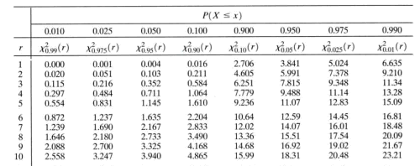
Example 1: Testing for Proportions
χ²_{α=0.05} = 5.991

Slide 18
Example 1: Testing for Proportions
 | Brand A | Brand B | Brand C | Total
Observed | 25 | 18 | 17 | 60
Expected | 20 | 20 | 20 | 60
O-E | 5 | -2 | -3 | 0
(O-E)² E | 1.25 | 0.2 | 0.45 | χ² = 1.90
Chi-square statistic: χ² = 5.991 Our calculated value: χ² = 1.90
*If chi-square statistic > your calculated value, then you do not reject your null hypothesis. There is a significant difference that is not due to chance.
5.991 > 1.90 ∴ We do not reject our null hypothesis.

Slide 19
2. Test of independence of attributes
Test enables us to explain whether or not two attributes are associated.
Eg. We may be interested in knowing whether anew medicine is effective in controlling fever or not, Chi square is useful.
We proceed with the H0 that the two attributes viz. new medicine and control of fever are independent which means that new medicine is not effective in controlling fever.
X2( calculated) > X2 (tabulated) at a certain level of significant for given degrees of freedom, the H0 is rejected and can conclude that new medicine is effective in controlling fever.

Slide 20
3. Test of Homogeneity
This test can also be used to test whether the occurrence of events follow uniformity or not eg. The admission of student in University in all days of week is uniform or not can be tested with the help of X2.
X2(calculated) > X2 (tabulated), then H0- rejected and can conclude that admission of students in University is not uniform.

Slide 21
Eg.2 Suppose we want to toss 50 times a coin
 | Head | Tail
Expected | 25 | 25
Observed | 28 | 22
(O-E)2/E | 9/25 | 0/25
 | 0.72< 3.841(Table value)

Slide 22
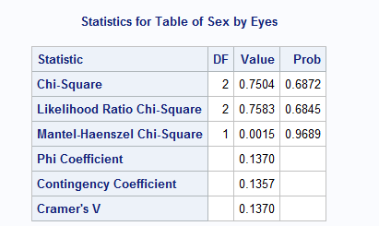
What do these mean?

Slide 23
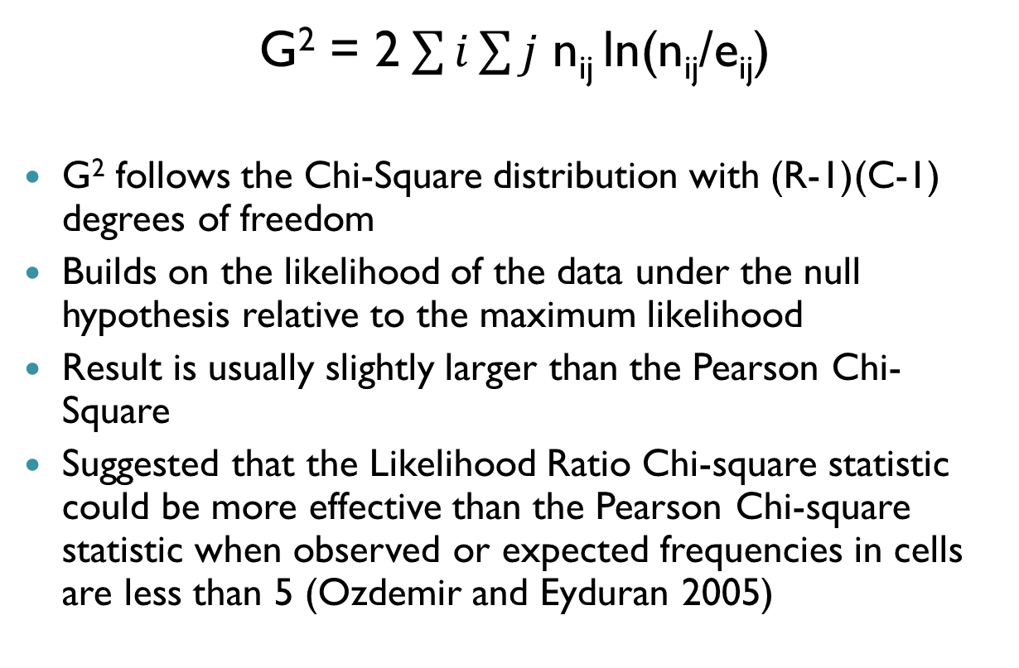
Likelihood Ratio Chi Square

Slide 24
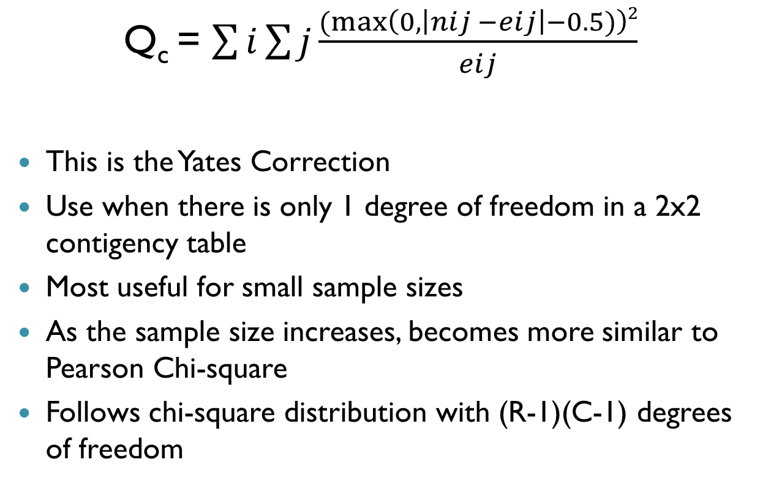
Continuity-Adjusted Chi-Square Test

Slide 25
Mantel-Haenszel Chi-Square Test
Q_{MH} = (n-1)r²
r² is the Pearson correlation coefficient (which also measures the linear association between row and column)
  http://support.sas.com/documentation/cdl/en/procstat/63104/HTML/default/viewer.htm#procstat_freq_a0000000659.htm
Tests alternative hypothesis that there is a linear association between the row and column variable
Follows a Chi-square distribution with 1 degree of freedom

Slide 26
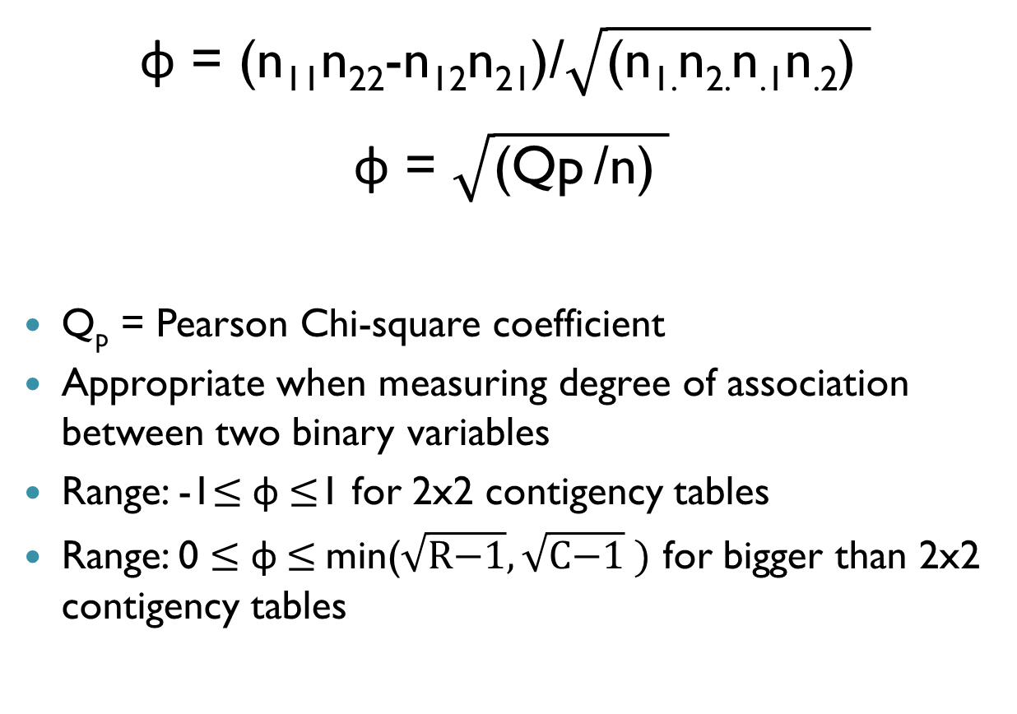
Phi Coefficient

Slide 27
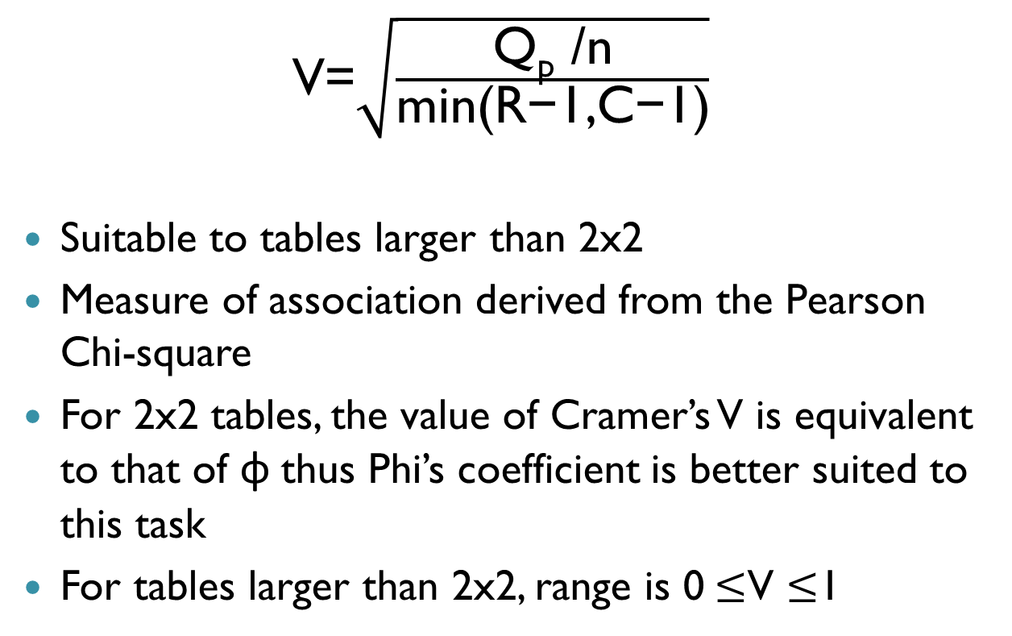
Cramer’s V

Slide 28
Limitations of Chi square test
The data is from a random sample.
This test is applied in a four fould tabel, will not give a reliabel result with one degree of freedom if the expected value in any cell is less than 5.
In contingency table larger than 2x2. Yate’s correction can not be applied.
Only absolute value of original data should be used for the test.
P & Ab. Of association does not measure the strength of association.
Does not indicate cause and effect.

