Slide 1
By : Dr. Nilofer Syed
Subphylum Cehalochordata

Slide 2
The cephalochordates are the lancelets, which are small (3-7 cm long) laterally compressed fishlike animals that inhabit sandy sediments of coastal waters. They lack a distinct head and have no cranium.
They are commonly referred to as Amphioxus as this was the original genus name. There are 29 species, five of which occur in North American coastal waters.

Slide 4
Amphioxus is a filter feeder.
Water enters the mouth and then passes through the pharyngeal slits, where food is trapped in mucus. Cilia then move the food to the gut.

Slide 6
Amphioxus is interesting because it displays the basic chordate characteristics in a simple and obvious form because of its transparency.
Amphioxus is considered to be the closest living relative of the vertebrates because it shares several characteristics with vertebrates that Urochordates do not possess.

Slide 7
As well as possessing the chordate characteristics, amphioxus shares a number of traits with vertebrates including:
  Segmented myomeres (muscle blocks)
  Dorsal and ventral aortas
  Branchial (gill) arches (blood vessels running over the gills).

Slide 8
Amphioxus however lacks several characteristics that biologists think the ancestor of vertebrates possessed. These include:
  Tripartite brain (with forebrain, midbrain and hindbrain) protected by a cranium
  Chambered heart
  Muscular gut and pharynx
  List continues on next slide

Slide 9
  Various special sensory organs (eyes, chemical and pressure receptors)
  Neural crest (ectodermal cells that are found on the embryonic neural tube and are engaged in the formation of the cranium, tooth dentine, some endocrine glands and Schwann cells, which provide myelin insulation to nerve cells).

Slide 10
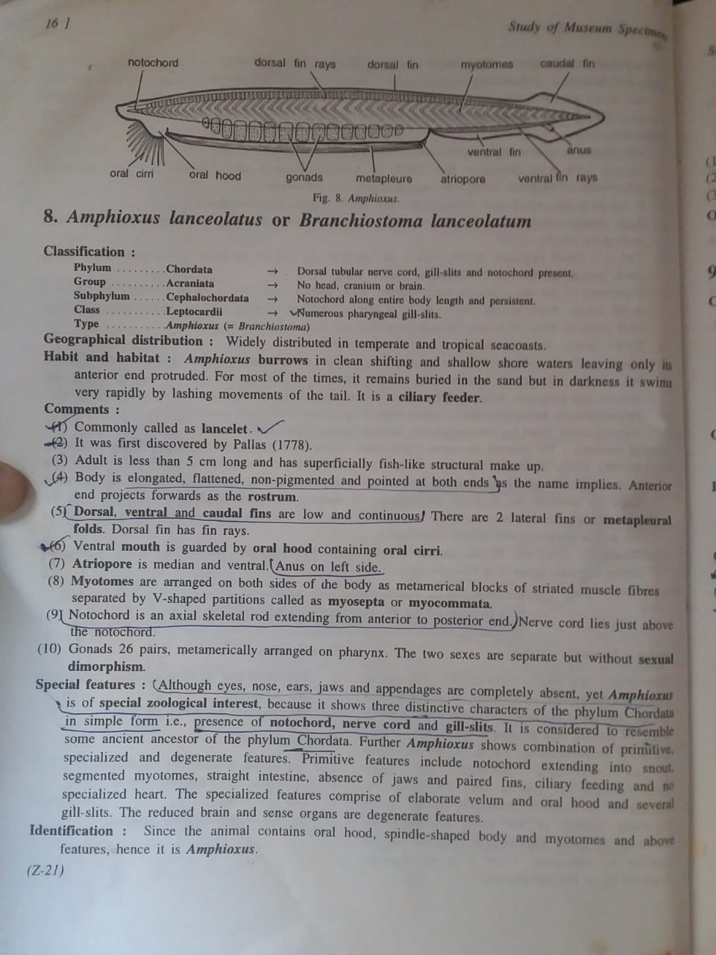

Slide 11
Thanks

