Slide 1
REPTILIA
BY: NILOFER SYED

Slide 2
These were the first class of organisms to adapt to life on land. They are believed to have evolved from the amphibians millions of years ago. There are about 10000 different species of reptiles on earth. They are cold-blooded animals belonging to the phylum Chordata of Animal kingdom.
The skull of the reptiles is modified that gives the reptiles an efficient and powerful jaw action. The modification also makes the skull light.

Slide 3
Characteristics of Reptilia
Following are the important characteristics of the animals belonging to Class Reptilia:
These are creeping and burrowing terrestrial animals with scales on their body.
They are cold-blooded animals found in most of the warmer regions of the world.
Their skin is dry, and rough, without any glands.
The body is divided into head, neck, trunk, and tail.
Few of these shed the scales on their skin as skin cast.
The respiration takes place with the help of the lungs.
The skull is monocondylic.
They have two pairs of pentadactyl limbs, each bearing claws. Snakes are an exception.
The heart is 3 chambered. However, crocodiles have a 4-chambered heart.
The nervous system comprises of 12 pairs of cranial nerves.

Slide 4
The lateral line system is absent in reptiles.
Except for snakes, all the reptiles have well-developed ears.
They possess a typical cloaca.
Reptiles are ureotelic, uricotelic, and ammonotelic.
Fertilization is internal.
They exhibit a meroblastic segmentation.
They are oviparous and the eggs are very yolky.
Eg., Snakes, Turtles, Lizards, Crocodiles

Slide 5
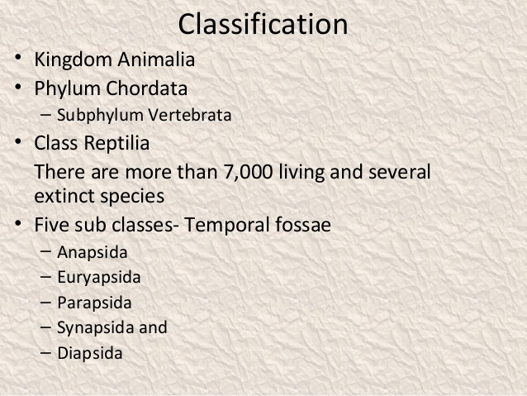

Slide 6
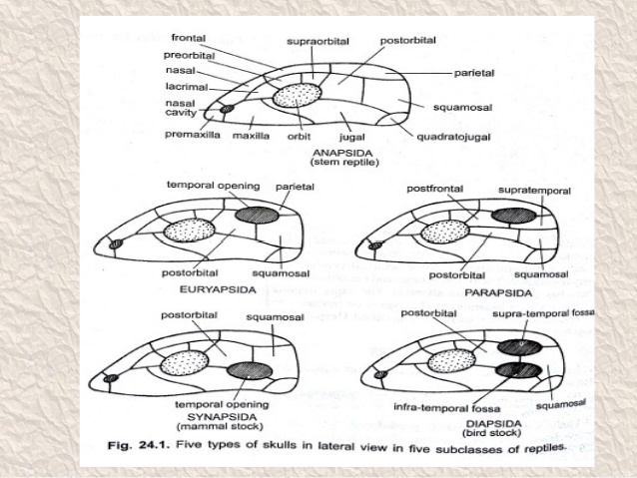

Slide 7
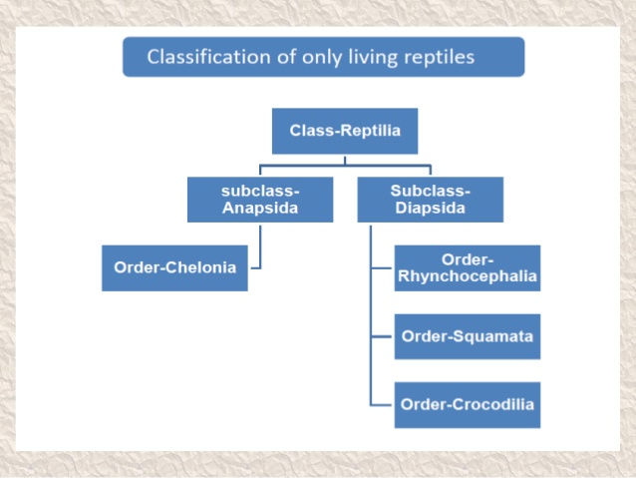

Slide 8
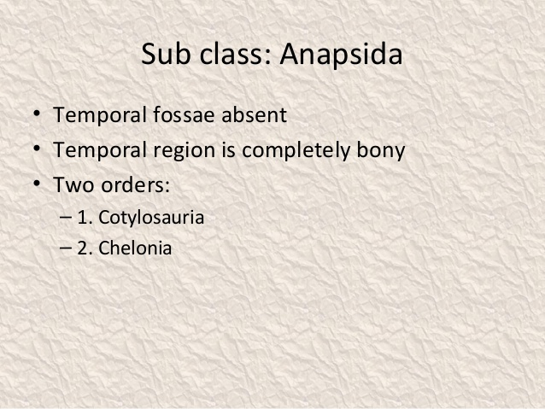

Slide 9
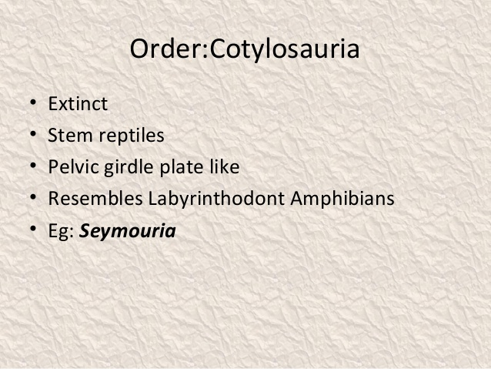

Slide 10
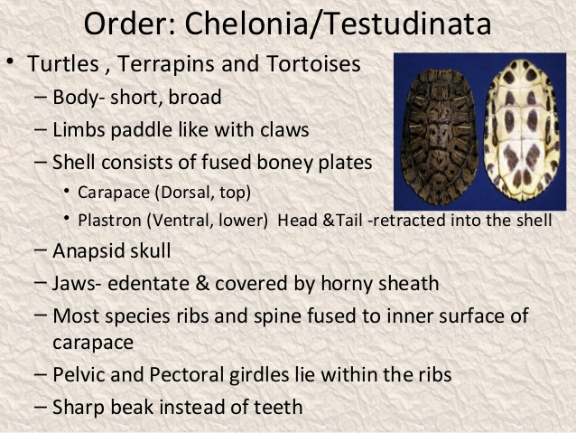

Slide 11
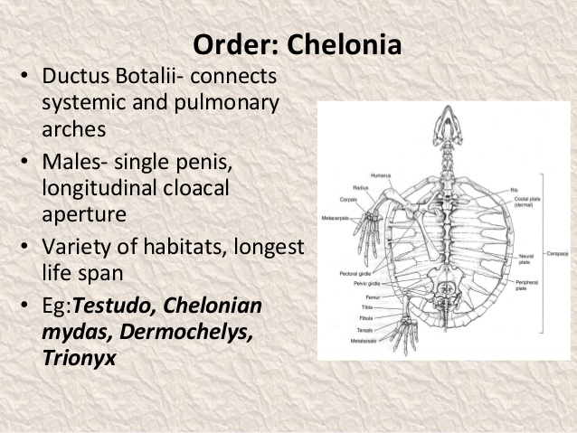

Slide 12
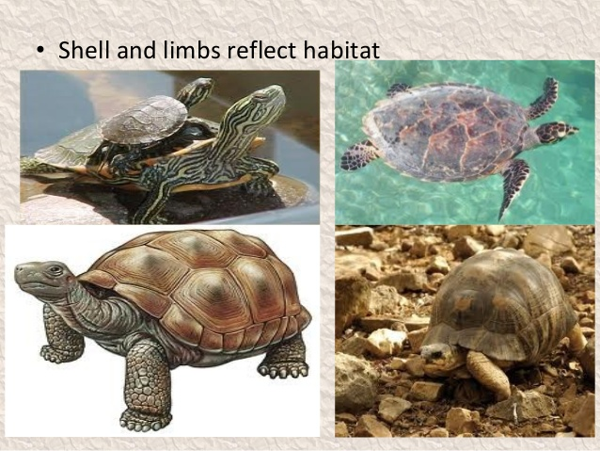

Slide 13
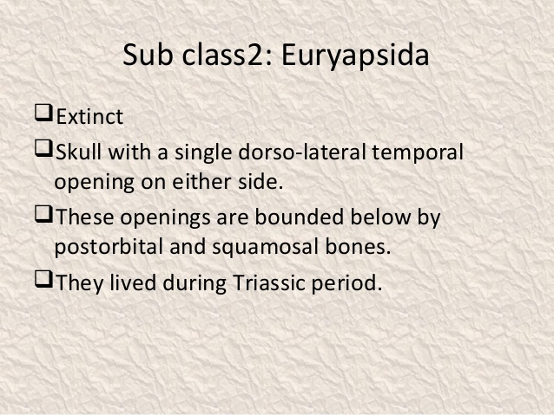

Slide 14
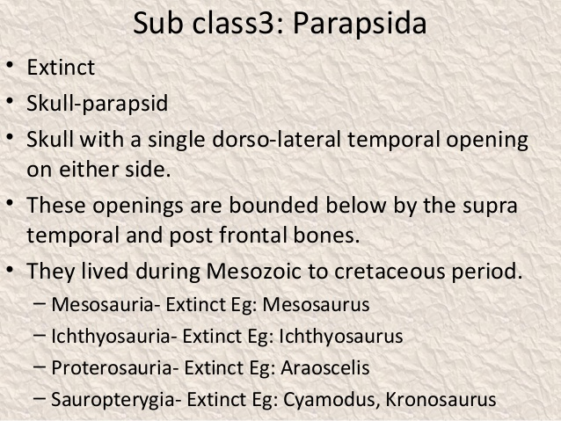

Slide 15
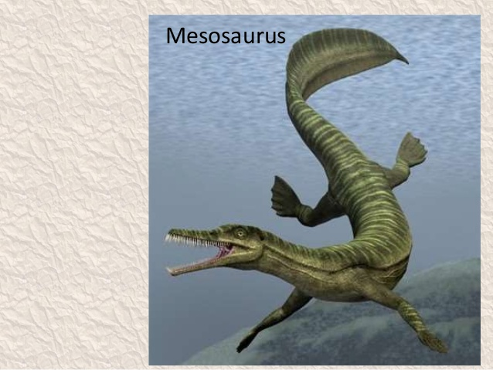

Slide 16
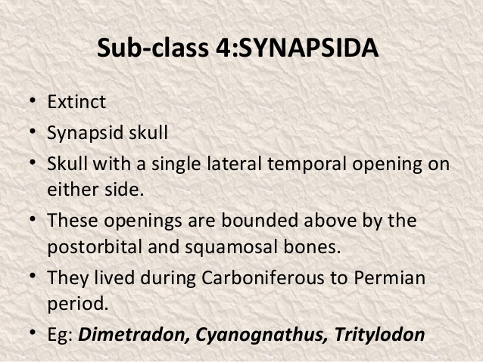

Slide 17
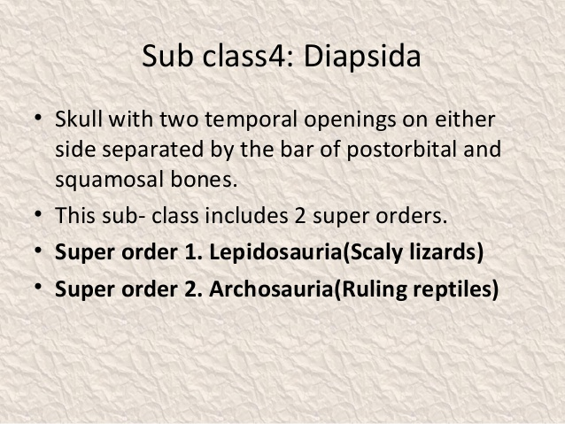

Slide 18
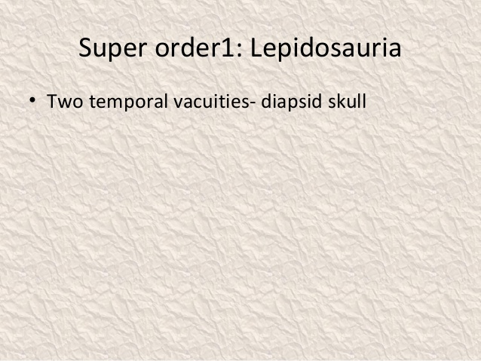

Slide 19
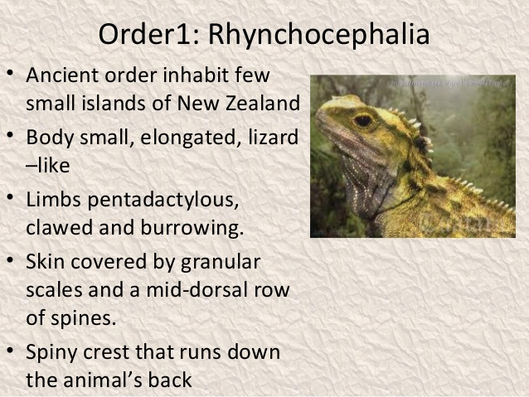

Slide 20
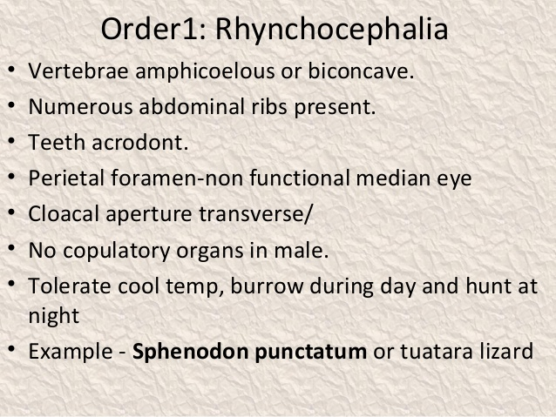

Slide 21
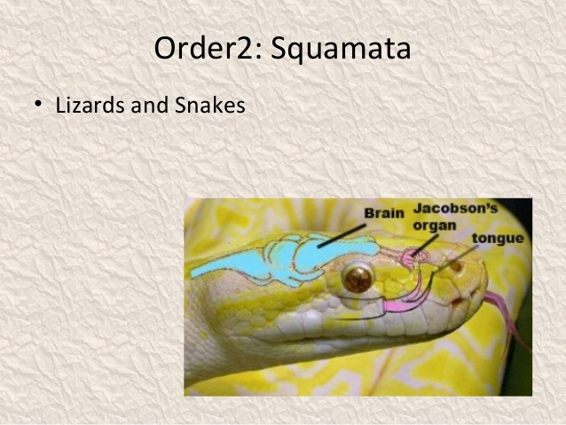

Slide 22
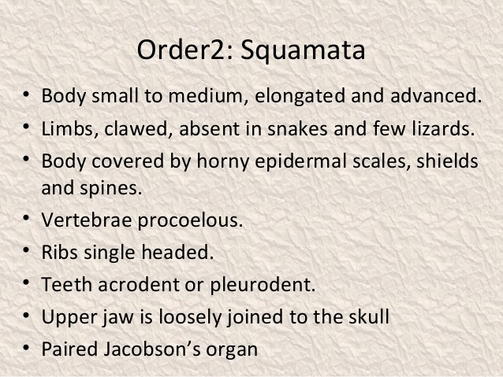

Slide 23
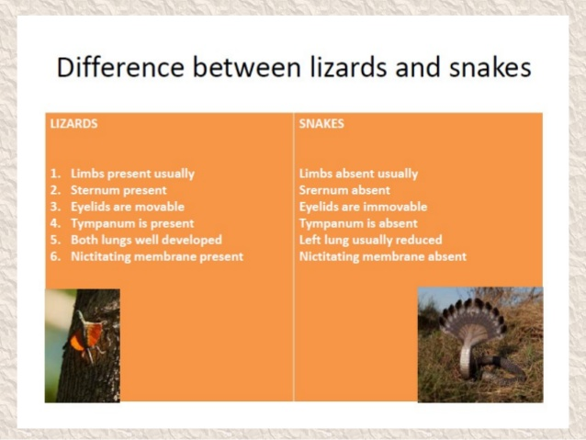

Slide 24
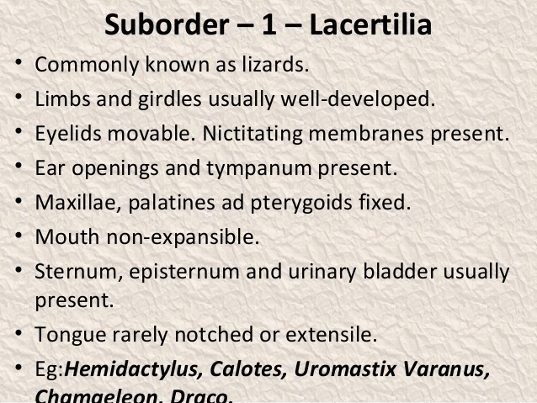

Slide 25
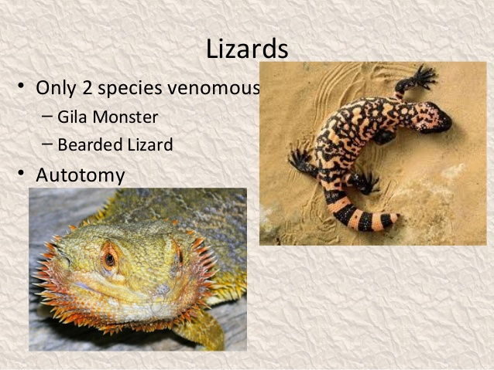

Slide 26
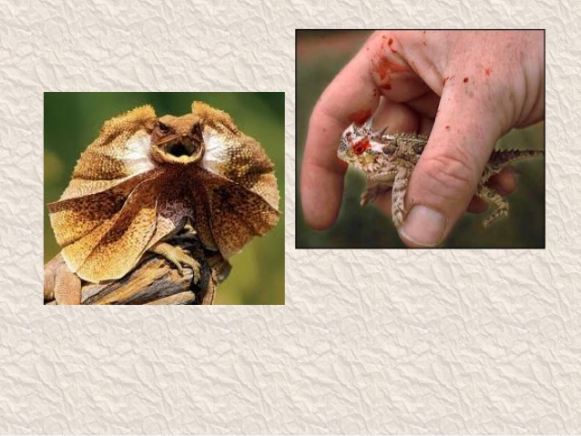

Slide 27
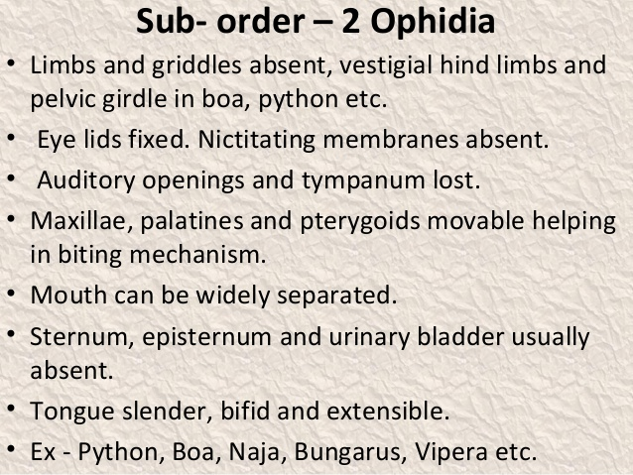

Slide 28
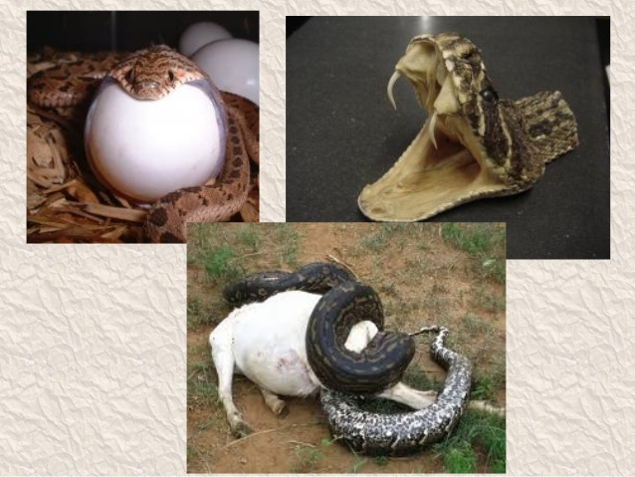

Slide 29
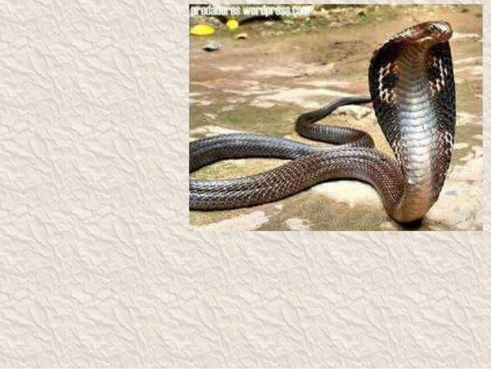

Slide 30
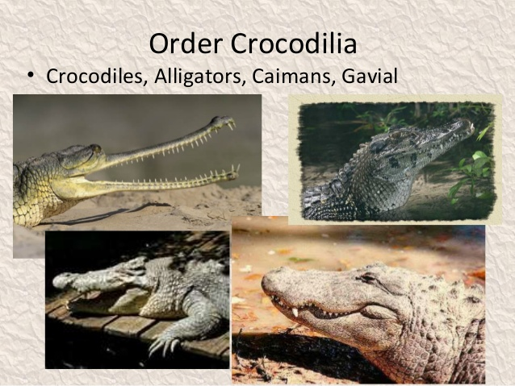

Slide 31
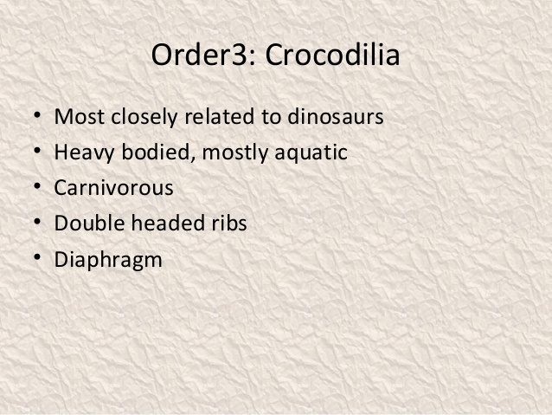

Slide 32
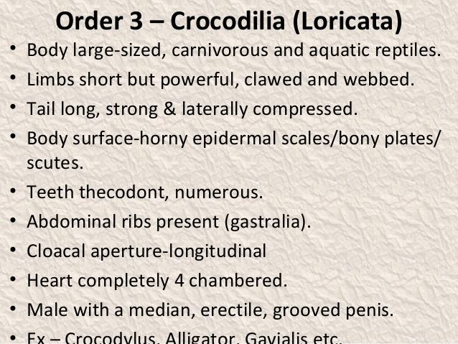

Slide 33
Thanks

