Slide 1
ORIENTATION - KINESIS
BY : DR. NILOFER SYED

Slide 5
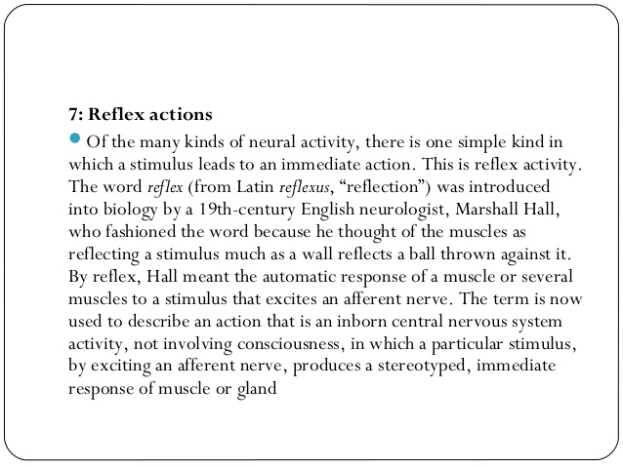

Slide 6
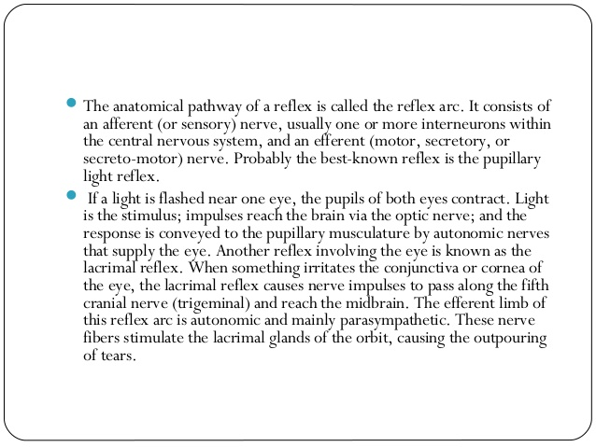

Slide 8
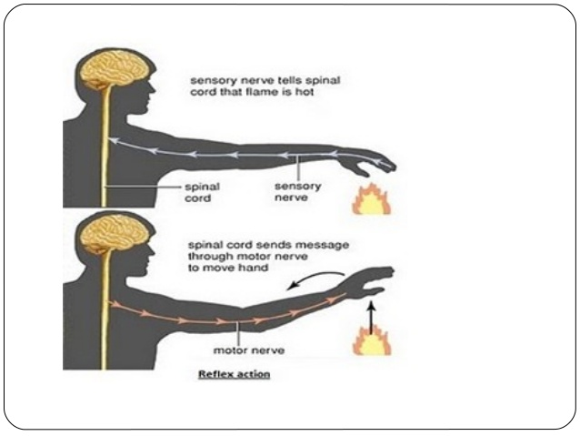

Slide 9
THANKS

