Slide 1
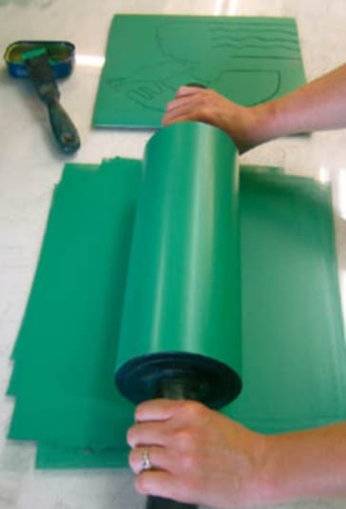
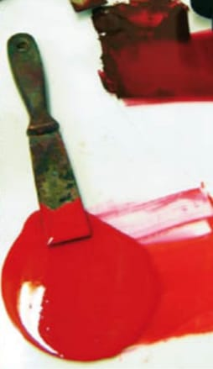
PRINTMAKING
WITH
TECHNIQUES
PROF. MADAN SINGH RATHORE
HEAD, DEPT. OF VISUAL ARTS
MOHANLAL SUKHADIA UNIVERSITY

Slide 2
What Is Printmaking?
Printmaking is the process of transferring an image from a matrix to a substrate with the possibility of identical repetition (called editions). This means that once you create your design or image you can print it (several times in most cases) onto paper, fabric, wood, etc., using ink and a few additional tools. The number of different looks you can achieve using the different techniques and materials is infinite, and all you need to start is an idea, some paper, and ink.
Printmaking has been around since the invention of paper in China, almost 2,000 years ago. At its inception, it was a means of communication as it allowed for the mass production and dissemination of social, political, and historical ideas. Today, it is widely used as an artistic process.

Slide 3
Printmaking Began in China
The Chinese developed a printing technique called “woodcut” to print books of Chinese characters and images, around 100 AD.

Slide 4
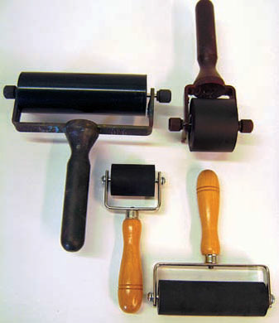
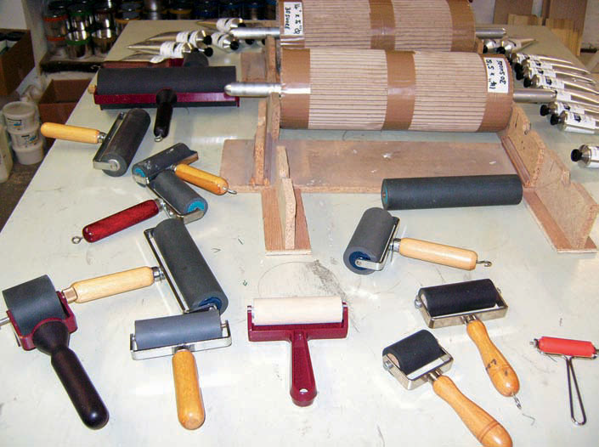
Equipment, Tools, Materials GENERAL EQUIPMENTS
ROLLERS
An assortment of rollers is needed for inking plates and blocks, and rolling on grounds.

Slide 5
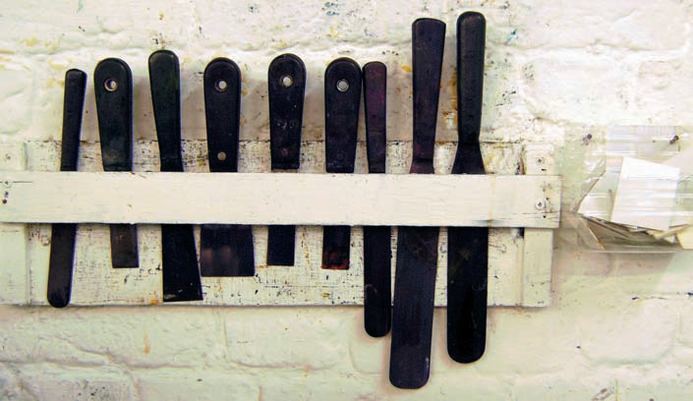
PALETTE KNIVES
Palette knives are used for mixing and spreading inks

Slide 6
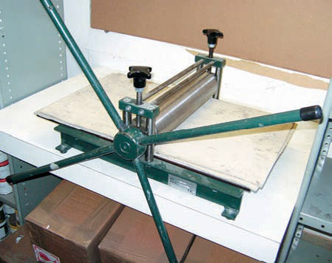
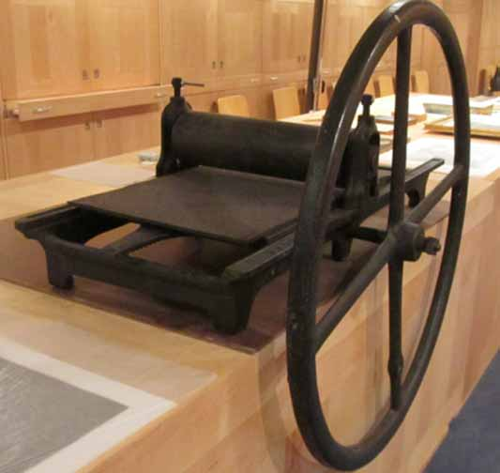
As it is only relief prints that can be successfully hand-printed, the use of a printing press is paramount for most printmakers. A printing press is the most expensive single item in a printmaking studio. However, once purchased a good press should last a lifetime
PRINTING PRESSES

Slide 7
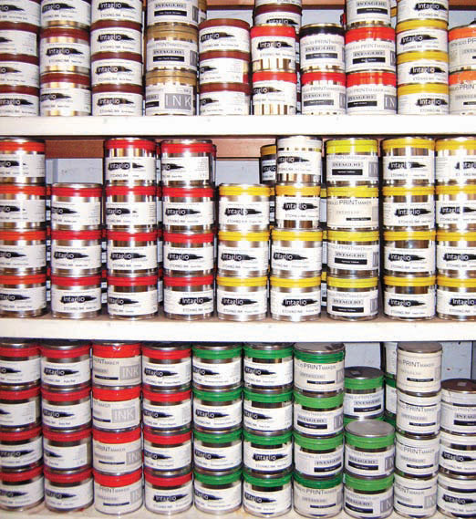
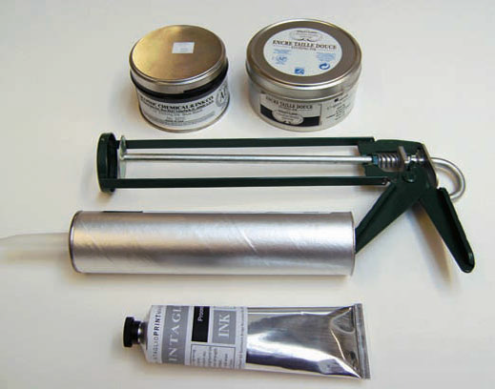
INK
When purchasing inks it is wise to consult a colour chart, as colour names can be unfamiliar compared to those of artists’ paints.

Slide 8
.
PAPERS
The choice of papers available to printmakers is wide. Papers vary in texture, colour and weight. The paper choice, particularly in respect to colour (there are many shades from white through off-white to cream) is important and can really affect the printed image. For this reason it always worth experimenting by printing an image on different papers

Slide 9
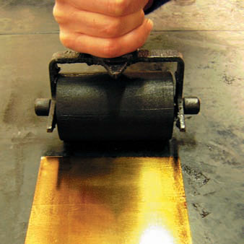
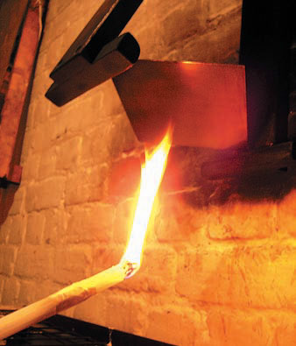
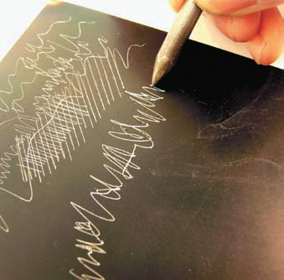
TECHNIQUES
ETCHING
Etching is a process in which lines or textures are bitten (etched) into a metal plate with a variety of mordants (acids). The metal plate is first covered with an acid-resistant coating (ground). The design is then scratched or pressed into the ground, exposing the metal in these areas. Finally, the plate is submerged in an acid solution until the desired depth and width in the exposed areas is reached.

Slide 10
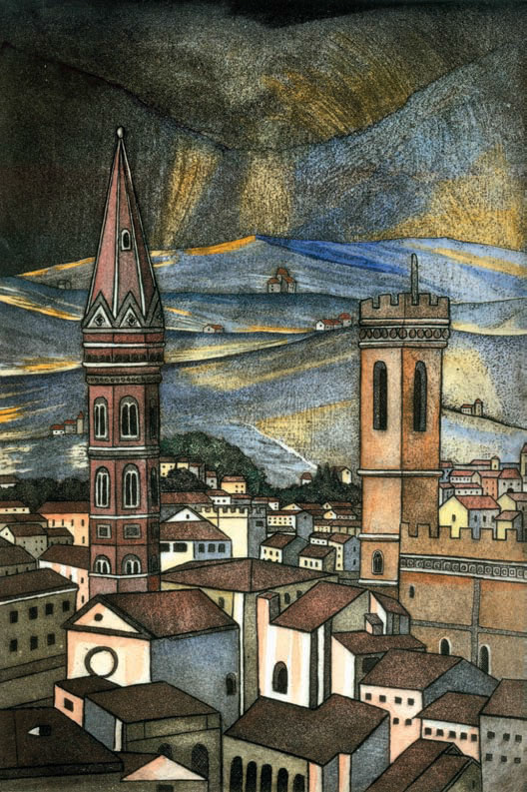
Meg Dutton, 2007. Etching on zinc with hand-colouring,
40 x 60 cm

Slide 11
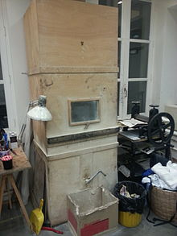
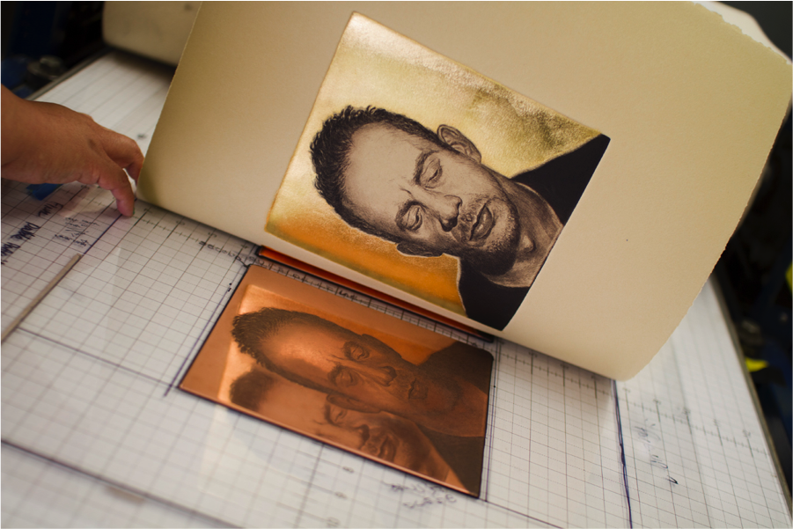
AQUATINT
Aquatint is a process used to etch tonal areas on the plate.
Aquatint Box
Aquatint by Joseph P. Gerges

Slide 12
Aquatint is an etching process used to achieve subtle shifts between light and dark. Aquatinting is the application of fine particles of resin onto all or part of a plate. The basic concept behind an aquatint is to stop out the areas you don’t want the acid to etch. In order to stop out an area, you cover that area of the plate with a barrier so that the acid can’t touch the surface of the metal.
The plate is heated to melt the resin and is then exposed to acid. The acid eats into the metal around the particles, creating a granular pattern. Tonal gradations depend on the strength of the acidic bath and the length of time the plate is submerged. Aquatint produces areas of tone ranging from deep black to light gray, and can give the appearance of ink washes, but upon close inspection it is made up of a network of fine grains much like a pixelated image.
Variations on the aquatint process include sugar-lift, spit biting, and soap- grounding. The processes rely on alternate materials applied to the plate's surface. These techniques can heighten tonal gradations and produce printed marks that resemble brushstrokes.

Slide 13
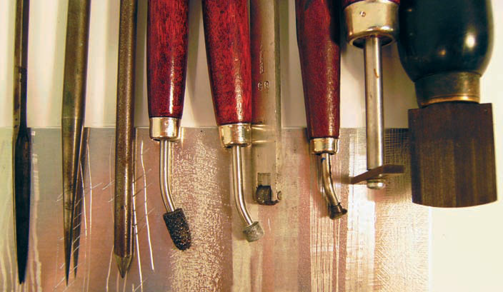
DRYPOINT
Drypoint is a non-acid intaglio technique. To make a drypoint, marks are scratched directly into the surface of a plate made of card, plastic or metal. A sharp metal tool referred to as a drypoint needle is used. As the marks are incised into the plate’s surface a burr is displaced. When the plate is inked, ink is held not only in the groove created below the surface but also by the burr that is pushed up. The resulting printed mark has a characteristic velvety look.
Scraper, drypoint needle, sharpened nail,
irregular roulette, fine roulette, medium
drum roulette, line roulette, halftone rake,
mezzotint rocker. [from left to right]

Slide 14
Different marks using drypoint tools

Slide 15
Melvyn Petterson, 2008. Drypoint on aluminium,
76 x 90 cm

Slide 16
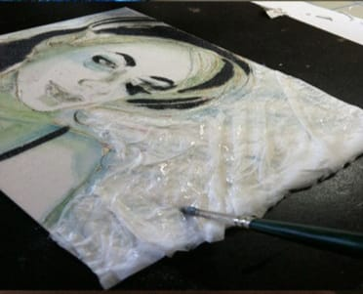
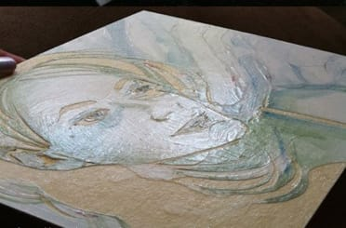
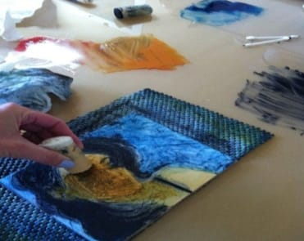
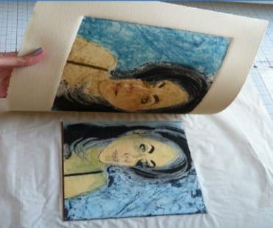
Collagraph
Collagraph is a technique allowing printmaking from a plate made of collaged textures and materials. A wide range of materials such as glues, varnishes, acrylics and textiles can be used to form a contoured surface on a flat base plate of card or metal.
This technique is well suited to artists who love an experimental mixed media approach. Collagraph can incorporate both intaglio and relief on a single plate. The technique produces heavily embossed, bold, vibrant images.

