Slide 1
Magmatic Differentiation, Assimilation & Magma Mixing
Rajnikant Patidar
Department of Geology, M.L. Sukhadia University, Udaipur – 313002
Email: rajnikantpatidar7@gmail.com

Slide 2
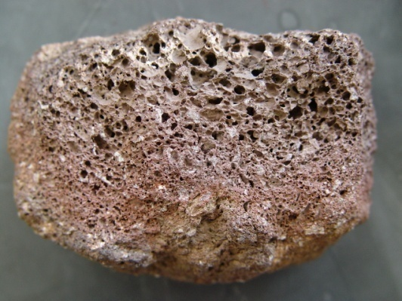
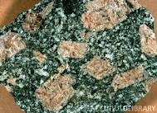
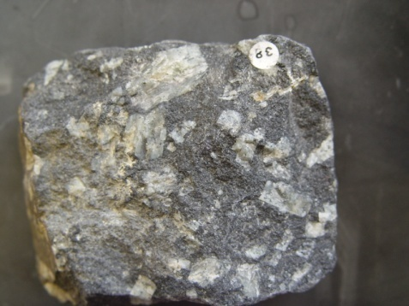
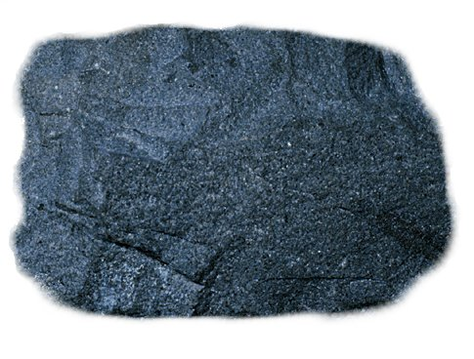
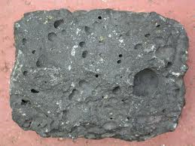
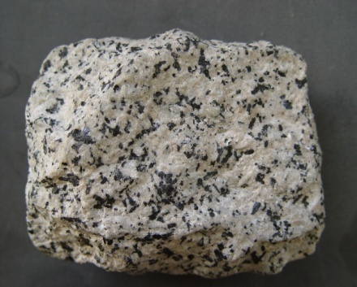
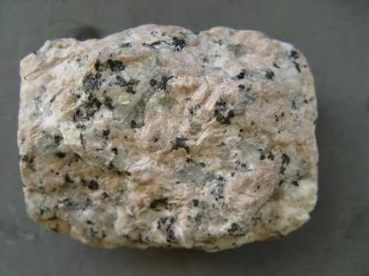
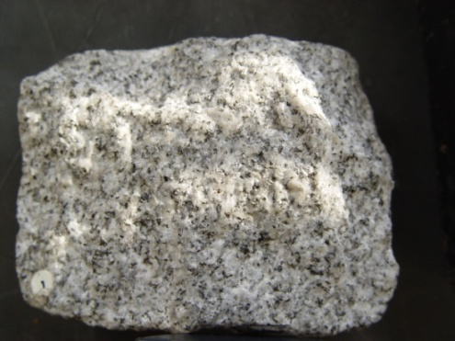
Why do we get so much variation in igneous rocks?
There is only Two or Three Types of Primary Magmas and Igneous rocks are formed due to cooling and solidification of magma. In principle, there should be two types of igneous rocks.
Over 700 types of igneous rocks are found.

Slide 3
A primary magma: Is the "first melt" produced by partial melting within the mantle, and which has not yet undergone any differentiation.
A primary magma may therefore evolve into a parental magma by differentiation.
A parental magma: Is a magma capable of producing all rocks belonging to an igneous rock series by differentiation.

Slide 4
Magmatic Differentiation - Definition
Magmatic differentiation is process through which a single homogeneous magma is able to produce two or more fractions (daughter magmas) of different composition, which ultimately forms diverse rock types.
The primary cause of change in the composition of a magma is cooling. Cooling causes the magma to begin to crystallize minerals from the melt or liquid portion of the magma.
Contamination is another cause of magma differentiation. Contamination can be caused by assimilation of wall rocks or mixing of two or more magmas.

Slide 5
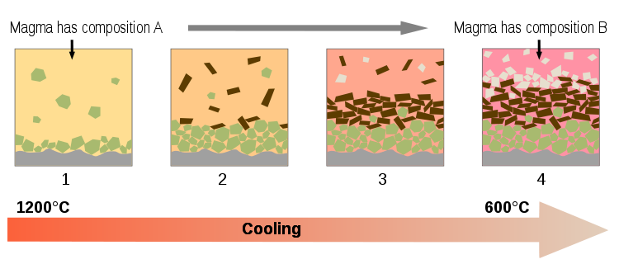

Slide 6
Mechanism of Differentiation
Four potential mechanism of differentiation are suggested:
Fractional Crystallization
Liquid Immiscibility
Vapour Transport (Gaseous Transfer)
Thermo – gradient Diffusion

Slide 7
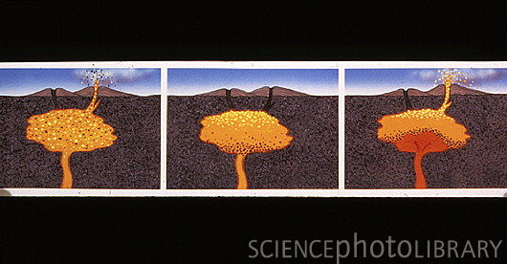
Fractional Crystallization
Most powerful mechanism of magmatic differentiation.
Fractional crystallization is the segregation and removal of crystallized minerals from a melt, which changes the composition of the melt.

Slide 8
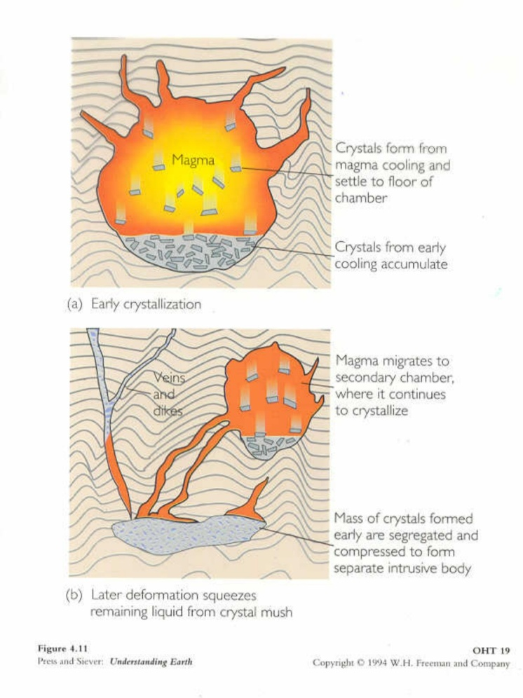
The process of Fractional Crystallization involves the separation and preservation of early-forming minerals, usually due to density differences.
Figure A show CRYSTAL SETTLING (a form of FRACTIONAL CRYSTALLIZATION.)
Figure B show MAGMA MIGRATION (another form of FRACTIONAL CRYSTALLIZATION.)

Slide 9
Gravity plays a very important role in settling of early formed crystals from the melt.
Parting between crystals and melt within a magmatic body may also be observed in flowing magma (documented in many dykes and sills), where greater concentration of large sized crystals commonly occur at the core (inner part) of dyke or sill (slow cooling at inner region so crystal grow in large size). This is known as Flowage Segregation.
Tectonic movements and some time the “Filter Pressing” (weight of accumulated crystals presses the underlying melt to squeeze out (move away) are responsible of removal of crystallized portion from the magma.

Slide 10
Bowen’s Reaction Series
The process of magmatic differentiation by Crystal – Liquid Fractionation (Fractional Crystallization) is also explained by N.L. Bowen (1928). This process is popularly known as Bowen’ Reaction Series or Bowen’s Reaction Principle.
Bowens reaction series is a series of crystallization sequences that occur during magmatic cooling.
Bowen suggested a mechanism through which a magma may solidify as a single rock type or may give rise to many rock types.

Slide 11
According to Bowen’s Reaction Principle “ As crystallization of magma starts, there is a tendency for equilibrium to be maintained between solid (crystals) and liquid (residual melt) phases. To maintain this equilibrium, the early formed crystals (unless removed from the melt) react with the residual melt and change in composition (formation of new mineral) takes place”.
Bowen’ Reaction Principle illustrates how a primary basaltic magma may give rise granite or other igneous rocks (depending upon the degree of crystallization and reaction of early formed crystals with melt or removal of these crystals from the melt.

Slide 12
In Bowen’s Reaction Series there are two parallel series. One for Fe-Mg minerals and the other represents Plagioclage felspar group.
Both these series converge and merge into a single series.
The reaction series of Fe-Mg minerals is called as Discontinuous Series and that of Plagioclase is called as Continuous Series.

Slide 13
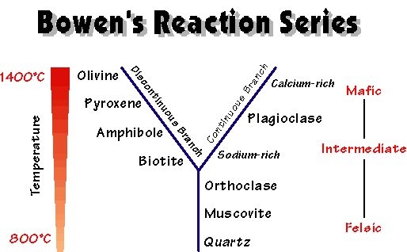

Slide 14
Discontinuous Series: At lowering of temperature (cooling starts), first mineral to crystallized is “Olivine”. As soon as it formed (unless it removed from the melt), with falling temperature the “Olivine” react with the melt and convert into “Mg-Pyroxene”. This will continue till whole “Olivine” get convert into “Mg-Pyroxenes”.
Later on the reaction remain continue and “Mg-Pyroxene” (unless removed from the melt), react with the melt and convert into “Ca-Pyroxene” and then “Hornblende”, then “Biotite”, with the falling temperature.

Slide 15
Continuous Series: At lowering of temperature (cooling starts), first plagioclase to crystallized is rich in Ca (Ca-Plagioclase). As the reaction goes on and temperature drops, the crystals become more and more sodic (unless remove from the melt).
The Potash Felspar and Muscovite are formed at later stages and the last formed mineral is “Quartz”.
Thus a basaltic magma on gradual cooling may convert into granitic melt (Quartz + K-Felspar + Muscovite), if the crystallized minerals do not removed from the melt. If removed in between the reaction then other rocks of that particular composition will form (at which stage the minerals removed).

Slide 16
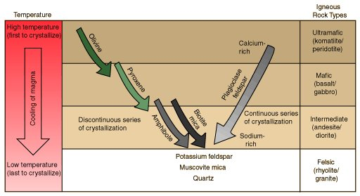

Slide 17
Liquid Immiscibility
Laboratory experiments have shown that the Liquid Immiscibility also play an important role in magmatic differentiation and diversification of igneous rocks.
It is believed that a homogenous liquid magma on cooling, split into two immiscible liquid fractions (having different composition).
For e.g. a Tholeiitic liquid magma on cooling may split into two fractions (a) Granitic melt (b) Fe-Mg rich melt.

Slide 18
Tholeiitic Magma
Cooling
Granitic Melt
Fe-Mg rich Melt
Likewise, from mafic silicate magmas, Sulfide liquids may separate as immiscible fraction.
Similarly, highly alkaline magmas rich in CO₂ may separate into two liquids, one rich in carbonate, and the other rich in silica and alkalies. This process may be responsible for forming the rare carbonatite magmas. Carbonatites (alkaline igneous rocks) are commonly generated through the process of liquid immiscibility.

Slide 19
Vapour Transport (Gaseous Tranfer)
Magma also consists of “Gaseous Phase”.
Several gases and highly volatile material ( H₂O, CO₂ , F, Cl, S etc.) are present in magma.
These gases and volatile material flows as a bubbles in magma and carry the early formed crystals or non volatile material.
When highly gaseous magma rises upward to the surface, the release of gases contribute in the change of original composition of magma (magmatic differentiation).

Slide 20
Thermo – gradient Diffusion
Also known as “Soret Effect”.
It is the compositional variation due to the difference of heat (thermal gradient) within the magma chamber.
An experiment of Walker & Delong (1982) has suggested the Soret – effect on a sample of basalt under thermal gradient. They found that Si, Al, Na, K were enriched towards the “hot-end” of the charge and Fe, Mg, Ca, Mn towards the “cold end”.

Slide 21
Assimilation
Assimilation is another process of responsible for diversification of igneous rock types.
Assimilation is the incorporation of matter from wall rocks into the magma to give a contaminated or hybrid magma.
During the intrusion of magma in wall rocks, some of the fraction of wall rock mixed in the magma and may become partially or completely melted (due to heat of magma) and merged into the liquid fraction of magma (causing change of composition of primary magma).

Slide 22
According to the Bowen (1928), a considerable amount of heat is necessary to melt the minerals of country rocks.
For the process of assimilation, magmatic temperature should be high otherwise only those minerals of wall rock will melt, which are having lower melting temperature. Wholesale (Bulk) assimilation by a liquid magma requires a superheated magma (very high temperature).
The presence of xenoliths (fractured portion of country rocks) is indicative of assimilation.

Slide 23
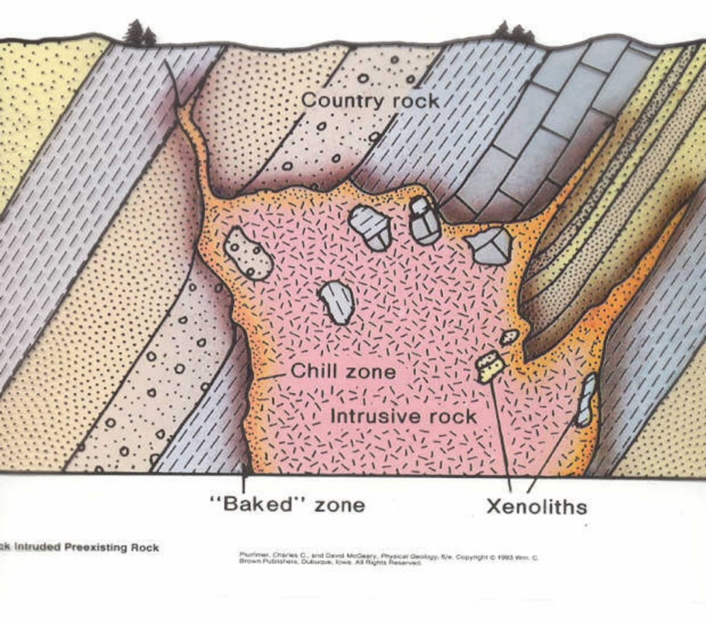
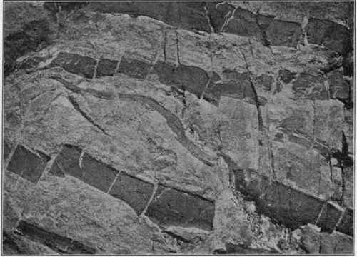
The process of ASSIMILATION by a magma is shown. Un-melted
parent rock remains intact in the
form of XENOLITHS.
Inclusions (xenoliths) of schist in granite

Slide 24
Magma Mixing
The process of magma mixing is also responsible for variation in igneous rocks.
Bunsen (1851) first suggested that the mixing of two contrast primary magmas (basaltic and rhyolitic) may account for the range of variation in the lava. Later on Durocher (1909) explained that all igneous rocks are derived from two primary magma only.
Magma mixing do occur in nature but petrologists do not consider it as the principal factor in magmatic evolution.

Slide 25
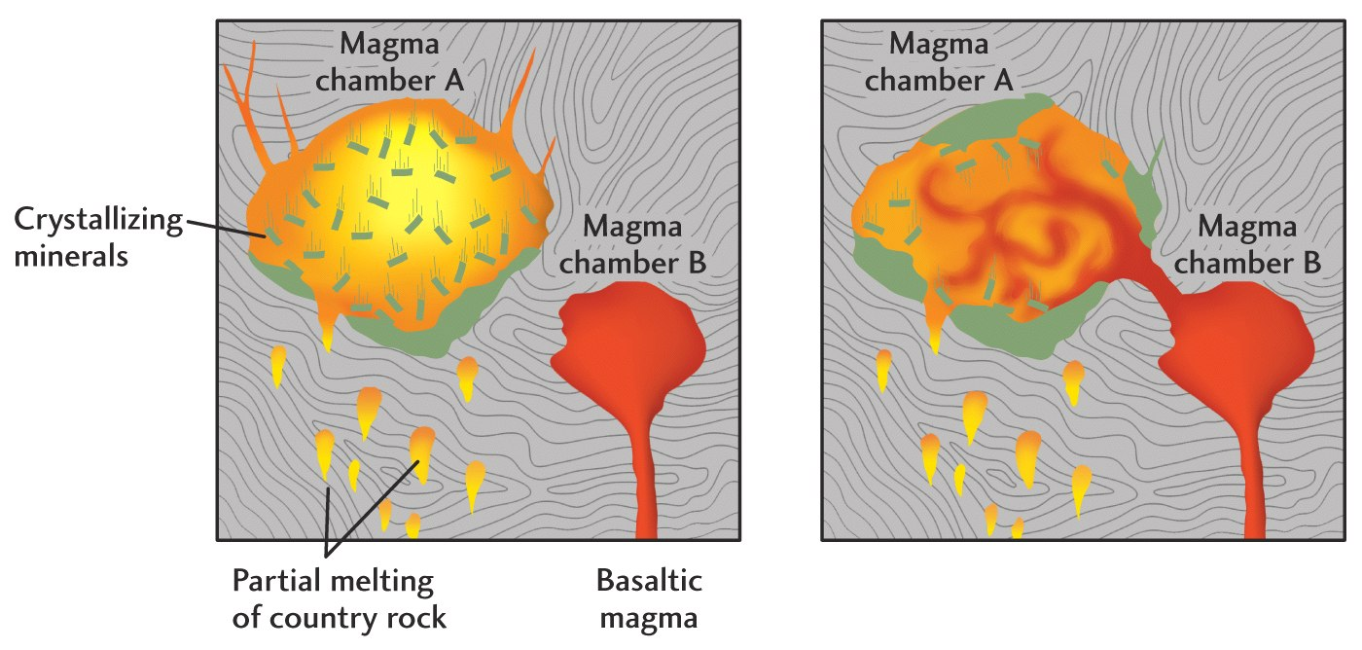
The magma mixing may be partial or complete. In partial mixing, the separate body or xenolith on one magma type is found in another. If it mixed completely, then it form a magma of different composition (hybrid magma).

Slide 26
Magma mixing can occur by two end-member processes: blending, and mingling.
Blending involves the mixing of two or more unlike magmas, forming a chemically and physically homogeneous mixture with an intermediate composition.
Mingling of dissimilar magmas produces a heterogeneous mixture containing distinct portions of the end-member magmas, (eg: rhyolite and basalt), due to the incomplete mixing of the different magmas. The resulting igneous rock is chemically intermediate between the two original magmas. However, the rock comprises spatially discrete portions of each rock type and is very heterogeneous.

Slide 27
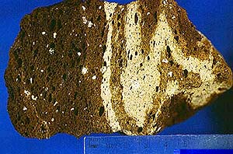
The photograph below is of a vesicular basalt with bands of rhyolite. The sample is the result of two magmas of different composition coming into contact at or before the time of eruption. Cooling after eruption was rapid enough to "freeze" the mingling-action in place. So what we see is incomplete mixing of the two magmas.

Slide 28
Unusual composition of igneous rocks are the result of magma mixing (formation of hybrid magma).
Kaiwekites of New Zealand is having unusal composition and believed as product of magma mixing.
High-magnesian andesites from Mount Shasta (California) are the product of magma mixing.

Slide 29
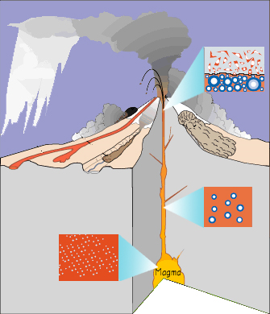
Thanks

