Slide 1
Ore Deposits Formed By Metamorphism Process

Slide 2
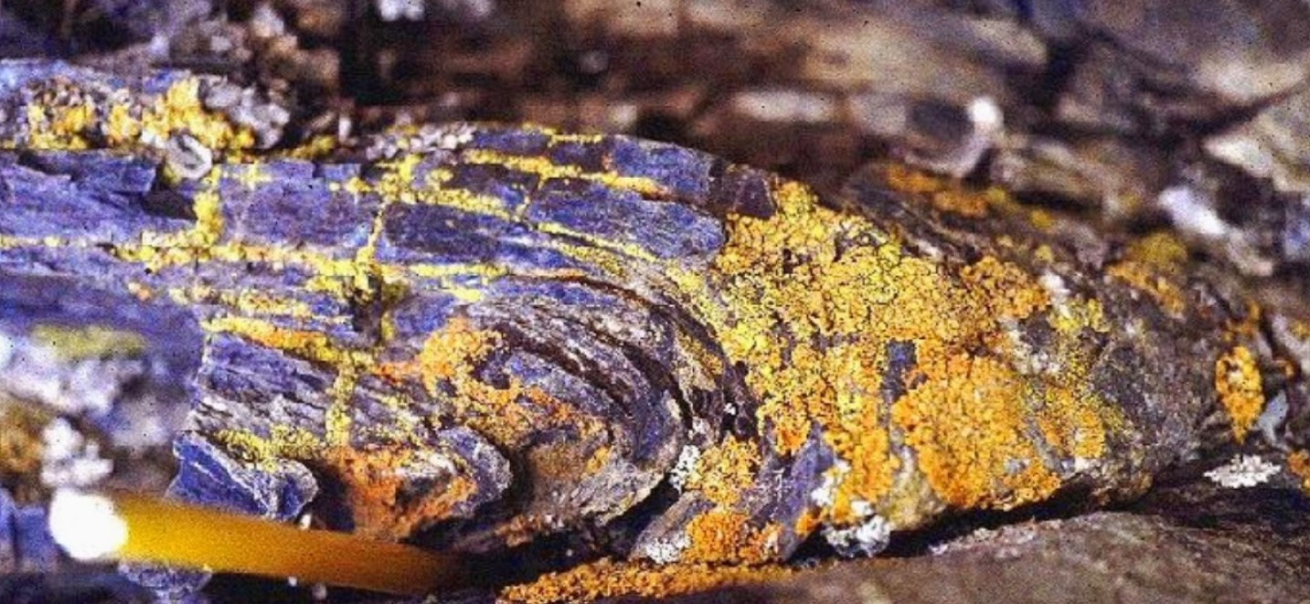
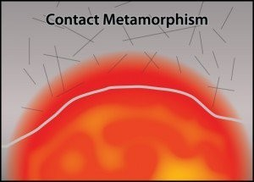
Metamorphic and metamorphosed ore deposits
Metamorphic
ore
deposits is a class
that owes its
economic
interest to
re of
largely isochemical
metamorphic
equilibration and recrystallization
pre-existing material which had no use in its original state. (e.g., transformation of alumina-rich claystones to kyanite/sillimanite deposits, or graphite flakes formed from dispersed bitumen).
Contact metamorphism of ore in the heated zone around magmatic bodies is usually static (i.e., in the absence of dynamic deformation). Exposure to high
temperatures (with a maximum of
and
750°C) affects fabric, mineralogy
mineral chemistry (e.g. by driving off water and other volatiles). Fabric
changes increase
are confined to in grain size
a general with rising
ores
temperature. Monomineralic
recrystallize into triple grain boundary junctions at angles of 120°.

Slide 3
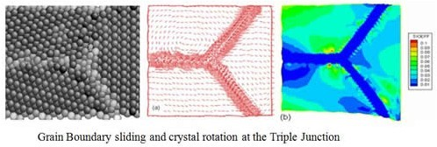
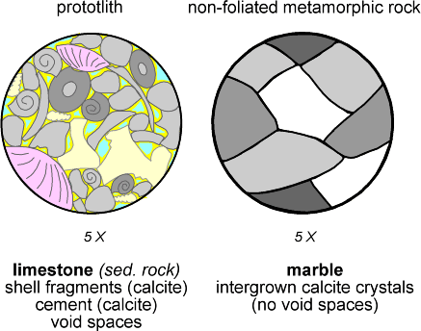
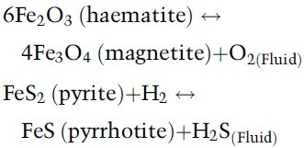
Increase of grain size by metamorphism is important in practice, because processing of coarse ore is less energy intensive.
Sulphur release (e.g. from pyrite) may induce formation of metamorphic pyrrhotite or even magnetite. Iron oxide ore at contacts may recrystallize to a different oxidation state (e.g. haematite to magnetite) controlled by the oxygen activity imposed by magma or by heated country rocks.
Oxidation/reduction sulphidation/desulphidation during metamorphism:
and reactions

Slide 4
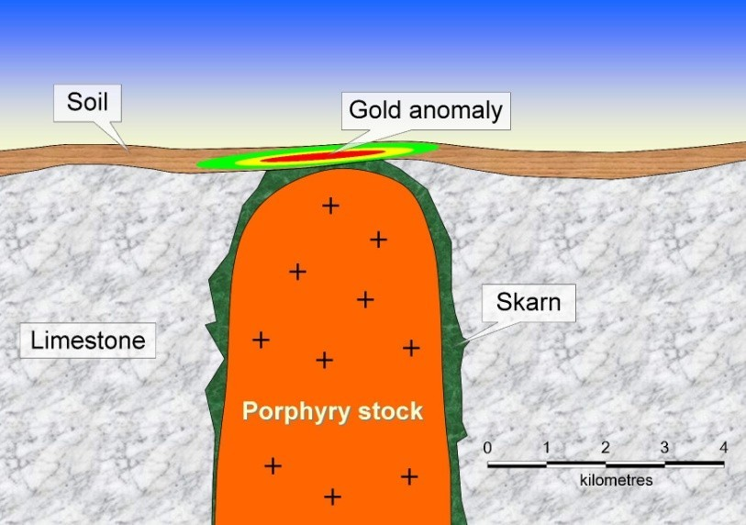
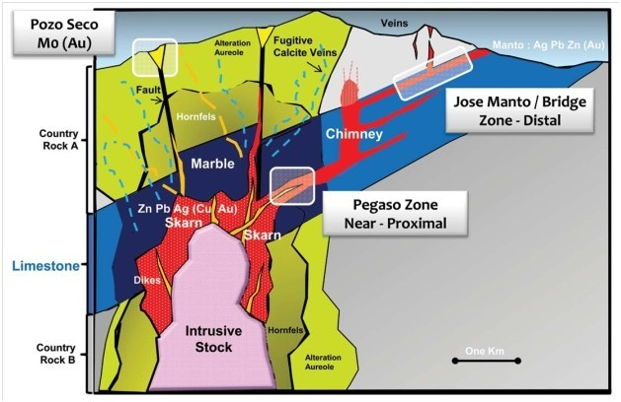
Skarn and contact-metasomatic ore deposits are intimately related to thermal aureoles of magmatic intrusions. They may be said to be products of contact metamorphism, but the causal agent is the interaction with magmatic fluids and not simple change by heating. Therefore, it was discussed in the magmatic domain.

Slide 5
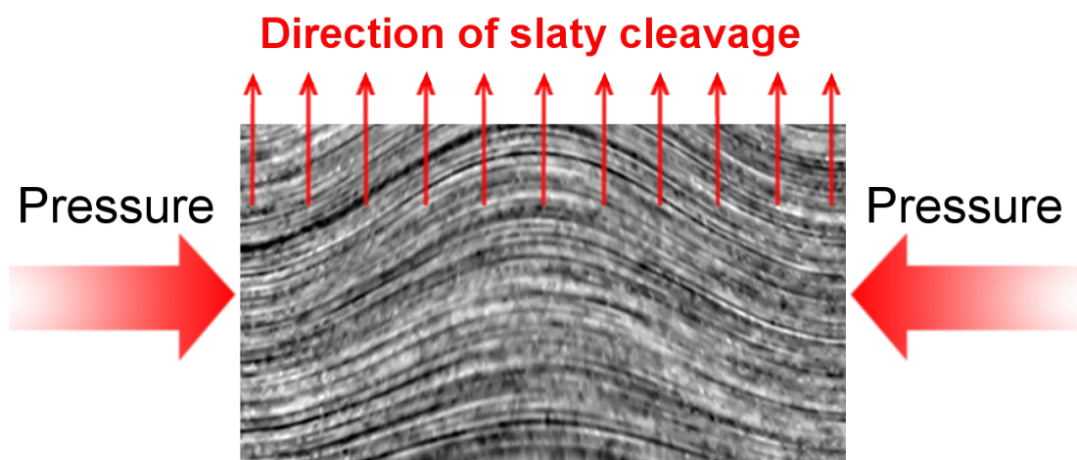
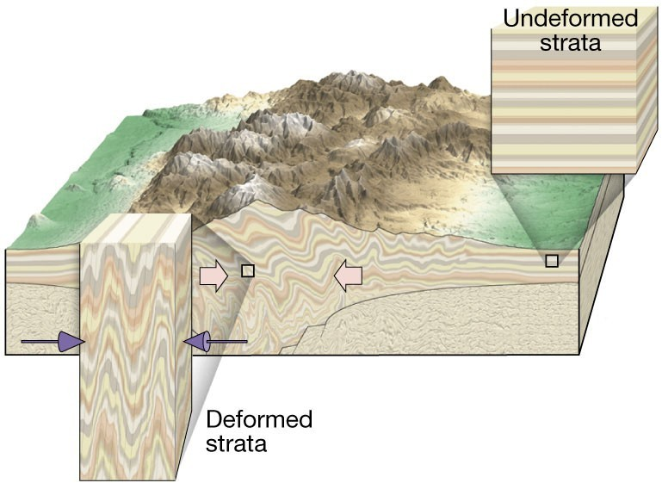
Orogenic
(regional) metamorphism of
ore deposits is common. Temperatures may reach 1100°C and pressures 30 kbar. Under these conditions, volatiles (water, etc.) are partly to wholly (at very
high metamorphic grades) removed from the system.
Metamorphic
rocks
exhibit grain coarsening,
minerals
preferred
orientation of penetrative foliation).
and a
fabric (e.g. schistosity,
Under conditions,
regional oxides,
metamorphic
especially
of iron
with This
and manganese,
react
readily minerals.
carbonate and silicate
caused, for example, formation of the diagenetic-metamorphic skarn rocks in Sweden. Elevated Mn-contents of metamorphic silicates (garnet, pyroxene, stilpnomelane, etc.) conserve the geochemical halos of Sedex ore deposits and are useful prospecting tools.

Slide 6
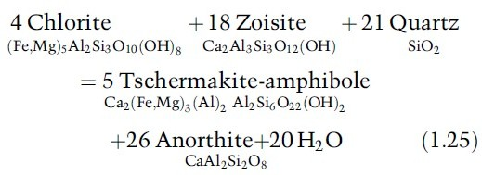
Example of dehydration reactions at the transition from greenschist to amphibolite:
Ores could also be formed from metamorphic fluids. The metamorphic fluids can be considered as solutions that are in equilibrium with host rocks, and although they are dilute, their sheer mass allows significant transfer of dissolved matter.
Metamorphic fluids originate primarily by chemical release (devolatilization). Increasing metamorphism, from sub- greenschist facies to anatexis, produces a steady flow of metamorphic dehydration fluids and a decrease of volatiles in the respective metamorphic rocks.
Shales contain 4 wt.% water in contrast to mica schist with 2%. By exothermic reactions, basalt assimilates water during the formation of greenschists to a maximum of 13%. Siliceous carbonates lose CO2 due to generation of metamorphic calcsilicate minerals.
Water in
metamorphic OH-groups
rocks occurs of hydrous
mainly in
minerals and in fluid inclusions. Grain boundaries also host tiny inclusions. Some fluids fill open fissures and the pore space.
Fluids liberated from rocks undergoing
prograde metamorphism economically interesting trace
acquire metals
(e.g. gold) or other elements (arsenic), either together with the volatiles H2O, F and Cl from the lattice of transforming minerals.

Slide 7
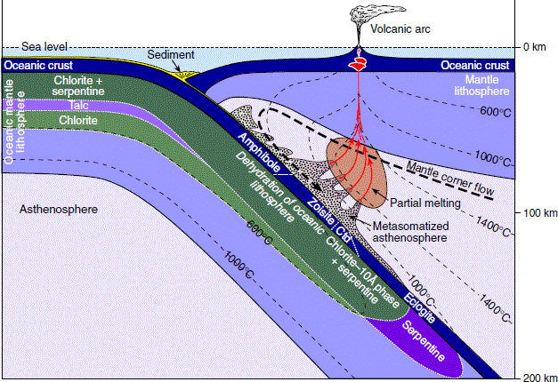

Slide 8
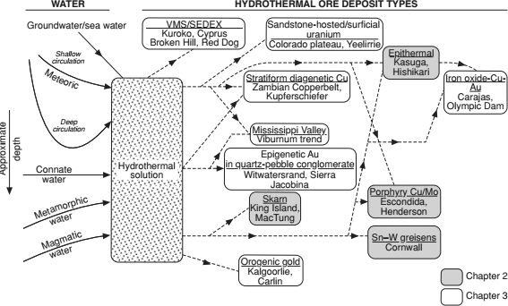
Diagram illustrating the relationship between different fluid types and various hydrothermal ore deposit types

