Slide 1
Aristolochia stem
Dr. Rohini Trivedi
Deptt. of Botany
MLSU

Slide 2
Aristolocia
Outline almost circular, with thick cuticle and multicellular hairs.
Cortex is differentiated into outer collenchyma and inner parenchyma. The inner parenchymatous cells develops chloroplast as they get sunlight and thus forms chlorenchyma.

Slide 3
Endodermis is the innermost layer of cortex with barrel shaped cell which contains starch grains.
Endodermis is Followed by pericycle of sclerenchymatous cells which splits in the old stem.
The vascular bundles are conjoint collateral endarch and open with xylem towards pith (inside) and phloem towards outside.
The bundles are separated from each other by wide parenchymatous rays

Slide 4
The trend is also followed in the secondary tissues where they are separated by wide medullary rays and the xylem appears fractured.
As wide medullary rays were present in the primary structure also so it is a primary abnormality.

Slide 5
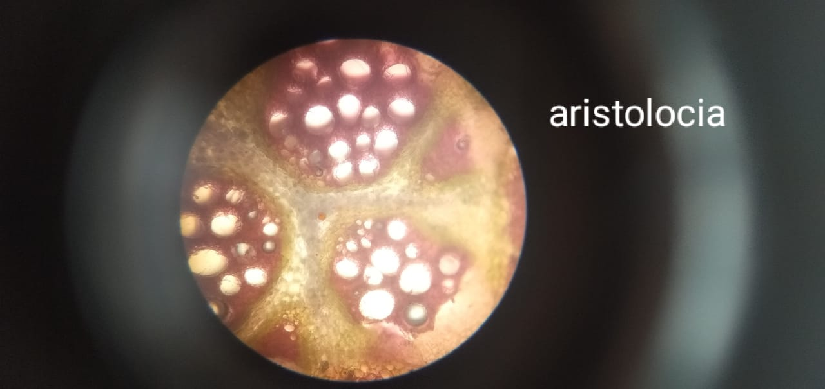
Aristolochia

Slide 6
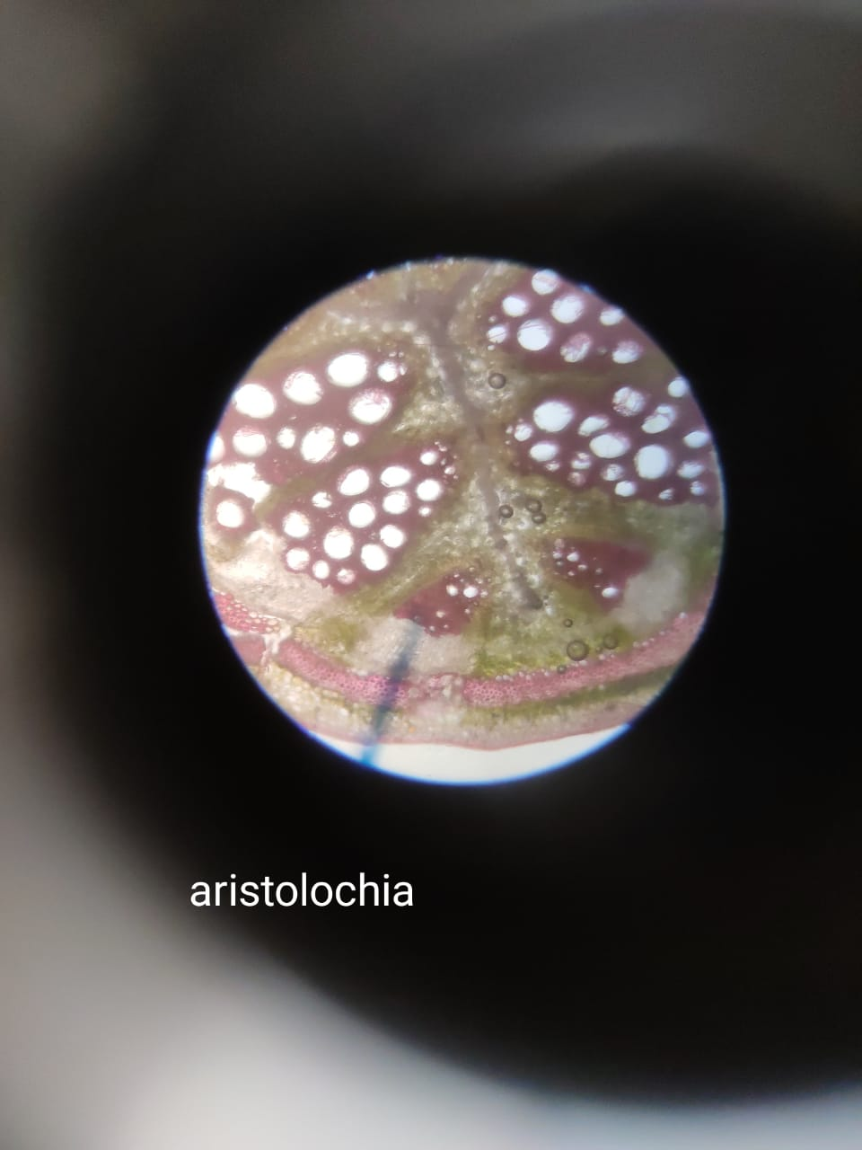
Aristolochia

