Slide 1
roHINI trivedi deptt. of Botany MLSU
Primary abnormality in Nyctanthus stem

Slide 3
The TS (transverse section) of stem is quadrangular in outline.
The outermost layer is the epidermis, with cuticle and hair.
This layer is followed by cortex-outer layers are collenchymatous and inner layers-parenchymatous, with intercellular spaces.
Four vascular bundles are present at the four corners or four bulges.

Slide 4
The vascular bundles as they are in the cortex so are called cortical vascular bundles(VB).
Basically they are leaf traces which arises from the lower nodes and move upward during their journey they get inverted and lie in the cortex.
The cortical VB are conjoint , collateral, exarch (metaxylem inside & protoxylem outside or towards periphery) and open.

Slide 5
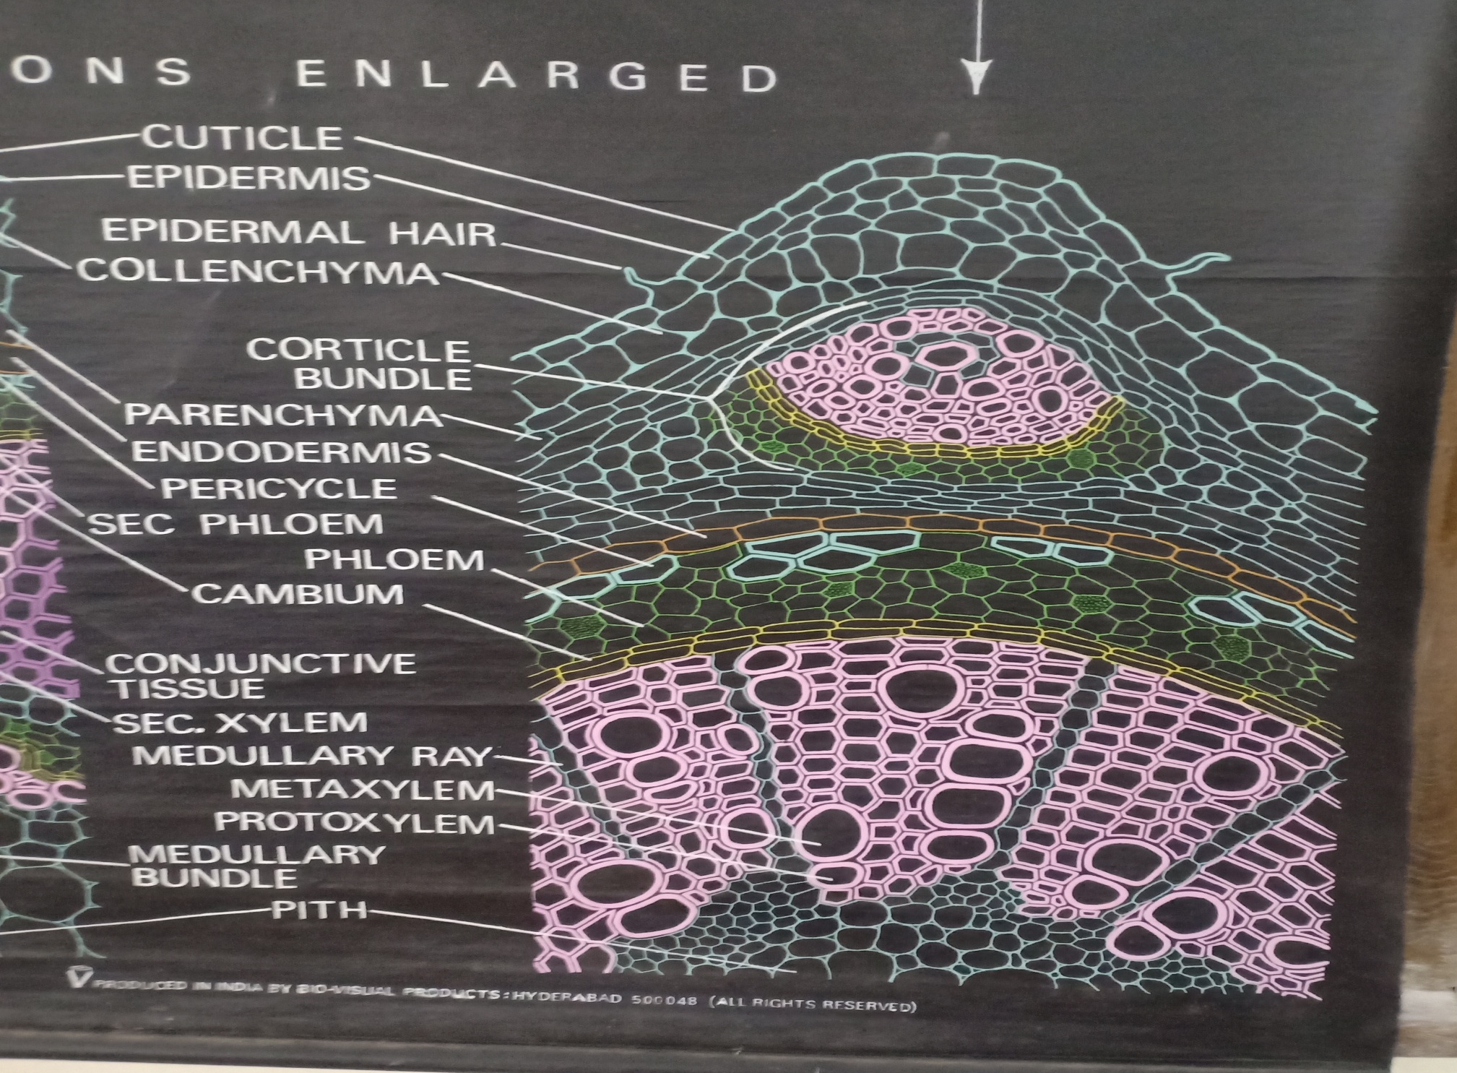

Slide 6
The cortex is followed by endodermis , pericycle and vascular tissues- conjoint, collateral, endarch and open vascular bundles.
Central parenchymatous pith.
Secondary growth is normal -cambium ring is formed by interfascicular and fascicular cambium.
Cambium produces secondary xylem towards inside and secondary phloem outside.

